Slide 1

S. J. P. N. TRUST’S
HIRASUGAR INSTITUTE OF TECHNOLOGY, NIDASOSHI
Accredited at 'A' Grade by NAAC
Programmes Accredited by NBA: CSE, ECE, EEE & ME.
Department of Computer Science & Engineering
Course: Design And Analysis of Algorithms (18CS42)
Module 1: Introduction, What is an Algorithm? Algorithm Specification Analysis Framework
Prof. C. R. Belavi
Asst. Prof. , Dept. of Computer Science & Engg.,
Hirasugar Institute of Technology, Nidasoshi

Slide 2
Introduction
The word “ALGORITHM” comes from the name of a Persian author, Abu Ja’far Mohammed ibn Musa al Khowarizmi (c. 825A.D.), who wrote a textbook on mathematics
This word has taken on a special significance in computer science, where “ALGORITHM” has come to refer to a method that can be used by a computer for the solution of a problem

Slide 3
What is an Algorithm
An “ALGORITHM” is a finite set of instructions that, if followed, accomplishes a particular task.
In addition, all algorithm must satisfy the following criteria:
  Input – Zero or more quantities are externally supplied
  Output – At least one quantity is produced
  Definiteness – Each instruction is clear and unambiguous
  Finiteness – After tracing all instructions in ALG, the ALG terminates after a finite number of steps
  Effectiveness - Every instruction must be very basic so that it can be carried out, in principle, by a person using only pencil and paper. Also each operation must feasible

Slide 4
Algorithm Specification
Pseudocode Conventions
ALG can be described using many ways
Graphic representation called flowcharts are another possibility, but they work well only if the algorithm is small and simple
In this text we present most of our algorithm using a Pseudocode that resembles C program
  Comments begins with // and continue until the end of line
  Blocks are indicated with matching braces { and }
  An identifier begins with a letter. The data types of variables are not explicitly declared

Slide 5
Algorithm Specification
Pseudocode Conventions
  Assignment of values to variables is done using the assignment statement - <variable> = <expression>;
  Boolean values – true and false, logical operators – and, or and not, relational operators - <, >, == etc. are provided
  Elements of multidimensional arrays are accessed using [ and ]. Array indices start at zero
  for, while and repeat-until looping statements are provided-
  While < condition> do for variable:= value1 to value2 step step do
  { {
  statement1; statement1;
  …. …….
  statementn; statementn;
  } }

Slide 6
Pseudocode Conventions
A repeat-until statement is constructed as follows-
repeat
<statement1>
….
<statementn>
until<condition>
A conditional statements has the following forms-
if <condition> then <statement>
if <condition> then <statement1> else <statement2>
case
{
:<condition1>: <statement1>;
……
……
:<condition1>: <statement1>;
:else: <statement n + 1>
}

Slide 7
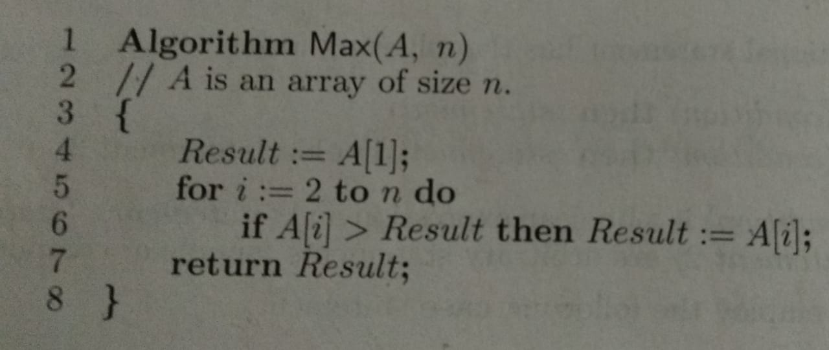
Pseudocode Conventions
Input and Output are done using the instruction read and write
An algorithm consists of a heading and a body – Algorithm Name (<parameter list>)
Example:- ALG to find maximum element in Array

Slide 8
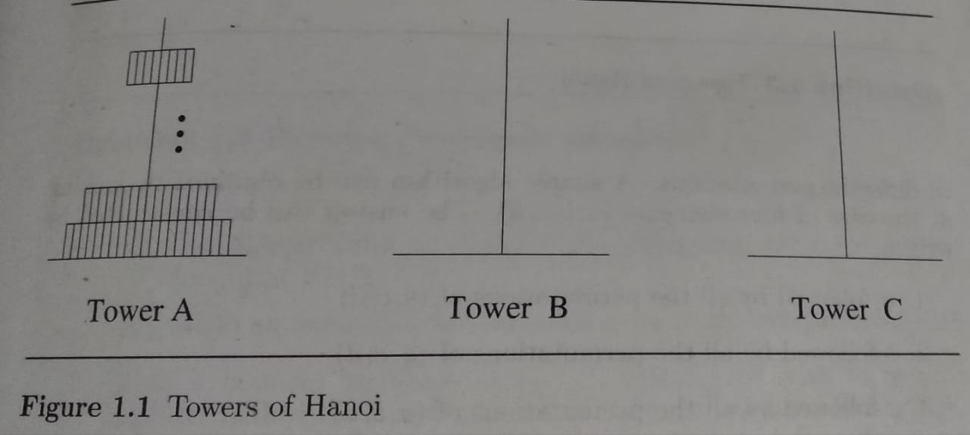
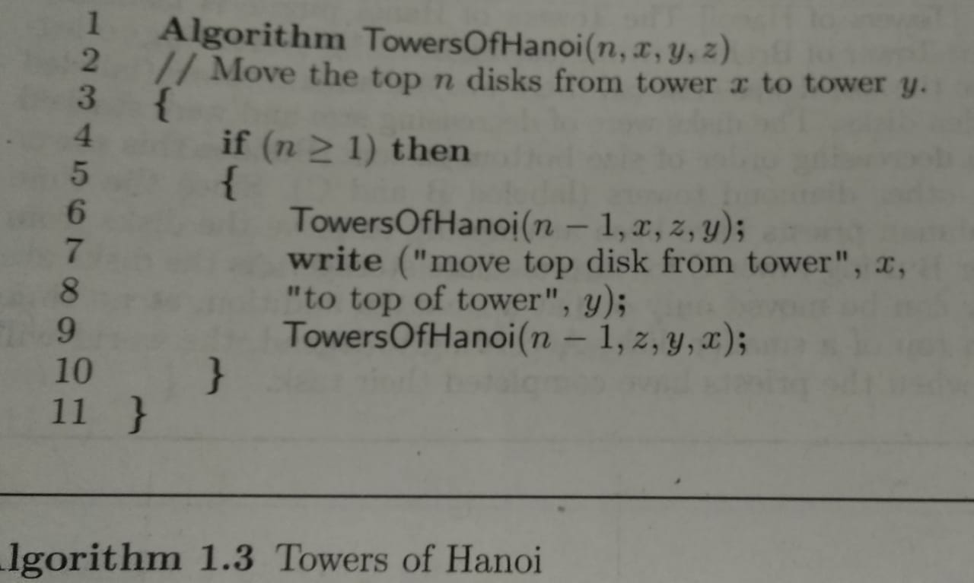
Recursive Algorithms
A recursive function is a function that is defined in terms of itself
An ALG that calls itself is direct recursive
ALG A is said to be indirect recursive if it calls another algorithm which in turns calls A

Slide 9
Analysis Framework
There are two kinds of efficiency – Time and Space
Time efficiency indicates how fast an algorithm in question runs
Space efficiency deals with the extra space the algorithm requires
Measuring an Input’s size – almost all ALGs run longer on larger inputs. For example, it takes longer to sort larger arrays, multiply larger matrices, and so on
Units for Measuring Running Time – measuring an ALGs running time, simply can use a standard unit as seconds, milliseconds and so on. But, practically to identify the most important operation of the algorithm, called the basic operation, the operation contributing the most to the total running time, and compute the number of times the basic operation is executed. Hence, we can estimate, T(n) ≈ C_{op}C(n), where T(n) is running time of a program, C_{op} be the execution time of an ALGs basic operation on a particular computer, and C(n) be the number of times this basic operation needs to be executed for this algorithm.

Slide 10
Analysis Framework
Worst-Case Efficiency – of an ALG is its efficiency for the worst-case input of size n, which is an input of size for which the algorithm runs the longest among all possible inputs of that size. Example – C_{worst}(n)=n
Best-Case Efficiency - of an ALG is its efficiency for the best-case input of size n, which is an input of size for which the algorithm runs the fastest among all possible inputs of that size. Example – C_{best}(n)=1
Average-Case Efficiency - Example – C_{avg}(n)=p(n+1)/2 + n(1-p)

Slide 11
Performance Analysis
Major goal of this subject is to develop skills for making evaluative judgments about algorithm
There are many criteria upon which we judge algorithm-
  Does it do what we want it to do?
  Does it work correctly according to the original specification of the task?
  Is there documentation that describes how to use it and how it works?
  Are procedures created in such a way that they perform logical sub-functions?
  Is the code readable?
There are other important criteria for judging algorithms that have a more direct relationship to performance
  Space Complexity ( Storage Requirement )
  Time Complexity ( Computing Time )

Slide 12
  Space Complexity ( Storage Requirement )
The space complexity of an algorithm is the amount of memory it needs to run to completion
The space needed is the sum of a fixed part and variable part
  Fixed Part – is independent of characters of the inputs and outputs. It includes instruction space(space for code), space for simple variables and fixed size component variables, space for constants etc.
  Variable Part – consists of the space needed by component variables whose size is dependent on the particular problem instance being solved, the space needed by referenced variables and recursion stack space
The space requirement S(P) of any algorithm P may therefore be written as S(P) = c + S_{p}(instance characteristics) , where c is constant

Slide 13
Time Complexity ( Computing Time)
The time complexity of an algorithm is the amount of computer time it needs to run to completion
The time T(P) taken by a program P is the sum of the compile time and the run ( or execution time)
The compile time does not depend on the instance characteristics
Hence, we concern with just the run time of a program
This run time is denoted by t_{p}(instance characteristics)

Slide 14
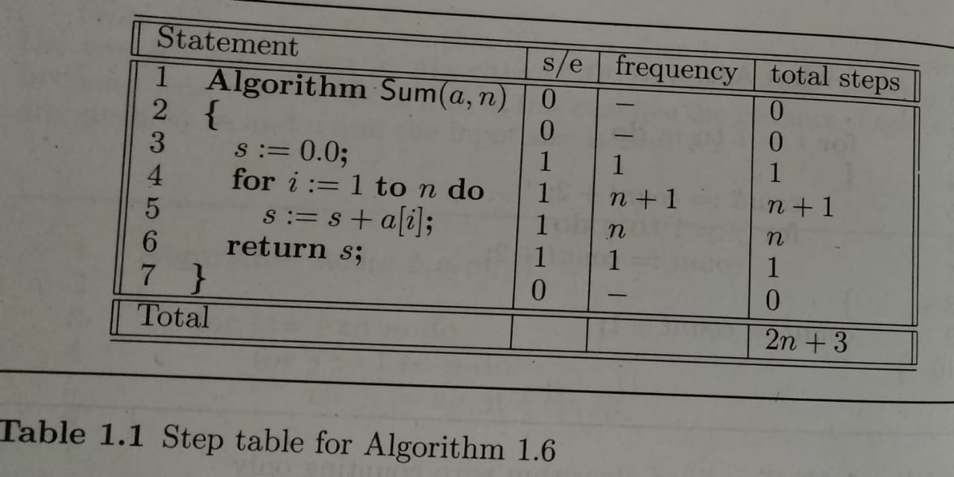
Step Count for Array Element Addition

Slide 15
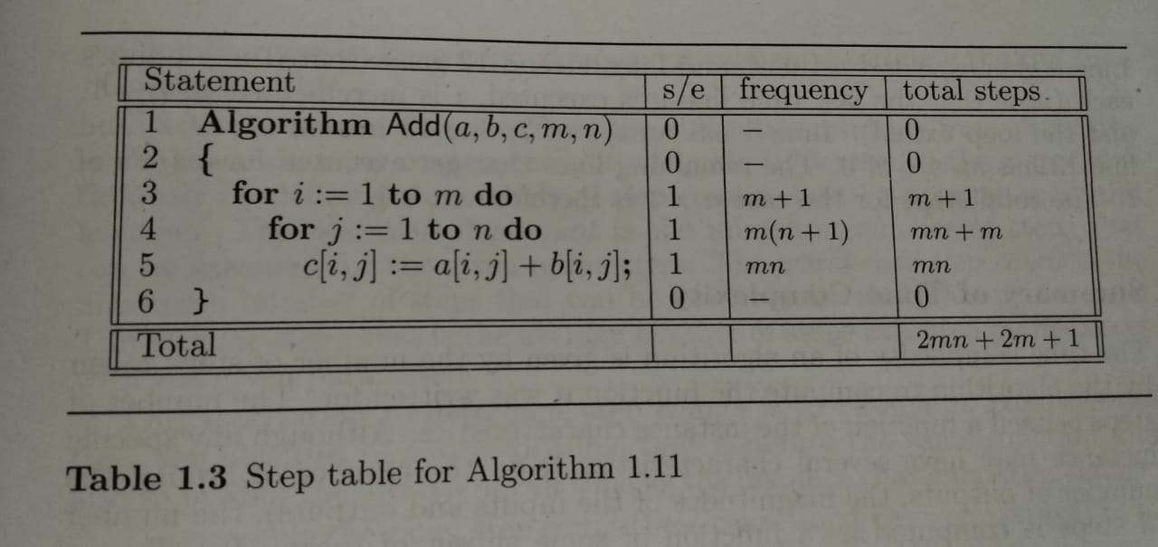
Step Count for Two Matrix Addition

Slide 16
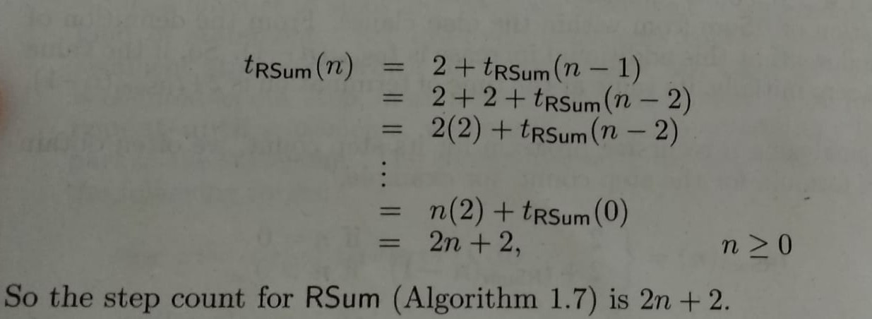
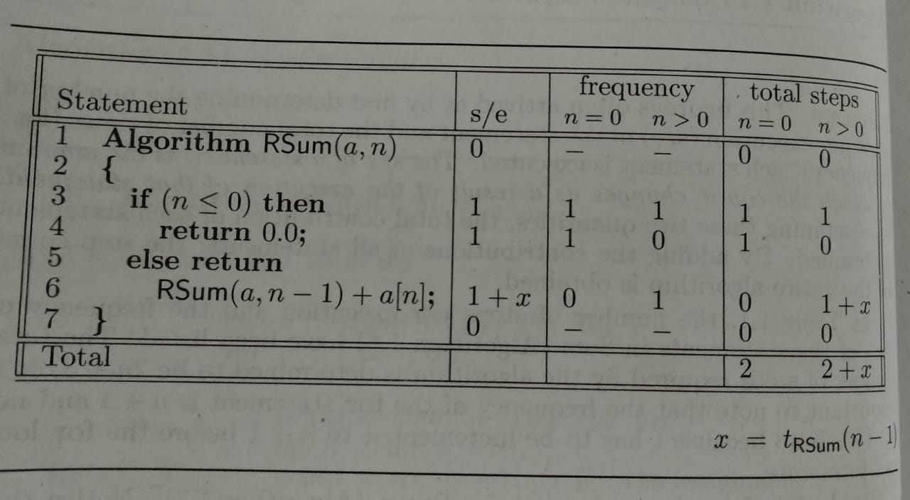
Step Count for Rsum of Array Elements

Slide 17
Module – 1
Asymptotic Notations
Big-Oh notation (O)
Big-Omega notation (Ω)
Big-Theta notation (Q)
Mr. C. R. BELAVI
Dept. of CSE,
HIT, Nidasoshi

Slide 18
Asymptotic Notations
The efficiency analysis framework concentrates on the order of growth of an algorithm’s basic operation count as the principal indicator of the algorithm’s efficiency
To compare and rank such orders of growth, computer scientists use three notations:- Big-Oh notation (O), Big-Omega notation (Ω) and Big-Theta notation (Θ)

Slide 19
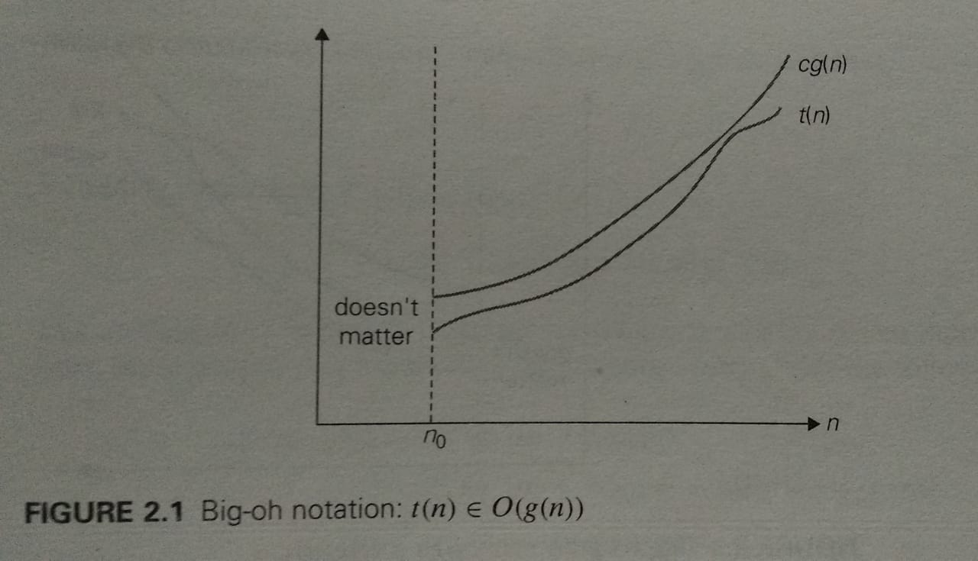
Big-Oh notation (O)
A function t(n) is said to be in O(g(n)), denoted t(n) ϵ O(g(n)), if t(n) is bounded above by some constant multiple of g(n) for all large n, i.e., if there exist some positive constant c and some nonnegative integer n₀ such that t(n) ≤ cg(n) for all n ≥ n₀

Slide 20
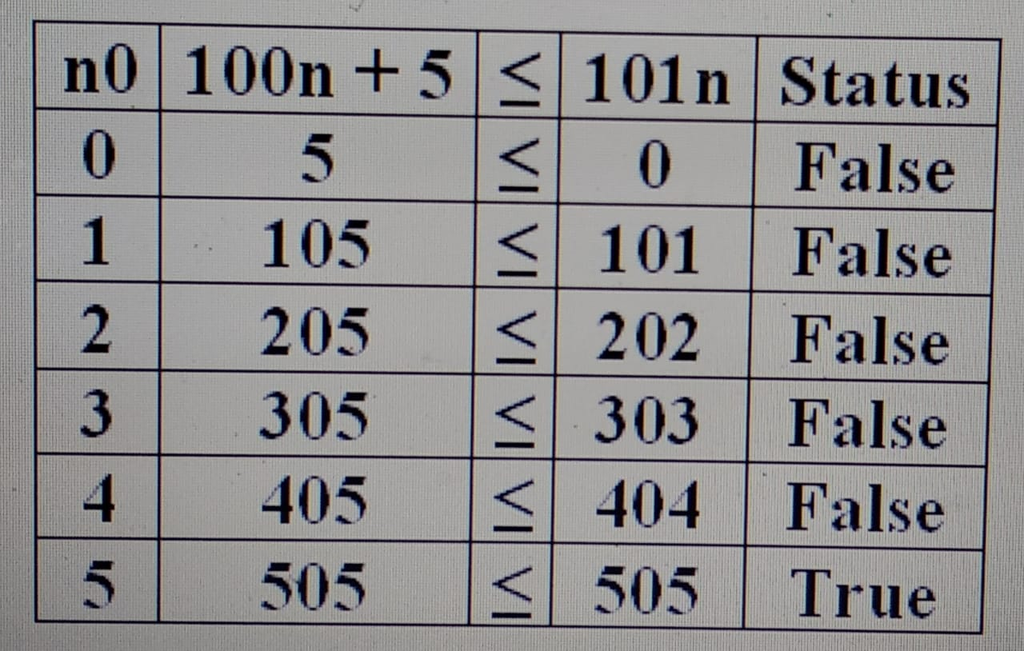
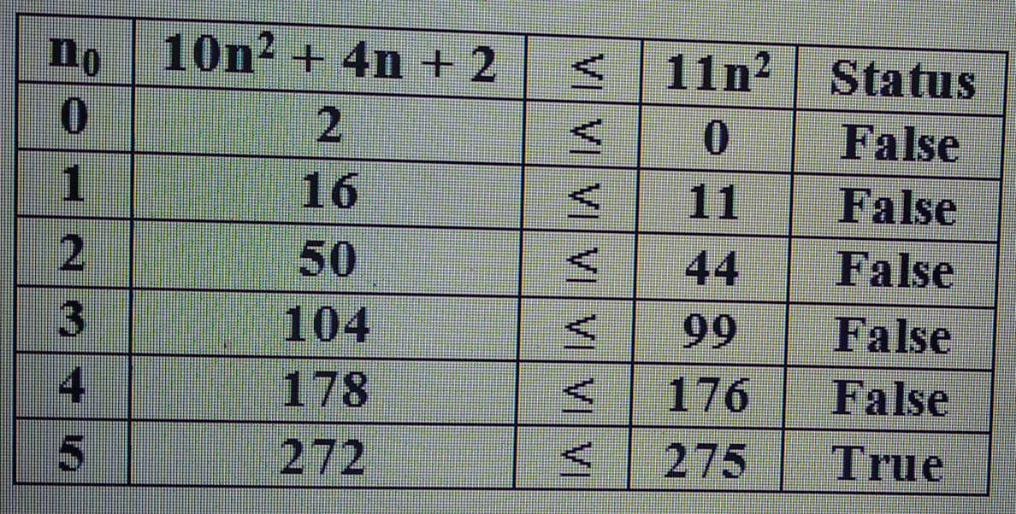
Big-Oh notation (O) - Example
Prove the following example –
100n + 5 ϵ O(n²)
Solution:-
100n + 5 ≤ 100n + n = n(100+1) = 101n
Hence Constant, c = 101
Hence, 100n + 5 ϵ O(n²) for all n ≥ 5 and constant c=101
Prove the following example – 10n² + 4n + 2 ≤ O(n²)
Solution - = 10n² + n²
= n²( 10 + 1)
= 11n²
Hence, constant, c = 11
Hence, 10n² + 4n + 2 ≤ O(n²) for all n ≥ 5 and constant c=11

Slide 21
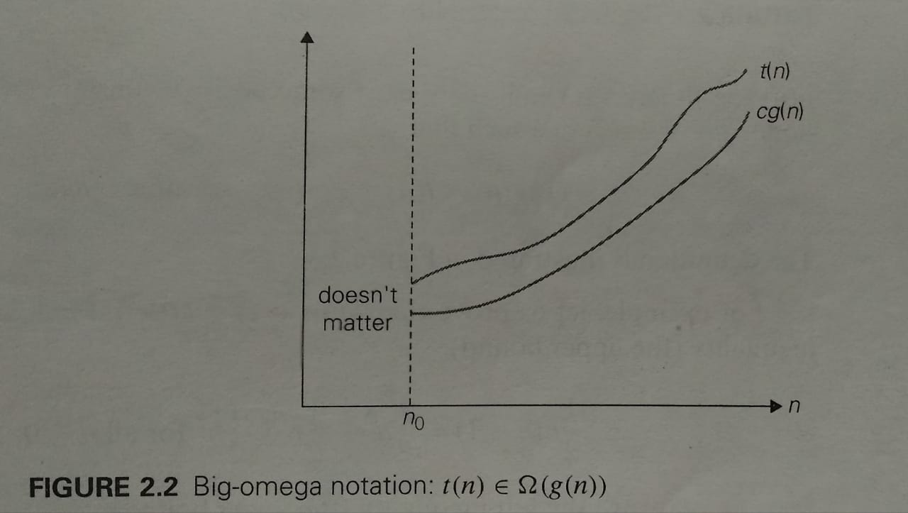
Big-Omega notation (Ω)
A function t(n) is said to be in Ω(g(n)), denoted t(n) ϵ Ω(g(n)), if t(n) is bounded below by some positive constant multiple of g(n) for all large n, i.e., if there exist some positive constant c and some nonnegative integers n₀ such that
t(n) ≥ cg(n) for all n ≥ n₀

Slide 22
Big-Omega notation (Ω) - Example
Prove the following examples-
  n³ ϵ Ω (n²) - where n³ becomes greater than n² when we select constant, c=1 and n₀=0
  3n + 2 ϵ Ω (n) - where 3n + 2 becomes greater than n when we select constant, c=3 and n₀=0
Prove the following examples-
  3n + 3 ϵ Ω (1) - where 3n + 3 becomes greater than 1 when we select constant, c=3 and n₀=0
  6 * 2^{n} + n² ϵ Ω (2^{n}) - where 6 * 2^{n} + n² becomes greater than 2^{n} when we select constant, c=6 and n₀=0

Slide 23
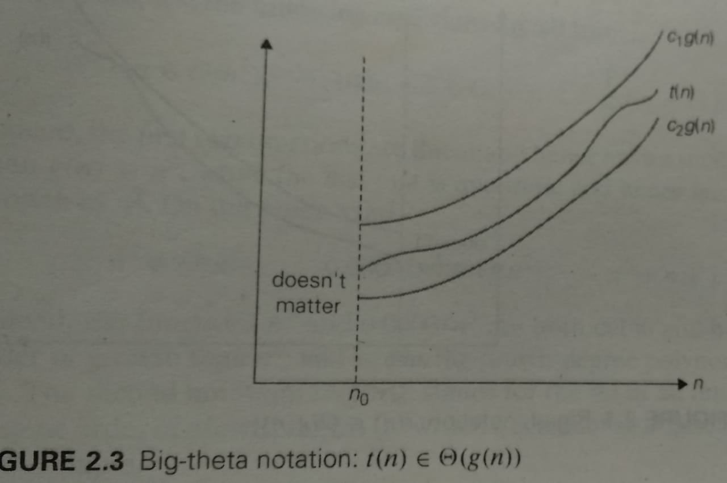
Big-Theta notation (Θ)
A function t(n) is said to be in Θ(g(n)), denoted t(n) ϵ Θ(g(n)), if t(n) is bounded both above and below by some positive constant multiples of g(n) for all large n, i.e., if there exist some positive constant c1 and c2 and some nonnegative integers n₀ such that
c₂g(n) ≤ t(n) ≤ c₁g(n) for all n ≥ n₀

Slide 24
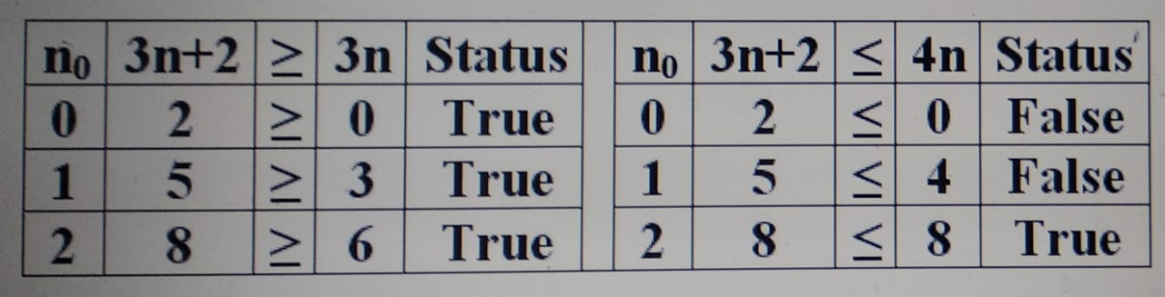
Big-Theta notation (Θ) - Example
Prove the following example of Big-Theta
3n + 2 ϵ Θ(n)
Solution:-
For 3n + 2 ≥ n, constant c1 = 3
For 3n + 2 ≤ n, = 3n + n = n (3 + 1) = 4n, constant c2 = 4
Hence 3n+2 ϵ Θ(n) with constant c1=3, c2=4 and for all n ≥ 2

Slide 25
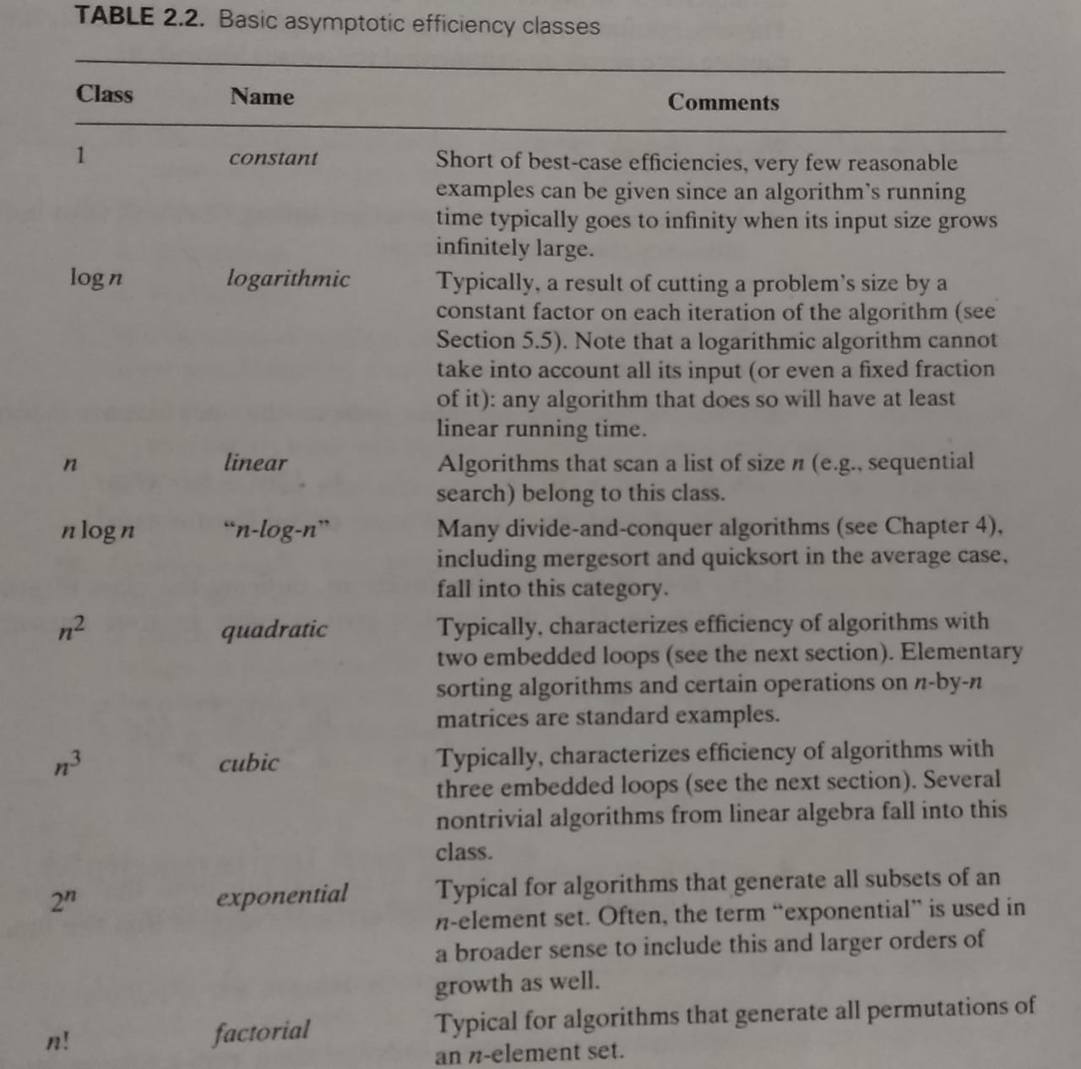
Basic Asymptotic Efficiency Classes

Slide 26
Module - 1
Mathematical analysis of Non-Recursive Algorithms with Examples
Mathematical analysis of Recursive Algorithms with Examples (T1:2.2, 2.3, 2.4).
Mr. C. R. BELAVI
Dept. of CSE,
HIT, Nidasoshi

Slide 27
Mathematical analysis of Non-Recursive Algorithms with Examples
General plan for Analyzing Time Efficiency of Non-Recursive algorithms-
  Decide on a parameter/parameter’s indicating an input size
  Identify the algorithm’s basic operation
  Check whether the number of times the basic operation is executed depends only on the size of an input. If it also depends on some additional property, the worst-case, average-case and best-case efficiencies have to be investigated seperately
  Set up a sum expressing the number of times the algorithm’s basic operation is executed
  Using standard formulas and rules of sum manipulation, either find a closed-form formula for the count or, at the very least, establish its order of growth

Slide 28
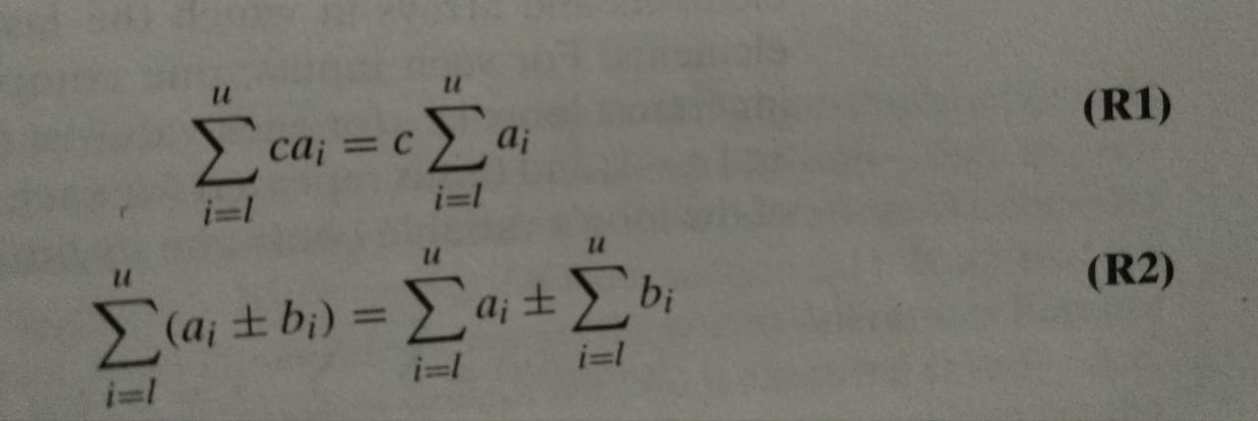
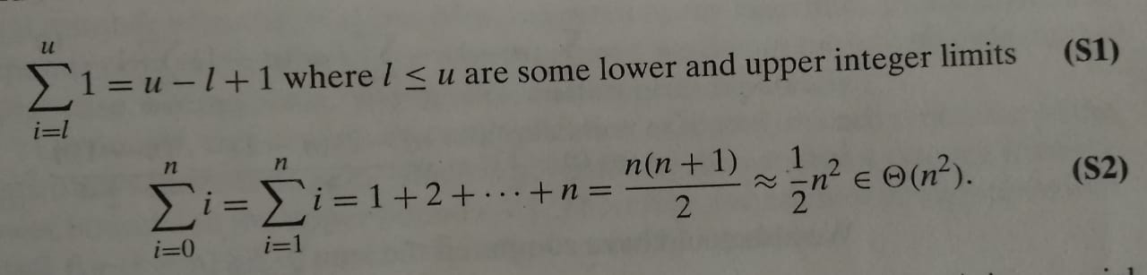
Summation Rules & Formulas
Summation Rules
Summation Formulae

Slide 29
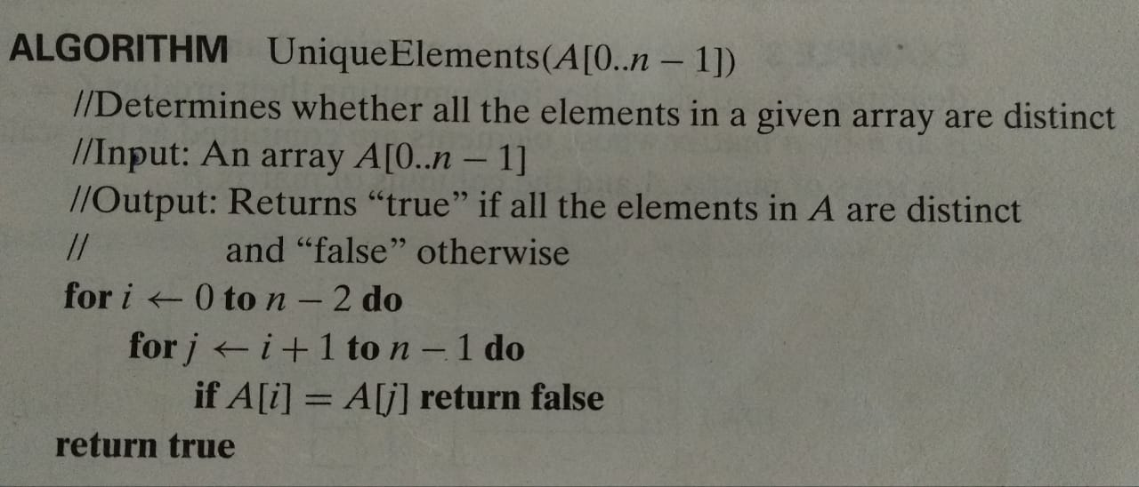
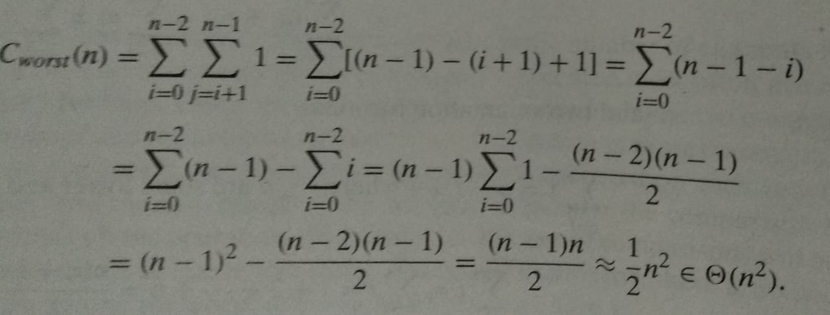
Element Uniqueness Problem

Slide 30
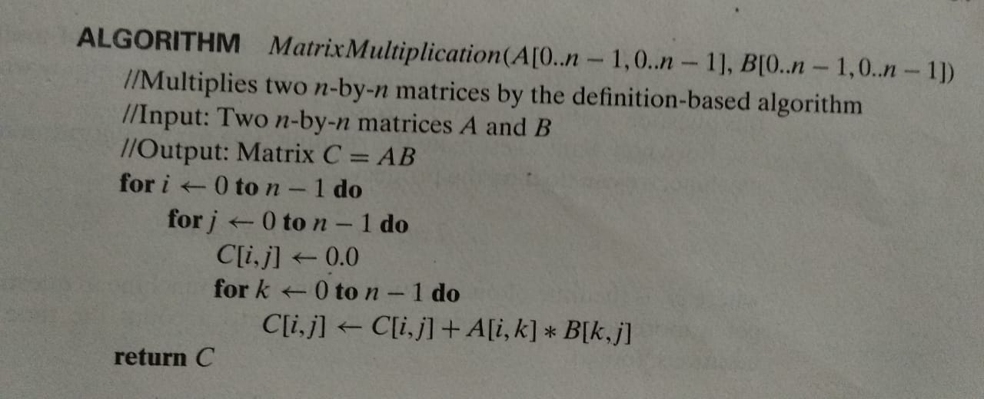
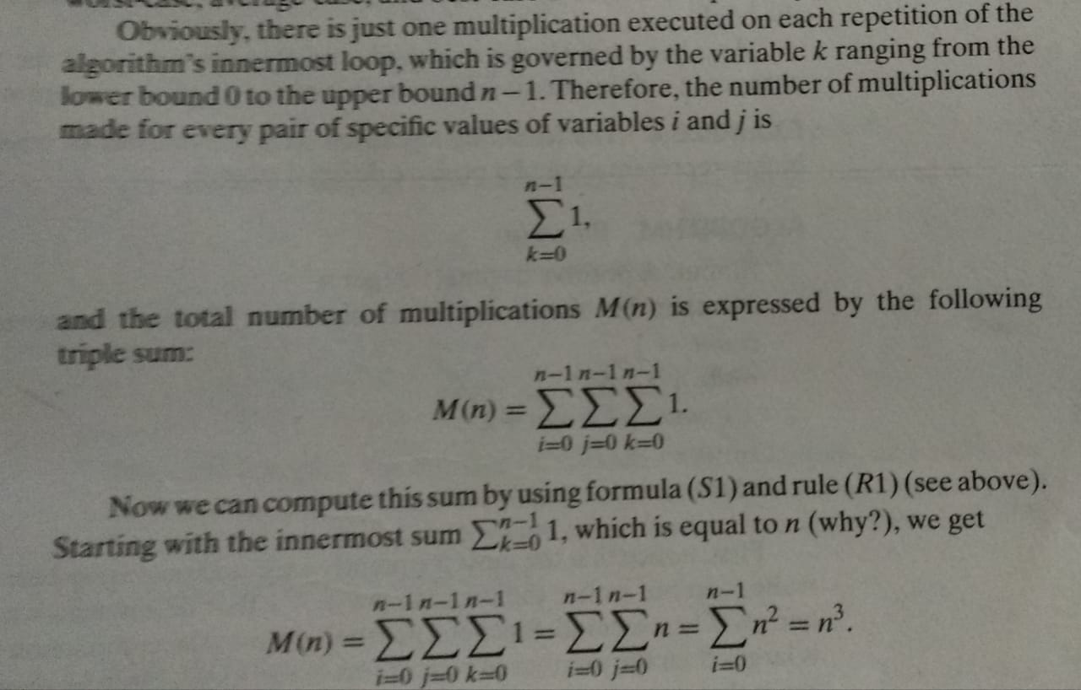
Matrix Multiplication Example

Slide 31
Mathematical analysis of Recursive Algorithms with Examples
General plan for Analyzing Time Efficiency of Non-Recursive algorithms-
  Decide on a parameter/parameter’s indicating an input’s size
  Identify the algorithm’s basic operation
  Check whether the number of times the basic operation is executed can vary on different inputs of the same size; if it can, the worst-case, average-case and best-case efficiencies must be investigated separately
  Set up a recurrence relation, with an appropriate initial condition for number of times the basic operation is executed.
  Solve the recurrence or at least ascertain the order of growth of its solution

Slide 32
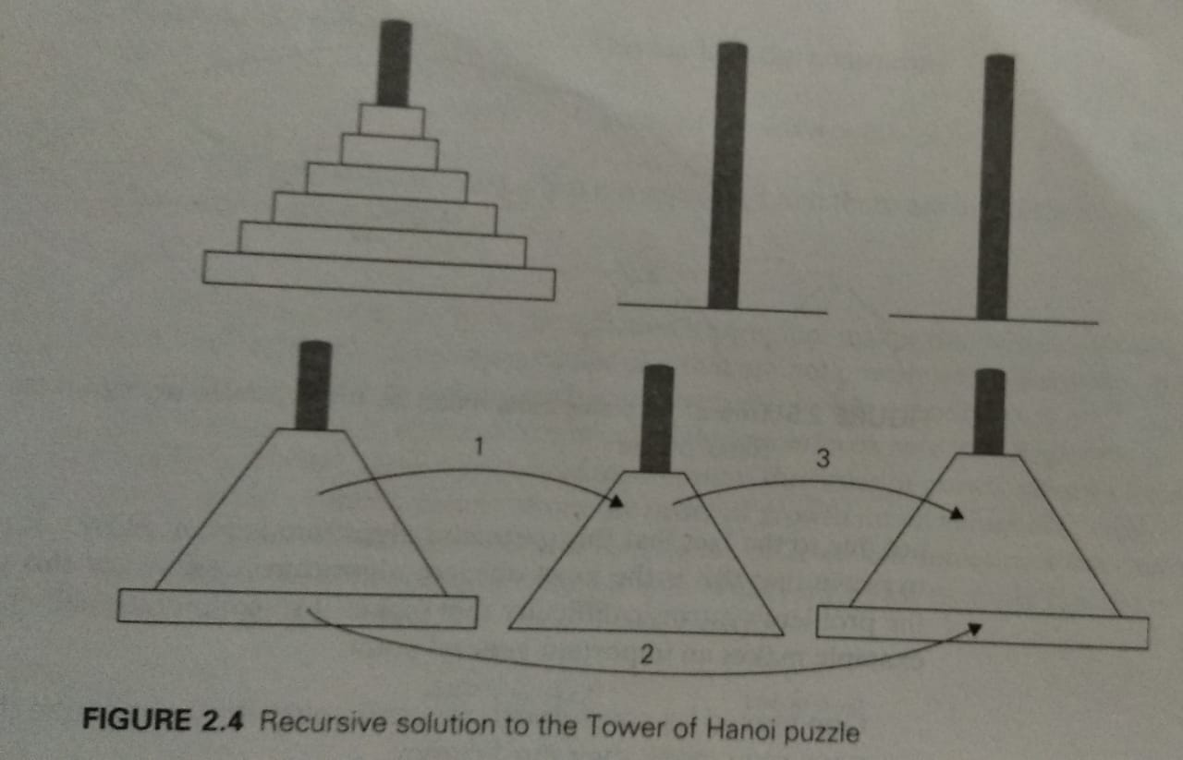
Tower of Hanoi Example

Slide 33
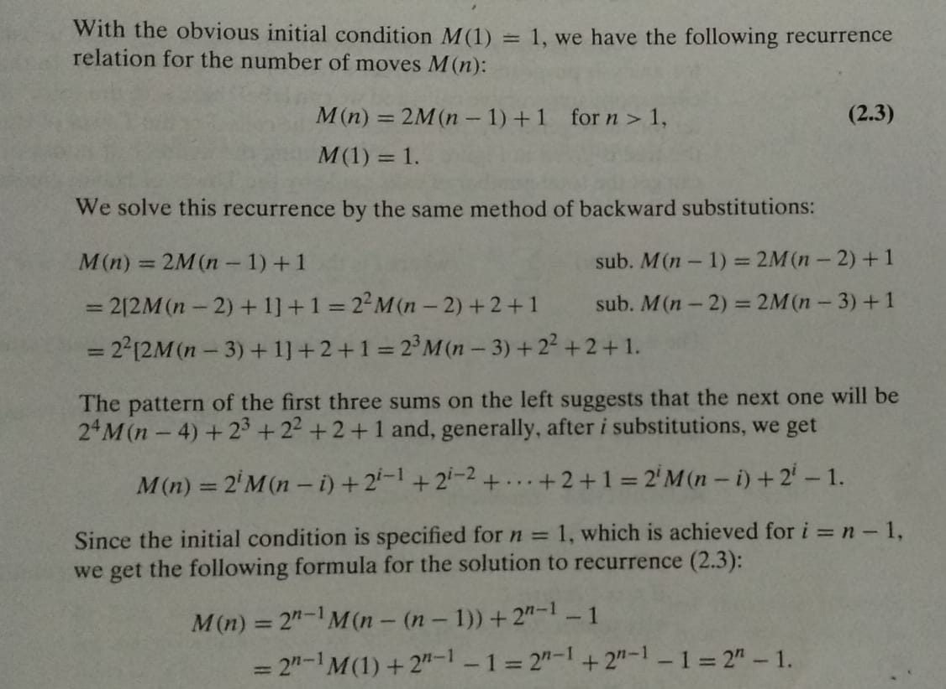
Tower of Hanoi Example

Slide 34
Module - 1
Important Problem Types
Sorting
Searching
String processing
Graph Problems
Combinatorial Problems
Mr. C. R. BELAVI
Dept. of CSE,
HIT, Nidasoshi

Slide 35
Important Problem Types
Sorting- The sorting problem asks us to rearrange the items of a given list in ascending or descending order. As a practical matter, we need to sort list of numbers, characters from alphabets, character string and most important records about students, employees, libraries about holding books etc.. The special piece of information called “key” is used to sort list items. For example, student name, number or grade point in student records. Many types of sorting algorithms are – quick sort, merge sort, bubble sort, selection sort etc.
Searching- The searching problem deals with finding a given value, called a search key, in a given set. There are two types of searching algorithms – sequential searching and binary searching

Slide 36
Important Problem Types
String Processing- a string is a sequence of characters from an alphabets. Text strings comprise letters, numbers and special characters. Bit strings comprise of zeros and once. String processing ALGs are important for computer languages and compiling issues. Several string processing algorithms are available like string matching, string comparison, string concatenation, finding string length etc.
Graph Problems- A graph can be thought of as a collection of points called vertices, some of which are connected by line segments called edges. Graphs can be used for modeling a wide variety of real-life applications, including transportation and communication network, project scheduling and games. Examples are Traveling Salesman Problem, Graph Coloring etc.

Slide 37
Important Problem Types
Combinatorial Problems- The Travelling Salesman Problem and Graph Coloring Problem are examples of combinatorial problems. These are problems that ask (explicitly or implicitly) to find a combinatorial object – such as a permutation, a combination, or a subset – that satisfies certain constraints and has some desired property ( e.g., maximize a value or minimize a cost)
Geometric Problems- Geometric algorithms deals with geometric objects such as points, lines and polygons. Ancient Greeks developed solution for variety of geometric problems, including problems of constructing simple geometric shapes- triangles, circles and so on
Numerical Problems- Numerical problems, are problems that involve mathematical objects of continuous nature: solving equations and systems of equations, computing definite integrals, evaluating functions and so on

Slide 38
Module - 1
Fundamental Data Structures
Stacks
Queues
Graphs
Trees
Sets and Dictionaries
Mr. C. R. BELAVI
Dept. of CSE,
HIT, Nidasoshi

Slide 39
Fundamental Data Structures
A data structure can be defined as a particular scheme of organizing related data items
Linear data structures are array and linked lists
Array - A (one dimensional) array is a sequence of n items of the same data type that are stored contiguously in computer memory and made accessible by specifying a value of the array’s index as shown in below figure-
Item[0] | Item[1] | ……………… | Item[n-1]

Slide 40
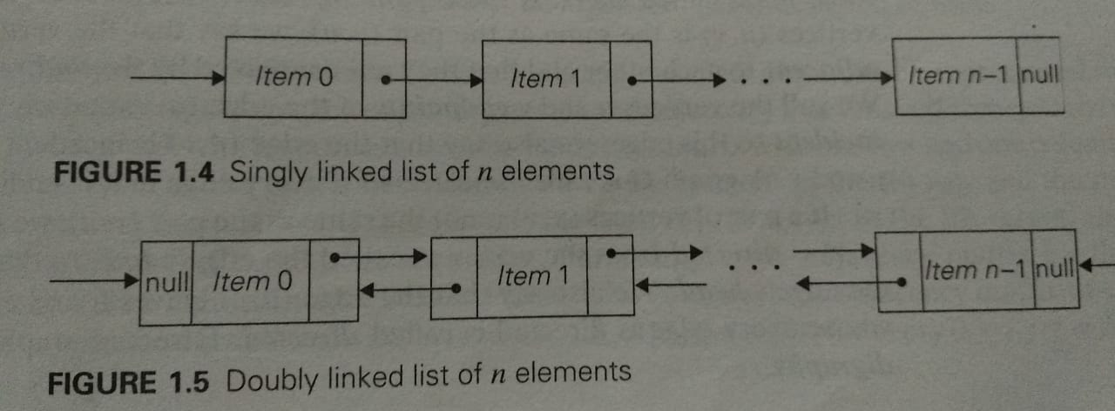
Fundamental Data Structures
A linked list is a sequence of zero or more elements called nodes each containing two kinds of information: some data and one or more links called pointers to other nodes of the linked list.
Two types of linked lists are singly linked lists and doubly linked lists. There working principles are shown in below diagram-

Slide 41
Fundamental Data Structures
Stack- A Stack is a list in which insertions and deletions can be done only at the end. This end is called the top because a stack is usually visualized not horizontally but vertically. It operates in the “last-in-first-out” (LIFO) fashion.
Queue- is a list from which elements are deleted from one end of the structure, called the front (dequeue), and new elements are added to the other end, called the rear (enqueue). It operates in the “firstt-in-first-out” (FIFO) fashion.

Slide 42
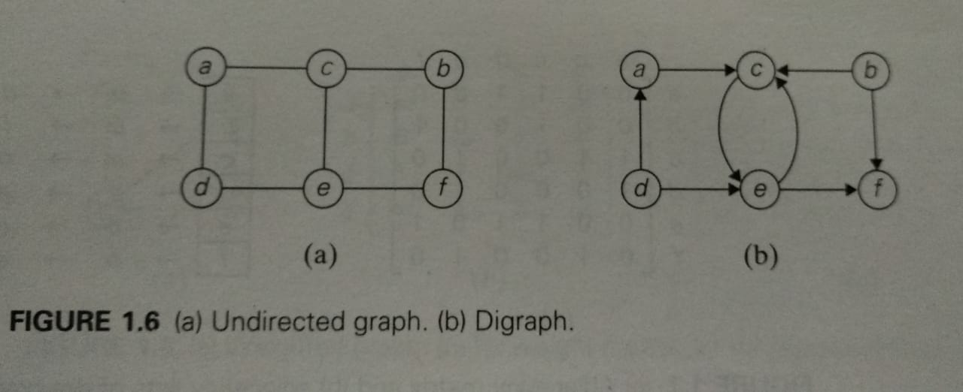
Fundamental Data Structures
Graphs- A graph G=<V,E> is defined by a pair of two sets: a finite set V of items called vertices and a set E of pairs of these items called edges

Slide 43
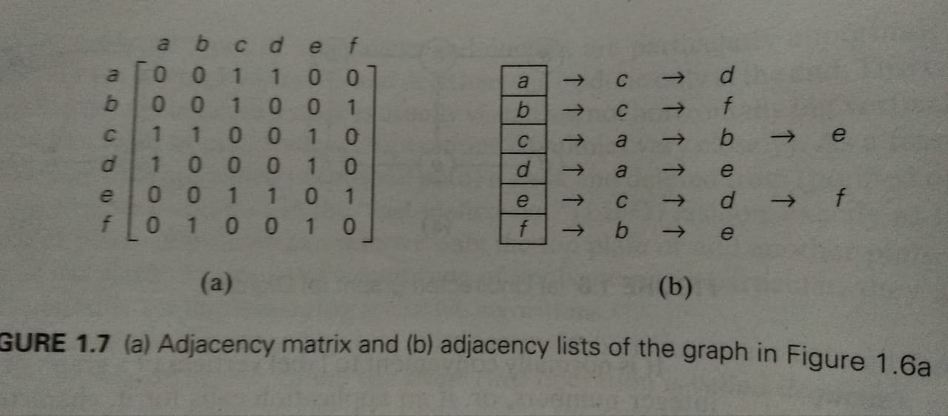
Fundamental Data Structures
Graph Representation- A graphs for computer algorithms can be represented in two principal ways – the adjacency matrix and adjacency lists

Slide 44
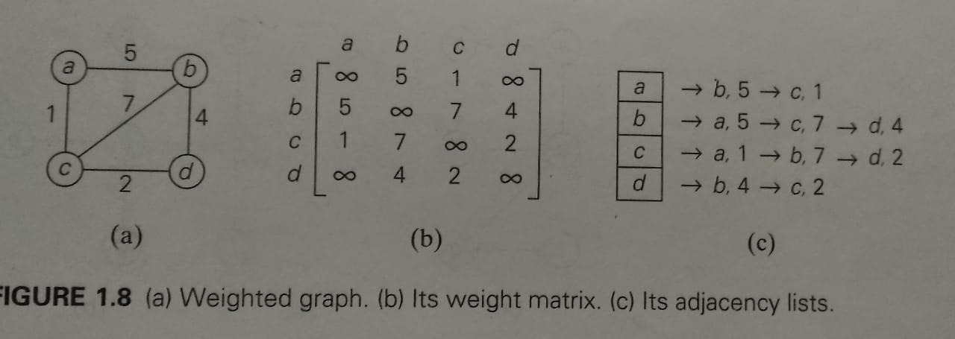
Fundamental Data Structures
Weighted Graph - A weighted graph is a graph with numbers assigned to its edges. These numbers are called weights or costs.

Slide 45
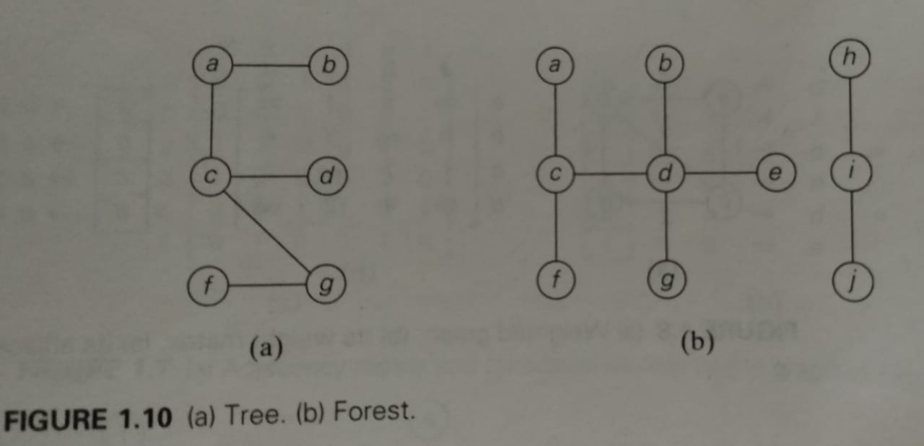
Fundamental Data Structures
Trees – A tree is a connected acyclic graph. A graph that has no cycles but is not necessarily connected is called a forest.

Slide 46
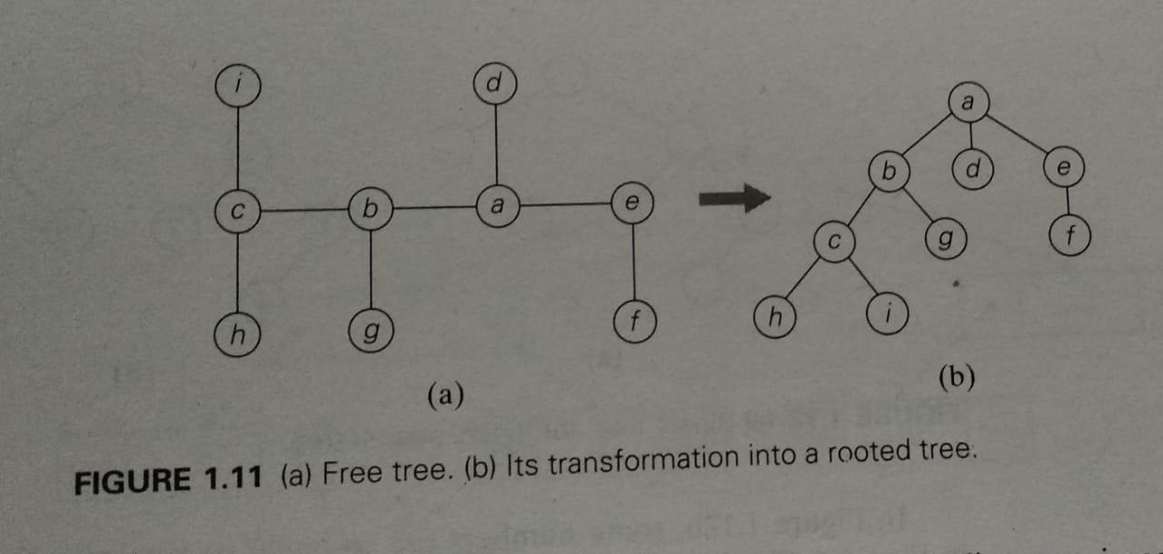
Fundamental Data Structures
Free Tree & Rooted Trees

Slide 47
Fundamental Data Structures
Sets and Dictionaries- The notion of a set plays a central role in mathematics.
A set - can be described as an unordered collection of distinct items called elements of the set
The dictionary - a data structure that implements three operations that is searching for a given item, adding a new item and deleting an item on given set or multiset is called dictionary

