Slide 1
S. J. P. N. TRUST’S HIRASUGAR INSTITUTE OF TECHNOLOGY, NIDASOSHI Accredited at 'A' Grade by NAAC Programmes Accredited by NBA: CSE, ECE, EEE & ME.
Department of Computer Science & Engineering
Course: Design And Analysis of Algorithms (18CS42)
Module 3: Greedy Method, Minimum Cost Spanning Tree, Single Source Shortest Path, Optimal Tree Problem, Transform And Conquer Approach
Prof. C. R. Belavi
Asst. Prof. , Dept. of Computer Science & Engg.,
Hirasugar Institute of Technology, Nidasoshi

Slide 2
Module – 3 Greedy Method
Introduction
Coin Change Problem
Knapsack problem
Job Sequencing with deadlines
Spanning Tree
Minimum Cost Spanning Tree

Slide 3
Module – 3 Greedy Method
Prim’s Agorithm
Kruskal’s Algorithm
Single Source Shortest Path
Dijkstra’s Algorithm
Huffman Trees & Codes
Heaps and Heap Sort

Slide 4
Introduction
Greedy method is an optimization technique used to solve many real time examples
Greedy method has a constraint that must be followed
Greedy method has a objective to achieve
Objective of greedy method is to find either minimum or maximum value by choosing feasible solution

Slide 5
Greedy Method Algorithm

Slide 6
Coin change problem Statement
A customer buys items valued less than 50 rupees and gives a 50 rupees note to the cashier (shopkeeper)
Now, cashier wish to return remaining change to the customer with minimum number of coins available
The cashier constructs the change in stages using greedy method
In each stage increase the total amount of change constructed by as much as possible

Slide 7
Coin Change Problem Example
Suppose customer buys items valued 39 rupees and gives 50 rupees note to cashier
Then cashier needs to return 11 rupees change back to customer
Also assume unlimited denominations of 1, 2, 5 and 10 rupees are available with cashier
Then possible solutions to return remaining change i.e. 11 rupees back to customer will be-
Solution1 - 10 + 1 = 11 and it takes 2 coins
Solution2 - 5 + 5 + 1 = 11 and it takes 3 coins
Solution3 - 5 + 2 + 2 + 1 + 1 = 11 and it takes 5 coins

Slide 8
Coin Change Problem Example
Similarly N solutions are possible to solve above example
Among N solutions, Solution1 will be optimal solution because it takes only 2 coins
Also Solution1 achieved the objective of coin change problem i. e. to return 11 rupees change back to customer

Slide 9
Module - 3
Greedy Method
Knapsack Problem
Mr. C. R. BELAVI
Dept. of CSE,
HIT, Nidasoshi

Slide 10
KNAPSACK PROBLEM STATEMENT

Slide 11
Knapsack Problem
Objective:-
filling of knapsack(bag) that maximizes the total profit earned
Constraint:-
Total weight of all chosen object must be less than or equal to knapsack capacity m
Profits(Pi) and Weights(Wi) are positive integers

Slide 12
Knapsack Problem Example
Consider the following instance of the knapsack problem:
Number of Objects(n) = 7
Knapsack Capacity(m) = 15
Profits(p1,p2,p3,p4,p5,p6,p7) = (10,5,15,7,6,18,3)
Weights(w1,w2,w3,w4,w5,w6,w7) = (2,3,5,7,1,4,1)
Find the optimal solution. i.e. maximum profit

Slide 13
KNAPSACK PROBLEM EXAMPLE SOLUTION

Slide 14
Module - 3
Greedy Method
JOB SEQUENCING WITH DEADLINES
Mr. C. R. BELAVI
Dept. of CSE,
HIT, Nidasoshi

Slide 15
JOB SEQUENCING WITH DEADLINES STATEMENT

Slide 16
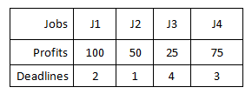
What is the deadline of a Job?
Assume all jobs takes 1 hour to complete its processing
Suppose machine starts processing a jobs at 8am then job(J1) needs to complete its processing within 10am because job(J1) has a deadline of 2 hour
job(J2) needs to complete its processing within 9am because job(J2) has a deadline of 1 hour

Slide 17
JOB SEQUENCING WITH DEADLINES
OBJECTIVES:
To obtain feasible solution with maximum profit value
CONSTRAINTS:
Only one machine is available for processing all jobs
Only one unit of time is assigned to complete a job on a machine

Slide 18
JOB SEQUENCING WITH DEADLINES EXAMPLE-1

Slide 19
JOB SEQUENCING WITH DEADLINES EXAMPLE-2

Slide 20
Module - 3
Greedy Method
Spanning Tree
Minimum Cost Spanning Tree
Prim’s Algorithm
Mr. C. R. BELAVI
Dept. of CSE,
HIT, Nidasoshi

Slide 21
SPANNING TREE & MINIMUM COST SPANNING TREE EXAMPLES

Slide 22
PRIM’S ALGORITHM

Slide 23
PRIM’S ALGORITHM EXAMPLE-1

Slide 24
PRIM’S ALGORITHM EXAMPLE-2

Slide 25
Module - 3
Greedy Method
Kruskal’s Algorithm
Mr. C. R. BELAVI
Dept. of CSE,
HIT, Nidasoshi

Slide 26
KRUSKAL’S ALGORITHM

Slide 27
KRUSKAL’S ALGORITHM EXAMPLE-1

Slide 28
KRUSKAL’S ALGORITHM EXAMPLE-2

Slide 29
Module - 3
Greedy Method
Single Source Shortest Path
Dijkstra’s Algorithm
Mr. C. R. BELAVI
Dept. of CSE,
HIT, Nidasoshi

Slide 30
SINGLE SOURCE SHORTEST PATH PROBLEM
Is a problem in which consider one source vertex in a given weighted connected graph and find shortest paths to all its other vertices from source vertex
That is to generate separate paths from source vertex to remaining vertex of shortest distance
Dijkstra’s algorithm is the best-known algorithm used to solve single source shortest-paths problem

Slide 31
Dijkstra’s Algorithm

Slide 32
Dijkstra’s Algorithm – Example1

Slide 33
Dijkstra’s Algorithm – Example2

Slide 34
Module - 3
Greedy Method
Huffman Trees & Codes
Mr. C. R. BELAVI
Dept. of CSE,
HIT, Nidasoshi

Slide 35
Huffman Coding
Huffman coding is lossless data compression technique widely used while transmitting data over network or storing data on the disk
Huffman coding assigns codeword's of different lengths to different characters. Hence, it is a variable-length encoding technique
Fixed-length encoding assigns codeword’s of same length to different characters

Slide 36
Fixed Length Vs. Variable Length
Fixed Length Encoding Example:
Assume 4 characters A, B, C, D are given
Then minimum 3-bits are required to encode all 4-characters
Each character are represented by using 3-bits as shown below-A=000, B=001, C=010, D=011
Hence final codeword results as- 000 001 010 011
Total 12 bits are used to encode 4-characters A, B, C, D
It takes more time to transfer data over network
Also takes more storage space to save data on disk
Variable Length Encoding Example:
Assume 4 characters A, B, C, D are given
Then different length bits are used to encode all 4-characters
Each character are represented by using variable length bits as shown below- A=00, B=001, C=10, D=111
Hence final codeword results as-
00 001 10 111
Only 10 bits are used to encode 4-charactes A, B, C, D
It takes less time to transfer data over network
Also takes less storage space to save data on disk

Slide 37
Huffman algorithm to Construct Huffman Tree
Step 1:- Initialize n one-node trees and label them with the characters of the alphabet. Record the frequency of each character in its tree’s root to indicate the tree’s weight
Step 2:- Repeat the following operation until a single tree is obtained. Find two trees with the smallest weight and make them the left and right subtree of new tree and record the sum of their weights in the root of new tree as its weight

Slide 38
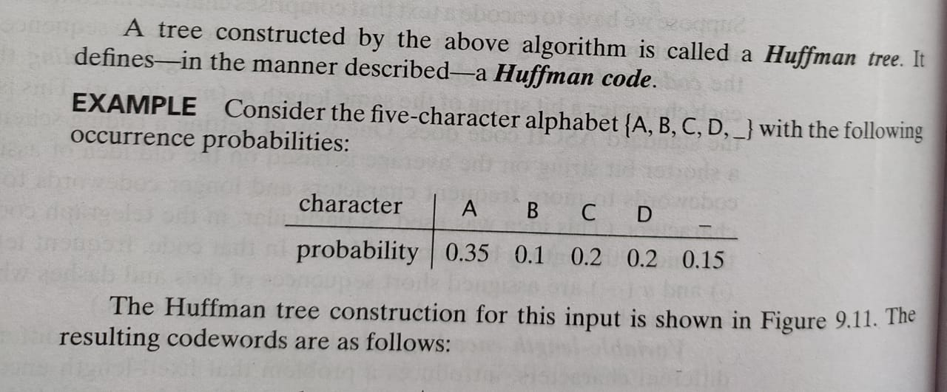

Slide 39
Encoding & Decoding
From above table, now characters DAD is encoded as 01 11 01
BAD is encoded as 100 11 01
Similarly codeword 100 11 01 101 11 01 is decoded as BAD_AD

Slide 40
Module - 3
Greedy Method
Heaps & Heapsort
Mr. C. R. BELAVI
Dept. of CSE,
HIT, Nidasoshi

Slide 41
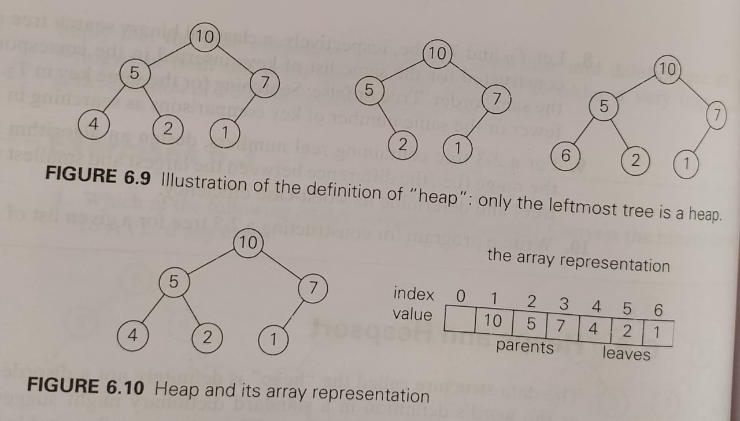
Heap Definition
A heap can be defined as a BINARY TREE with keys assigned to its each nodes that satisfies following two conditions-
Condition 1: The Binary Tree shape Requirement
BT is complete BT, that is, all its levels are full expect last level , where only some rightmost leaves may be missing
Condition 2: The Parental dominance Requirement
the key at each parent node is greater than or equal to the keys at its children

Slide 42
Heapsort Algorithm
Heapsort algorithm has two stages as shown below-
stage 1: Heap Construction
Construct a heap for a given array
stage 2: Maximum Deletion
Apply the root deletion operation n-1 times for remaining heap

Slide 43
Bottom-Up Heap Construction

Slide 44
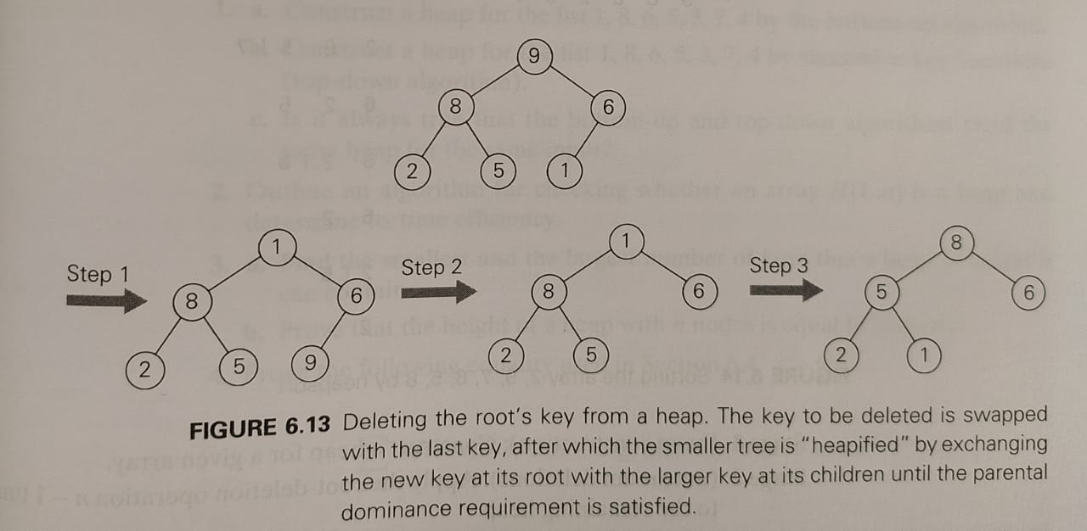
Maximum Key Deletion from a Heap
Step 1:- Exchange the Root’s key with last key K of the heap
Step 2:- Decrease the Heap’s size by 1
Step 3:- “Heapify” means construct new heap by using bottom-up heap construction algorithm

Slide 45
HeapSort Example

