Slide 1
Applets
Applets are small applications that are accessed on an Internet server, transported over the Internet, automatically installed, and run as part of a web document on client
Applets do not need a main( ) method
Applets must be run under an applet viewer or a Java-compatible browser
Applets use the interface provided by the AWT or Swing
Every applet that you create must be a subclass of Applet.

Slide 2
Two Types of Applets
First are those based directly on the Applet class, use the Abstract Window Toolkit (AWT) to provide the graphic user interface
Second type of applets are those based on the Swing class JApplet. Swing applets use the Swing classes to provide the GUI.
Swings offers a richer and often easier-to-use user interface than does the AWT.
JApplet inherits Applet, all the features of Applet are also available in JApplet,

Slide 3
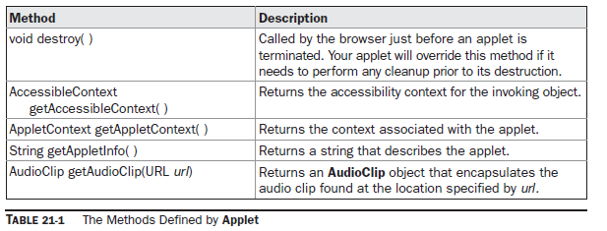
Applet Class

Slide 4
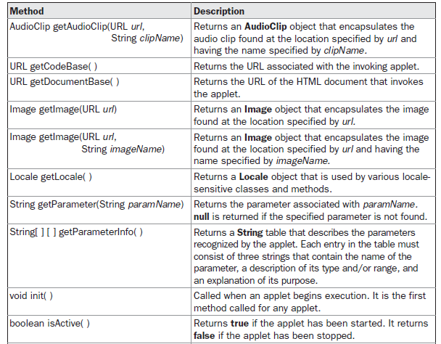

Slide 5
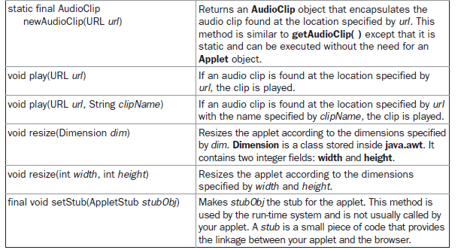

Slide 6
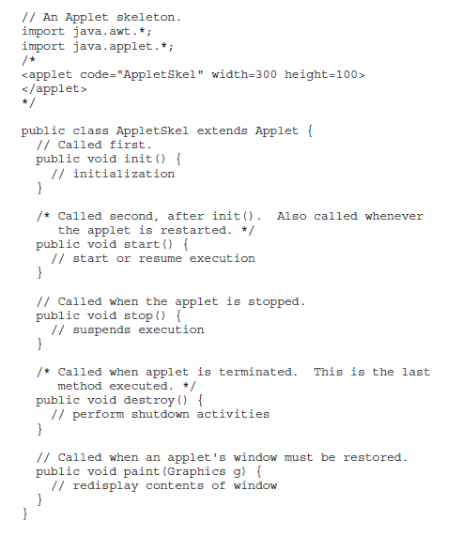
An Applet Skeleton

Slide 7
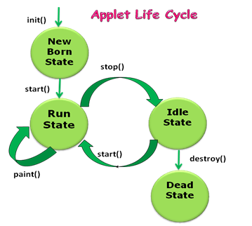

Slide 8
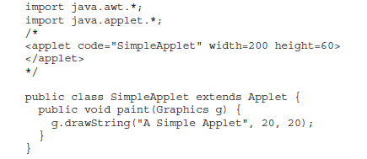
First Applet program

Slide 9

Simple Applet Display Methods
void drawString(String message, int x, int y)
void setBackground(Color newColor)
void setForeground(Color newColor)
The class Color defines the constants shown here that can be used to specify colors:

Slide 10
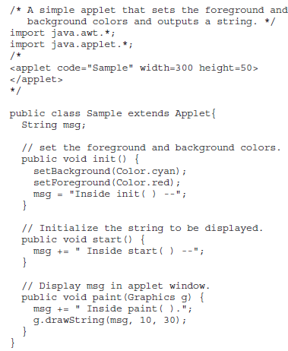

Slide 11
Requesting Repainting
How can the applet itself cause its window to be updated when its information changes?
Whenever your applet needs to update the information displayed in its window, it simply calls repaint( ).
The repaint( ) method is defined by the AWT.
It calls applet’s update( ) method, which, in its default implementation, calls paint( ).

Slide 12
repaint( ) method
void repaint( )- causes the entire window to be repainted.
void repaint(int left, int top, int width, int height)- the coordinates of the upper-left corner of the region are specified by left and top, and the width and height of the region are passed in width and height.

Slide 13
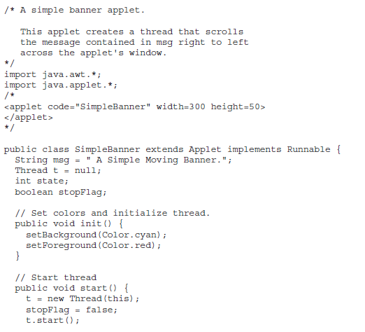
A Simple Banner Applet

Slide 14
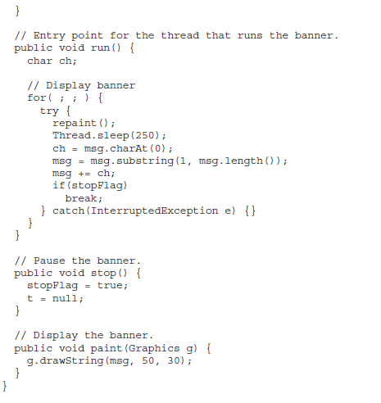

Slide 15
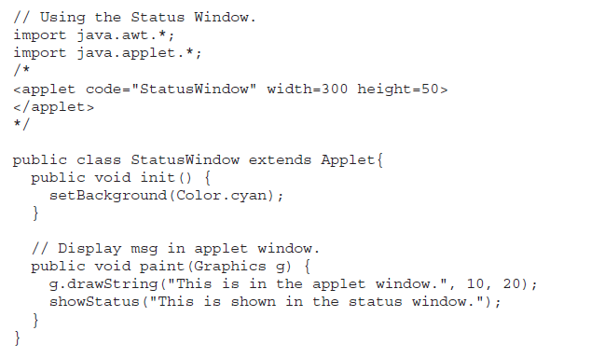
Using the Status Window

Slide 16
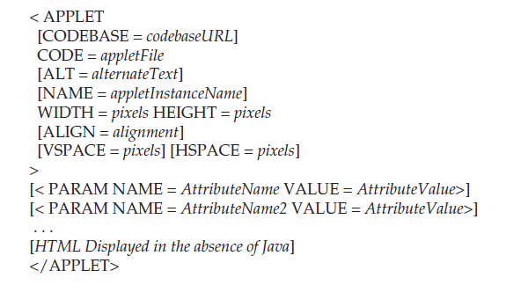
HTML APPLET Tag

Slide 17
Passing Parameters to Applets
APPLET tag in HTML allows you to pass parameters to your applet.
To retrieve a parameter, use the getParameter( ) method.
It returns the value of the specified parameter in the form of a String object.

Slide 18
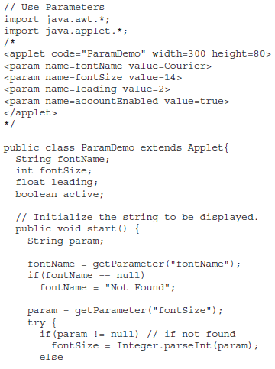

Slide 19
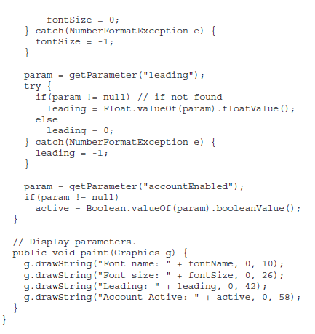

Slide 20
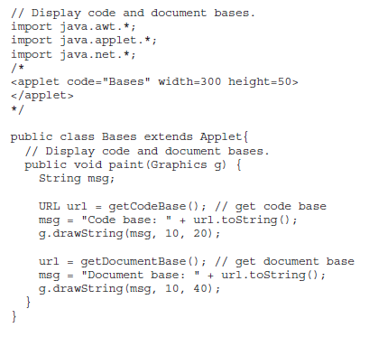
getDocumentBase( ) and getCodeBase( )

