Slide 1
Event Handling
Applets are event-driven programs that use a graphical user interface to interact with the user.
Events are supported by a number of packages, including java.util, java.awt, and java.awt.event
There are several types of events, including those generated by the mouse, the keyboard, and various GUI controls, such as a push button, scroll bar, or check box, etc.

Slide 2
The Delegation Event Model
Defines standard and consistent mechanisms to generate and process events
a source generates an event and sends it to one or more listeners.
the listener simply waits until it receives an event.
Once an event is received, the listener processes the event and then returns.
In the delegation event model, listeners must register with a source in order to receive an event notification.

Slide 3
Events
In the delegation model, an event is an object that describes a state change in a source.
pressing a button, entering a character via the keyboard, selecting an item in a list, and clicking the mouse.

Slide 4
Event Sources
A source is an object that generates an event. This occurs when the internal state of that object changes in some way.
A source must register listeners in order for the listeners to receive notifications about a specific type of event.
public void addTypeListener(TypeListener el)
addKeyListener( ), addMouseMotionListener( )
public void removeTypeListener(TypeListener el)

Slide 5
Event Listeners
A listener is an object that is notified when an event occurs. It has two major requirements. First, it must have been registered with one or more sources to receive notifications about specific types of events. Second, it must implement methods to receive and process these notifications.

Slide 6
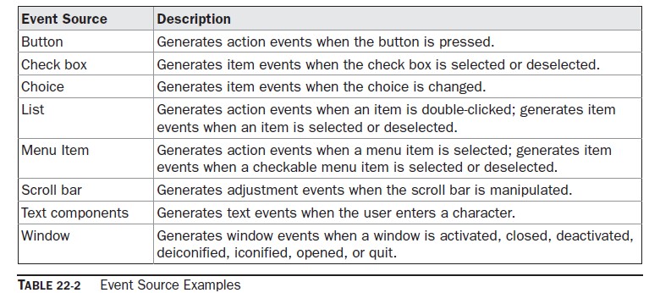
Sources of Events

Slide 7
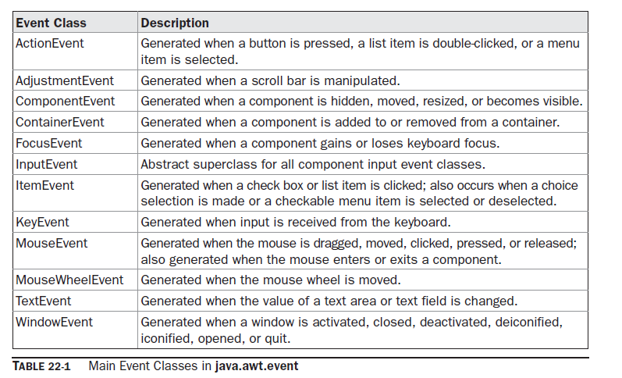
Event Classes

Slide 8
The ActionEvent Class
An ActionEvent is generated when a button is pressed, a list item is double-clicked, or a menu item is selected.
ActionEvent(Object src, int type, String cmd)
ActionEvent(Object src, int type, String cmd, int modifiers)
ActionEvent(Object src, int type, String cmd, long when, int modifiers)
String getActionCommand( )
int getModifiers( )
long getWhen( )

Slide 9
The AdjustmentEvent Class
An AdjustmentEvent is generated by a scroll bar.
There are five types of adjustment events.
AdjustmentEvent(Adjustable src, int id, int type, int data)

Slide 10
The ComponentEvent Class
A ComponentEvent is generated when the size, position, or visibility of a component is changed.
ComponentEvent is the superclass either directly or indirectly of ContainerEvent, FocusEvent, KeyEvent, MouseEvent, and WindowEvent.
ComponentEvent(Component src, int type)
Component getComponent( )

Slide 11
The ContainerEvent Class
A ContainerEvent is generated when a component is added to or removed from a container.
There are two types of container events: COMPONENT_ADDED and COMPONENT_REMOVED
ContainerEvent(Component src, int type, Component comp)
Container getContainer( )
Component getChild( )

Slide 12
FocusEvent Class
A FocusEvent is generated when a component gains or loses input focus.
FOCUS_GAINED and FOCUS_LOST

Slide 13
InputEvent Class
InputEvent is a subclass of ComponentEvent and is the superclass for component input events. Its subclasses are KeyEvent and MouseEvent.

Slide 14
The ItemEvent Class
An ItemEvent is generated when a check box or a list item is clicked or when a checkable menu item is selected or deselected.
ItemEvent(ItemSelectable src, int type, Object entry, int state)

Slide 15
The KeyEvent Class
A KeyEvent is generated when keyboard input occurs. There are three types of key events, which are identified by these integer constants: KEY_PRESSED, KEY_RELEASED, and KEY_TYPED.
KeyEvent is a subclass of InputEvent.
KeyEvent(Component src, int type, long when, int modifiers, int code, char ch)
char getKeyChar( )
int getKeyCode( )

Slide 16
MouseEvent Class
int getX( ), int getY( ), Point getPoint( ),
void translatePoint(int x, int y), int getClickCount( )
int getButton( )

Slide 17
The MouseWheelEvent Class

Slide 18
The TextEvent Class
TEXT_VALUE_CHANGED
TextEvent(Object src, int type)

Slide 19
The WindowEvent Class
WindowEvent(Window src, int type)

Slide 20
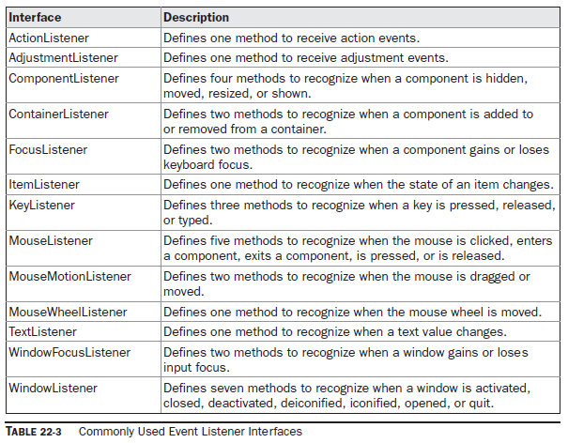
Event Listener Interfaces

Slide 21
The ActionListener Interface
void actionPerformed(ActionEvent ae)
The AdjustmentListener Interface
void adjustmentValueChanged(AdjustmentEvent ae)

Slide 22
The ComponentListener Interface

Slide 23
The ContainerListener Interface
void componentAdded(ContainerEvent ce)
void componentRemoved(ContainerEvent ce)
The FocusListener Interface
void focusGained(FocusEvent fe)
void focusLost(FocusEvent fe)
The ItemListener Interface
void itemStateChanged(ItemEvent ie)

Slide 24
The KeyListener Interface
void keyPressed(KeyEvent ke)
void keyReleased(KeyEvent ke)
void keyTyped(KeyEvent ke)
The MouseListener Interface
void mouseClicked(MouseEvent me)
void mouseEntered(MouseEvent me)
void mouseExited(MouseEvent me)
void mousePressed(MouseEvent me)
void mouseReleased(MouseEvent me)
The MouseMotionListener Interface
void mouseDragged(MouseEvent me)
void mouseMoved(MouseEvent me)

Slide 25
MouseWheelListener Interface
void mouseWheelMoved(MouseWheelEvent mwe)
TextListener Interface
void textChanged(TextEvent te)
WindowFocusListener Interface
void windowGainedFocus(WindowEvent we)
void windowLostFocus(WindowEvent we)

Slide 26
WindowListener Interface
void windowActivated(WindowEvent we)
void windowClosed(WindowEvent we)
void windowClosing(WindowEvent we)
void windowDeactivated(WindowEvent we)
void windowDeiconified(WindowEvent we)
void windowIconified(WindowEvent we)
void windowOpened(WindowEvent we)

Slide 27
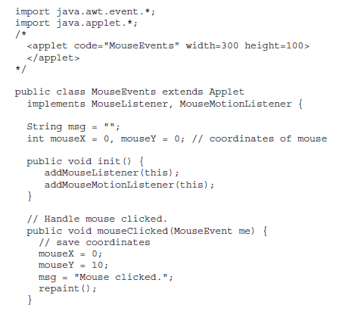
Handling Mouse Events

Slide 28
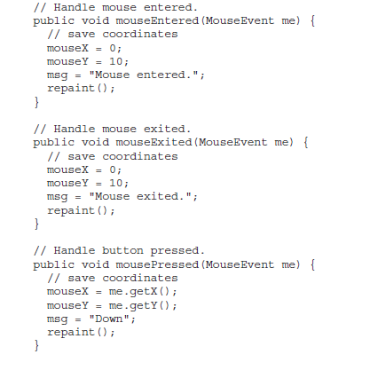

Slide 29
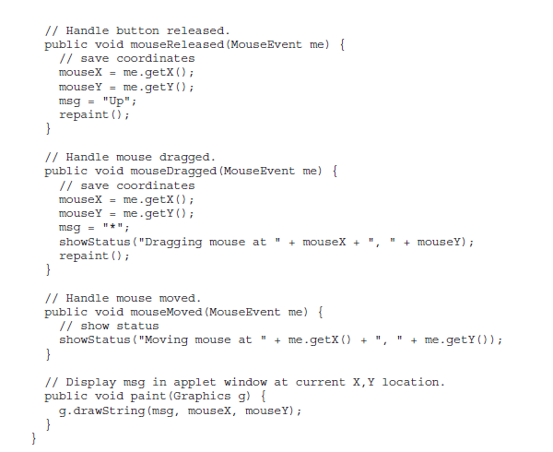

Slide 30
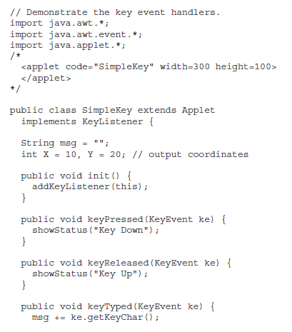
Handling Keyboard Events

Slide 31
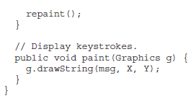

Slide 32
Adapter Classes
An adapter class provides an empty implementation of all methods in an event listener interface.
Adapter classes are useful when you want to receive and process only some of the events that are handled by a particular event listener interface.
For example, the MouseMotionAdapter class has two methods, mouseDragged( ) and mouseMoved( ), which are the methods defined by the MouseMotionListener interface.

Slide 33
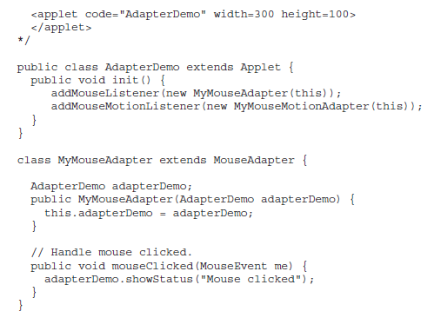

Slide 34
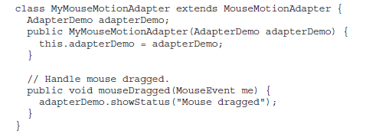

Slide 35
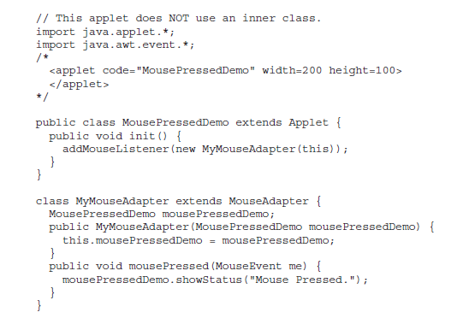
Inner Classes

Slide 36
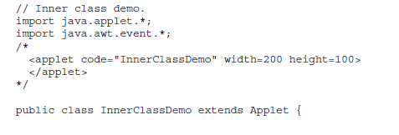
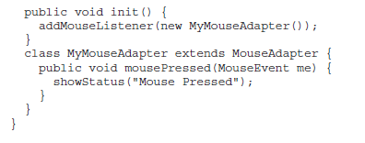

Slide 37
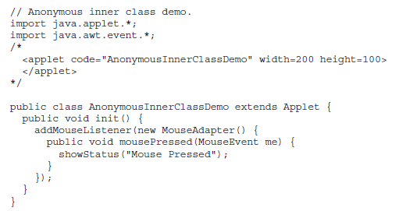
Anonymous Inner Classes

