Slide 1
Multithreaded Programming
A multithreaded program contains two or more parts that can run concurrently.
Each part of such a program is called a thread, and each thread defines a separate path of execution.
This means that a single program can perform two or more tasks simultaneously.
Multithreading enables you to write very efficient programs that make maximum use of the CPU

Slide 2
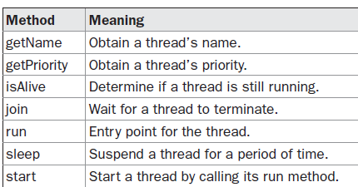
Thread Class and Runnable Interface
Java’s multithreading system is built upon the Thread class, its methods, and its companion interface, Runnable
To create a new thread, your program will either extend Thread or implement the Runnable interface.

Slide 3
The Main Thread
When a Java program starts up, one thread begins running immediately. This is usually called the main thread of your program.
The main thread is important for two reasons:
It is the thread from which other “child” threads will be spawned.
it must be the last thread to finish execution because it performs various shutdown actions.
Main thread can be controlled through a Thread object. To do so, you must obtain a reference to it by calling the method currentThread( ).
static Thread currentThread( )

Slide 4
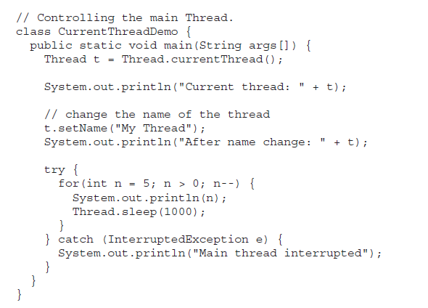

Slide 5
static void sleep(long milliseconds) throws InterruptedException
final void setName(String threadName)
final String getName( )
Creating a Thread
You can implement the Runnable interface.
You can extend the Thread class, itself.

Slide 6
Implementing Runnable
The easiest way to create a thread is to create a class that implements the Runnable interface.
To implement Runnable, a class need only implement a single method called run( ), which is declared like this: public void run( )
Run() is the entry point for new thread.
The thread will end when run( ) returns.
Thread defines several constructors.
Thread(Runnable threadOb, String threadName)
After the new thread is created, it will not start running until you call its start( ) method
start( ) executes a call to run( ).

Slide 7
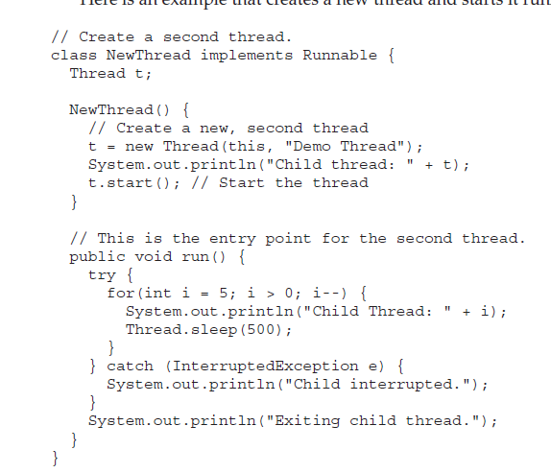

Slide 8
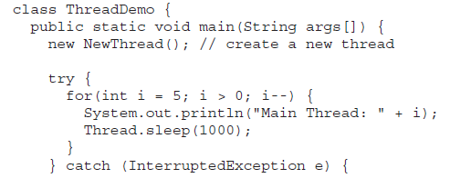
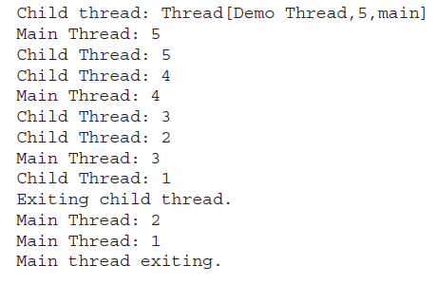

Slide 9
Extending Thread
The second way to create a thread is to create a new class that extends Thread
The extending class must override the run( ) method, which is the entry point for the new thread.
It must also call start( ) to begin execution of the new thread.

Slide 10
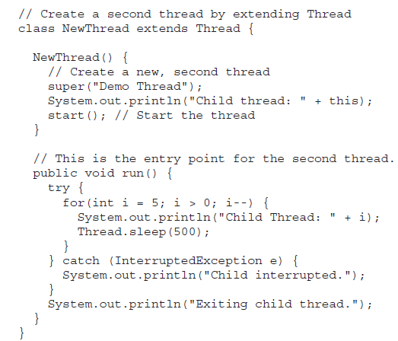

Slide 11
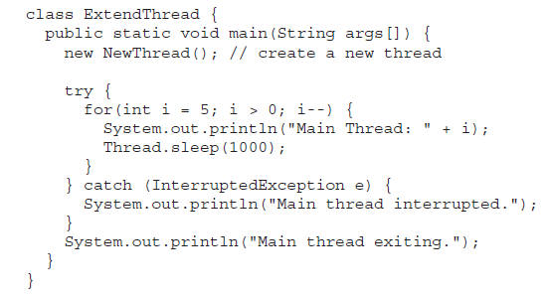

Slide 12
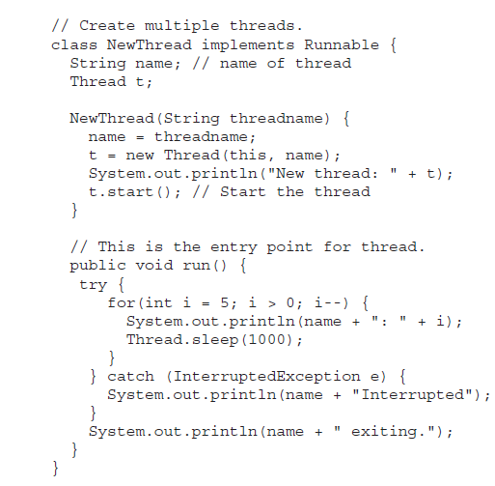
Creating Multiple Threads

Slide 13
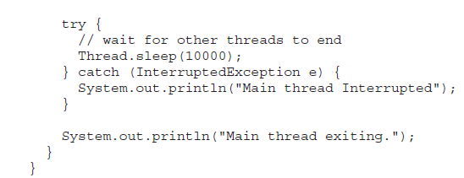

Slide 14
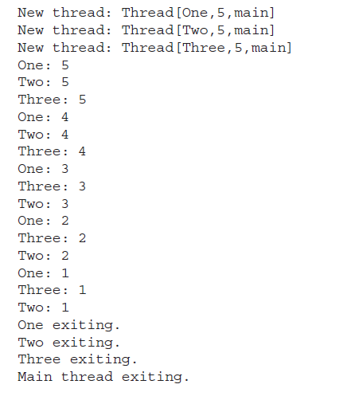

Slide 15
Using isAlive( ) and join( )
final boolean isAlive( )-returns true if the thread upon which it is called is still running. It returns false otherwise.
final void join( ) throws InterruptedException
waits until the thread on which it is called terminates.
Its name comes from the concept of the calling thread waiting until the specified thread joins it.

Slide 16
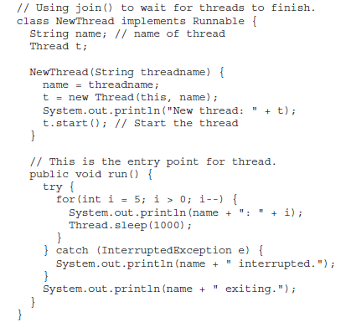

Slide 17
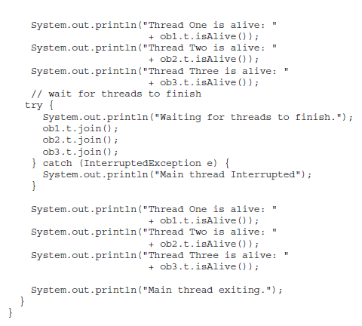

Slide 18
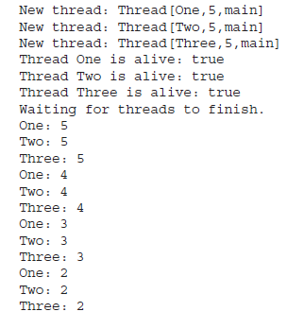
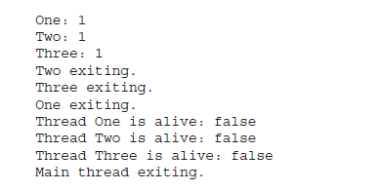

Slide 19
Thread Priorities
To set a thread’s priority, use the setPriority( ) method, which is a member of Thread.
This is its general form:
final void setPriority(int level)
The value of level must be within the range MIN_PRIORITY and MAX_PRIORITY.
Currently, these values are 1 and 10, respectively.
To return a thread to default priority, specify NORM_PRIORITY, which is currently 5.
You can obtain the current priority by calling the getPriority( )
final int getPriority( )

Slide 20
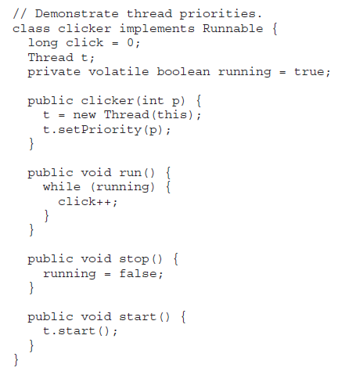

Slide 21
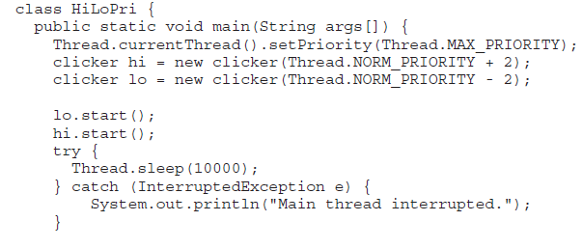
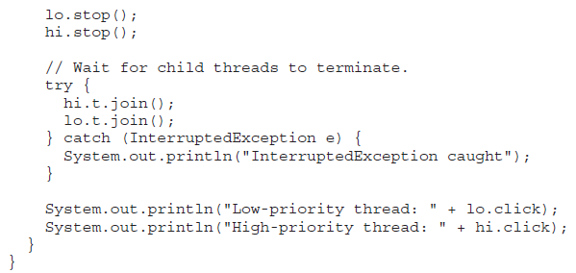

Slide 22
Synchronization
When two or more threads need access to a shared resource, they need some way to ensure that the resource will be used by only one thread at a time. The process by which this is achieved is called synchronization.
Key to synchronization is the concept of the monitor (also called a semaphore).
A monitor is an object that is used as a mutually exclusive lock, or mutex.
Only one thread can own a monitor at a given time.
When a thread acquires a lock, it is said to have entered the monitor.
All other threads attempting to enter the locked monitor will be suspended until the first thread exits the monitor.

Slide 23
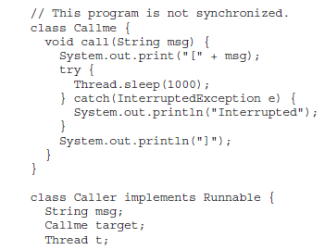
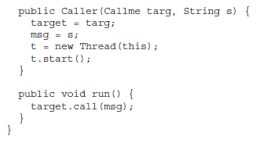

Slide 24
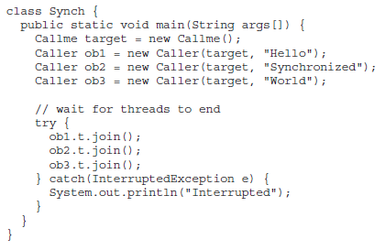

Slide 25
Using Synchronized Methods

Slide 26
The synchronized Statement
This is the general form of the synchronized statement:
synchronized(object) {
// statements to be synchronized
}

Slide 27
Interthread Communication
wait( ) tells the calling thread to give up the monitor and go to sleep until some other thread enters the same monitor and calls notify( ).
notify( ) wakes up a thread that called wait( ) on the same object.
notifyAll( ) wakes up all the threads that called wait( ) on the same object. One of the threads will be granted access.

Slide 28
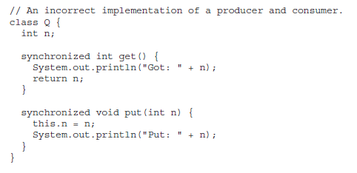

Slide 29
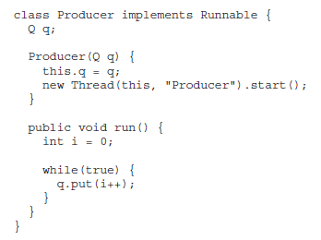

Slide 30
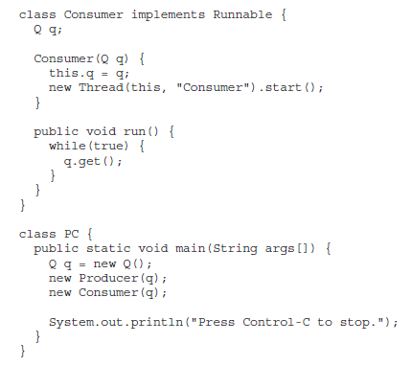

Slide 31
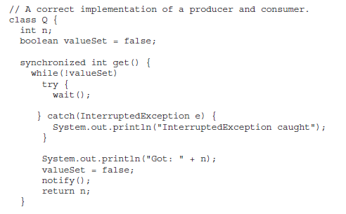

Slide 32
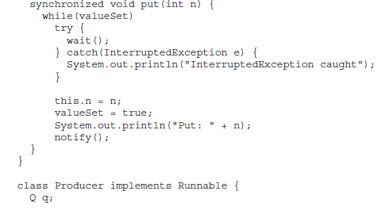

Slide 33
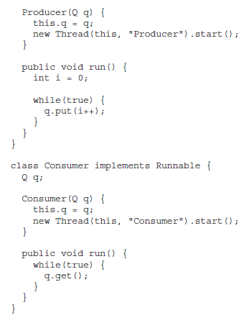

Slide 34
