Slide 1
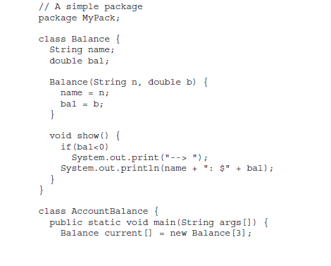

Slide 3
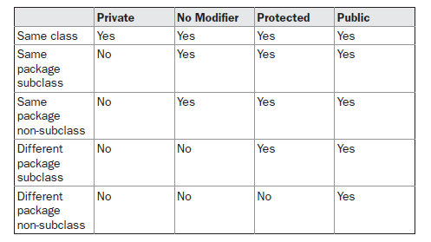
Access Protection

Slide 4
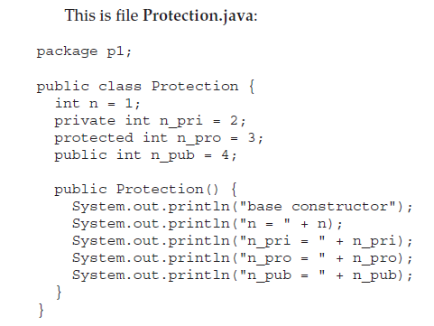
An Access Example

Slide 5
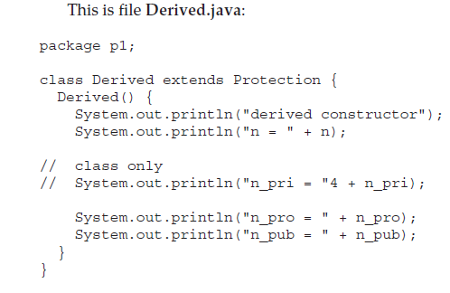

Slide 6
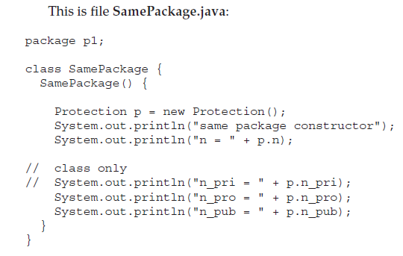

Slide 7
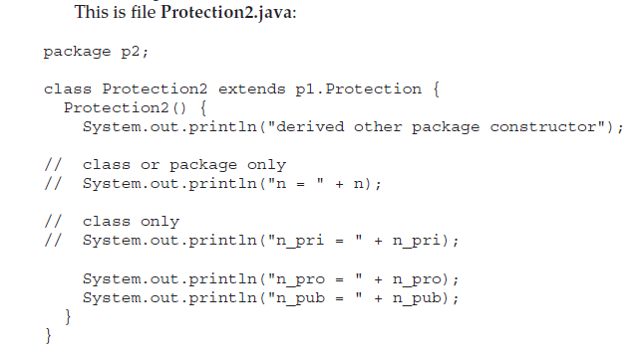

Slide 8
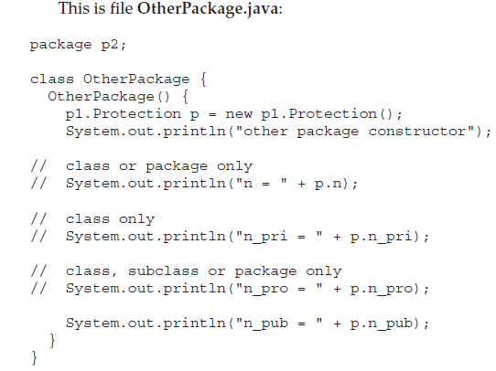

Slide 9
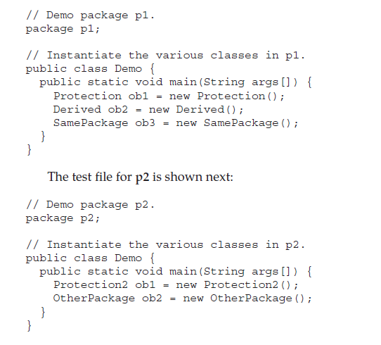

Slide 10
Importing Packages

Slide 11
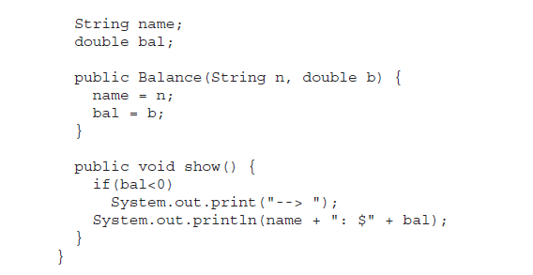

Slide 12
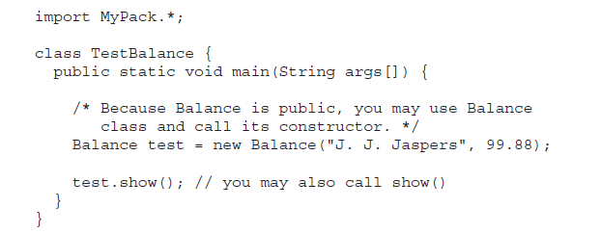

Slide 13
Exception Handling
An exception is an abnormal condition that arises in a code sequence at run time. In other words, an exception is a run-time error.
A Java exception is an object that describes an exceptional (that is, error) condition that has occurred in a piece of code.
When an exceptional condition arises, an object representing that exception is created and thrown in the method that caused the error.
That method may choose to handle the exception (caught and processed.)
Java exception handling is managed via five keywords: try, catch, throw, throws, and finally.
System-generated exceptions are automatically thrown by the Java run-time system.

Slide 14
The general form of an exception-handling block
try {
// block of code to monitor for errors
}
catch (ExceptionType1 exOb) {
// exception handler for ExceptionType1
}
catch (ExceptionType2 exOb) {
// exception handler for ExceptionType2
}
// ...
finally {
// block of code to be executed after try block ends
}

Slide 15
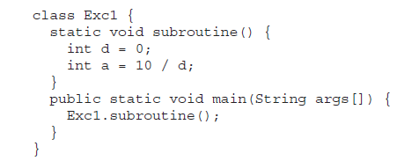
Uncaught Exceptions

Slide 16
Using try and catch

Slide 17
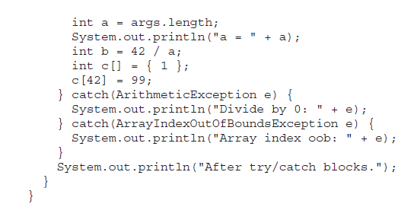
Multiple catch Clauses

Slide 19
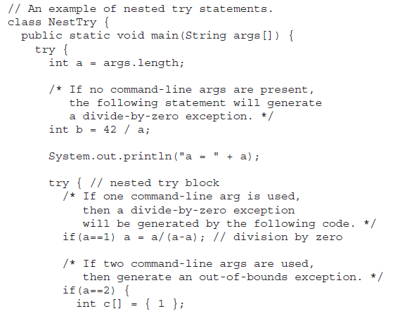

Slide 20
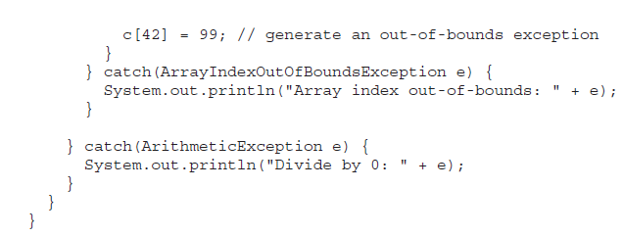
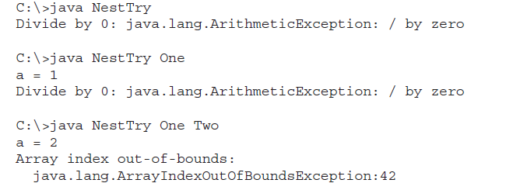

Slide 21
throw
It is possible for your program to throw an exception explicitly, using the throw statement.
The general form of throw
throw ThrowableInstance;
ThrowableInstance must be an object of type Throwable or a subclass of Throwable
The flow of execution stops immediately after the throw statement; any subsequent statements are not executed.

Slide 22
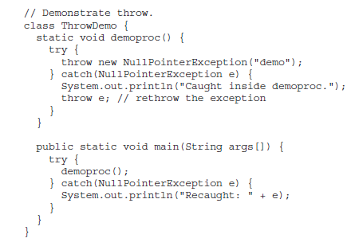

Slide 23
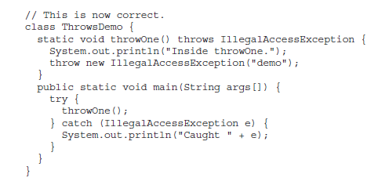
throws
A throws clause lists the types of exceptions that a method might throw.

Slide 24
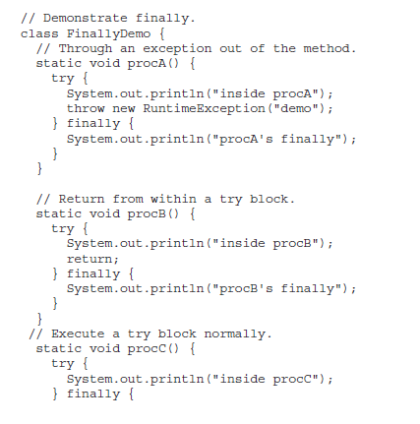
finally

Slide 25
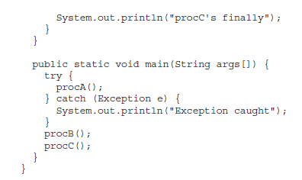
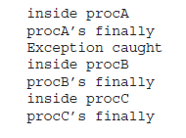

Slide 26
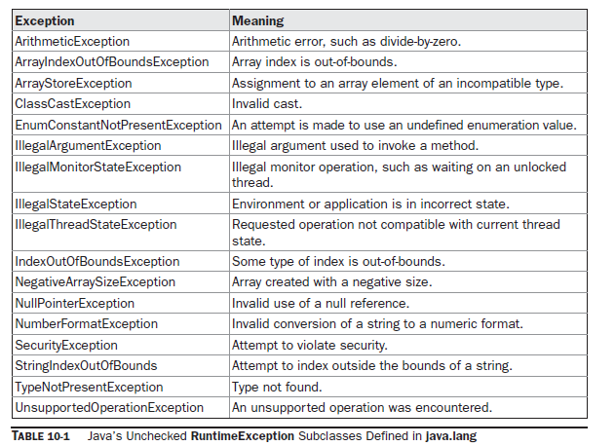

Slide 27
