Slide 1
Chapter 23 – Project planning
Lecture 1

Slide 2
Topics covered
Software pricing
Plan-driven development
Project scheduling
Estimation techniques

Slide 3
Project planning
Project planning involves breaking down the work into parts and assign these to project team members, anticipate problems that might arise and prepare tentative solutions to those problems.
The project plan, which is created at the start of a project, is used to communicate how the work will be done to the project team and customers, and to help assess progress on the project.

Slide 4
Planning stages
At the proposal stage, when you are bidding for a contract to develop or provide a software system.
During the project startup phase, when you have to plan who will work on the project, how the project will be broken down into increments, how resources will be allocated across your company, etc.
Periodically throughout the project, when you modify your plan in the light of experience gained and information from monitoring the progress of the work.

Slide 5
Proposal planning
Planning may be necessary with only outline software requirements.
The aim of planning at this stage is to provide information that will be used in setting a price for the system to customers.

Slide 6
Software pricing
Estimates are made to discover the cost, to the developer, of producing a software system.
  You take into account, hardware, software, travel, training and effort costs.
There is not a simple relationship between the development cost and the price charged to the customer.
Broader organisational, economic, political and business considerations influence the price charged.

Slide 7
Factors affecting software pricing
Factor | Description
Market opportunity | A development organization may quote a low price because it wishes to move into a new segment of the software market. Accepting a low profit on one project may give the organization the opportunity to make a greater profit later. The experience gained may also help it develop new products.
Cost estimate uncertainty | If an organization is unsure of its cost estimate, it may increase its price by a contingency over and above its normal profit.
Contractual terms | A customer may be willing to allow the developer to retain ownership of the source code and reuse it in other projects. The price charged may then be less than if the software source code is handed over to the customer.

Slide 8
Factors affecting software pricing
Factor | Description
Requirements volatility | If the requirements are likely to change, an organization may lower its price to win a contract. After the contract is awarded, high prices can be charged for changes to the requirements.
Financial health | Developers in financial difficulty may lower their price to gain a contract. It is better to make a smaller than normal profit or break even than to go out of business. Cash flow is more important than profit in difficult economic times.

Slide 9
Plan-driven development
Plan-driven or plan-based development is an approach to software engineering where the development process is planned in detail.
  Plan-driven development is based on engineering project management techniques and is the ‘traditional’ way of managing large software development projects.
A project plan is created that records the work to be done, who will do it, the development schedule and the work products.
Managers use the plan to support project decision making and as a way of measuring progress.

Slide 10
Plan-driven development – pros and cons
The arguments in favor of a plan-driven approach are that early planning allows organizational issues (availability of staff, other projects, etc.) to be closely taken into account, and that potential problems and dependencies are discovered before the project starts, rather than once the project is underway.
The principal argument against plan-driven development is that many early decisions have to be revised because of changes to the environment in which the software is to be developed and used.

Slide 11
Project plans
In a plan-driven development project, a project plan sets out the resources available to the project, the work breakdown and a schedule for carrying out the work.
Plan sections
  Introduction
  Project organization
  Risk analysis
  Hardware and software resource requirements
  Work breakdown
  Project schedule
  Monitoring and reporting mechanisms

Slide 12
Project plan supplements
Plan | Description
Quality plan | Describes the quality procedures and standards that will be used in a project.
Validation plan | Describes the approach, resources, and schedule used for system validation.
Configuration management plan | Describes the configuration management procedures and structures to be used.
Maintenance plan | Predicts the maintenance requirements, costs, and effort.
Staff development plan | Describes how the skills and experience of the project team members will be developed.

Slide 13
The planning process
Project planning is an iterative process that starts when you create an initial project plan during the project startup phase.
Plan changes are inevitable.
  As more information about the system and the project team becomes available during the project, you should regularly revise the plan to reflect requirements, schedule and risk changes.
  Changing business goals also leads to changes in project plans. As business goals change, this could affect all projects, which may then have to be re-planned.

Slide 14
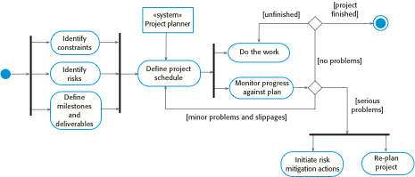
The project planning process

Slide 15
Project scheduling
Project scheduling is the process of deciding how the work in a project will be organized as separate tasks, and when and how these tasks will be executed.
You estimate the calendar time needed to complete each task, the effort required and who will work on the tasks that have been identified.
You also have to estimate the resources needed to complete each task, such as the disk space required on a server, the time required on specialized hardware, such as a simulator, and what the travel budget will be.

Slide 16
Project scheduling activities
Split project into tasks and estimate time and resources required to complete each task.
Organize tasks concurrently to make optimal
use of workforce.
Minimize task dependencies to avoid delays
caused by one task waiting for another to complete.
Dependent on project managers intuition and experience.

Slide 17
Milestones and deliverables
Milestones are points in the schedule against which you can assess progress, for example, the handover of the system for testing.
Deliverables are work products that are delivered to the customer, e.g. a requirements document for the system.

Slide 18

The project scheduling process

Slide 19
Scheduling problems
Estimating the difficulty of problems and hence the cost of developing a solution is hard.
Productivity is not proportional to the number of people working on a task.
Adding people to a late project makes it later because of communication overheads.
The unexpected always happens. Always allow contingency in planning.

Slide 20
Schedule representation
Graphical notations are normally used to illustrate the project schedule.
These show the project breakdown into tasks. Tasks should not be too small. They should take about a week or two.
Bar charts are the most commonly used representation for project schedules. They show the schedule as activities or resources against time.

Slide 21
Tasks, durations, and dependencies
Task | Effort (person-days) | Duration (days) | Dependencies
T1 | 15 | 10
T2 | 8 | 15
T3 | 20 | 15 | T1 (M1)
T4 | 5 | 10
T5 | 5 | 10 | T2, T4 (M3)
T6 | 10 | 5 | T1, T2 (M4)
T7 | 25 | 20 | T1 (M1)
T8 | 75 | 25 | T4 (M2)
T9 | 10 | 15 | T3, T6 (M5)
T10 | 20 | 15 | T7, T8 (M6)
T11 | 10 | 10 | T9 (M7)
T12 | 20 | 10 | T10, T11 (M8)

Slide 22
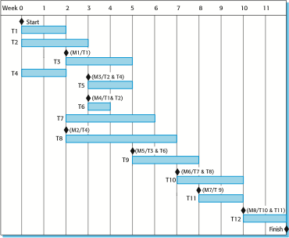
Activity bar chart

Slide 23
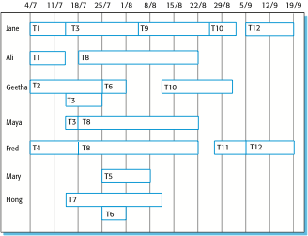
Staff allocation chart

Slide 24
Chapter 23 – Project planning
Lecture 2

Slide 25
Estimation techniques
Organizations need to make software effort and cost estimates. There are two types of technique that can be used to do this:
  Experience-based techniques The estimate of future effort requirements is based on the manager’s experience of past projects and the application domain. Essentially, the manager makes an informed judgment of what the effort requirements are likely to be.
  Algorithmic cost modeling In this approach, a formulaic approach is used to compute the project effort based on estimates of product attributes, such as size, and process characteristics, such as experience of staff involved.

Slide 26
Experience-based approaches
Experience-based techniques rely on judgments based on experience of past projects and the effort expended in these projects on software development activities.
Typically, you identify the deliverables to be produced in a project and the different software components or systems that are to be developed.
You document these in a spreadsheet, estimate them individually and compute the total effort required.
It usually helps to get a group of people involved in the effort estimation and to ask each member of the group to explain their estimate.

Slide 27
Algorithmic cost modelling
Cost is estimated as a mathematical function of product, project and process attributes whose values are estimated by project managers:
  Effort = A X Size^{B} X M
  Where,
  A is an organisation-dependent constant,
  B reflects the disproportionate effort for large projects and
  M is a multiplier reflecting product, process and people attributes.
The most commonly used product attribute for cost
estimation is code size.
Most models are similar but they use different values for A, B and M.

Slide 28
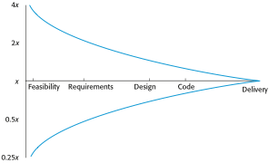
Estimate uncertainty

Slide 29
The COCOMO 2 model
An empirical model based on project experience.
Well-documented, ‘independent’ model which is not tied to a specific software vendor.
Long history from initial version published in 1981 (COCOMO-81) through various instantiations to COCOMO 2.
COCOMO 2 takes into account different approaches to software development, reuse, etc.

Slide 30
COCOMO 2 models
COCOMO 2 incorporates a range of sub-models that produce increasingly detailed software estimates.
The sub-models in COCOMO 2 are:
  Application composition model. Used when software is composed from existing parts.
  Early design model. Used when requirements are available but design has not yet started.
  Reuse model. Used to compute the effort of integrating reusable components.
  Post-architecture model. Used once the system architecture has been designed and more information about the system is available.

Slide 31
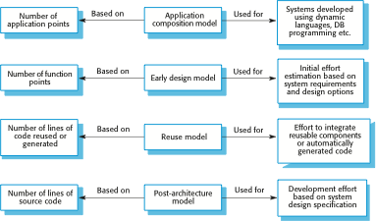
COCOMO estimation models

Slide 32
Application composition model
Supports prototyping projects and projects where there is extensive reuse.
Based on standard estimates of developer productivity in application (object) points/month.
Formula is
  PM = ( NAP X (1 - %reuse/100 ) ) / PROD
  PM is the effort in person-months,
  NAP is the number of application points and
  PROD is the productivity.

Slide 33
Application-point productivity
Developer’s experience and capability | Very low | Low | Nominal | High | Very high
ICASE maturity and capability | Very low | Low | Nominal | High | Very high
PROD (NAP/month) | 4 | 7 | 13 | 25 | 50
Where,
ICASE is a software tool.

Slide 34
Early design model
Estimates can be made after the requirements have been agreed.
Based on a standard formula for algorithmic models
  PM = A X Size^{B} X M
  where
  M = PERS X RCPX X RUSE X PDIF X PREX X FCIL X SCED
  A = 2.94 in initial calibration,
  Size in KLOC,
  B varies from 1.1 to 1.24 depending on novelty of the project, development flexibility, risk management approaches and the process maturity.

Slide 35
Multipliers
Multipliers reflect the capability of the developers, the non-functional requirements, the familiarity with the development platform, etc.
  RCPX - product reliability and complexity;
  RUSE - the reuse required;
  PDIF - platform difficulty;
  PREX - personnel experience;
  PERS - personnel capability;
  SCED - required schedule;
  FCIL - the team support facilities.

Slide 36
The reuse model
Takes into account black-box code that is reused without change and code that has to be adapted to integrate it with new code.
There are two versions:
  Black-box reuse where code is not modified. An effort estimate (PM) is computed.
  White-box reuse where code is modified. A size estimate equivalent to the number of lines of new source code is computed. This then adjusts the size estimate for new code.

Slide 37
Reuse model estimates 1
For automatically generated code:
  PM = (ASLOC X AT/100)/ATPROD
  Where,
  ASLOC is the number of lines of generated code
  AT is the percentage of code automatically generated.
  ATPROD is the productivity of engineers in integrating this code.

Slide 38
Reuse model estimates 2
When code has to be understood and integrated:
  ESLOC = ASLOC * (1-AT/100) * AAM.
  ASLOC and AT as before.
  AAM is the adaptation adjustment multiplier computed from the costs of changing the reused code, the costs of understanding how to integrate the code and the costs of reuse decision making.

Slide 39
Post-architecture level
Uses the same formula as the early design model but with 17 rather than 7 associated multipliers.
The code size is estimated as:
  Number of lines of new code to be developed;
  Estimate of equivalent number of lines of new code computed using the reuse model;
  An estimate of the number of lines of code that have to be modified according to requirements changes.

Slide 40
Project duration and staffing
As well as effort estimation, managers must estimate the calendar time required to complete a project and when staff will be required.
Calendar time can be estimated using a COCOMO 2 formula
  TDEV = 3 × (PM)^{(0.33+0.2*(B-1.01))}
  PM is the effort computation and B is the exponent computed as discussed above (B is 1 for the early prototyping model). This computation predicts the nominal schedule for the project.
The time required is independent of the number of people working on the project.

Slide 41
Staffing requirements
Staff required can’t be computed by diving the development time by the required schedule.
The number of people working on a project varies depending on the phase of the project.
The more people who work on the project, the more total effort is usually required.
A very rapid build-up of people often correlates with schedule slippage.

Slide 42
Key points
Estimation techniques for software may be experience-based, where managers judge the effort required, or algorithmic, where the effort required is computed from other estimated project parameters.
The COCOMO II costing model is an algorithmic cost model that uses project, product, hardware and personnel attributes as well as product size and complexity attributes to derive a cost estimate.

