Slide 1
Chapter 24 - Quality Management
Lecture 1

Slide 2
Topics covered
Software quality
Software standards
Reviews and inspections
Software measurement and metrics

Slide 3
Software quality management
Concerned with ensuring that the required level of quality is achieved in a software product.
Three principal concerns:
  At the organizational level, quality management is concerned with establishing a framework of organizational processes and standards that will lead to high-quality software.
  At the project level, quality management involves the application of specific quality processes and checking that these planned processes have been followed.
  At the project level, quality management is also concerned with establishing a quality plan for a project. The quality plan should set out the quality goals for the project and define what processes and standards are to be used.

Slide 4
Quality management activities
Quality management provides an independent check on the software development process (Fig.).
The quality management process checks the project deliverables to ensure that they are consistent with organizational standards and goals.
The quality team should be independent from the development team so that they can take an objective view of the software. This allows them to report on software quality without being influenced by software development issues.

Slide 5
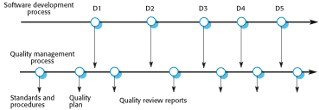
Quality management and software development

Slide 6
Quality planning
A quality plan sets out the desired product qualities and how these are assessed and defines the most significant quality attributes.
The quality plan should define the quality assessment process.
It should set out which organisational standards should be applied and, where necessary, define new standards to be used.

Slide 7
Quality plans
Quality plan structure
  Product introduction;
  Product plans;
  Process descriptions;
  Quality goals;
  Risks and risk management.
Quality plans should be short, succinct documents
  If they are too long, no-one will read them.

Slide 8
1. Software Quality
Quality, simplistically, means that a product should meet its specification.
This is problematical for software systems
  It is difficult to write complete and unambiguous requirements.
  Software specifications are usually incomplete and often inconsistent.
  It is impossible to measure some quality characteristics. (Eg. Maintainability)
Because of these, assessment of software quality is subjective process..

Slide 9
Software fitness for purpose
Questions to be answered about system characteristics
Have programming and documentation standards been followed in the development process?
Has the software been properly tested?
Is the software sufficiently dependable to be put into use?
Is the performance of the software acceptable for normal use?
Is the software usable?
Is the software well-structured and understandable?

Slide 10
Software quality attributes
Safety | Understandability | Portability
Security | Testability | Usability
Reliability | Adaptability | Reusability
Resilience | Modularity | Efficiency
Robustness | Complexity | Learnability

Slide 11
Process and Product quality
The quality of a developed product is influenced by the quality of the production process.
This is important in software development as some product quality attributes are hard to assess.
However, there is a very complex and poorly understood relationship between software processes and product quality.
But, there exist a clear link between these in manufacturing.

Slide 12
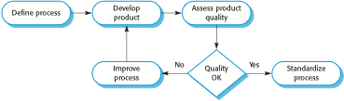
Process-based quality

Slide 13
2. Software standards
Standards define the required attributes of a product or process. They play an important role in quality management.
Standards may be international, national, organizational or project standards.
Product standards define characteristics that all software components should exhibit.
e.g. a common programming style.

Slide 14
Importance of standards
Standards capture wisdom that is of value to the organisation. Based on the knowledge about the best or most appropriate practice for the company.
They are a framework for defining what quality means in a particular setting i.e. that organization’s view of quality.
They provide continuity - new staff can understand the organisation by understanding the standards that are used.
Product Standards
Process Standards

Slide 15
Product and Process standards
Product standards | Process standards
Design review form | Design review conduct
Requirements document structure | Submission of new code for system building
Method header format | Version release process
Java programming style | Project plan approval process
Project plan format | Change control process
Change request form | Test recording process

Slide 16
Problems with standards
They may not be seen as relevant and up-to-date by software engineers.
They often involve too much bureaucratic form filling.
If they are unsupported by software tools, tedious form filling work is often involved to maintain the documentation associated with the standards.

Slide 17
Standards development steps
Involve software engineers in the selection of product standards.
Review and modify standards regularly to reflect changing technologies.
Provide software tools to support standards.

Slide 18
ISO 9001 standards framework
It is an international set of standards that can be used as a basis for developing quality management systems.
ISO 9001, the most general of these standards, applies to organizations that design, develop and maintain products, including software.
The ISO 9001 standard is a framework for developing software standards.
  It sets out general quality principles, describes quality processes in general and lays out the organizational standards and procedures that should be defined. These should be documented in an organizational quality manual.

Slide 19
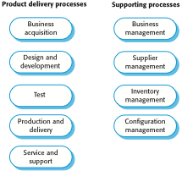
ISO 9001 core processes

Slide 20
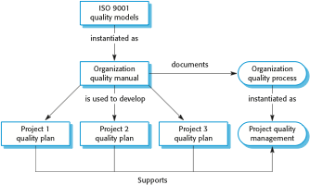
ISO 9001 and quality management

Slide 21
ISO 9001 certification
Quality standards and procedures should be documented in an organisational quality manual.
An external body may certify that an organisation’s quality manual conforms to ISO 9000 standards.
Some customers require suppliers to be ISO 9000 certified although the need for flexibility here is increasingly recognised.

Slide 22
3. Reviews and Inspections
A group examines part or all of a process or system and its documentation to find potential problems.
Software or documents may be 'signed off' at a
review which signifies that progress to the next
development stage has been approved by
management.
There are different types of review with different objectives
  Inspections for defect removal (product);
  Reviews for progress assessment (product and process);
  Quality reviews (product and standards).

Slide 23
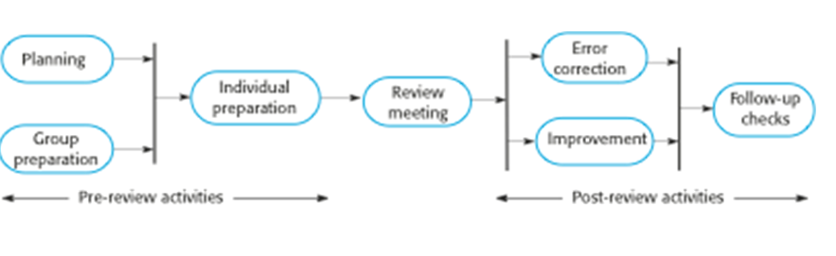
The software review process
Three Phases,
Pre-review activities
The review meeting
Post-review activities

Slide 24
Program inspections
These are peer reviews where engineers examine the program that is being developed, to find bugs, anomalies and defects.
Inspections do not require execution of a system so may be used before implementation.
They may be applied to any representation of the system (requirements, design, configuration data, test data, etc.)
They have been shown to be an effective technique for discovering program errors.

Slide 25
Inspection checklists
Checklist of common errors should be used to
drive the inspection.
Error checklists are programming language
dependent and reflect the characteristic errors that are likely to arise in the language.
In general, the 'weaker' the type checking, the larger the checklist.
Examples: Initialisation, Constant naming, loop
termination, array bounds, etc.

Slide 26
An inspection checklist (a)
Fault class | Inspection check
Data faults | Are all program variables initialized before their values are used? Have all constants been named? Should the upper bound of arrays be equal to the size of the array or Size -1? If character strings are used, is a delimiter explicitly assigned? Is there any possibility of buffer overflow?
Control faults | For each conditional statement, is the condition correct? Is each loop certain to terminate? Are compound statements correctly bracketed? In case statements, are all possible cases accounted for? If a break is required after each case in case statements, has it been included?
Input/output faults | Are all input variables used? Are all output variables assigned a value before they are output? Can unexpected inputs cause corruption?

Slide 27
An inspection checklist (b)
Fault class | Inspection check
Interface faults | Do all function and method calls have the correct number of parameters? Do formal and actual parameter types match? Are the parameters in the right order? If components access shared memory, do they have the same model of the shared memory structure?
Storage management faults | If a linked structure is modified, have all links been correctly reassigned? If dynamic storage is used, has space been allocated correctly? Is space explicitly deallocated after it is no longer required?
Exception management faults | Have all possible error conditions been taken into account?

Slide 28
4. Software measurement and metrics
Software measurement is concerned with deriving a numeric value for an attribute of a software product or process.
This allows for objective comparisons between techniques and processes.
By the comparison, you can draw conclusions about quality of software or assess effectiveness of processes and tools used.
There are few established standards in this area.

Slide 29
Software metric
Characteristic of a software system or component that can be objectively measured.
  Ex: Lines of code in a program, the Fog index, number of person-days required to develop a component.
Allow the software and the software process to
be quantified.
May be used to predict product attributes or to control the software process.
Product metrics can be used for general predictions or to identify anomalous components.

Slide 30
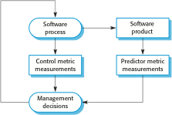
Predictor and control measurements

Slide 31
Use of measurements
To assign a value to system quality attributes
  By measuring the characteristics of system components, such as their cyclomatic complexity, and then aggregating these measurements, you can assess system quality attributes, such as maintainability.
To identify the system components whose quality is sub-standard
  Measurements can identify individual components with characteristics that deviate from the norm. For example, you can measure components to discover those with the highest complexity. These are most likely to contain bugs because the complexity makes them harder to understand.

Slide 32
Metrics assumptions/ Conditions
A software property can be measured.
The relationship exists between what we can
measure and what we want to know. We can only measure internal attributes but are often more interested in external software attributes.
This relationship (Internal and External attributes) must be understood, validated and formalised.
It may be difficult to relate what can be measured to desirable external quality attributes.

Slide 33
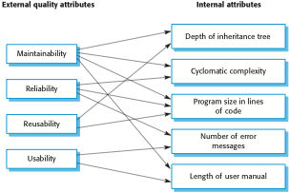
Relationships between internal and external software

Slide 34
Problems with measurement in industry
It is impossible to quantify the return on investment of introducing an organizational metrics program.
There are no standards for software metrics or standardized processes for measurement and analysis.
In many companies, software processes are not standardized and are poorly defined and controlled.
Most work on software measurement has focused on code-based metrics and plan-driven development processes. However, more and more software is now developed by configuring ERP systems or COTS.
Introducing measurement adds additional overhead to processes.

Slide 35
4.1 Product metrics
A quality metric should be a predictor of product quality.
Classes of product metric
  Dynamic metrics which are collected by measurements made of a program in execution; Dynamic metrics help assess efficiency and reliability
  Static metrics which are collected by measurements made of the system representations; Static metrics help assess complexity, understandability and maintainability.

Slide 36
Dynamic and static metrics
Dynamic metrics are closely related to software quality attributes
  It is relatively easy to measure the response time of a system (performance attribute) or the number of failures (reliability attribute).
Static metrics have an indirect relationship with quality attributes
  You need to try and derive a relationship between these metrics and properties such as complexity, understandability and maintainability.

Slide 37
Static software product metrics
Software metric | Description
Fan-in/Fan-out | Fan-in is a measure of the number of functions or methods that call another function or method (say X). Fan-out is the number of functions that are called by function X. A high value for fan-in means that X is tightly coupled to the rest of the design and changes to X will have extensive knock-on effects. A high value for fan-out suggests that the overall complexity of X may be high because of the complexity of the control logic needed to coordinate the called components.
Length of code | This is a measure of the size of a program. Generally, the larger the size of the code of a component, the more complex and error-prone that component is likely to be. Length of code has been shown to be one of the most reliable metrics for predicting error-proneness in components.

Slide 38
Static software product metrics
Software metric | Description
Cyclomatic complexity | This is a measure of the control complexity of a program. This control complexity may be related to program understandability. I discuss cyclomatic complexity in Chapter 8.
Length of identifiers | This is a measure of the average length of identifiers (names for variables, classes, methods, etc.) in a program. The longer the identifiers, the more likely they are to be meaningful and hence the more understandable the program.
Depth of conditional nesting | This is a measure of the depth of nesting of if-statements in a program. Deeply nested if-statements are hard to understand and potentially error-prone.
Fog index | This is a measure of the average length of words and sentences in documents. The higher the value of a document’s Fog index, the more difficult the document is to understand.

Slide 39
The CK object-oriented metrics suite
Object-oriented metric | Description
Weighted methods per class (WMC) | This is the number of methods in each class, weighted by the complexity of each method. Therefore, a simple method may have a complexity of 1, and a large and complex method a much higher value. The larger the value for this metric, the more complex the object class. Complex objects are more likely to be difficult to understand. They may not be logically cohesive, so cannot be reused effectively as superclasses in an inheritance tree.
Depth of inheritance tree (DIT) | This represents the number of discrete levels in the inheritance tree where subclasses inherit attributes and operations (methods) from superclasses. The deeper the inheritance tree, the more complex the design. Many object classes may have to be understood to understand the object classes at the leaves of the tree.
Number of children (NOC) | This is a measure of the number of immediate subclasses in a class. It measures the breadth of a class hierarchy, whereas DIT measures its depth. A high value for NOC may indicate greater reuse. It may mean that more effort should be made in validating base classes because of the number of subclasses that depend on them.

Slide 40
The CK object-oriented metrics suite
Object-oriented metric | Description
Coupling between object classes (CBO) | Classes are coupled when methods in one class use methods or instance variables defined in a different class. CBO is a measure of how much coupling exists. A high value for CBO means that classes are highly dependent, and therefore it is more likely that changing one class will affect other classes in the program.
Response for a class (RFC) | RFC is a measure of the number of methods that could potentially be executed in response to a message received by an object of that class. Again, RFC is related to complexity. The higher the value for RFC, the more complex a class and hence the more likely it is that it will include errors.
Lack of cohesion in methods (LCOM) | LCOM is calculated by considering pairs of methods in a class. LCOM is the difference between the number of method pairs without shared attributes and the number of method pairs with shared attributes. The value of this metric has been widely debated and it exists in several variations. It is not clear if it really adds any additional, useful information over and above that provided by other metrics.

Slide 41
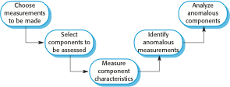
The process of product measurement

Slide 42
Measurement Surprises/ Ambiguities
Reducing the number of faults in a program leads to an increased number of help desk calls
  The program is now thought of as more reliable and so has a wider more diverse market. The percentage of users who call the help desk may have decreased but the total may increase;
  A more reliable system is used in a different way from a system where users work around the faults. This leads to more help desk calls.

Slide 43
Key points
Reviews of the software process deliverables involve a team of people who check that quality standards are being followed.
In a program inspection or peer review, a small team systematically checks the code. They read the code in detail and look for possible errors and omissions
Software measurement can be used to gather data about software and software processes.
Product quality metrics are particularly useful for highlighting anomalous components that may have quality problems.

