Slide 1
Servlets
Servlets are small programs that execute on the server side of a web connection.
applets dynamically extend the functionality of a web browser, servlets dynamically extend the functionality of a web server.
Servlets execute within the address space of a web server. It is not necessary to create a separate process to handle each client request.
servlets are platform-independent because they are written in Java.
the Java security manager on the server enforces a set of restrictions to protect the resources on a server machine.

Slide 2
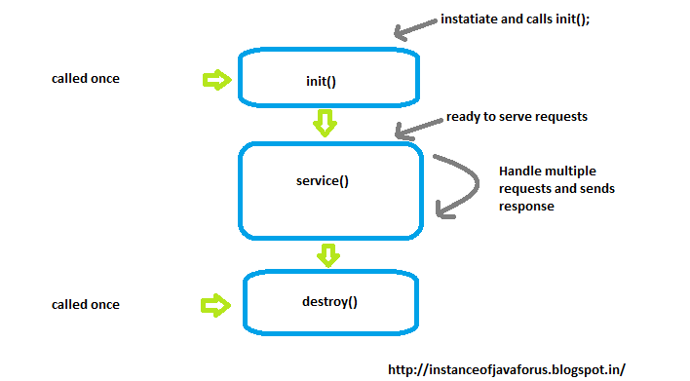
The Life Cycle of a Servlet

Slide 3
The Life Cycle of a Servlet
First, assume that a user enters a Uniform Resource Locator (URL) to a web browser. The browser then generates an HTTP request for this URL. This request is then sent to the appropriate server.
Second, this HTTP request is received by the web server. The server maps this request to a particular servlet. The servlet is dynamically retrieved and loaded into the address space of the server.
Third, the server invokes the init( ) method of the servlet. This method is invoked only when the servlet is first loaded into memory.
Fourth, the server invokes the service( ) method of the servlet. This method is called to process the HTTP request.
It may also formulate an HTTP response for the client.

Slide 4
Using Tomcat for Servlet Development

Slide 5
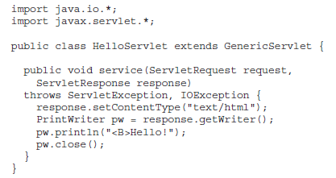
A Simple Servlet

Slide 6
Servlet Pakages
Two packages contain the classes and interfaces that are required to build servlets.
javax.servlet and javax.servlet.http.

Slide 7
The javax.servlet Package

Slide 8
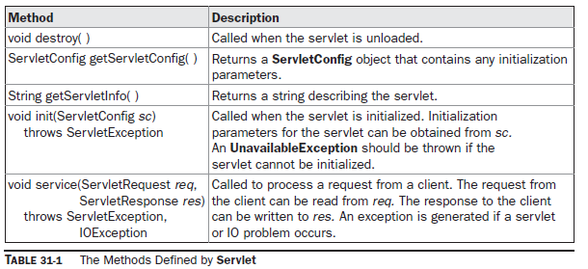
The Servlet Interface: It declares the init( ), service( ), and destroy( ) methods

Slide 9
The ServletConfig Interface

Slide 10
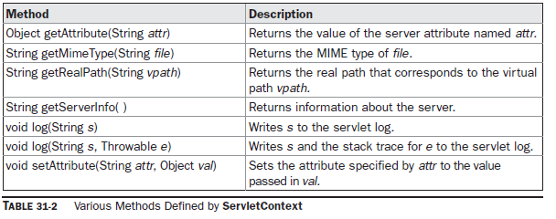
The ServletContext Interface

Slide 11
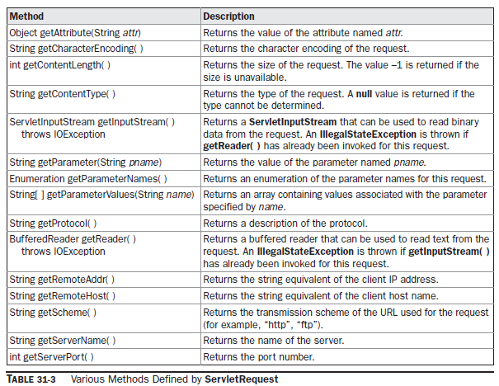
The ServletRequest Interface

Slide 12
The ServletResponse Interface

Slide 13
Servlet Classes

Slide 14
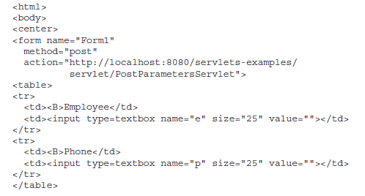
Reading Servlet Parameters
PostParameters.htm

Slide 15
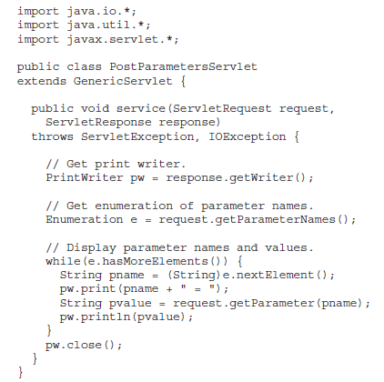

Slide 16
The javax.servlet.http Package

Slide 17
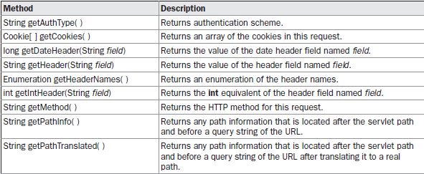
The HttpServletRequest Interface

Slide 18
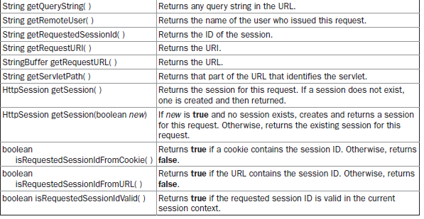

Slide 19
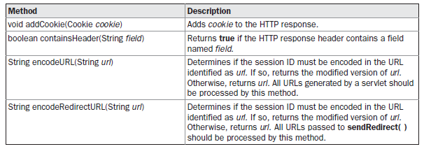
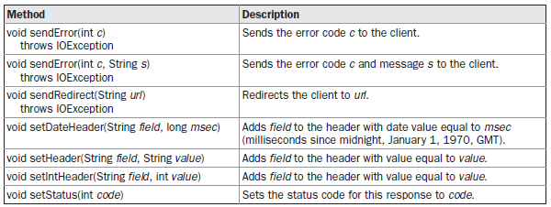
The HttpServletResponse Interface

Slide 20
The HttpSession Interface

Slide 21
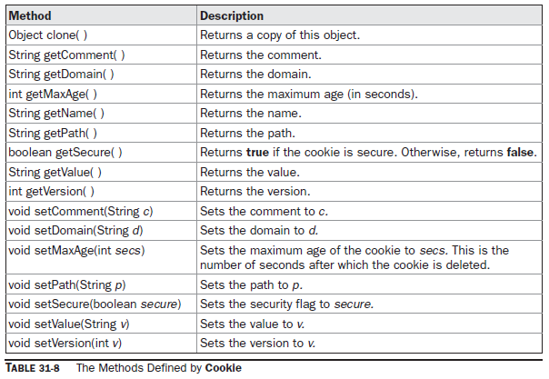
The Cookie Class
Cookie(String name, String value)

Slide 23
Handling HTTP Requests and Responses
A servlet developer typically overrides one of these methods. These methods are
doDelete( ), doGet( ), doHead( ), doOptions( ), doPost( ), doPut( ), and doTrace( ).
GET and POST requests are commonly used when handling form input

Slide 24
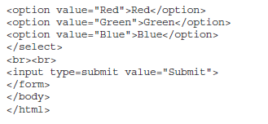
Handling HTTP GET Requests
ColorGet.html

Slide 25
ColorGetServlet.java

Slide 26
How to run?
1. Start Tomcat, if it is not already running.
2. Display the web page in a browser.
3. Select a color.
4. Submit the web page.

Slide 27
Handling HTTP POST Requests
ColorGet.htm

Slide 28
ColorPostServlet.java

Slide 29
Using Cookies
AddCookie.htm

Slide 30
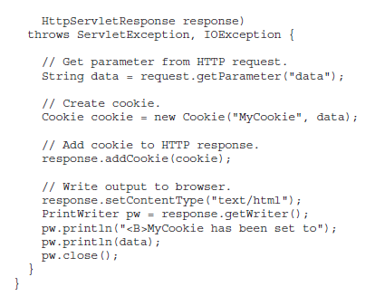
AddCookieServlet.java

Slide 31
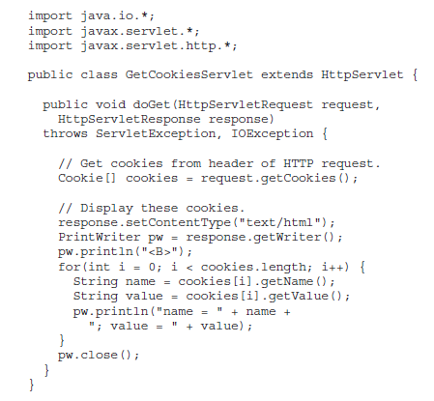
GetCookiesServlet.java

Slide 32
Session Tracking
A session can be created via the getSession( ) method of HttpServletRequest.
An HttpSession object is returned.
The setAttribute( ), getAttribute( ), getAttributeNames( ), and removeAttribute( )

Slide 35
Java Server Pages (JSP)
A JSP is java server page is server side program that is similar in design and functionality to a java servlet.
A JSP is called by a client to provide web services, the nature of which depends on client application.
A jsp is simpler to create than a java servlet because a jsp is written in HTML rather than with the java programming language.
There are three methods that are automatically called
when jsp is requested and when jsp terminates normally.
jspInit() method , the jspDestroy() method and service() method.

Slide 36
JSP tags
A JSP tag consists of a combination of HTML tags and JSP tags.
A JSP tag begin with a <%, which is followed by java code , and ends with %>
XML version of jsp tag <jap:TagId></jsp:TagId>
A jsp tags are embedded into the HTML component of a jsp program and are processed by Jsp virtual engine such as Tomcat.
Java code associated with jsp tag are executed and sent to browser.

Slide 37
Five types of JSP tags :
Comment tag : opens with <%-- and close with --%>
Declaration statement tags: A declartion statement tag opens with <%! And is followed by declaration statements that define the variables, object, and methods that are aavilabe to other component of jsp program.
Directive tags: opens with <%@ and commands the jsp virtual engine to perform a specific task, such as importing java package required.
<%@ page import=”import java.sql.*” ; %>
<%@ include file=”keogh\books.html” %>
<%@ taglib url=”myTags.tld” ; %>

Slide 38
Expression tags: opens with <%= and is used for an expression statement whose result page replaces the expression tag when the jsp virtual engine resolves JSP tags. An expression tag closes with %>
Scriptlet tag: A sciptlet tag opens with <% and contains commonly used java control statements and loops. And Scriptlet tag closes with %>

Slide 39
First JSP
<%--
Document : helloworld
Created on : Oct 26, 2018
Author : XYZ
--%>
<html>
<head>
<title>JSP Page</title>
</head>
<body>
<p> Hi, <h3><%="Hello!" %></h3></p>
<p>You successfully run a simple jsp program.</p>
<p>Learn More concept about jsp.</p>
</body>
</html>

Slide 40
Declaring & using variables
<html>
<head>
<title> Jsp Programming </title>
<head>
<body>
<%! int age=29; %>
<p> Your age is : <%=age%> </p>
</body>
</html>

Slide 41
Declaring multiple variables
<html>
<head>
<title> Jsp Programming </title>
<head>
<body>
<%! int age=29;
float salary;
int emonumber;
%>
<p> Your age is : <%=age%> </p>
</body>
</html>

Slide 42
How method are declared and used in JSP programs?
<html>
<head>
<title> Jsp programming</title>
</head>
<body>
<%! int add(int a, int b)
{
int c;
c=a+b;
return c;
}
%>
<p> Addition of two numbers : <%= add(45,46)%> </p>
</body>
</html>

Slide 43
control statements in JSP
<html>
<head>
<title> JSP Programming </title>
</head>
<body>
<%! int grade=26; %>
</body>
<% if(grade >69) { %>
<p> You Passed !</p>
<% } else { %>
<p> Better Luck Next Time</p>
<% } %>
</body>
</html>

Slide 44
Looping Statement in JSP
<html><head><title>For Loop </title></head>
<body>
<%
for (int i = 0; i < 10;i++) {
%>
<p> Hello World</p>
<% } %>
</body>
</html>

Slide 45
JSP - Form Processing
<html>
<body>
<center>
<form name="Form1"
method="Get"
action="http://localhost:8080/testjsp/getform.jsp">
<table>
<tr>
<td><B>First Name:</td>
<td><input type=textbox name="fn" size="25" value=""></td>
</tr>
<tr>
<td><B>Last Name:</td>
<td><input type=textbox name="ln" size="25" value=""></td>
</tr>
</table>
<input type=submit value="Submit">
</body>
</html>

Slide 46
Getform.jsp
<html>
<head>
<title>Using GET Method to Read Form Data</title>
</head>
<body>
<h1>Using GET Method to Read Form Data</h1>
<p><b>First Name:</b>
<%= request.getParameter("fn")%>
</p>
<p><b>Last Name:</b>
<%= request.getParameter("ln")%>
</p>
</body>
</html>

Slide 47
Cookies in JSP
<%@page import="javax.servlet.http.Cookie"%>
<html>
<head>
<title>JSP Set Cookie</title>
</head>
<body>
<%
Cookie cookie = new Cookie("ClientID“,"JSP Cookie");
cookie.setMaxAge(3600);
response.addCookie(cookie);
%>
</body>
</html>

Slide 48
<%@page import="javax.servlet.http.Cookie"%>
<html>
<head>
<title>JSP Read Cookie</title>
</head>
<body>
<%
Cookie[] list = request.getCookies();
if(list != null){
for(int i = 0; i < list.length;i++){
out.println(list[i].getName() + ":" + list[i].getValue());
}
}
%>
</body>
</html>

Slide 49
Session Objects
<HTML>
<HEAD> <TITLE> JSP Programming</TITLE>
</HEAD>
<BODY>
<%! String AtName=“Product”;
String AtValue=“1234”;
%>
</BODY>
<HTML>

Slide 50
<HTML>
<HEAD> <TITLE> JSP Programming</TITLE>
</HEAD>
<BODY>
<%! Enumeration purchases=session.getAtrributeNames( );
while(purchases.hasMoreElements())
{
String AtName=(String) attributeNames.nextElement();
String AtValue=(String)session.getAttribute(AtName);
%>
<p> Attribute Name <%= AtName %> </p>
<p> Attribute Value <%= AtValue %> </p>
<% } %>
</BODY>
<HTML>

