Slide 1
The Concept of JDBC
Java was not considered industrial strength programming language since java was unable to access the DBMS.
The JDBC ( Java Database Connectivity) API defines interfaces and classes for writing database applications in Java by making database connections.
Using JDBC you can send SQL, PL/SQL statements to almost any relational database.
JDBC is a Java API for executing SQL statements.

Slide 2
JDBC drivers has to do the following
Open connection between DBMS and J2EE environment.
Translate low level equivalents of SQL statements sent by J2EE component into messages that can be processed by the DBMS.
Return the data that conforms to JDBC specifications to the JDBC driver
Provides transaction management routines that conforms to JDBC specifications to the JDBC driver
Close connection between the DBMS and the J2EE component.

Slide 3
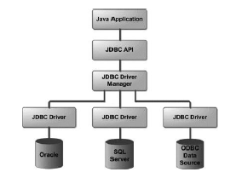
JDBC Architecture

Slide 4
JDBC Driver Types
Type 1 driver JDBC to ODBC Driver
  It is also called JDBC/ODBC Bridge , developed by MicroSoft.
  It receives messages from a J2EE component that conforms to the JDBC specifications
  Then it translates into the messages understood by the DBMS.
  This is DBMS independent database program that is ODBC open database connectivity.

Slide 5
JDBC Driver Types
Type 2 JAVA / Native Code Driver
  It Generates platform specific code that is code understood by platform specific code only understood by specific databases.
  Manufacturer of DBMS provides both java/ Native code driver.
  It provides portability of code.
  It won’t work for another DBMS manufacturer

Slide 6
JDBC Driver Types
Type 3 JDBC Driver
  Most commonly used JDBC driver.
  Coverts SQL queries into JDBC Formatted statements.
  Then JDBC Formatted statements are translated into the format required by the DBMS.
  Referred as Java protocol
Type 4 JDBC Driver
  Referred as Type 4 database protocol
  SQL statements are transferred into the format required by the DBMS.
  This is the fastest communication protocol.

Slide 7
JDBC Packages
java.sql
javax.sql

Slide 8
Explain the various steps of the JDBC process with code snippets.
Step1. Loading the JDBC driver
  The JDBC driver must be loaded before the J2EE componet can be connected to the database.
  Driver is loaded by calling the method and passing it the name of driver Class.forName(“sun:jdbc.odbc.JdbcOdbcDriver”);

Slide 9
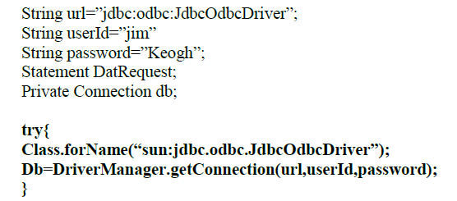
Steps of the JDBC process
Step 2: Connecting to the DBMS.
  Once the driver is loaded , J2EE component must connect to the DBMS using DriverManager.getConnection() method.
  It takes three arguments URL, User, Password
  It returns connection interface that is used through out the process to reference a database

Slide 10
Steps of the JDBC process
Step 3: Creating and Executing a statement.
  The next step after the JDBC is loaded and connection is successfully made with a particular database managed by the DBMS, is to send a particular query to the DBMS for processing.
  Connect.createStatement() method is used to create a statement Object.
  The statement object is then used to execute a query and return result object that contain response from the DBMS
Statement DataRequest;
ResultSet Results;
try {
String query=“select * from Customers”;
DataRequest=Database.createStatement();
Results= DataRequests.executeQuery(query);
DataRequest.close( );
}

Slide 11
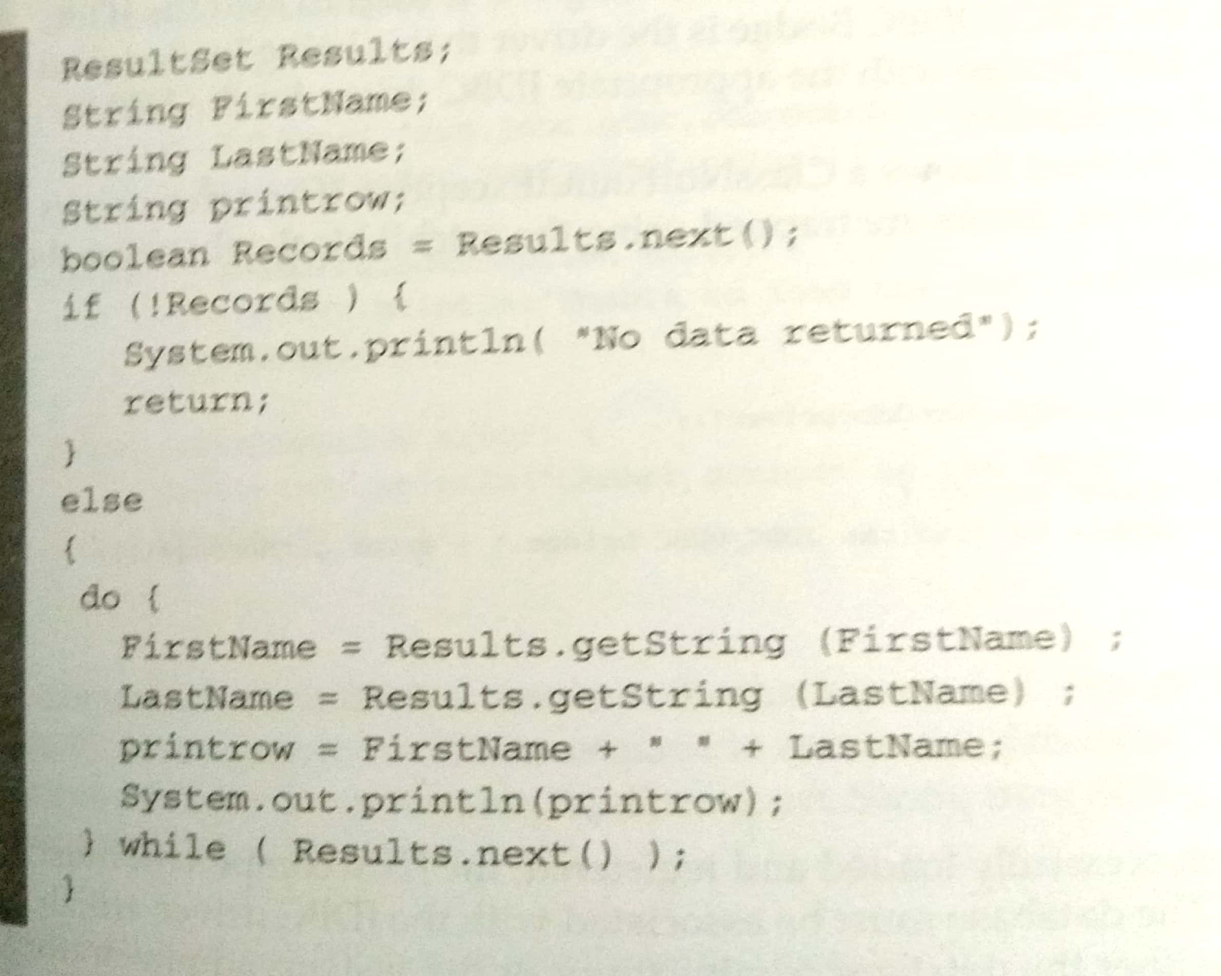
Steps of the JDBC process
Step 4: Processing data returned by the DBMS
  java.sql.ResultSet object is assigned the result received from the DBMS after the query is processed.

Slide 12
Steps of the JDBC process
Step 5:Terminating the connection with the DBMS.
  Database.close()

Slide 13
Database Connection
After the JDBC driver is successfully loaded and registered, the J2EE component must connect to the database. The database must be associated with the JDBC driver.
The datasource that JDBC component will connect to is identified using the URL format. The URL consists of three format.
  These are jdbc which indicate jdbc protocol is used to read the URL.
  <subprotocol> which is JDBC driver name.
  <subname> which is the name of database.
Connection to the database is achieved by using one of three getConnection() methods. It returns connection object otherwise returns SQLException .

Slide 14
Three forms of Three getConnection()
getConnection(String url)
getConnection(String url, String UserID, String pwd)
getConnection(String url, Properties prop)

Slide 15
getConnection(String url)
String url=” jdbc:odbc:JdbcOdbcDriver ”;
Connection Db;
try{
  Class.forName(“sun:jdbc.odbc.JdbcOdbcDriver”);
  Db=DriverManager.getConnection(url);
}
Catch(ClassNotFoundException error)
{
System.err.printnln(“ Unable to load the JDBC/ODBC driver”+error);
System.exit(1);
}
Catch(SQLException error)
{
System.err.printnln(“ Cannot connect to DBMS”+error);
System.exit(2);
}

Slide 16
getConnection(String url, String UserID, String pwd)
String url=” jdbc:odbc:JdbcOdbcDriver ”;
String userID =“xyz”;
String pwd=“abc”;
Connection Db;
try{
  Class.forName(“sun:jdbc.odbc.JdbcOdbcDriver”);
  Db=DriverManager.getConnection(url, userID, pwd);
}
Catch(ClassNotFoundException error)
{
System.err.printnln(“ Unable to load the JDBC/ODBC driver”+error);
System.exit(1);
}
Catch(SQLException error)
{
System.err.printnln(“ Cannot connect to DBMS”+error);
System.exit(2);
}

Slide 17
getConnection(String url, Properties prop)
Connection Db;
Properties props=new Properties();
try {
FileInputStream inputfile=new FileInputStream(“DBPops.txt”);
props.load(inputfile);
}
try{
  Class.forName(“sun:jdbc.odbc.JdbcOdbcDriver”);
  Db=DriverManager.getConnection(url, props);
}
Catch(ClassNotFoundException error)
{
System.err.printnln(“ Unable to load the JDBC/ODBC driver”+error);
System.exit(1);
}
Catch(SQLException error)
{
System.err.printnln(“ Cannot connect to DBMS”+error);
System.exit(2);
}

Slide 18
Associating JDBC/ODBC bridge with database

Slide 19
Connection Pool
A Client that needs to frequently interact with database must either open connection and leave open connection during processing or open or close and reconnect each time.
Leaving the connection may open might prevent another client from accessing the database when DBMS have limited no of connections. Connecting and reconnecting is time consuming.
The release of JDBC 2.1 Standard extension API introduced concept on connection pooling
A connection pool is a collection of database connection that are opened and loaded into memory so these connection can be reused with out reconnecting to the database.
DataSource interface to connect to the connection pool.
Context ctext= new IntialContext()
DataSource pool =(DataSource) text.lookup(“java:comp/env/jdbc/pool”);
Connection db=pool.getConnection();

Slide 20
Statement object
Statement object executes query immediately without precompiling.
Statement contains three different methods
  executeQuery()
  executeUpdate()
  execute()

Slide 21
  executeQuery()
This method returns the ResultSet object that contains rows, columns and metadata that represent data requested by the query.
ResultSet executeQuery(String query);
this method is used to execute only the ‘SELECT’ query of the SQL.
String url=”jdbc:odbc:JdbcOdbcDriver”;
String userId=”jim”
String password=”Keogh”;
Statement DatRequest;
Private Connection db;
ResultSet rs;
// code to load driver
//code to connect to the database
try{
String query=”SELECT * FROM Customers;
DatRequest=Db.createStaement();
rs=DatRequest.executeQuery(query);// return result set object
}catch(SQLException err)
{
System.err.println(“Error”);
System.exit(1);
}

Slide 22
  executeUpdate()
This method is used to execute the queries that contain INSERT, DELETE and UPDATE statements.
This method returns integer indicating the number of rows that were updated by the query.
int executeUpdate(String query);
String url=”jdbc:odbc:JdbcOdbcDriver”;
String userId=”jim”
String password=”Keogh”;
Statement DatRequest;
Private Connection db;
ResultSet rs;
try{
String query=”UPDATE Customer set PAID=’Y’ where BALANCE =’0’;
DatRequest=Db.createStaement();
int n=DatRequest.executeUpdate(query);// returns no of rows updated
}catch(SQLException err)
{
System.err.println(“Error”);
System.exit(1);
}

Slide 23
  execute()
It executes the given SQL statement, which may return multiple results.
public boolean execute(String sql)

Slide 24
PreparedStatement object
A SQL query must be compiled before DBMS processes the query. Query is precompiled and executed using Prepared statements.
In such cases a query is created similar to other queries. However, a question mark is given on the place for the value that is inserted into the query after it is compiled.
Setxxx() is used to replace the question mark with the value passed to the setxxx() method . xxx represents data type of the field.
Example if it is string then setString() is used.

Slide 25
String url=”jdbc:odbc:JdbcOdbcDriver”;
String userId=”jim”
String password=”Keogh”;
ResultSet rs;
// code to load driver
//code to connect to the database
try{
String query=”SELECT * FROM Customers where cno=?”;
PreparedStatement pstatement=db.preparedStatement(query);
pstatement.setString( 1,”123”); // 1 represents first place holder, 123 is value
rs= pstatement.executeQuery();
}catch(SQLException err)
{
System.err.println(“Error”);
System.exit(1);
}

Slide 26
CallableStatement Object
The callableStatement object is used to call a stored procedure from with in J2EE object. A stored procedure is block of code and is identified by unique name. the code can be written in Transact-C ,PL/SQL.
Stored procedure is executed by invoking by the name of procedure.
The callableStatement uses three types of parameter when calling stored procedure. The parameters are IN ,OUT,INOUT.
IN parameter contains data that needs to be passed to the stored procedure whose value is assigned using setxxx() method
OUT parameter contains value returned by stored procedure. the OUT parameter should be registerd by using registerOutParameter() method and then later retrieved by the J2EE component using getxxx() method.
INOUT parameter is used to both pass information to the stored procedure and retrieve the information from the procedure.

Slide 27
Suppose, you need to execute the following Oracle stored procedure:
CREATE PROCEDURE getEmpName
(EMP_ID IN NUMBER, EMP_FIRSTNAME OUT VARCHAR) AS
BEGIN
SELECT firstname INTO EMP_FIRSTNAME FROM Employees WHERE ID = EMP_ID;
END;
The following code is used
CallableStatement cstmt = null;
try {
  String SQL = "{call getEmpName (?, ?)}";
  cstmt = conn.prepareCall (SQL);
}
catch (SQLException e) { }

Slide 28
ResultSet
ResultSet object that contains data requested by the query.
The ResultSet object contains methods that are used to copy data from the ResultSet into a Java collection of objects or variable(s) for further processing.
Data in a ResultSet object is logically organized into a virtual table consisting of rows and columns. In addition to data, the ResultSet object also contains metadata, such as column names, column size, and column data type.
The ResultSet uses a virtual cursor to point to a row of the virtual table.
J2EE application must move the virtual cursor to each row, then use other methods of the ResultSet object to interact with the data stored in columns of that row.
The virtual cursor is positioned above the first row of data when the ResultSet is returned by the executeQuery() method.
This means that the virtual cursor must be moved to the first row using the next() method.
The next() method returns a boolean true if the row contains data, otherwise a boolean false is returned, indicating that no more rows exist in the ResultSet

Slide 29
ResultSet
Once the virtual cursor points to a row, the getXXX() method is used to copy data from the row to a collection, object, or variable.
For example, the getString() method is used to copy String data from a column of the ResultSet.
The getXXX() method requires one parameter, which is an integer that represents the number of the column that contains the data. For example, getString(1) copies the data from the first column of the ResultSet.

Slide 30
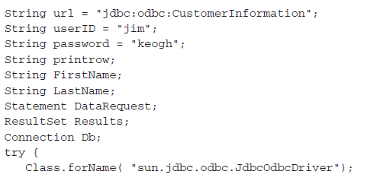
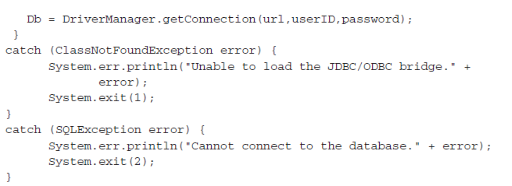
Reading the ResultSet

Slide 31
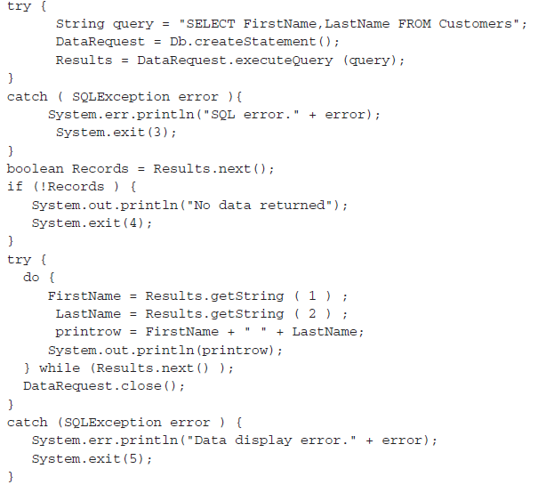

Slide 32
Scrollable ResultSet
Until the release of JDBC 2.1 API, the virtual cursor could only be moved down the ResultSet object. But today the virtual cursor can be moved backwards or even positioned at a specific row.
Next(), first(), last(), previous(), absolute(), relative(), and getRow().
to handle a scrollable ResultSet by passing the createStatement() method one of three constants. These constants are TYPE_FORWARD_ONLY, TYPE_SCROLL_INSENSITIVE, and TYPE_SCROLL_SENSITIVE.

Slide 33
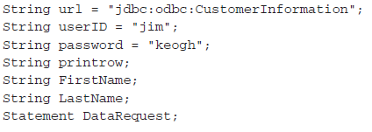
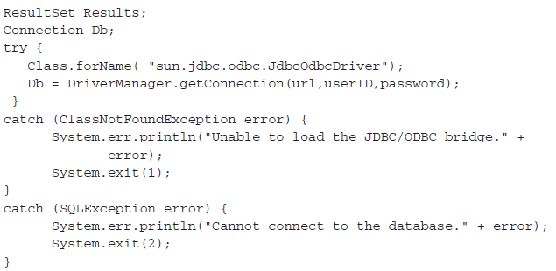

Slide 34
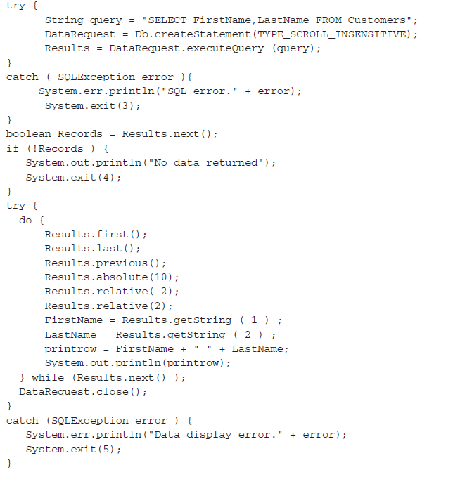

Slide 35
Updatable ResultSet
Rows contained in the ResultSet can be updated similar to how rows in a table can be updated.
This is made possible by passing the createStatement() method of the Connection object the CONCUR_UPDATABLE. Alternatively, the CONCUR_READ_ONLY constant can be passed to the createStatement() method to prevent the ResultSet from being updated.

Slide 36
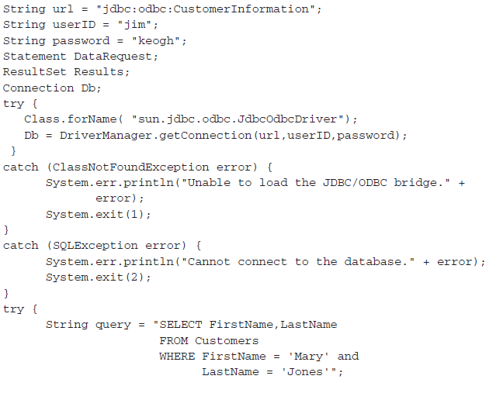

Slide 37
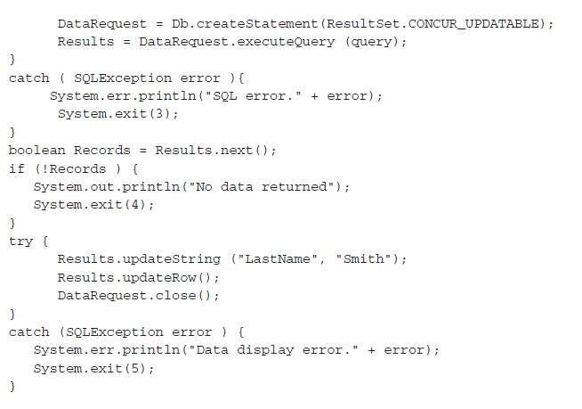

Slide 38
Delete a Row in the ResultSet
Results.deleteRow(0);

Slide 39
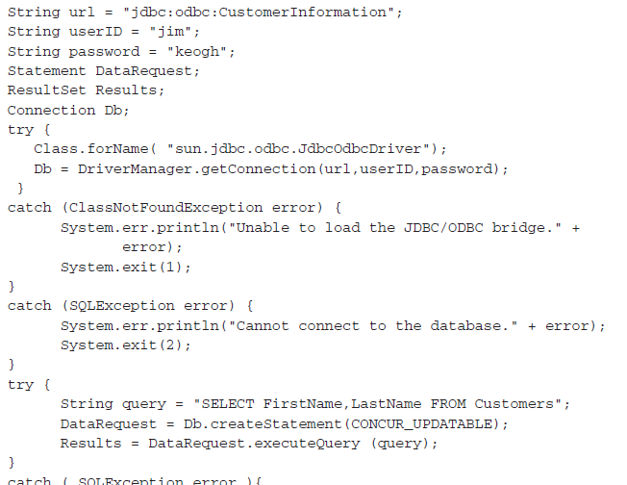
Insert a Row in the ResultSet

Slide 40

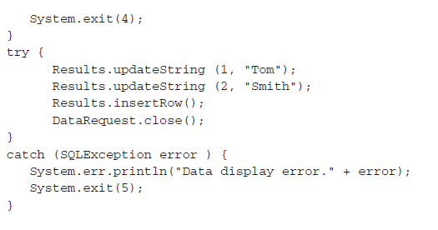

Slide 41
Transaction Processing
A database transaction consists of a set of SQL statements, each of which must be successfully completed for the transaction to be completed.
If one fails, SQL statements that executed successfully up to that point in the transaction must be rolled back.
A database transaction isn’t completed until the J2EE application calls the commit() method of the Connection object.
once the commit() method is called, none of the SQL statements can be rolled back
The commit() method must be called regardless of whether the SQL statement is part of a transaction or not.
the commit() method was automatically called in these examples because the DBMS has an AutoCommit feature that is by default set to true.

Slide 42
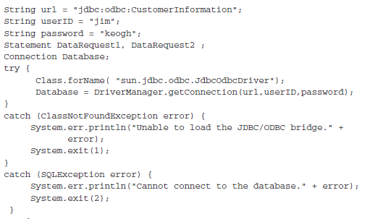

Slide 43
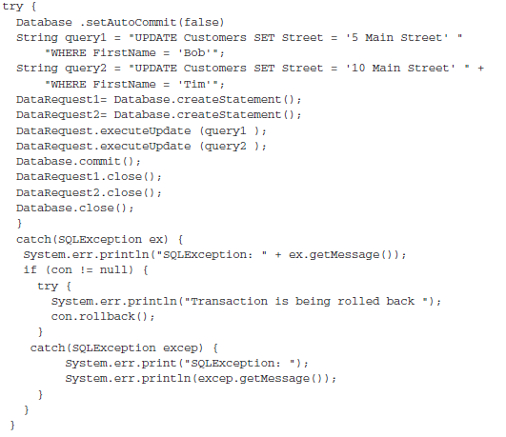

Slide 44
Savepoints
A savepoint, introduced in JDBC 3.0, is a virtual marker that defines the task at which the rollback stops.

Slide 45
Metadata
Metadata is data about data.
A J2EE application can access metadata by using the DatabaseMetaData interface.
The DatabaseMetaData interface is used to retrieve information about databases, tables, columns, and indexes, among other information about the DBMS.
getDatabaseProductName() Returns the product name of the database
getUserName() Returns the user name
getURL() Returns the URL of the database
getSchemas() Returns all the schema names available in this database
getPrimaryKeys() Returns primary keys
getProcedures() Returns stored procedure names
getTables() Returns names of tables in the database.

Slide 46
ResultSet Metadata
ResultSetMetaData rm = Result.getMetaData()
getColumnCount() Returns the number of columns contained in the ResultSet
getColumnName(int number) Returns the name of the column specified by the column number
getColumnType(int number) Returns the data type of the column specified by the column number

