Slide 1
String Handling
Java implements strings as objects of type String.
String Constructors
To create an empty String, you call the default constructor.
For example, String s = new String();
will create an instance of String with no characters in it.
String(char chars[ ])
char chars[] = { 'a', 'b', 'c' };
String s = new String(chars);

Slide 2
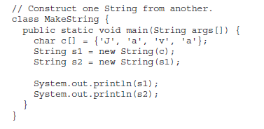
String(char chars[ ], int startIndex, int numChars)
char chars[] = { 'a', 'b', 'c', 'd', 'e', 'f' };
String s = new String(chars, 2, 3);
String(String strObj)
String(byte asciiChars[ ])
String(byte asciiChars[ ], int startIndex, int numChars)
String(StringBuffer strBufObj)

Slide 3
String Length
int length( )
char chars[] = { 'a', 'b', 'c' };
String s = new String(chars);
System.out.println(s.length());

Slide 4
Special String Operations
String Literals
char chars[] = { 'a', 'b', 'c' };
String s1 = new String(chars);
String s2 = "abc"; // use string literal
System.out.println("abc".length());
String Concatenation
String age = "9";
String s = "He is " + age + " years old.";
System.out.println(s);
int age = 9;
String s = "He is " + age + " years old.";
System.out.println(s);
String s = "four: " + 2 + 2;
System.out.println(s);

Slide 5
Character Extraction
char charAt(int where)
char ch;
ch = "abc".charAt(1);
void getChars(int sourceStart, int sourceEnd, char target[ ], int targetStart)
class getCharsDemo
{
public static void main(String args[])
{
String s = "This is a demo of the getChars method.";
int start = 10;
int end = 14;
char buf[] = new char[end - start];
s.getChars(start, end, buf, 0);
System.out.println(buf);
}
}

Slide 6
Character Extraction
getBytes( )
toCharArray( )
char[ ] toCharArray( )

Slide 7
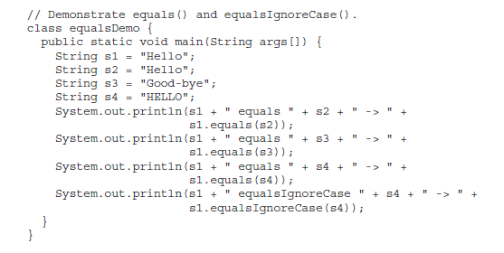
String Comparison
boolean equals(Object str)
boolean equalsIgnoreCase(String str)

Slide 8
String Comparison
boolean regionMatches(int startIndex, String str2, int str2StartIndex, int numChars)
boolean regionMatches(boolean ignoreCase,
int startIndex, String str2, int str2StartIndex,
int numChars)
boolean startsWith(String str)
boolean endsWith(String str)
"Football".endsWith("ball")
and
"Football".startsWith("Foot")
are both true.

Slide 9
String Comparison
boolean startsWith(String str, int startIndex)
"Football".startsWith("ball", 4)
equals( ) Versus ==

Slide 10
String Comparison
int compareTo(String str)

Slide 11
// A bubble sort for Strings.
class SortString
{
static String arr[] = {"Now", "is", "the", "time", "for", "all", "good", "men“, "to", "come", "to", "the", "aid", "of", "their", "country"
};
public static void main(String args[])
{
for(int j = 0; j < arr.length; j++)
{
for(int i = j + 1; i < arr.length; i++)
{
if(arr[i].compareTo(arr[j]) < 0)
{
String t = arr[j];
arr[j] = arr[i];
arr[i] = t;
}
}
System.out.println(arr[j]);
}
}
}

Slide 12
Searching Strings
indexOf( ) Searches for the first occurrence of a character or substring.
lastIndexOf( ) Searches for the last occurrence of a character or substring.
int indexOf(int ch)
int lastIndexOf(int ch)

Slide 13
Searching Strings
To search for the first or last occurrence of a substring, use
int indexOf(String str)
int lastIndexOf(String str)
Here, str specifies the substring.
You can specify a starting point for the search using these forms:
int indexOf(int ch, int startIndex)
int lastIndexOf(int ch, int startIndex)
int indexOf(String str, int startIndex)
int lastIndexOf(String str, int startIndex)

Slide 14
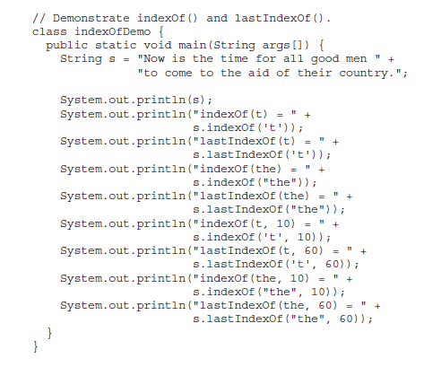
Searching Strings

Slide 15
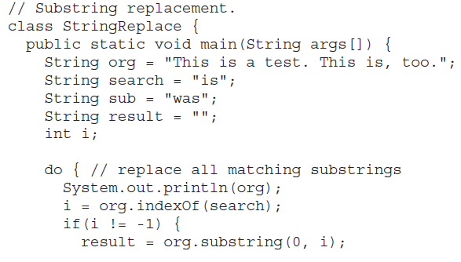
Modifying a String
substring( )
String substring(int startIndex)
String substring(int startIndex, int endIndex)

Slide 16
Modifying a String
concat( )
String concat(String str)
String s1 = "one";
String s2 = s1.concat("two");
replace( )
String replace(char original, char replacement)
String s = "Hello".replace('l', 'w');
trim( )
String trim( )
String s = " Hello World ".trim();
This puts the string “Hello World” into s.

Slide 17
Data Conversion Using valueOf( )
static String valueOf(double num)
static String valueOf(long num)
static String valueOf(Object ob)
static String valueOf(char chars[ ])

Slide 18
Changing the Case of Characters Within a String
String toLowerCase( )
String toUpperCase( )
// Demonstrate toUpperCase() and toLowerCase().
class ChangeCase {
public static void main(String args[])
{
String s = "This is a test.";
System.out.println("Original: " + s);
String upper = s.toUpperCase();
String lower = s.toLowerCase();
System.out.println("Uppercase: " + upper);
System.out.println("Lowercase: " + lower);
}
}

Slide 19
StringBuffer
StringBuffer represents growable and writeable character sequences.
StringBuffer may have characters and substrings inserted in the middle or appended to the end.
StringBuffer( ) → 16 chars
StringBuffer(int size)
StringBuffer(String str)
StringBuffer(CharSequence chars)

Slide 20
StringBuffer: length( ) and capacity( )
int length( )
int capacity( )
// StringBuffer length vs. capacity.
class StringBufferDemo {
public static void main(String args[]) {
StringBuffer sb = new StringBuffer("Hello");
System.out.println("buffer = " + sb);
System.out.println("length = " + sb.length());
System.out.println("capacity = " + sb.capacity());
}
}

Slide 21
ensureCapacity( ): to set the size of the buffer.
void ensureCapacity(int capacity)
setLength( ):set the length of the buffer within a StringBuffer object.
void setLength(int len)
charAt( ) and setCharAt( ):
char charAt(int where)
void setCharAt(int where, char ch)
getChars( )
void getChars(int sourceStart, int sourceEnd, char target[ ], int targetStart)

Slide 22
append( )
StringBuffer append(String str)
StringBuffer append(int num)
StringBuffer append(Object obj)
// Demonstrate append().
class appendDemo {
public static void main(String args[]) {
String s;
int a = 42;
StringBuffer sb = new StringBuffer(40);
s = sb.append("a = ").append(a).append("!").toString();
System.out.println(s);
}
}

Slide 23
insert( )
The insert( ) method inserts one string into another
StringBuffer insert(int index, String str)
StringBuffer insert(int index, char ch)
StringBuffer insert(int index, Object obj)
// Demonstrate insert().
class insertDemo {
public static void main(String args[]) {
StringBuffer sb = new StringBuffer("I Java!");
sb.insert(2, "like ");
System.out.println(sb);
}
}

Slide 24
reverse( )
StringBuffer reverse( )
// Using reverse() to reverse a StringBuffer.
class ReverseDemo {
public static void main(String args[]) {
StringBuffer s = new StringBuffer("abcdef");
System.out.println(s);
s.reverse();
System.out.println(s);
}
}

Slide 25
delete( ) and deleteCharAt( )
StringBuffer delete(int startIndex, int endIndex)
StringBuffer deleteCharAt(int loc)
// Demonstrate delete() and deleteCharAt()
class deleteDemo {
public static void main(String args[]) {
StringBuffer sb = new StringBuffer("This is a test.");
sb.delete(4, 7);
System.out.println("After delete: " + sb);
sb.deleteCharAt(0);
System.out.println("After deleteCharAt: " + sb);
}
}

Slide 26
replace( )
StringBuffer replace(int startIndex, int endIndex, String str)
// Demonstrate replace()
class replaceDemo {
public static void main(String args[]) {
StringBuffer sb = new StringBuffer("This is a test.");
sb.replace(5, 7, "was");
System.out.println("After replace: " + sb);
}
}

