Slide 1
Module 3
Understanding Parameter Arrays
Modified by: Mohan A. Gholap Original Slides by: Pavan D.M.

Slide 2
Overloading: A Recap
Overloading is the technical term for declaring two or more methods with the same name in the same scope.
Being able to overload a method is very useful in cases where you want to perform the same action on arguments of different types.
The classic example of overloading in microsoft visual c# is the console.Writeline method.
This method is overloaded numerous times so that you can pass any primitive type argument.
The following code example illustrates some of the ways in which the writeline method is defined in the console class:
class Console
{
public static void WriteLine(Int32 value)
public static void WriteLine(Double value)
public static void WriteLine(Decimal value)
public static void WriteLine(Boolean value)
public static void WriteLine(String value)
…………………...
}
As useful as overloading is, it doesn’t cover every case. In particular, overloading doesn’t easily handle a situation in which the type of parameters doesn’t vary but the number of parameters does.
For example, what if you want to write many values to the console? Do you have to provide versions of Console.WriteLine that can take two parameters of various combinations, other versions that can take three parameters, and so on? That would quickly get tedious.

Slide 3
Contd…
And wouldn’t the massive duplication of all these overloaded methods worry you? It should. Fortunately, there is a way to write a method that takes a variable number of arguments (a variadic method): you can use a parameter array (a parameter declared with the params keyword).
To understand how params arrays solve this problem, it helps to first understand the uses and shortcomings of ordinary arrays.

Slide 4
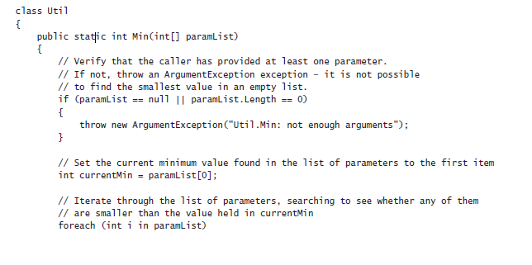
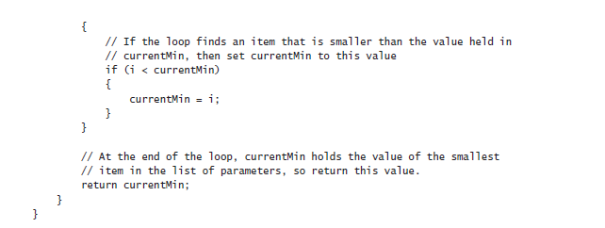
Using Array Arguments
Suppose you want to write a method to determine the minimum value in a set of values passed as parameters. One way is to use an array. For example, to find the smallest of several int values, you could write a static method named Min with a single parameter representing an array of int values:

Slide 5
Contd…
To use the Min method to find the minimum of two int variables named first and second, you can write this:
int[ ] array = new int[2];
array[0] = first;
array[1] = second;
int min = Util.Min(array);
And to use the Min method to find the minimum of three int variables (named first, second, and third), you can write this:
int[] array = new int[3];
array[0] = first;
array[1] = second;
array[2] = third;
int min = Util.Min(array);
You can see that this solution avoids the need for a large number of overloads, but it does so at a price: you have to write additional code to populate the array that you pass in. You can, of course, use an anonymous array if you prefer, like this:
int min = Util.Min(new int[] {first, second, third});
However, the point is you still need to create and populate an array, and the syntax can get a little confusing. The solution is to get the compiler to write some of this code for you by using a params array as the parameter to the Min method.

Slide 6
Declaring a params Array
A params array enables you pass a variable number of arguments to a method. You indicate a params array by using the params keyword as an array parameter modifier when you define the method parameters.
For example, here’s Min again—this time with its array parameter declared as a params array:
class Util
{
public static int Min(params int[] paramList)
{
// code exactly as before
}
}
The effect of the params keyword on the Min method is that it allows you to call it by using any number of integer arguments without worrying about creating an array. For example, to find the minimum of two integer values, you can simply write this:
int min = Util.Min(first, second);
The compiler translates this call into code similar to this:
int[] array = new int[2];
array[0] = first;
array[1] = second;
int min = Util.Min(array);
To find the minimum of three integer values, you write the code shown here, which is also converted by the compiler to the corresponding code that uses an array:
int min = Util.Min(first, second, third);

Slide 7
Contd…
Both calls to Min (one call with two arguments and another with three arguments) resolve to the same Min method with the params keyword.
And as you can probably guess, you can call this Min method with any number of int arguments. The compiler just counts the number of int arguments, creates an int array of that size, fills the array with the arguments, and then calls the method by passing the single array parameter.
There are several points worth noting about params arrays:
1) You can’t use the params keyword with multidimensional arrays. The code in the following example will not compile:
// compile-time error
public static int Min(params int[,] table)
………………....
2) You can’t overload a method based solely on the params keyword. The params keyword does not form part of a method’s signature, as shown in this example:
// compile-time error: duplicate declaration
public static int Min(int[] paramList)
………………….....
public static int Min(params int[] paramList)
…………………....

Slide 8
Contd…
3) You’re not allowed to specify the ref or out modifier with params arrays, as shown in this example:
// compile-time errors
public static int Min(ref params int[ ] paramList)
…………….....
public static int Min(out params int[ ] paramList)
…………………...
4) A params array must be the last parameter. (This means that you can have only one params array per method.) Consider this example:
// compile-time error
public static int Min(params int[ ] paramList, int i)
………………………...
5) A non-params method always takes priority over a params method. This means that if you want to, you can still create an overloaded version of a method for the common cases. For example:
public static int Min(int leftHandSide, int rightHandSide)
…………………….....
public static int Min(params int[ ] paramList)
………………………...

Slide 9
Using params object[ ]
A parameter array of type int is very useful because it enables you to pass any number of int arguments in a method call.
However, what if not only the number of arguments varies but also the argument type?
C# has a way to solve this problem, too.
The technique is based on the facts that object is the root of all classes and that the compiler can generate code that converts value types (things that aren’t classes) to objects by using boxing, as described in Chapter 8, “Understanding Values and References.”
You can use a parameters array of type object to declare a method that accepts any number of object arguments, allowing the arguments passed in to be of any type. Look at this example:
class Black
{
public static void Hole(params object [] paramList)
………………… ...
}
I’ve called this method Black.Hole, because no argument can escape from it:
You can pass the method no arguments at all, in which case the compiler will pass an object array whose length is 0:
Black.Hole( ); // converted to Black.Hole(new object[0]);
You can call the Black.Hole method by passing null as the argument. An array is a reference type, so you’re allowed to initialize an array with null:
Black.Hole(null);

Slide 10
Contd…
You can pass the Black.Hole method an actual array. In other words, you can manually create the array normally generated by the compiler:
object[] array = new object[2];
array[0] = "forty two";
array[1] = 42;
Black.Hole(array);
You can pass the Black.Hole method arguments of different types, and these arguments will automatically be wrapped inside an object array:
Black.Hole("forty two", 42);
//converted to Black.Hole(new object[]{"forty two", 42});

Slide 11
Using a params Array
In the following exercise, you will implement and test a static method named Sum.
The purpose of this method is to calculate the sum of a variable number of int arguments passed to it, returning the result as an int.
You will do this by writing Sum to take a params int[ ] parameter. You will implement two checks on the params parameter to ensure that the Sum method is completely robust.
You will then call the Sum method with a variety of different arguments to test it.
Write a params array method
1) Start Microsoft Visual Studio 2015 if it is not already running.
2) Open the ParamsArray project, located in the \Microsoft Press\Visual CSharp Step By Step\Chapter 11\Windows X\ParamArrays folder in your Documents folder.
The ParamsArray project contains the Program class in the Programs.cs file, including the doWork method framework that you have seen in previous chapters. You will implement the Sum method as a static method of another class called Util (short for “utility”), which you will add to the project.
3) In Solution Explorer, right-click the ParamsArray project in the ParamsArray solution, point to Add, and then click Class.
4) In the Add New Item – ParamsArray dialog box, click the Class template in the middle pane, type Util.cs in the Name text box type, and then click Add.
The Util.cs file is created and added to the project. It contains an empty class named Util in the ParamsArray namespace.

Slide 12
Contd…
5) Add a public static method named Sum to the Util class. This method should return an int and accept a params array of int values. It should look like this:
public static int Sum(params int[ ] paramList){ }
The first step in implementing the Sum method is to check the paramList parameter. Apart from containing a valid set of integers, it can also be null or it can be an array of zero length.
In both of these cases, it is difficult to calculate the sum, so the best option is to throw an ArgumentException exception. (You could argue that the sum of the integers in a zero-length array is 0, but treat this situation as an exception in this example.)
6) Add code shown below in bold to Sum. This code throws an ArgumentException exception if paramList is null.
The Sum method should now look like this:
public static int Sum(params int[] paramList)
{
if (paramList == null)
{
throw new ArgumentException("Util.Sum: null parameter list");
}
}

Slide 13
Contd…
7) Add code to the Sum method that throws an ArgumentException exception if the length of the parameter list array is 0, as shown in bold here:
public static int Sum(params int[ ] paramList)
{
if (paramList == null)
{
throw new ArgumentException("Util.Sum: null parameter list");
}
if (paramList.Length == 0)
{
throw new ArgumentException("Util.Sum: empty parameter list");
}
}
If the array passes these two tests, the next step is to add all the elements inside the array together.
You can use a foreach statement to add all the elements together. You will need a local variable to hold the running total.
8) Declare an integer variable named sumTotal, and initialize it to 0 following the code from the preceding step.
public static int Sum(params int[ ] paramList)
{
………....
if (paramList.Length == 0)
{
throw new ArgumentException("Util.Sum: empty parameter list");
}
int sumTotal = 0;
}

Slide 14
Contd…
9) Add a foreach statement to the Sum method to iterate through the paramList array. The body of this foreach loop should add each element in the array to sumTotal.
At the end of the method, return the value of sumTotal by using a return statement, as shown in bold here:
public static int Sum(params int[ ] paramList)
{
…………….. ...
int sumTotal = 0;
foreach (int i in paramList)
{
sumTotal += i;
}
return sumTotal;
}
10)On the BUILD menu, click Build Solution. Confirm that your solution builds without any errors.

Slide 15
Test the Util.Sum method
1) Display the Program.cs file in the Code and Text Editor window.
2) In the Code and Text Editor window, delete the // TODO: comment and add the following statement to the doWork method:
Console.WriteLine(Util.Sum(null));
3) On the DEBUG menu, click Start Without Debugging.
The program builds and runs, writing the following message to the console:
Exception: Util.Sum: null parameter list
This confirms that the first check in the method works.
4) Press the Enter key to close the program and return to Visual Studio 2015.
5) In the Code and Text Editor window, change the call to Console.WriteLine in doWork as shown here:
Console.WriteLine(Util.Sum());
This time, the method is called without any arguments. The compiler translates the empty argument list into an empty array.
6) On the DEBUG menu, click Start Without Debugging.
The program builds and runs, writing the following message to the console:
Exception: Util.Sum: empty parameter list
This confirms that the second check in the method works.

Slide 16
Contd..
7) Press the Enter key to close the program and return to Visual Studio 2012.
8) Change the call to Console.WriteLine in doWork as follows:
Console.WriteLine(Util.Sum(10, 9, 8, 7, 6, 5, 4, 3, 2, 1));
9) On the DEBUG menu, click Start Without Debugging.
Verify that the program builds, runs, and writes the value 55 to the console.
10) Press Enter to close the application and return to Visual Studio 2015.

Slide 17
Comparing Parameter Arrays and Optional Parameters
In Chapter 3, “Writing Methods and Applying Scope,” you saw how to define methods that take optional parameters.
At first glance, it appears there is a degree of overlap between methods that use parameter arrays and methods that take optional parameters. However, there are fundamental differences between them:
A method that takes optional parameters still has a fixed parameter list, and you cannot pass an arbitrary list of arguments. The compiler generates code that inserts the default values onto the stack for any missing arguments before the method runs, and the method is not aware of which of the arguments are caller provided and which are compiler-generated defaults.
A method that uses a parameter array effectively has a completely arbitrary list of parameters, and none of them has a default value. Furthermore, the method can determine exactly how many arguments the caller provided.
Generally, you use parameter arrays for methods that can take any number of parameters (including none), whereas you use optional parameters only where it is not convenient to force a caller to provide an argument for every parameter.
There is one final question worth pondering. If you define a method that takes a parameter list and provide an overload that takes optional parameters, it is not always immediately apparent which version of the method will be called if the argument list in the calling statement matches both method signatures.
You will investigate this scenario in the final exercise in this chapter.

Slide 18
Compare a params array and optional parameters
1) Return to the ParamsArray solution in Visual Studio 2012, and display the Util.cs file in the Code and Text Editor window.
2) Add the following Console.WriteLine statement shown in bold to the start of the Sum method in the Util class:
public static int Sum(params int[ ] paramList)
{
Console.WriteLine("Using parameter list");
………………….....
}
3) Add another implementation of the Sum method to the Util class. This version should take four optional int parameters, each with a default value of 0. In the body of the method, output the message “Using optional parameters” and then calculate and return the sum of the four parameters. The completed method should look like this:
public static int Sum(int param1 = 0, int param2 = 0, int param3 = 0, int param4 = 0)
{
Console.WriteLine("Using optional parameters");
int sumTotal = param1 + param2 + param3 + param4;
return sumTotal;
}
4) Display the Program.cs file in the Code and Text Editor window.

Slide 19
Contd….
5) In the doWork method, comment out the existing code and add the following statement:
Console.WriteLine(Util.Sum(2, 4, 6, 8));
This statement calls the Sum method, passing four int parameters. This call matches both overloads of the Sum method.
6) On the DEBUG menu, click Start Without Debugging to build and run the application.
When the application runs, it displays the following messages:
Using optional parameters
20
In this case, the compiler generated code that called the method that takes four optional parameters. This is the version of the method that most closely matches the method call.
7) Press Enter and return to Visual Studio.
8) In the doWork method, change the statement that calls the Sum method and remove the final argument (8), as shown here:
Console.WriteLine(Util.Sum(2, 4, 6));

Slide 20
Contd….
9) On the DEBUG menu, click Start Without Debugging to build and run the application.
When the application runs, it displays the following messages:
Using optional parameters
12
The compiler still generated code that called the method that takes optional parameters, even though the method signature does not exactly match the call.
Given a choice between a method that takes optional parameters and a method that takes a parameter list, the C# compiler will use the method that takes optional parameters.
10) Press Enter and return to Visual Studio.
11) In the doWork method, change the statement that calls the Sum method again and add two more arguments:
Console.WriteLine(Util.Sum(2, 4, 6, 8, 10));
12) On the DEBUG menu, click Start Without Debugging to build and run the application.
  When the application runs, it displays the following messages:
Using parameter list
30
This time there are more arguments than the method that takes optional parameters specifies, so the compiler generated code that calls the method that takes a parameter array.
13) Press Enter and return to Visual Studio.

Slide 21
Working with Inheritance
What Is Inheritance?
If you ask several experienced programmers the meaning of the term inheritance, you will typically get different and conflicting answers.
Part of the confusion stems from the fact that the word inheritance itself has several subtly different meanings.
If someone bequeaths something to you in a will, you are said to inherit it. Similarly, we say that you inherit half of your genes from your mother and half of your genes from your father.
Both of these uses of the word inheritance have very little to do with inheritance in programming.
Inheritance in programming is all about classification—it’s a relationship between classes.
For example, when you were at school, you probably learned about mammals, and you learned that horses and whales are examples of mammals.
Each has every attribute that a mammal does (it breathes air, it suckles its young, it is warm-blooded, and so on), but each also has its own special features (a horse has hooves, but a whale has flippers and a fluke).
How can you model a horse and a whale in a program? One way would be to create two distinct classes named Horse and Whale.
Each class can implement the behaviors that are unique to that type of mammal, such as Trot (for a horse) or Swim (for a whale), in its own way.

Slide 22
Contd….
But how do you handle behaviors that are common to a horse and a whale, such as Breathe or SuckleYoung?
You can add duplicate methods with these names to both classes, but this situation becomes a maintenance nightmare, especially if you also decide to start modeling other types of mammals, such as Human and Aardvark.
In C#, you can use class inheritance to address these issues. A horse, a whale, a human, and an aardvark are all types of mammals, so you can create a class named Mammal that provides the common functionality exhibited by these types.
You can then declare that the Horse, Whale, Human, and Aardvark classes all inherit from Mammal.
These classes then automatically include the functionality of the Mammal class (Breathe, SuckleYoung, and so on), but you can also augment each class with the functionality peculiar to a particular type of mammal to the corresponding class—the Trot method for the Horse class and the Swim method for the Whale class.
If you need to modify the way in which a common method such as Breathe works, you need to change it in only one place, the Mammal class.

Slide 23
Using Inheritance
You declare that a class inherits from another class by using the following syntax:
class DerivedClass : BaseClass
{
……………… ...
}
The derived class inherits from the base class, and the methods in the base class become part of the derived class.
In C#, a class is allowed to derive from, at most, one base class; a class is not allowed to derive from two or more classes.
However, unless DerivedClass is declared as sealed, you can create further derived classes that inherit from DerivedClass using the same syntax. (You will learn about sealed classes in Chapter 13, “Creating Interfaces and Defining Abstract Classes.”)
class DerivedSubClass : DerivedClass
{
……………………. ...
}

Slide 24
Contd…
In the example described earlier, you could declare the Mammal class as shown here. The methods Breathe and SuckleYoung are common to all mammals.
class Mammal
{
public void Breathe()
{
…………....
}
public void SuckleYoung()
{
…………...
}
…………....
}
You could then define classes for each different type of mammal, adding more methods as necessary.
For example:
class Horse : Mammal
{
………...
public void Trot( )
{
……....
}
}
class Whale : Mammal
{
…….....
public void Swim( )
{
…………...
}
}

Slide 25
Contd…
If you create a Horse object in your application, you can call the Trot, Breathe, and SuckleYoung methods:
Horse myHorse = new Horse();
myHorse.Trot();
myHorse.Breathe();
myHorse.SuckleYoung();
Similarly, you can create a Whale object, but this time you can call the Swim, Breathe, and SuckleYoung methods; Trot is not available as it is only defined in the Horse class.
The System.Object Class Revisited
The System.Object class is the root class of all classes. All classes implicitly derive from System.Object. Consequently, the C# compiler silently rewrites the Mammal class as the following code (which you can write explicitly if you really want to):
class Mammal : System.Object
{
…………….....
}
Any methods in the System.Object class are automatically passed down the chain of inheritance to classes that derive from Mammal, such as Horse and Whale.
What this means in practical terms is that all classes that you define automatically inherit all the features of the System.Object class.

Slide 26
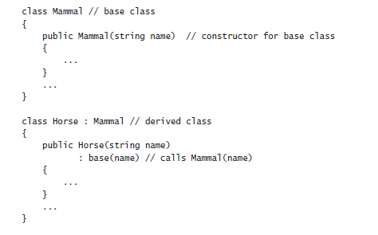
Calling Base Class Constructors
In addition to the methods that it inherits, a derived class automatically contains all the fields from the base class. These fields usually require initialization when an object is created.
You typically perform this kind of initialization in a constructor. Remember that all classes have at least one constructor. (If you don’t provide one, the compiler generates a default constructor for you.)
It is good practice for a constructor in a derived class to call the constructor for its base class as part of the initialization, which enables the base class constructor to perform any additional initialization that it requires.
You can specify the base keyword to call a base class constructor when you define a constructor for an inheriting class, as shown in this example:

Slide 27
Contd…
If you don’t explicitly call a base class constructor in a derived class constructor, the compiler attempts to silently insert a call to the base class’s default constructor before executing the code in the derived class constructor. Taking the earlier example, the compiler rewrites this:
class Horse : Mammal
{
public Horse(string name) as this:
{
……….....
}
………
}
This works if Mammal has a public default constructor.
However, not all classes have a public default constructor (for example, remember that the compiler generates only a default constructor if you don’t write any nondefault constructors), in which case forgetting to call the correct base class constructor results in a compile-time error.
class Horse : Mammal
{
public Horse(string name)
: base()
{
….....
}
………...
}

Slide 28
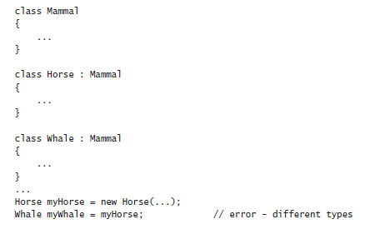
Assigning Classes
In previous examples in this book, you have seen how to declare a variable by using a class type, and then how to use the new keyword to create an object.
You have also seen how the type-checking rules of C# prevent you from assigning an object of one type to a variable declared as a different type.
For example, given the definitions of the Mammal, Horse, and Whale classes shown here, the code that follows these definitions is illegal:
However, it is possible to refer to an object from a variable of a different type as long as the type used is a class that is higher up the inheritance hierarchy. So the following statements are legal:
Horse myHorse = new Horse(...);
Mammal myMammal = myHorse; // legal, Mammal is the base class of Horse

Slide 29
Contd…
If you think about it in logical terms, all Horses are Mammals, so you can safely assign an object of type Horse to a variable of type Mammal.
The inheritance hierarchy means that you can think of a Horse simply as a special type of Mammal; it has everything that a Mammal has with a few extra bits defined by any methods and fields you added to the Horse class.
You can also make a Mammal variable refer to a Whale object. There is one significant limitation, however—when referring to a Horse or Whale object by using a Mammal variable, you can access only methods and fields that are defined by the Mammal class.
Any additional methods defined by the Horse or Whale class are not visible through the Mammal class:
Horse myHorse = new Horse(...);
Mammal myMammal = myHorse;
myMammal.Breathe(); // OK - Breathe is part of the Mammal classmy
Mammal.Trot(); // error - Trot is not part of the Mammal class
Be warned that the converse situation is not true. You cannot unreservedly assign a Mammal object to a Horse variable:
Mammal myMammal = new Mammal(...);
Horse myHorse = myMammal; // error
This looks like a strange restriction, but remember that not all Mammal objects are Horses—some might be Whales. You can assign a Mammal object to a Horse variable as long as you check that the Mammal is really a Horse first, by using the as or is operator, or by using a cast.

Slide 30
Contd…
The following code example uses the as operator to check that myMammal refers to a Horse, and if it does, the assignment to myHorseAgain results in myHorseAgain referring to the same Horse object.
If myMammal refers to some other type of Mammal, the as operator returns null instead.
Horse myHorse = new Horse(...);
Mammal myMammal = myHorse; // myMammal refers to a Horse
…………………………..
Horse myHorseAgain = myMammal as Horse; // OK - myMammal was a Horse...
Whale myWhale = new Whale(...);
myMammal = myWhale;
……………....
myHorseAgain = myMammal as Horse; // returns null - myMammal was a Whale

Slide 31
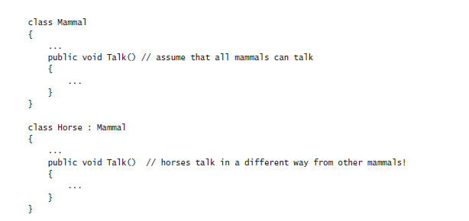
Declaring new Methods
One of the hardest tasks in the realm of computer programming is thinking up unique and meaningful names for identifiers.
If you are defining a method for a class and that class is part of an inheritance hierarchy, sooner or later you are going to try to reuse a name that is already in use by one of the classes higher up the hierarchy.
If a base class and a derived class happen to declare two methods that have the same signature, you will receive a warning when you compile the application.
A method in a derived class masks (or hides) a method in a base class that has the same signature.
For example, if you compile the following code, the compiler generates a warning message telling you that Horse.Talk hides the inherited method Mammal.Talk:

Slide 32
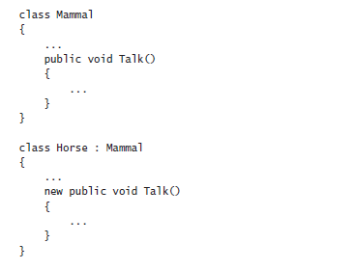
Contd…
Although your code will compile and run, you should take this warning seriously. If another class derives from Horse and calls the Talk method, it might be expecting the method implemented in the Mammal class to be called.
However, the Talk method in the Horse class hides the Talk method in the Mammal class, and the Horse.Talk method will be called instead.
Most of the time, such a coincidence is at best a source of confusion, and you should consider renaming methods to avoid clashes.
However, if you’re sure that you want the two methods to have the same signature, thus hiding the Mammal.Talk method, you can silence the warning by using the new keyword as follows:

Slide 33
Contd…
Using the new keyword like this does not change the fact that the two methods are completely unrelated and that hiding still occurs.
It just turns the warning off. In effect, the new keyword says, “I know what I’m doing, so stop showing me these warnings.”
Declaring virtual Methods
Sometimes you do want to hide the way in which a method is implemented in a base class. As an example, consider the ToString method in System.Object.
The purpose of ToString is to convert an object to its string representation. Because this method is very useful, it is a member of the System.Object class, thereby automatically providing all classes with a ToString method.
However, how does the version of ToString implemented by System.Object know how to convert an instance of a derived class to a string? A derived class might contain any number of fields with interesting values that should be part of the string.
The answer is that the implementation of ToString in System.Object is actually a bit simplistic. All it can do is convert an object to a string that contains the name of its type, such as “Mammal” or “Horse.”
This is not very useful after all. So why provide a method that is so useless? The answer to this second question requires a bit of detailed thought.

Slide 34
Contd…
Obviously, ToString is a fine idea in concept, and all classes should provide a method that can be used to convert objects to strings for display or debugging purposes.
It is only the implementation that requires attention. In fact, you are not expected to call the ToString method defined by System.Object—it is simply a placeholder.
Instead, you may find it more useful to provide your own version of the ToString method in each class you define, overriding the default implementation in System.Object.
The version in System.Object is there only as a safety net, in case a class does not implement or require its own specific version of the ToString method.
A method that is intended to be overridden is called a virtual method. You should be clear on the difference between overriding a method and hiding a method.
Overriding a method is a mechanism for providing different implementations of the same method—the methods are all related because they are intended to perform the same task, but in a class-specific manner.
Hiding a method is a means of replacing one method with another—the methods are usually unrelated and might perform totally different tasks.
Overriding a method is a useful programming concept; hiding a method is often an error.

Slide 35
Contd…
You can mark a method as a virtual method by using the virtual keyword. For example, the ToString method in the System.Object class is defined like this:
namespace System
{
class Object
{
public virtual string ToString( )
{
……………….....
}
……………………………….....
}
……………………....
}

Slide 36
Declaring override Methods
If a base class declares that a method is virtual, a derived class can use the override keyword to declare another implementation of that method. For example:
class Horse : Mammal
{
……………....
public override string ToString( )
{
…………....
}
}
The new implementation of the method in the derived class can call the original implementation of the method in the base class by using the base keyword, like this:
public override string ToString( )
{
base.ToString();
……....
}
There are some important rules you must follow when declaring polymorphic methods (as discussed in the following sidebar, “Virtual Methods and Polymorphism”) by using the virtual and override keywords:

Slide 37
Contd…
There are some important rules you must follow when declaring polymorphic methods (as discussed in the following sidebar, “Virtual Methods and Polymorphism”) by using the virtual and override keywords:
A virtual method cannot be private; it is intended to be exposed to other classes through inheritance. Similarly, override methods cannot be private because a class cannot change the protection level of a method that it inherits.
However, override methods can have a special form of privacy known as protected access, as you will find out in the next section.
2) The signatures of the virtual and override methods must be identical; they must have the same name, number, and types of parameters. In addition, both methods must return the same type.
3) You can only override a virtual method. If the base class method is not virtual and you try to override it, you’ll get a compile-time error. This is sensible; it should be up to the designer of the base class to decide whether its methods can be overridden.
4) If the derived class does not declare the method by using the override keyword, it does not override the base class method—it hides the method.
In other words, it becomes an implementation of a completely different method that happens to have the same name. As before, this will cause a compile-time hiding warning, which you can silence by using the new keyword as previously described.
5) An override method is implicitly virtual and can itself be overridden in a further derived class. However, you are not allowed to explicitly declare that an override method is virtual by using the virtual keyword.

Slide 38
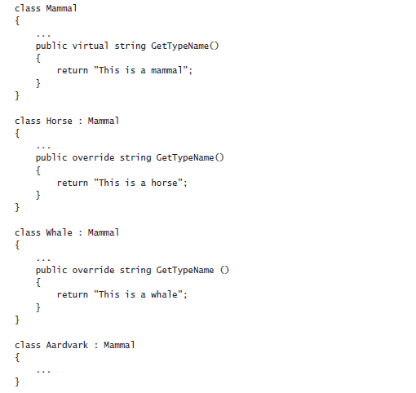
Virtual Methods and Polymorphism
Virtual methods enable you to call different versions of the same method, based on the type of the object determined dynamically at run time.
Consider the following example classes that define a variation on the Mammal hierarchy described earlier:
Notice two things: first, the override keyword used by the GetTypeName method in the Horse and Whale classes, and second, the fact that the Aardvark class does not have a GetTypeName method.
Mammal myMammal;
Horse myHorse = new Horse(...);
Whale myWhale = new Whale(...);
Aardvark myAardvark = new Aardvark(...);
myMammal = myHorse;
Console.WriteLine(myMammal.GetTypeName()); // Horse myMammal = myWhale;
Console.WriteLine(myMammal.GetTypeName()); // Whale myMammal = myAardvark;
Console.WriteLine(myMammal.GetTypeName()); // Aardvark

Slide 39
Contd…
What will be output by the three different Console.WriteLine statements? At first glance, you would expect them all to print “This is a mammal,” because each statement calls the GetTypeName method on the myMammal variable, which is a Mammal.
However, in the first case, you can see that myMammal is actually a reference to a Horse. (Remember, you are allowed to assign a Horse to a Mammal variable because the Horse class inherits from the Mammal class.) Because the GetTypeName method is defined as virtual, the runtime works out that it should call the Horse.GetTypeName method, so the statement actually prints the message “This is a horse.”
The same logic applies to the second Console.WriteLine statement, which outputs the message “This is a whale.”
The third statement calls Console.WriteLine on an Aardvark object.
However, the Aardvark class does not have a GetTypeName method, so the default method in the Mammal class is called, returning the string “This is a mammal.”
This phenomenon of the same statement invoking a different method depending on its context is called polymorphism, which literally means “many forms.”

Slide 40
Understanding protected Access
The public and private access keywords create two extremes of accessibility: public fields and methods of a class are accessible to everyone, whereas private fields and methods of a class are accessible to only the class itself.
These two extremes are sufficient when considering classes in isolation. However, as all experienced object-oriented programmers know, isolated classes cannot solve complex problems.
Inheritance is a powerful way of connecting classes, and there is clearly a special and close relationship between a derived class and its base class.
Frequently, it is useful for a base class to allow derived classes to access some of its members while hiding these same members from classes that are not part of the inheritance hierarchy.
In this situation, you can mark members with the protected keyword. It works like this:
1) If a class A is derived from another class B, it can access the protected class members of class B. In other words, inside the derived class A, a protected member of class B is effectively public.
2) If a class A is not derived from another class B, it cannot access any protected members of class B. So, within class A, a protected member of class B is effectively private.
C# gives programmers complete freedom to declare methods and fields as protected.
However, most object-oriented programming guidelines recommend keeping your fields strictly private whenever possible, and only relax these restrictions when absolutely necessary.
Public fields violate encapsulation because all users of the class have direct, unrestricted access to the fields.

Slide 41
Contd…
Protected fields maintain encapsulation for users of a class, for whom the protected fields are inaccessible.
However, protected fields still allow encapsulation to be violated by other classes that inherit from the base class.
In the following exercise, you will define a simple class hierarchy for modeling different types of vehicles. You will define a base class named Vehicle and derived classes named Airplane and Car.
You will define common methods named StartEngine and StopEngine in the Vehicle class, and you will add some methods to both of the derived classes that are specific to those classes.
you will add a virtual method named Drive to the Vehicle class and override the default implementation of this method in both of the derived classes.

Slide 42
Create a hierarchy of classes
1) Start Microsoft Visual Studio 2015 if it is not already running.
2) Open the Vehicles project, located in the \Microsoft Press\Visual CSharp Step By Step\Chapter 12\Windows X\Vehicles folder in your Documents folder.
The Vehicles project contains the file Program.cs, which defines the Program class with the Main and doWork methods that you have seen in previous exercises.
3) In Solution Explorer, right-click the Vehicles project, point to Add, and then click Class.
The Add New Item—Vehicles dialog box appears.
4) In the Add New Item—Vehicles dialog box, verify that the Class template is highlighted in the middle pane, type Vehicle.cs in the Name text box, and then click Add.
The file Vehicle.cs is created and added to the project and appears in the Code and Text Editor window. The file contains the definition of an empty class named Vehicle.
5) Add the StartEngine and StopEngine methods to the Vehicle class as shown next in bold:
class Vehicle
{
public void StartEngine(string noiseToMakeWhenStarting)
{
Console.WriteLine("Starting engine: {0}", noiseToMakeWhenStarting);
}
public void StopEngine(string noiseToMakeWhenStopping)
{
Console.WriteLine("Stopping engine: {0}", noiseToMakeWhenStopping);
}
}

Slide 43
Contd…
All classes that derive from the Vehicle class will inherit these methods.
The values for the noiseToMakeWhenStarting and noiseToMakeWhenStopping parameters will be different for each different type of vehicle and will help you to identify which vehicle is being started and stopped later.
6) On the PROJECT menu, click Add Class.
The Add New Item—Vehicles dialog box appears again.
7) Type Airplane.cs in the Name text box, and then click Add.
A new file containing a class named Airplane is added to the project and appears in the Code and Text Editor window.
8) In the Code and Text Editor window, modify the definition of the Airplane class so that it inherits from the Vehicle class, as shown in bold here:
class Airplane : Vehicle
{
}
9) Add the TakeOff and Land methods to the Airplane class, as shown in bold here:

Slide 44
Contd…
class Airplane : Vehicle
{
public void TakeOff()
{
Console.WriteLine("Taking off");
}
public void Land()
{
Console.WriteLine("Landing");
}
}
10) On the PROJECT menu, click Add Class.
The Add New Item—Vehicles dialog box appears again.
11) Type Car.cs in the Name text box, and then click Add.
A new file containing a class named Car is added to the project and appears in the Code and Text Editor window.
12) In the Code and Text Editor window, modify the definition of the Car class so that it derives from the Vehicle class, as shown here in bold:
class Car : Vehicle
{
}

Slide 45
Contd…
13) Add the Accelerate and Brake methods to the Car class, as shown in bold here:
class Car : Vehicle
{
public void Accelerate()
{
Console.WriteLine("Accelerating");
}
public void Brake()
{
Console.WriteLine("Braking");
}
}
14) Display the Vehicle.cs file in the Code and Text Editor window.
15) Add the virtual Drive method to the Vehicle class, as shown here in bold:
class Vehicle
{
….....
public virtual void Drive()
{
Console.WriteLine("Default implementation of the Drive method");
}
}

Slide 46
Contd…
16) Display the Program.cs file in the Code and Text Editor window.
17) In the doWork method, delete the // TODO: comment and add code to create an instance of the Airplane class and test its methods by simulating a quick journey by airplane, as follows:
static void doWork()
{
Console.WriteLine("Journey by airplane:");
Airplane myPlane = new Airplane();
myPlane.StartEngine("Contact");
myPlane.TakeOff();
myPlane.Drive();
myPlane.Land(); myPlane.StopEngine("Whirr");
}
18) Add the following statements shown in bold to the doWork method after the code you have just written. These statements create an instance of the Car class and test its methods.
static void doWork()
{
……...
Console.WriteLine("\nJourney by car:");
Car myCar = new Car( );
myCar.StartEngine("Brm brm");
myCar.Accelerate();
myCar.Drive();
myCar.Brake();
myCar.StopEngine("Phut phut");
}

Slide 47
Contd…
19) On the DEBUG menu, click Start Without Debugging.
In the console window, verify that the program outputs messages simulating the different stages of performing a journey by airplane and by car, as shown in the following image:
Notice that both modes of transport invoke the default implementation of the virtual Drive method because neither class currently overrides this method.
20) Press Enter to close the application and return to Visual Studio 2015.
21) Display the Airplane class in the Code and Text Editor window. Override the Drive method in the Airplane class, as follows in bold:

Slide 48
Contd…
class Airplane : Vehicle
{
….....
public override void Drive()
{
Console.WriteLine("Flying");
}
}
23) On the DEBUG menu, click Start Without Debugging.
In the console window, notice that the Airplane object now displays the message Flying when the application calls the Drive method, and the Car object displays the message Motoring:
24)Press Enter to close the application and return to Visual Studio 2015.
25) Display the Program.cs file in the Code and Text Editor window.
26) Add the statements shown here in bold to the end of the doWork method:

Slide 49
Contd…
static void doWork()
{
……….....
Console.WriteLine("\nTesting polymorphism");
Vehicle v = myCar;
v.Drive();
v = myPlane;
v.Drive();
}
This code tests the polymorphism provided by the virtual Drive method. The code creates a reference to the Car object using a Vehicle variable (which is safe, because all Car objects are Vehicle objects) and then calls the Drive method using this Vehicle variable.
The final two statements refer the Vehicle variable to the Airplane object and call what seems to be the same Drive method again.
27) On the DEBUG menu, click Start Without Debugging.
In the console window, verify that the same messages appear as before, followed by this text:
Testing polymorphism
Motoring
Flying

Slide 50
Contd…
The Drive method is virtual, so the runtime (not the compiler) works out which version of the Drive method to call when invoking it through a Vehicle variable based on the real type of the object referenced by this variable.
In the first case, the Vehicle object refers to a Car, so the application calls the Car.Drive method. In the second case, the Vehicle object refers to an Airplane, so the application calls the Airplane.Drive method.
28) Press Enter to close the application and return to Visual Studio 2015.

Slide 51
Understanding Extension Methods
Inheritance is a powerful feature, enabling you to extend the functionality of a class by creating a new class that derives from it.
However, sometimes using inheritance is not the most appropriate mechanism for adding new behaviors, especially if you need to quickly extend a type without affecting existing code.
For example, suppose you want to add a new feature to the int type, such as a method named Negate that returns the negative equivalent value that an integer currently contains. (I know that you could simply use the unary minus operator [-] to perform the same task, but bear with me.)
One way to achieve this is to define a new type named NegInt32 that inherits from System.Int32 (int is an alias for System.Int32) and that adds the Negate method:
class NegInt32 : System.Int32 // don't try this!
{
public int Negate( )
{
……….....
}
}
The theory is that NegInt32 will inherit all the functionality associated with the System.Int32 type in addition to the Negate method. There are two reasons why you might not want to follow this approach:
1) This method applies only to the NegInt32 type, and if you want to use it with existing int variables in your code, you have to change the definition of every int variable to the NegInt32 type.
2) The System.Int32 type is actually a structure, not a class, and you cannot use inheritance with structures.
This is where extension methods become very useful.

Slide 52
Contd…
An extension method enables you to extend an existing type (a class or a structure) with additional static methods.
These static methods become immediately available to your code in any statements that reference data of the type being extended.
You define an extension method in a static class and specify the type that the method applies to as the first parameter to the method, along with the this keyword.
Here’s an example showing how you can implement the Negate extension method for the int type.
static class Util
{
public static int Negate(this int i)
{
return -i;
}
}
The syntax looks a little odd, but it is the this keyword prefixing the parameter to Negate that identifies it as an extension method, and the fact that the parameter that this prefixes is an int means that you are extending the int type.
To use the extension method, bring the Util class into scope. (If necessary, add a using statement specifying the namespace to which the Util class belongs.) Then you can simply use dot notation (.) to reference the method, like this:
int x = 591;
Console.WriteLine("x.Negate {0}", x.Negate( ));

Slide 53
Contd…
Notice that you do not need to reference the Util class anywhere in the statement that calls the Negate method.
The C# compiler automatically detects all extension methods for a given type from all the static classes that are in scope.
You can also invoke the Util.Negate method passing an int as the parameter, using the regular syntax you have seen before, although this use obviates the purpose of defining the method as an extension method:
int x = 591;
Console.WriteLine("x.Negate {0}", Util.Negate(x));
In the following exercise, you will add an extension method to the int type. This extension method enables you to convert the value an int variable contains from base 10 to a representation of that value in a different number base.

Slide 54
Create an extension method
1) In Visual Studio 2015, open the ExtensionMethod project, located in the \Microsoft Press\Visual CSharp Step By Step\Chapter 12\Windows X\ExtensionMethod folder in your Documents folder.
2) Display the Util.cs file in the Code and Text Editor window.
This file contains a static class named Util in a namespace named Extensions. Remember that you must define extension methods inside a static class. The class is empty apart from the // TODO: comment.
3) Delete the comment and declare a public static method in the Util class, named ConvertToBase.
The method should take two parameters: an int parameter named i, prefixed with the this keyword to indicate that the method is an extension method for the int type, and another ordinary int parameter named baseToConvertTo.
The method will convert the value in i to the base indicated by baseToConvertTo. The method should return an int containing the converted value.
The ConvertToBase method should look like this:
static class Util
{
public static int ConvertToBase(this int i, int baseToConvertTo)
{
}
}
4) Add an if statement to the ConvertToBase method that checks that the value of the baseToConvertTo parameter is between 2 and 10. The algorithm used by this exercise does not work reliably outside this range of values.
Throw an ArgumentException exception with a suitable message if the value of baseToConvertTo is outside this range.

Slide 55
Contd…
The ConvertToBase method should look like this:
public static int ConvertToBase(this int i, int baseToConvertTo)
{
if (baseToConvertTo < 2 || baseToConvertTo > 10)
{
throw new ArgumentException("Value cannot be converted to base "
+baseToConvertTo.ToString( ));
}
}
5) Add the following statements shown in bold to the ConvertToBase method, after the statement that throws the ArgumentException exception.
This code implements a well-known algorithm that converts a number from base 10 to a different number base. (You saw a version of this algorithm for converting a decimal number to octal in Chapter 5, “Using Compound Assignment and Iteration Statements.”)

Slide 56
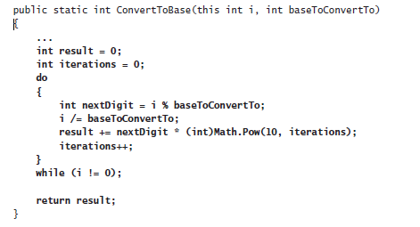
Contd…
6) Display the Program.cs file in the Code and Text Editor window.
7) Add the following using directive after the using System; directive at the top of the file:
using Extensions;
This statement brings the namespace containing the Util class into scope. The ConvertToBase extension method will not be visible in the Program.cs file if you do not perform this task.
8) Add the following statements shown in bold to the doWork method of the Program class, replacing the // TODO: comment:

Slide 57
Contd…
static void doWork()
{
int x = 591;
for (int i = 2; i <= 10; i++)
{
Console.WriteLine("{0} in base {1} is {2}", x, i, x.ConvertToBase(i));
}
}
This code creates an int named x and sets it to the value 591. (You can pick any integer value you want.)
The code then uses a loop to print out the value 591 in all number bases between 2 and 10.
Notice that ConvertToBase appears as an extension method in IntelliSense when you type the period (.) after x in the Console.WriteLine statement.

Slide 58
Contd…
9) On the DEBUG menu, click Start Without Debugging. Confirm that the program displays messages showing the value 591 in the different number bases to the console, like this:
10) Press Enter to close the program and return to Visual Studio 2015.

Slide 59
Creating Interfaces and Defining Abstract Classes
An interface does not contain any code or data; it just specifies the methods and properties that a class that inherits from the interface must provide.
Using an interface enables you to completely separate the names and signatures of the methods of a class from the method’s implementation.
Abstract classes are similar in many ways to interfaces except that they can contain code and data.
However, you can specify that certain methods of an abstract class are virtual, so that a class that inherits from the abstract class must provide its own implementation of these methods
You frequently use abstract classes with interfaces, and together they provide a key technique for enabling you to build extensible programming frameworks.
Understanding Interfaces
Suppose you want to define a new class that enables you to store collections of objects, a bit like an array.
However, unlike using an array, you want to provide a method named RetrieveInOrder to enable applications to retrieve objects in a sequence that depends on the type of object the collection contains (an ordinary array simply enables you to iterate through its contents, and by default you retrieve items according to their index).
For example, if the collection holds alphanumeric objects such as strings, the collection should enable an application to retrieve these strings in sequence according to the collating sequence of the computer, and if the collection holds numeric objects such as integers, the collection should enable the application to retrieve objects in numerical order.

Slide 60
Contd…
When you define the collection class, you do not want to restrict the types of objects that it can hold (the objects can even be class or structure types), and consequently you don’t know how to order these objects.
The question is, how do you provide a method in the collection class that sorts objects whose types you do not know when you actually write the collection class? At first glance, this problem seems similar to the ToString problem in Chapter 12, “Working with Inheritance,”
which could be resolved by declaring a virtual method that subclasses of your collection class can override.
However, this is not the case. There is no inheritance relationship between the collection class and the objects that it holds, so a virtual method would not be of much use.
If you think for a moment, the problem is that the way in which the objects in the collection should be ordered is dependent on the type of the object in the collection, and not on the collection itself.
The solution, therefore, is to require that all the objects provide a method, such as the CompareTo method shown here that the RetrieveInOrder method of the collection can call, enabling the collection to compare these objects with one another:
int CompareTo(object obj)
{
// return 0 if this instance is equal to obj
// return < 0 if this instance is less than obj
// return > 0 if this instance is greater than obj
…………………....
}
You can define an interface for collectable objects that includes the CompareTo method and specify that the collection class can contain only classes that implement this interface.

Slide 61
Contd…
In this way, an interface is similar to a contract. If a class implements an interface, the interface guarantees that the class contains all the methods specified in the interface.
This mechanism ensures that you will be able to call the CompareTo method on all objects in the collection and sort them.
Interfaces enable you to truly separate the “what” from the “how.”
The interface tells you only the name, return type, and parameters of the method. Exactly how the method is implemented is not a concern of the interface.
The interface describes the functionality that a class should provide but not how this functionality is implemented.

Slide 62
Defining an Interface
Defining an interface is syntactically similar to defining a class, except that you use the interface keyword instead of the class keyword.
Inside the interface, you declare methods exactly as in a class or a structure, except that you never specify an access modifier (public, private, or protected).
Additionally, the methods in an interface have no implementation; they are simply declarations, and all types that implement the interface must provide their own implementations.
Consequently, you replace the method body with a semicolon. Here is an example:
interface ILandBound
{
int NumberOfLegs();
}
You could then implement this interface in the Horse class. You inherit from the interface and provide an implementation of every method defined by the interface (in this case, there is just the one method: NumberOfLegs).
class Horse : ILandBound
{
…….....
public int NumberOfLegs( )
{
return 4;
}
}

Slide 63
Contd…
When you implement an interface, you must ensure that each method matches its corresponding interface method exactly, according to the following rules:
1) The method names and return types match exactly.
2) Any parameters (including ref and out keyword modifiers) match exactly.
3) All methods implementing an interface must be publicly accessible. However, if you are using an explicit interface implementation, the method should not have an access qualifier.
If there is any difference between the interface definition and its declared implementation, the class will not compile.
A class can extend another class and implement an interface at the same time.
In this case, C# does not distinguish between the base class and the interface by using specific keywords as, for example, Java does.
Instead, C# uses a positional notation. The base class is always named first, followed by a comma, followed by the interface.
The following example defines Horse as a class that is a Mammal but that additionally implements the ILandBound interface:

Slide 64
Contd…
interface ILandBound
{
……….....
}
class Mammal
{
…………...
}
class Horse : Mammal , ILandBound
{
……………….....
}
Referencing a Class Through Its Interface
In the same way that you can reference an object by using a variable defined as a class that is higher up the hierarchy, you can reference an object by using a variable defined as an interface that its class implements.
Taking the preceding example, you can reference a Horse object by using an ILandBound variable, as follows:
Horse myHorse = new Horse(...);
ILandBound iMyHorse = myHorse; // legal

Slide 65
Contd…
This works because all horses are land-bound mammals, although the converse is not true—you cannot assign an ILandBound object to a Horse variable without casting it first to verify that it does actually reference a Horse object and not some other class that also happens to implement the ILandBound interface.
The technique of referencing an object through an interface is useful because it enables you to define methods that can take different types as parameters, as long as the types implement a specified interface.
For example, the FindLandSpeed method shown here can take any argument that implements the ILandBound interface:
int FindLandSpeed(ILandBound landBoundMammal)
{
……………....
}
You can verify that an object is an instance of a class that implements a specific interface by using the is operator, which you first saw in Chapter 8, “Understanding Values and References.”
You use the is operator to determine whether an object has a specified type, and it works with interfaces as well as classes and structs.
For example, the following block of code checks that the variable myHorse actually implements the ILandBound interface before attempting to assign it to an ILandBound variable:

Slide 66
Contd…
if (myHorse is ILandBound)
{
ILandBound iLandBoundAnimal = myHorse;
}
Note that when referencing an object through an interface, you can invoke only methods that are visible through the interface.
Working with Multiple Interfaces
A class can have at most one base class, but it is allowed to implement an unlimited number of interfaces. A class must implement all the methods declared by these interfaces.
If a structure or class implements more than one interface, you specify the interfaces as a comma-separated list. If a class also has a base class, the interfaces are listed after the base class.
For example, suppose you define another interface named IGrazable that contains the ChewGrass method for all grazing animals. You can define the Horse class like this:
class Horse : Mammal, ILandBound, Igrazable
{
…………………………….
}

Slide 67
Explicitly Implementing an Interface
The examples so far have shown classes that implicitly implement an interface.
If you revisit the ILandBound interface and the Horse class (shown next), although the Horse class implements from the ILandBound interface, there is nothing in the implementation of the NumberOfLegs method in the Horse class that says it is part of the ILandBound interface:
interface ILandBound
{
int NumberOfLegs();
}
class Horse : ILandBound
{
……....
public int NumberOfLegs()
{
return 4;
}
}
This might not be an issue in a simple situation, but suppose the Horse class implemented multiple interfaces.
There is nothing to prevent multiple interfaces from specifying a method with the same name, although they might have different semantics.
For example, suppose you wanted to implement a transportation system based on horse-drawn coaches. A lengthy journey might be broken down into several stages, or “legs.”
If you wanted to keep track of how many legs each horse had pulled the coach for, you might define the following interface:

Slide 68
Contd…
interface Ijourney
{
int NumberOfLegs();
}
Now if you implement this interface in the Horse class, you have an interesting problem:
class Horse : ILandBound, Ijourney
{
…………….. ...
public int NumberOfLegs( )
{
return 4;
}
}
This is legal code, but does the horse have four legs, or has it pulled the coach for four legs of the journey?
The answer as far as C# is concerned is both of these! By default, C# does not distinguish which interface the method is implementing, so the same method actually implements both interfaces.

Slide 69
Contd…
To solve this problem and disambiguate which method is part of which interface implementation, you can implement interfaces explicitly.
To do this, you specify which interface a method belongs to when you implement it, like this:
class Horse : ILandBound, Ijourney
{
………………...
int ILandBound.NumberOfLegs()
{
return 4;
}
int IJourney.NumberOfLegs()
{
return 3;
}
}
Now you can see that the horse has four legs and has pulled the coach for three legs of the journey.

Slide 70
Contd…
Apart from prefixing the name of the method with the interface name, there is one other subtle difference in this syntax: the methods are not marked as public.
You cannot specify the protection for methods that are part of an explicit interface implementation.
This leads to another interesting phenomenon. If you create a Horse variable in code, you cannot actually invoke either of the NumberOfLegs methods because they are not visible.
As far as the Horse class is concerned, they are both private. In fact, this makes sense.
If the methods were visible through the Horse class, which method would the following code actually invoke—the one for the ILandBound interface or the one for the IJourney interface?
Horse horse = new Horse();
……....
int legs = horse.NumberOfLegs();
So, how do you access these methods? The answer is that you reference the Horse object through the appropriate interface, like this :
Horse horse = new Horse();
…….....
IJourney journeyHorse = horse;
int legsInJourney = journeyHorse.NumberOfLegs();
ILandBound landBoundHorse = horse;
int legsOnHorse = landBoundHorse.NumberOfLegs();

Slide 71
Interface Restrictions
The essential idea to remember is that an interface never contains any implementation. The following restrictions are natural consequences of this:
1) You’re not allowed to define any fields in an interface, not even static ones. A field is an implementation detail of a class or structure.
2) You’re not allowed to define any constructors in an interface. A constructor is also considered to be an implementation detail of a class or structure.
3) You’re not allowed to define a destructor in an interface. A destructor contains the statements used to destroy an object instance. (Destructors are described in Chapter 14, “Using Garbage Collection and Resource Management.”)
4) You cannot specify an access modifier for any method. All methods in an interface are implicitly public.
5) You cannot nest any types (such as enumerations, structures, classes, or interfaces) inside an interface.
6) An interface is not allowed to inherit from a structure or a class, although an interface can inherit from another interface. Structures and classes contain implementation; if an interface were allowed to inherit from either, it would be inheriting some implementation.

Slide 72
Defining and Using Interfaces
In the following exercises, you will define and implement interfaces that constitute part of a simple graphical drawing package.
You will define two interfaces called IDraw and IColor, and then you will define classes that implement them.
Each class will define a shape that can be drawn on a canvas on a form. (A canvas is a control that enables you to draw lines, text, and shapes on the screen.)
The IDraw interface defines the following methods:
SetLocation This method enables you to specify the position as x- and y-coordinates of the shape on the canvas.
Draw This method actually draws the shape on the canvas at the location specified by using the SetLocation method.
The IColor interface defines the following method:
SetColor This method lets you specify the color of the shape. When the shape is drawn on the canvas, it will appear in this color.

Slide 73
Define the IDraw and IColor interfaces
1) Start Microsoft Visual Studio 2015 if it is not already running.
2) Open the Drawing project, located in the \Microsoft Press\Visual CSharp Step By Step\Chapter 13\Windows X\Drawing folder in your Documents folder.
The Drawing project is a graphical application. It contains a form called DrawingPad. This form contains a canvas control called drawingCanvas. You will use this form and canvas to test your code.
3) In Solution Explorer, click the Drawing project. On the PROJECT menu, click Add New Item.
The Add New Item – Drawing dialog box appears.
4) In the left pane of the Add New Item – Drawing dialog box, click Visual C# and then click Code. In the middle pane, click the Interface template. In the Name text box, type IDraw.cs, and then click Add.
Visual Studio creates the IDraw.cs file and adds it to your project. The IDraw.cs file appears in the Code and Text Editor window. It should look like this:
using System;
using System.Collections.Generic;
using System.Linq;
using System.Text;
using System.Threading.Tasks;
namespace Drawing
{
interface IDraw { }
}

Slide 74
Contd…
In the IDraw.cs file, if you are using Window 8, add the following using directive to the list at the top of the file:
using Windows.UI.Xaml.Controls;
If you are using Windows 7, add this using directive instead:
using System.Windows.Controls;
You will reference the Canvas class in this interface. The Canvas class is located in the Windows.UI.Xaml.Controls namespace for Windows Store apps and in the System.Windows.Controls namespace for Windows Presentation Foundation (WPF) applications
6) Add the methods shown here in bold to the IDraw interface:
interface Idraw
{
void SetLocation(int xCoord, int yCoord);
void Draw(Canvas canvas);
}
7) On the PROJECT menu, click Add New Item again.
8) In the middle pane of the Add New Item – Drawing dialog box, click the Interface template. In the Name text box, type IColor.cs, and then click Add.
    Visual Studio creates the IColor.cs file and adds it to your project. The IColor.cs file appears in the Code and Text Editor window.
9) In the IColor.cs file, if you are using Window 8, add the following using directive to the list at the top of the file:

Slide 75
Contd…
using Windows.UI;
If you are using Windows 7, add this using directive:
using System.Windows.Media;
You will reference the Color class in this interface, which is located in the Windows.UI namespace for Windows Store apps and in the System.Windows.Media namespace for WPF applications.
10) Add the following method shown in bold to the IColor interface definition:
interface IColor
{
void SetColor(Color color);
}
You have now defined the IDraw and IColor interfaces. The next step is to create some classes that implement them. In the following exercise, you will create two new shape classes called Square and Circle. These classes will implement both interfaces.
Create the Square and Circle classes, and implement the interfaces
1)On the PROJECT menu, click Add Class.
2) In the Add New Item – Drawing dialog box, verify that the Class template is selected in the middle pane, type Square.cs in the Name text box, and then click Add.
Visual Studio creates the Square.cs file and displays it in the Code and Text Editor window.

Slide 76
Contd…
If you are using Windows 8, add the following using directives to the list at the top of the Square.cs file:
using Windows.UI;
using Windows.UI.Xaml.Media;
using Windows.UI.Xaml.Shapes;
using Windows.UI.Xaml.Controls;
If you are using Windows 7, add these using directives to the top of the Square.cs file:
using System.Windows.Media;
using System.Windows.Shapes;
using System.Windows.Controls;
4) Modify the definition of the Square class so that it implements the IDraw and IColor interfaces, as shown here in bold:
class Square : IDraw, Icolor
{
}
5) Add the following private variables shown in bold to the Square class. These variables will hold the position and size of the Square object on the canvas.
The Rectangle class is located in the Windows.UI.Xaml.Shapes namespace for Windows Store apps and in the System.Windows.Shapes namespace for WPF applications. You will use this class to draw the square:

Slide 77
Contd…
class Square : IDraw, Icolor
{
private int sideLength;
private int locX = 0, locY = 0;
private Rectangle rect = null;
}
6) Add the constructor shown in bold to the Square class. This constructor initializes the sideLength field and specifies the length of each side of the square.
class Square : IDraw, Icolor
{
…………...
public Square(int sideLength)
{
this.sideLength = sideLength;
}
}
7) In the definition of the Square class, right-click the IDraw interface. A shortcut menu appears. In the shortcut menu, point to Implement Interface, and then click Implement Interface Explicitly, as shown in the following image:

Slide 78
Contd…
This feature causes Visual Studio to generate default implementations of the methods in the IDraw interface. You can also add the methods to the Square class manually if you prefer. The following example shows the code generated by Visual Studio:
void IDraw.SetLocation(int xCoord, int yCoord)
{
throw new NotImplementedException();
}
void IDraw.Draw(Canvas canvas)
{
throw new NotImplementedException();
}
Each of these methods currently throws a NotImplementedException exception. You are expected to replace the body of these methods with your own code.
8) In the SetLocation method, replace the existing code with the statements shown in bold. This code stores the values passed in through the parameters in the locX and locY fields in the Square object.
void IDraw.SetLocation(int xCoord, int yCoord)
{
this.locX = xCoord;
this.locY = yCoord;
}

Slide 79
Contd…
9) Replace the code in the Draw method with the statements shown here in bold:
void IDraw.Draw(Canvas canvas)
{
if (this.rect != null)
{
canvas.Children.Remove(this.rect);
}
else
{
this.rect = new Rectangle();
}
this.rect.Height = this.sideLength;
this.rect.Width = this.sideLength;
Canvas.SetTop(this.rect, this.locY);
Canvas.SetLeft(this.rect, this.locX);
canvas.Children.Add(this.rect);
}
This method renders the Square object by drawing a Rectangle shape on the canvas. (A square is simply a rectangle where all four sides have the same length.)
If the Rectangle has been drawn previously (possibly at a different location and with a different color), it is removed from the canvas.
The height and width of the Rectangle are set by using the value of the sideLength field.
The position of the Rectangle on the canvas is set by using the static SetTop and SetLeft methods of the Canvas class, and then the Rectangle is added to the canvas. (This causes it to appear.)

Slide 80
Contd…
10) Add the SetColor method from the IColor interface to the Square class, as shown here:
void IColor.SetColor(Color color)
{
if (this.rect != null)
{
SolidColorBrush brush = new SolidColorBrush(color);
this.rect.Fill = brush;
}
}
This method checks that the Square object has actually been displayed. (The rect field will be null if it has not yet been rendered.) The code sets the Fill property of the rect field with the specified color by using a SolidColorBrush object.
11) On the PROJECT menu, click Add Class. In the Add New Item – Drawing dialog box, type Circle.cs in the Name text box, and then click Add.
Visual Studio creates the Circle.cs file and displays it in the Code and Text Editor window.
12) If you are using Windows 7, add these using directives to the top of the Circle.cs file:
using System.Windows.Media;
using System.Windows.Shapes;
using System.Windows.Controls;

Slide 81
Contd…
13) Modify the definition of the Circle class so that it implements the IDraw and IColor interfaces as shown here in bold:
class Circle : IDraw, Icolor
{
}
14) Add the following private variables shown in bold to the Circle class. These variables will hold the position and size of the Circle object on the canvas. The Ellipse class provides the functionality that you will use to draw the circle.
class Circle : IDraw, Icolor
{
private int diameter;
private int locX = 0, locY = 0;
private Ellipse circle = null;
}
15) Add the constructor shown in bold to the Circle class. This constructor initializes the diameter field.
class Circle : IDraw, Icolor
{
…………....
public Circle(int diameter)
{
this.diameter = diameter;
}
}

Slide 82
Contd…
16) Add the SetLocation method shown below to the Circle class. This method implements part of the IDraw interface, and the code is exactly the same as that in the Square class.
void IDraw.SetLocation(int xCoord, int yCoord)
{
this.locX = xCoord;
this.locY = yCoord;
}
17) Add the Draw method shown below to the Circle class. This method is also part of the IDraw interface.
void IDraw.Draw(Canvas canvas)
{
if (this.circle != null)
{
canvas.Children.Remove(this.circle);
}
else { this.circle = new Ellipse();
}
this.circle.Height = this.diameter;
this.circle.Width = this.diameter;
Canvas.SetTop(this.circle, this.locY);
Canvas.SetLeft(this.circle, this.locX);
canvas.Children.Add(this.circle);
}
This method is similar to the Draw method in the Square class, except that it renders the Circle object by drawing an Ellipse shape on the canvas.

Slide 83
Contd…
18) Add the SetColor method to the Circle class. This method is part of the IColor interface. As before, this method is similar to that of the Square class.
void IColor.SetColor(Color color)
{
if (this.circle != null)
{
SolidColorBrush brush = new SolidColorBrush(color);
this.circle.Fill = brush;
}
}
You have completed the Square and Circle classes. You can now use the form to test them.
Test the Square and Circle classes
1) Display the DrawingPad.xaml file in the Design View window.
2) Click the shaded area in the middle of the form.
The shaded area of the form is the Canvas object, and this action sets the focus to this object.
3) In Properties window, click the Event Handlers button. (This button has an icon that looks like a bolt of lightning.)

Slide 84
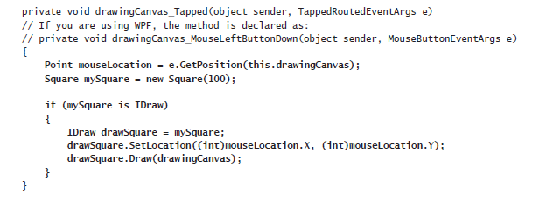
Contd…
If you are using Windows 8, in the list of events, locate the Tapped event and then double-click it.
If you are using Windows 7, locate the MouseLeftButtonDown event and then double-click it.
Visual Studio creates a method called drawingCanvas_Tapped (Windows Store apps) or drawingCanvas_MouseLeftButtonDown (WPF) for the DrawingPad class and displays it in the Code and Text Editor window.
This is an event handler that runs when the user taps the canvas with a finger (Windows Store apps) or clicks the left mouse button over the canvas (WPF). You will learn more about event handlers in Chapter 18, “Using Collections.”
5) If you are using Windows 8, add the following using directive to the list at the top of the DrawingPad.xaml.cs file:
using Windows.UI;
6) Add the code shown below in bold to the drawingCanvas_Tapped or drawingCanvas_MouseLeftButtonDown method:

Slide 85
Contd…
The TappedRoutedEventArgs parameter (Windows Store apps) or MouseButtonEventArgs parameter (WPF) to this method provides useful information about the position of the mouse.
In particular, the GetPosition method returns a Point structure that contains the x- and y-coordinates of the mouse.
The code that you have added creates a new Square object. It then checks to verify that this object implements the IDraw interface (which is good practice) and creates a reference to the object by using this interface.
Remember that when you explicitly implement an interface, the methods defined by the interface are available only by creating a reference to that interface. (The SetLocation and Draw methods are private to the Square class and are available only through the IDraw interface.)
The code then sets the location of the Square to the position of the user’s finger or mouse. Note that the x- and y-coordinates in the Point structure are actually double values, so this code casts them to ints.
The code then calls the Draw method to display the Square object.
7) Add the following code shown in bold to the end of the drawingCanvas_Tapped or drawingCanvas_MouseLeftButtonDown method:

Slide 86
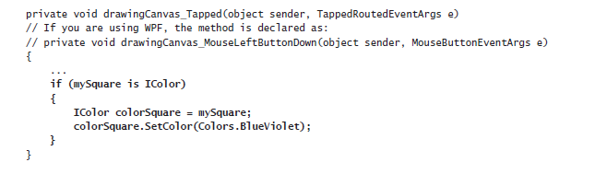
Contd…
This code tests the Square class to verify that it implements the IColor interface; if it does, it creates a reference to the Square class through this interface and calls the SetColor method to set the color of the Square object to Colors.BlueViolet. (The Colors enumeration is provided as part of the .NET Framework.)
8)Return to the DrawingPad.xaml file in the Design View window, and click the Canvas object in the middle of the form.
9) If you are using Windows 8, in the list of events, locate the RightTapped event and then double-click it.
If you are using Windows 7, locate the MouseRightButtonDown event and then double-click it.

Slide 87
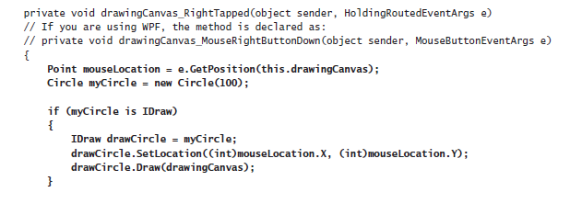
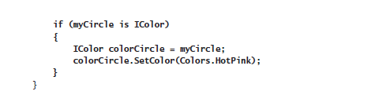
Contd…
9) Add the code shown below in bold to the drawingCanvas_RightTapped method (Windows Store apps) or drawingCanvas_MouseRightButtonDown method (WPF).
The logic in this code is similar to the method that handles the left mouse button, except that it displays a Circle object in HotPink.
The logic in this method is very similar to that of the drawingCanvas_Tapped and drawingCanvas_MouseRightButtonDown methods, except that they draw and fill a circle on the canvas.

Slide 88
Contd…
11) On the DEBUG menu, click Start Debugging to build and run the application.
12) When the Drawing Pad window appears, tap or left-click anywhere on the canvas displayed in the window. A violet square should appear.
13) Tap, hold, and release, or right-click anywhere on the canvas. A pink circle should appear. You can click the left and right mouse buttons any number of times, and each click will draw a square or circle at the mouse position, as shown in the following image:

Slide 89
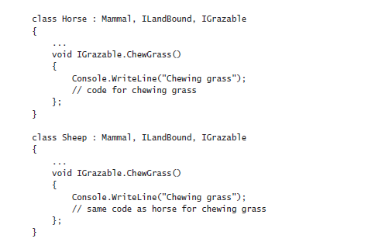
Abstract Classes
You can implement the ILandBound and IGrazable interfaces discussed before the previous set of exercises in many different classes, depending on how many different types of mammals you want to model in your C# application.
In situations such as this, it’s quite common for parts of the derived classes to share common implementations. For example, the duplication in the following two classes is obvious:
Duplication in code is a warning sign. If possible, you should refactor the code to avoid this duplication and reduce any associated maintenance costs. One way to achieve this refactoring is to put the common implementation into a new class created specifically for this purpose. In effect, you can insert a new class into the class hierarchy, as shown by the following code example

Slide 90
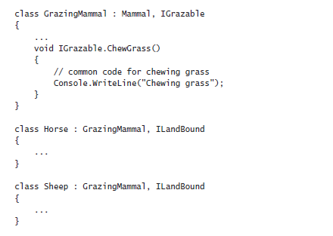
Contd..
This is a good solution, but there is one thing that is still not quite right: you can actually create instances of the GrazingMammal class (and the Mammal class, for that matter). This doesn’t really make sense.
The GrazingMammal class exists to provide a common default implementation. Its sole purpose is to be inherited from. The GrazingMammal class is an abstraction of common functionality rather than an entity in its own right.

Slide 91
Contd..
To declare that creating instances of a class is not allowed, you can declare that the class is abstract by using the abstract keyword. For example:
abstract class GrazingMammal : Mammal, Igrazable
{
……………………...
}
If you now try to instantiate a GrazingMammal object, the code will not compile:
GrazingMammal myGrazingMammal = new GrazingMammal(...); // illegal
Abstract Methods
An abstract class can contain abstract methods. An abstract method is similar in principle to a virtual method (which you met in Chapter 12), except that it does not contain a method body.
A derived class must override this method.
The following example defines the DigestGrass method in the GrazingMammal class as an abstract method; grazing mammals might use the same code for chewing grass, but they must provide their own implementation of the DigestGrass method.
An abstract method is useful if it does not make sense to provide a default implementation in the abstract class but you want to ensure that an inheriting class provides its own implementation of that method.
abstract class GrazingMammal : Mammal, Igrazable
{
abstract void DigestGrass();
………………....
}

Slide 92
Sealed Classes
Using inheritance is not always easy and requires forethought. If you create an interface or an abstract class, you are knowingly writing something that will be inherited from in the future.
The trouble is that predicting the future is a difficult business. With practice and experience, you can develop the skills to craft a flexible, easy-to-use hierarchy of interfaces, abstract classes, and classes, but it takes effort and you also need a solid understanding of the problem you are modeling.
To put it another way, unless you consciously design a class with the intention of using it as a base class, it’s extremely unlikely that it will function well as a base class.
C# allows you to use the sealed keyword to prevent a class from being used as a base class if you decide that it should not be. For example:
sealed class Horse : GrazingMammal, ILandBound
{
…………………....
}
If any class attempts to use Horse as a base class, a compile-time error will be generated. Note that a sealed class cannot declare any virtual methods and that an abstract class cannot be sealed.

Slide 93
Sealed Methods
You can also use the sealed keyword to declare that an individual method in an unsealed class is sealed.
This means that a derived class cannot override this method. You can seal only an override method, and you declare the method as sealed override.
You can think of the interface, virtual, override, and sealed keywords as follows:
1) An interface introduces the name of a method.
2) A virtual method is the first implementation of a method.
3) An override method is another implementation of a method.
4) A sealed method is the last implementation of a method.

Slide 94
Implementing and Using an Abstract Class
The following exercises use an abstract class to rationalize some of the code that you developed in the previous exercise.
The Square and Circle classes contain a high proportion of duplicate code.
It makes sense to factor this code out into an abstract class called DrawingShape because this will ease maintenance of the Square and Circle classes in the future.
Create the DrawingShape abstract class
1) Return to the Drawing project in Visual Studio.
2) In Solution Explorer, click the Drawing project in the Drawing solution. On the PROJECT menu, click Add Class.
The Add New Item – Drawing dialog box appears.
3) In the Name text box, type DrawingShape.cs, and then click Add.
Visual Studio creates the class and displays it in the Code and Text Editor window.
4) In the DrawingShape.cs file, if you are using Windows 8, add the following using directives to the list at the top:
using Windows.UI;
using Windows.UI.Xaml.Media;
using Windows.UI.Xaml.Shapes;
using Windows.UI.Xaml.Controls;

Slide 95
Contd…
If you are using Windows 7, add these using directives:
using System.Windows.Media;
using System.Windows.Shapes;
using System.Windows.Controls;
The purpose of this class is to contain the code common to the Circle and Square classes. A program should not be able to instantiate a DrawingShape object directly.
5) Modify the definition of the DrawingShape class, and declare it as abstract, as shown here in bold:
abstract class DrawingShape
{
}
6) Add the private variables shown in bold to the DrawingShape class:
abstract class DrawingShape
{
protected int size;
protected int locX = 0, locY = 0;
protected Shape shape = null;
}
The Square and Circle classes both use the locX and locY fields to specify the location of the object on the canvas, so you can move these fields to the abstract class.
Similarly, the Square and Circle classes both use a field to indicate the size of the object when it was rendered; although it has a different name in each class (sideLength and diameter), semantically the field performs the same task in both classes.
The name size is a good abstraction of the purpose of this field.

Slide 96
Contd…
Internally, the Square class uses a Rectangle object to render itself on the canvas, and the Circle class uses an Ellipse object.
Both of these classes are part of a hierarchy based on the abstract Shape class in the .NET Framework. The DrawingShape class uses a Shape field to represent both of these types.
7) Add the following constructor to the DrawingShape class:
abstract class DrawingShape
{
……….....
public DrawingShape(int size)
{
this.size = size;
}
}
This code initializes the size field in the DrawingShape object.
8) Add the SetLocation and SetColor methods to the DrawingShape class, as shown in bold below. These methods provide implementations that are inherited by all classes that derive from the DrawingShape class.
Notice that they are not marked as virtual, and a derived class is not expected to override them.
Also, the DrawingShape class is not declared as implementing the IDraw or IColor interfaces (interface implementation is a feature of the Square and Circle classes and not this abstract class), so these methods are simply declared as public.

Slide 97
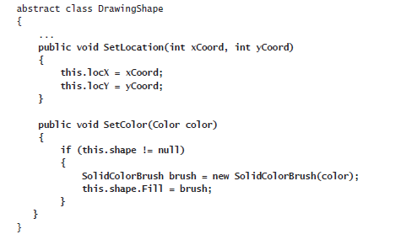
Contd…
9) Add the Draw method to the DrawingShape class. Unlike the previous methods, this method is declared as virtual, and any derived classes are expected to override it to extend the functionality.
The code in this method verifies that the shape field is not null and then draws it on the canvas. The classes that inherit this method must provide their own code to instantiate the shape object.

Slide 98
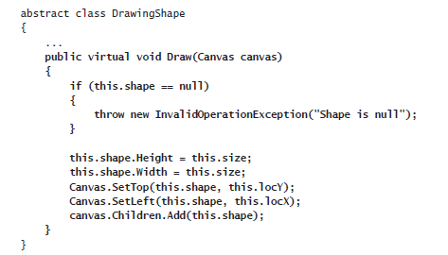
Contd…
You have now completed the DrawingShape abstract class. The next step is to change the Square and Circle classes so that they inherit from this class, and then remove the duplicated code from the Square and Circle classes.
10) Return to Visual Studio and stop debugging.

Slide 99
Using Garbage Collection and Resource Management
The Life and Times of an Object
First, let’s recap what happens when you create an object.
You create an object by using the new operator. The following example creates a new instance of the Square class that you met in Chapter 13, “Creating Interfaces and Defining Abstract Classes”:
Square mySquare = new Square( ); // Square is a reference type
From your point of view, the new operation is a single operation, but underneath, object creation is really a two-phase process:
1) The new operation allocates a chunk of raw memory from the heap. You have no control over this phase of an object’s creation.
2) The new operation converts the chunk of raw memory to an object; it has to initialize the object. You can control this phase by using a constructor.
After you have created an object, you can access its members by using the dot operator (.). For example, the Square class includes a method named Draw that you can call:
mySquare.Draw( );
When the mySquare variable goes out of scope, the Square object is no longer being actively referenced, and the object can be destroyed and the memory that it is using can be reclaimed (this may not happen immediately, though, as you will see later).
Like object creation, object destruction is a two-phase process. The two phases of destruction exactly mirror the two phases of creation:

Slide 100
Contd…
1) The common language runtime (CLR) has to perform some tidying up. You can control this by writing a destructor.
2) The CLR has to return the memory previously belonging to the object back to the heap; the memory that the object lived in has to be deallocated. You have no control over this phase.
The process of destroying an object and returning memory back to the heap is known as garbage collection.
Writing Destructors
You can use a destructor to perform any tidying up required when an object is garbage collected. The CLR will automatically clear up any managed resources that an object uses, and in many of these cases, writing a destructor is unnecessary.
However, if a managed resource is large (such as a multidimensional array), it may make sense to make this resource available for immediate disposal by setting any references that the object has to this resource to null.
Additionally, if an object references an unmanaged resource, either directly or indirectly, a destructor can prove useful.
A destructor is a special method, a little like a constructor, except that the CLR calls it after the reference to an object has disappeared.
The syntax for writing a destructor is a tilde (~) followed by the name of the class. For example, here’s a simple class that opens a file for reading in its constructor and closes the file in its destructor (note that this is simply an example, and I do not recommend that you always follow this pattern for opening and closing files):

Slide 101
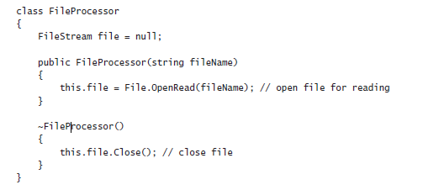
Contd…
There are some very important restrictions that apply to destructors:
Destructors apply only to reference types. You cannot declare a destructor in a value type, such as a struct.
struct MyStruct
{
~ MyStruct()
{
………....
} // compile-time error
}

Slide 102
Contd…
You cannot specify an access modifier (such as public) for a destructor. You never call the destructor in your own code—part of the CLR called the garbage collector does this for you.
public ~ FileProcessor() { ... } // compile-time error
A destructor cannot take any parameters. Again, this is because you never call the destructor yourself.
~ FileProcessor(int parameter) { ... } // compile-time error
Internally, the C# compiler automatically translates a destructor into an override of the Object.Finalize method. The compiler converts the following destructor:
into this
class FileProcessor
{
protected override void Finalize( )
{
try
{ // your code goes here }
finally
{
base.Finalize( );
}
}
}
class FileProcessor
{
~ FileProcessor( )
{ // your code goes here }
}

Slide 103
Contd…
The compiler-generated Finalize method contains the destructor body inside a try block, followed by a finally block that calls the Finalize method in the base class. (The try and finally keywords are described in Chapter 6, “Managing Errors and Exceptions.”)
This ensures that a destructor always calls its base class destructor, even if an exception occurs during your destructor code.
It’s important to understand that only the compiler can make this translation. You can’t write your own method to override Finalize, and you can’t call Finalize yourself.
Why Use the Garbage Collector?
You can never destroy an object yourself by using C# code. There just isn’t any syntax to do it. Instead, the CLR does it for you at a time of its own choosing.
In addition, bear in mind that you can also make more than one reference variable refer to the same object. In the following code example, the variables myFp and referenceToMyFp point to the same FileProcessor object:
FileProcessor myFp = new FileProcessor();
FileProcessor referenceToMyFp = myFp;
How many references can you create to an object? As many as you want! This has an impact on the lifetime of an object.
The CLR has to keep track of all these references. If the variable myFp disappears (by going out of scope), other variables (such as referenceToMyFp) might still exist and the resources used by the FileProcessor object cannot be reclaimed (the file should not be closed).
So, the lifetime of an object cannot be tied to a particular reference variable. An object can be destroyed and its memory made available for reuse only when all the references to it have disappeared.

Slide 104
Contd…
You can see that managing object lifetimes is complex, which is why the designers of C# decided to prevent your code from taking on this responsibility.
If it were your responsibility to destroy objects, sooner or later one of the following situations would arise:
1) You’d forget to destroy the object. This would mean that the object’s destructor (if it had one) would not be run, tidying up would not occur, and memory would not be deallocated back to the heap. You could quite easily run out of memory.
2) You’d try to destroy an active object and risk the possibility of one or more variables holding a reference to a destroyed object, known as a dangling reference. A dangling reference refers either to unused memory or possibly to a completely different object that now happens to occupy the same piece of memory. Either way, the outcome of using a dangling reference would be undefined at best or a security risk at worst. All bets would be off.
3) try and destroy the same object more than once. This might or might not be disastrous, depending on the code in the destructor.
These problems are unacceptable in a language like C#, which places robustness and security high on its list of design goals. Instead, the garbage collector destroys objects for you. The garbage collector makes the following guarantees:
1) Every object will be destroyed, and its destructor will be run. When a program ends, all outstanding objects will be destroyed.
2) Every object will be destroyed exactly once.
3) Every object will be destroyed only when it becomes unreachable—that is, when there are no references to the object in the process running your application.

Slide 105
Contd…
These guarantees are tremendously useful and free you, the programmer, from tedious housekeeping chores that are easy to get wrong. They enable you to concentrate on the logic of the program itself and be more productive.
When does garbage collection occur? This might seem like a strange question.
After all, surely garbage collection occurs when an object is no longer needed. Well, it does, but not necessarily immediately.
Garbage collection can be an expensive process, so the CLR collects garbage only when it needs to (when available memory is starting to run low or the size of the heap has exceeded the system-defined threshold, for example), and then it collects as much as it can.
Performing a few large sweeps of memory is more efficient than performing lots of little dustings!
One feature of the garbage collector is that you don’t know, and should not rely upon, the order in which objects will be destroyed. The final point to understand is arguably the most important:
destructors do not run until objects are garbage collected. If you write a destructor, you know it will be executed, but you just don’t know when. Consequently, you should never write code that depends on destructors running in a particular sequence or at a specific point in your application.

Slide 106
How Does the Garbage Collector Work?
The garbage collector runs in its own thread and can execute only at certain times—typically, when your application reaches the end of a method.
While it runs, other threads running in your application will temporarily halt. This is because the garbage collector might need to move objects around and update object references; it cannot do this while objects are in use.
The garbage collector is a complex piece of software that is self-tuning and implements a number of optimizations to try and balance the need to keep memory available against the requirement to maintain the performance of the application.
The details of the internal algorithms and structures that the garbage collector uses are beyond the scope of this book (and Microsoft continually refines the way in which the garbage collector performs its work), but at the high level, the steps that the garbage collector takes are as follows:
1) It builds a map of all reachable objects. It does this by repeatedly following reference fields inside objects. The garbage collector builds this map very carefully and ensures that circular references do not cause an infinite recursion. Any object not in this map is deemed to be unreachable.
2) It checks whether any of the unreachable objects has a destructor that needs to be run (a process called finalization). Any unreachable object that requires finalization is placed in a special queue called the freachable queue (pronounced “F-reachable”).
3) It deallocates the remaining unreachable objects (those that don’t require finalization) by moving the reachable objects down the heap, thus defragmenting the heap and freeing memory at the top of the heap. When the garbage collector moves a reachable object, it also updates any references to the object.
4) At this point, it allows other threads to resume.
5) It finalizes the unreachable objects that require finalization (now in the freachable queue) by running the Finalize methods on its own thread.

Slide 107
Recommendations
Writing classes that contain destructors adds complexity to your code and to the garbage collection process, and makes your program run more slowly.
If your program does not contain any destructors, the garbage collector does not need to place unreachable objects in the freachable queue and finalize them.
Clearly, not doing something is faster than doing it. Therefore, try to avoid using destructors except when you really need them; only use them to reclaim unmanaged resources.
For example, consider a using statement instead, as described later in this chapter.
You need to be very careful when you write a destructor. In particular, be aware that, if your destructor calls other objects, those other objects might have already had their destructor called by the garbage collector.
Remember that the order of finalization is not guaranteed. Therefore, ensure that destructors do not depend on one another or overlap with one another—don’t have two destructors that try to release the same resource, for example.

Slide 108
Resource Management
Sometimes it’s inadvisable to release a resource in a destructor; some resources are just too valuable to lie around waiting for an arbitrary length of time until the garbage collector actually releases them.
Scarce resources such as memory, database connections, or file handles need to be released, and they need to be released as soon as possible.
In these situations, your only option is to release the resource yourself. You can achieve this by creating a disposal method.
A disposal method is a method that explicitly disposes of a resource. If a class has a disposal method, you can call it and control when the resource is released.
Disposal Methods
An example of a class that implements a disposal method is the TextReader class from the System.IO namespace.
This class provides a mechanism to read characters from a sequential stream of input.
The TextReader class contains a virtual method named Close, which closes the stream.
The StreamReader class (which reads characters from a stream, such as an open file) and the StringReader class (which reads characters from a string) both derive from TextReader, and both override the Close method.
Here’s an example that reads lines of text from a file by using the StreamReader class and then displays them on the screen:

Slide 109
Contd….
TextReader reader = new StreamReader(filename);
string line;
while ((line = reader.ReadLine()) != null)
{
Console.WriteLine(line);
}
reader.Close( );
The ReadLine method reads the next line of text from the stream into a string. The ReadLine method returns null if there is nothing left in the stream.
It’s important to call Close when you have finished with reader to release the file handle and associated resources.
However, there is a problem with this example: it’s not exception-safe. If the call to ReadLine or WriteLine throws an exception, the call to Close will not happen; it will be bypassed.
If this happens often enough, you will run out of file handles and be unable to open any more files.

Slide 110
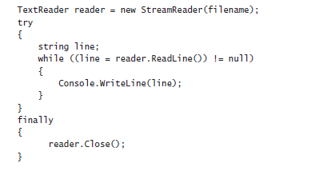
Exception-Safe Disposal
One way to ensure that a disposal method (such as Close) is always called, regardless of whether there is an exception, is to call the disposal method inside a finally block.
Here’s the preceding example coded using this technique:
Using a finally block like this works, but it has several drawbacks that make it a less than ideal solution:
It quickly gets unwieldy if you have to dispose of more than one resource. (You end up with nested try and finally blocks.)
In some cases, you might have to modify the code to make it fit this idiom. (For example, you might need to reorder the declaration of the resource reference, remember to initialize the reference to null, and remember to check that the reference isn’t null in the finally block.)

Slide 111
Contd…
It fails to create an abstraction of the solution. This means that the solution is hard to understand and you must repeat the code everywhere you need this functionality.
The reference to the resource remains in scope after the finally block. This means that you can accidentally try to use the resource after it has been released.
The using statement is designed to solve all these problems.
The using Statement and the IDisposable Interface
The using statement provides a clean mechanism for controlling the lifetimes of resources. You can create an object, and this object will be destroyed when the using statement block finishes.
The syntax for a using statement is as follows:
using ( type variable = initialization )
{
StatementBlock
}

Slide 112
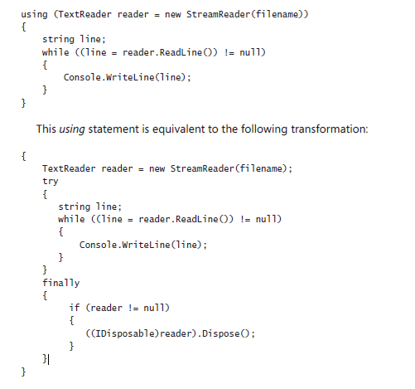
Contd…
Here is the best way to ensure that your code always calls Close on a TextReader:

Slide 113
Contd…
The variable you declare in a using statement must be of a type that implements the IDisposable interface.
The IDisposable interface lives in the System namespace and contains just one method, named Dispose:
namespace System
{
interface IDisposable
{
void Dispose();
}
}
The purpose of the Dispose method is to free any resources used by an object. It just so happens that the StreamReader class implements the IDisposable interface, and its Dispose method calls Close to close the stream.
You can employ a using statement as a clean, exception-safe, and robust way to ensure that a resource is always released.
This approach solves all of the problems that existed in the manual try/finally solution. You now have a solution that
Scales well if you need to dispose of multiple resources.
Doesn’t distort the logic of the program code.
Abstracts away the problem and avoids repetition.
Is robust. You can’t accidentally reference the variable declared inside the using statement (in this case, reader) after the using statement has ended because it’s not in scope anymore—you’ll get a compile-time error

Slide 114
Calling the Dispose Method from a Destructor
When writing your own classes, should you write a destructor or implement the IDisposable interface to enable instances of your class to be managed by a using statement?
A call to a destructor will happen, but you just don’t know when. On the other hand, you know exactly when a call to the Dispose method happens, but you just can’t be sure that it will actually happen, because it relies on the programmer using your classes remembering to write a using statement.
However, it is possible to ensure that the Dispose method always runs by calling it from the destructor.
This acts as a useful backup. You might forget to call the Dispose method, but at least you can be sure that it will be called, even if it’s only when the program shuts down.
You will investigate this feature in detail in the exercises at the end of the chapter, but here’s an example of how you might implement the IDisposable interface:

Slide 115
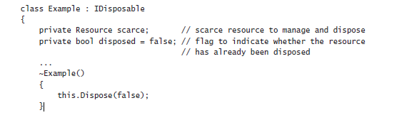
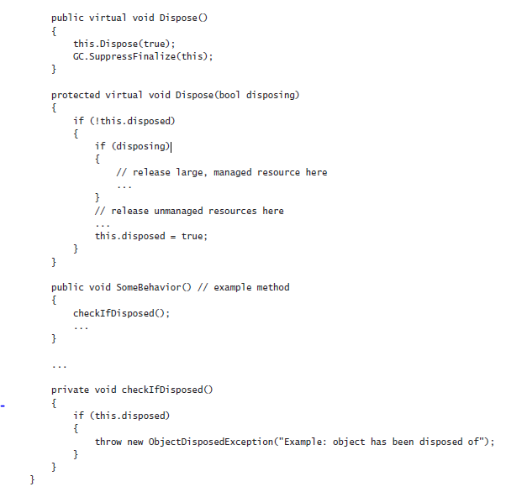
Calling the Dispose Method from a Destructor

Slide 116
Contd…
Notice the following features of the Example class:
The class implements the IDisposable interface.
The public Dispose method can be called at any time by your application code.
The public Dispose method calls the protected and overloaded version of the Dispose method that takes a Boolean parameter, passing the value true as the argument. This method actually performs the resource disposal.
The destructor calls the protected and overloaded version of the Dispose method that takes a Boolean parameter, passing the value false as the argument. The destructor is called only by the garbage collector, when your object is being finalized.
The protected Dispose method can safely be called multiple times. The variable disposed indicates whether the method has already been run and is a safety feature to prevent the method from attempting to dispose the resources multiple times if it is called concurrently. (Your application might call Dispose, but before the method completes, your object might be garbage collected and the Dispose method run again by the CLR from destructor.) The resources are released only the first time the method runs.
The protected Dispose method supports disposal of managed resources (such as a large array) and unmanaged resources (such as a file handle).
If the disposing parameter is true, then this method must have been called from the public Dispose method. In this case, the managed resources and unmanaged resources are all released.

Slide 117
Contd…
If the disposing parameter is false, then this method must have been called from the destructor, and the garbage collector is finalizing the object.
In this case, it is not necessary (or exception-safe) to release the managed resources, as they will be, or might already have been, handled by the garbage collector, so only the unmanaged resources are released.
The public Dispose method calls the static GC.SuppressFinalize method. This method stops the garbage collector from calling the destructor on this object, because the object has already been finalized.
All the regular methods of the class (such as SomeBehavior) check to see whether the object has already been disposed of. If it has, they throw an exception.

Slide 118
Implementing Exception-Safe Disposal
In the following set of exercises you will examine how the using statement helps to ensure that resources used by objects in your applications can be released in a timely manner, even if an exception occurs in your application code.
Initially, you will implement a simple class that implements a destructor and examine when this destructor is invoked by the garbage collector.
Create a simple class that uses a destructor
1) Start Microsoft Visual Studio 2015 if it is not already running.
2) On the FILE menu, point to New, and then click Project.
3) In the New Project dialog box, in the left pane under Templates, click Visual C#. In the middle pane, select the Console Application template. In the Name field near the bottom of the dialog box, type GarbageCollectionDemo. In the Location field, specify the folder Microsoft Press\Visual CSharp Step By Step\Chapter 14 under your Documents folder, and then click OK.
4) On the PROJECT menu, click Add Class.
5) In the Add New Item – GarbageCollectionDemo dialog box, ensure that the Class template is selected, type Calculator.cs in the Name field, and click Add.
The Calculator class is created and displayed in the Code and Text Editor window.
6) Add the public Divide method shown below in bold to the Calculator class:

Slide 119
Contd…
class Calculator
{
public int Divide(int first, int second)
{
return first / second;
}
}
This is a very straightforward method that divides the first parameter by the second and returns the result. It is provided just to add a bit of functionality that can be called by an application.
7) Add the public constructor shown below in bold to the start of the Calculator class, above the Divide method. The purpose of this constructor is to enable you to verify that a Calculator object has been successfully created.
class Calculator
{
public Calculator()
{
Console.WriteLine("Calculator being created");
}
………….....
}
8) Add the destructor shown below in bold to the Calculator class.

Slide 120
Contd…
class Calculator
{
……...
~Calculator()
{
Console.WriteLine("Calculator being finalized");
}
………....
}
This destructor simply displays a message so you can see when the garbage collector runs and finalizes instances of this class. When writing classes for real-world applications, you would not normally output text in a destructor.
9) Display the Program.cs file in the Code and Text Editor window.
10) Add the statements shown below in bold to the Main method in the Program class:
static void Main(string[] args)
{
Calculator calculator = new Calculator();
Console.WriteLine("{0} / {1} = {2}", 120, 15, calculator.Divide(120, 15));
Console.WriteLine("Program finishing");
}
This code creates a Calculator object, calls the Divide method of this object (and displays the result), and then outputs a message as the program finishes.

Slide 121
Contd…
11) On the DEBUG menu, click Start Without Debugging. Verify that the program displays the following series of messages:
Calculator being created
120 / 15 = 8
Program finishing
Calculator being finalized
  Notice that the finalizer for the Calculator object runs only when the application is about to finish, after the Main method has completed.
12) In the console window, press the Enter key and return to Visual Studio 2015.
The CLR guarantees that all objects created by your applications will be subject to garbage collection, but you cannot always be sure when this will happen.
In the exercise, the program was very short-lived and the Calculator object was finalized when the CLR tidied up as the program finished.
However, you might also find that this is the case in more substantial applications with classes that consume scarce resources, and unless you take the necessary steps to provide a means of disposal, the objects that your applications create might retain their resources until the application finishes.
If the resource is a file, this could prevent other users from being able to access that file; if the resource is a database connection, your application could prevent other users from being able to connect to the same database.
Ideally, you want to free resources as soon as you have finished using them rather than waiting for the application to terminate.
In the next exercise, you will implement the IDisposable interface in the Calculator class and enable the program to finalize Calculator objects at a time of its choosing.

Slide 122
Implement the IDisposable interface
Display the Calculator.cs file in the Code and Text Editor window.
Modify the definition of the Calculator class so that it implements the IDisposable interface, as shown below in bold:
  class Calculator : Idisposable
  {
  …….....
  }
Add the following method named Dispose to the Calculator class. This is the method required by the IDisposable interface:
class Calculator : Idisposable
{
……….....
public void Dispose( )
{
Console.WriteLine("Calculator being disposed");
}
}
You would normally add code to the Dispose method that releases the resources held by the object.
There are none in this case, and the purpose of the Console.WriteLine statement in this method is just to enable you to see when the Dispose method is run.
However, you can see that in a real-world application, there would likely be some duplication of code between the destructor and the Dispose method.
To remove this duplication, you would typically place this code in one place and call it from the other. Seeing as you cannot explicitly invoke a destructor from the Dispose method, it makes sense instead to call the Dispose method from the destructor and place the logic that releases resources in the Dispose method.

Slide 123
Contd…
4) Modify the destructor so that it calls the Dispose method, as shown in bold below (leave the statement displaying the message in place in the finalizer so you can see when it is being run by the garbage collector):
~Calculator()
{
Console.WriteLine("Calculator being finalized");
this.Dispose();
}
When you want to destroy a Calculator object in an application, the Dispose method does not run automatically; your code must either call it explicitly (with a statement such as calculator.Dispose()) or create the Calculator object within a using statement. In your program, you will adopt the latter approach.
5) Display the Program.cs file in the Code and Text Editor window. Modify the statements in the Main method that create the Calculator object and call the Divide method, as shown below in bold:
static void Main(string[] args)
{
using (Calculator calculator = new Calculator
{
Console.WriteLine("{0} / {1} = {2}", 120, 15, calculator.Divide(120, 15));
}
Console.WriteLine("Program finishing");
}

Slide 124
Contd…
6) On the DEBUG menu, click Start Without Debugging. Verify that the program now displays the following series of messages:
Calculator being created
120 / 15 = 8
Calculator being disposed
Program finishing
Calculator being finalized
Calculator being disposed
The using statement causes the Dispose method to run before the statement that displays the “Program finishing” message. However, you can see that the destructor for the Calculator object still runs when the application finishes, and it calls the Dispose method again. This is clearly a waste of processing.
7) In the console window, press the Enter key and return to Visual Studio 2015.
Disposing of the resources held by an object more than once may or may not be disastrous, but it is definitely not good practice.
The recommended approach to resolving this problem is to add a private Boolean field to the class to indicate whether the Dispose method has already been invoked, and then examine this field in the Dispose method.

Slide 125
Prevent an object from being disposed of more than once
1) Display the Calculator.cs file in the Code and Text Editor window.
2) Add a private Boolean field called disposed to the Calculator class, and initialize the value of this field to false as shown below in bold:
class Calculator : Idisposable
{
private bool disposed = false;
……….....
}
The purpose of this field is to track the state of this object and indicate whether the Dispose method has been invoked.
3) Modify the code in the Dispose method to display the message only if the disposed field is false. After displaying the message, set the disposed field to true, as shown below in bold:
public void Dispose()
{
if (!disposed)
{
Console.WriteLine("Calculator being disposed");
}
this.disposed = true;
}

Slide 126
Contd…..
On the DEBUG menu, click Start Without Debugging. Notice that the program displays the following series of messages:
Calculator being created
120 / 15 = 8
Calculator being disposed
Program finishing
Calculator being finalized
  The Calculator object is now only being disposed once, but the destructor is still running. Again, this is a waste; there is little point in running a destructor for an object that has already released its resources.
5) In the console window, press the Enter key and return to Visual Studio 2015.
6) Add the statement shown below in bold to the end of the Dispose method in the Calculator class:
public void Dispose()
{
if (!disposed)
{
Console.WriteLine("Calculator being disposed");
}
this.disposed = true;
GC.SuppressFinalize(this);
}

Slide 127
Contd…..
The GC class provides access to the garbage collector, and it implements several static methods that enable you to control some of the actions it performs.
The SuppressFinalize method enables you to indicate that the garage collector should not perform finalization on the specified object, and this prevents the destructor from running.
7) On the DEBUG menu, click Start Without Debugging. Notice that the program displays the following series of messages:
Calculator being created
120 / 15 = 8
Calculator being disposed
Program finishing
  You can see that the destructor is no longer running as the Calculator object has already been disposed before the program finishes.
8) In the console window, press the Enter key and return to Visual Studio 2015.

