Slide 1
MODULE 4
PART III
Defining Extensible Types with C#
Updated by: Mohan A. Gholap
Original Slides by: Pavan D.M.

Slide 2
Introduction
In Part III, you’ll learn about many of the more advanced features of C# such as properties, indexers, generics, and collection classes. You’ll also see how you can build highly responsive systems by using events, and how you can use delegates to invoke the application logic of one class from another without closely coupling them together; this is an extremely powerful technique that enables you to construct highly extensible systems.
You will also learn about the Language-Integrated Query (LINQ) feature of C#, which enables you to perform potentially complex queries over collections of objects in a clear and natural manner.

Slide 3
CHAP TE R 15
Implementing Properties to Access Fields

Slide 4
Introduction
This chapter looks at how to define and use properties to encapsulate fields and data in a class.
This approach ensures safe and controlled access to fields and enables you to encapsulate additional logic and rules concerning the values that are permitted. However, the syntax for accessing a field in this way is unnatural.
When you want to read or write a variable, you normally use an assignment statement, so calling a method to achieve the same effect on a field (which is, after all, just a variable) feels a little clumsy. Properties are designed to alleviate this awkwardness.

Slide 5
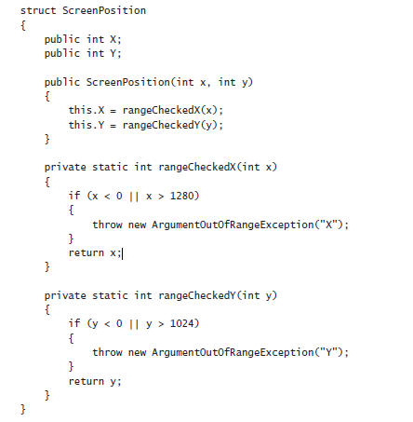
Implementing Encapsulation by Using Methods
First, let’s recap the original motivation for using methods to hide fields.
Consider the following structure that represents a position on a computer screen as a pair of coordinates, x and y. Assume that the range of valid values for the x-coordinate lies between 0 and 1280, and the range of valid values for the y-coordinate lies between 0 and 1024:

Slide 6
Contd…
One problem with this structure is that it does not follow the golden rule of encapsulation—that is, it does not keep its data private.
Public data is often a bad idea because the class cannot control the values that an application specifies.
For example, the ScreenPosition constructor range checks its parameters to make sure that they are in a specified range, but no such check can be done on the “raw” access to the public fields.
Sooner or later (probably sooner), an error or misunderstanding on the part of a developer using this class in an application can cause either X or Y to stray out of this range:
ScreenPosition origin = new ScreenPosition(0, 0);
…….....
int xpos = origin.X;
origin.Y = -100; // oops
The common way to solve this problem is to make the fields private and add an accessor method and a modifier method to respectively read and write the value of each private field.
The modifier methods can then range-check new field values. For example, the following code contains an accessor (GetX) and a modifier (SetX) for the X field. Notice that SetX checks its parameter value.

Slide 7
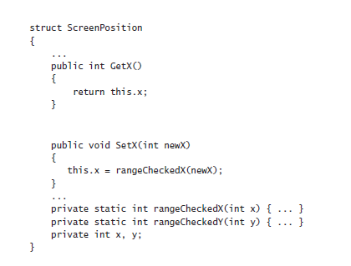
Contd…
The code now successfully enforces the range constraints, which is good. However, there is a price to pay for this valuable guarantee—ScreenPosition no longer has a natural fieldlike syntax;
it uses awkward method-based syntax instead. The following example increases the value of X by 10. To do so, it has to read the value of X by using the GetX accessor method and then write the value of X by using the SetX modifier method.

Slide 8
Contd…
int xpos = origin.GetX();
origin.SetX(xpos + 10);
Compare this with the equivalent code if the X field were public:
origin.X += 10;
There is no doubt that, in this case, using public fields is syntactically cleaner, shorter, and easier. Unfortunately, using public fields breaks encapsulation. Properties enable you to combine the best of both worlds (fields and methods) to retain encapsulation while providing a fieldlike syntax.

Slide 9
What Are Properties?
A property is a cross between a field and a method—it looks like a field but acts like a method. You access a property by using exactly the same syntax that you use to access a field.
However, the compiler automatically translates this fieldlike syntax into calls to accessor methods (sometimes referred to as property getters and property setters).
The syntax for a property declaration looks like this:
AccessModifier Type PropertyName
{
get
{
// read accessor code
}
set
{
// write accessor code
}
}
A property can contain two blocks of code, starting with the get and set keywords.
The get block contains statements that execute when the property is read, and the set block contains statements that run when the property is written to. The type of the property specifies the type of data read and written by the get and set accessors.

Slide 10
What Are Properties?
A property is a cross between a field and a method—it looks like a field but acts like a method. You access a property by using exactly the same syntax that you use to access a field.
However, the compiler automatically translates this fieldlike syntax into calls to accessor methods (sometimes referred to as property getters and property setters).
The syntax for a property declaration looks like this:
AccessModifier Type PropertyName
{
get
{
// read accessor code
}
set
{
// write accessor code
}
}
A property can contain two blocks of code, starting with the get and set keywords.
The get block contains statements that execute when the property is read, and the set block contains statements that run when the property is written to. The type of the property specifies the type of data read and written by the get and set accessors.

Slide 11
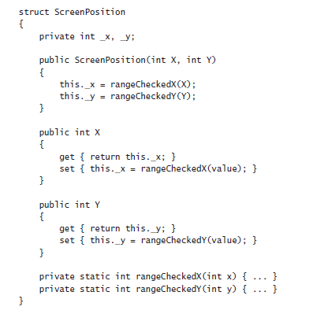
Contd….
The next code example shows the ScreenPosition structure rewritten by using properties. When looking at this code, notice the following:
Lowercase _x and _y are private fields.
Uppercase X and Y are public properties.
All set accessors are passed the data to be written by using a hidden, built-in parameter named value.

Slide 12
Contd….
In this example, a private field directly implements each property, but this is only one way to implement a property. All that is required is that a get accessor returns a value of the specified type.
Such a value can easily be calculated dynamically rather than being simply retrieved from stored data, in which case there would be no need for a physical field.
Using Properties
When you use a property in an expression, you can use it in a read context (when you are retrieving its value) and in a write context (when you are modifying its value).
The following example shows how to read values from the X and Y properties of the ScreenPosition structure:
ScreenPosition origin = new ScreenPosition(0, 0);
int xpos = origin.X; // calls origin.X.get
int ypos = origin.Y; // calls origin.Y.get
Notice that you access properties and fields by using identical syntax. When you use a property in a read context, the compiler automatically translates your fieldlike code into a call to the get accessor of that property.
Similarly, if you use a property in a write context, the compiler automatically translates your fieldlike code into a call to the set accessor of that property:

Slide 13
Contd….
origin.X = 40; // calls origin.X.set, with value set to 40
origin.Y = 100; // calls origin.Y.Set, with value set to 100
The values being assigned are passed in to the set accessors by using the value variable, as described in the preceding section. The runtime does this automatically.
It’s also possible to use a property in a read/write context. In this case, both the get accessor and the set accessor are used. For example, the compiler automatically translates statements such as the following into calls to the get and set accessors:
origin.X += 10;

Slide 14
Read-Only Properties
You can declare a property that contains only a get accessor. In this case, you can use the property only in a read context.
For example, here’s the X property of the ScreenPosition structure declared as a read-only property:
struct ScreenPosition
{
private int _x;
…...
public int X
{
get
{
return this._x;
}
}
}
The X property does not contain a set accessor; therefore, any attempt to use X in a write context will fail. For example:
origin.X = 140; // compile-time error

Slide 15
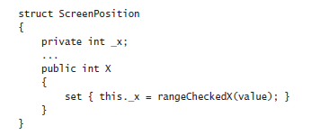
Write-Only Properties
Similarly, you can declare a property that contains only a set accessor. In this case, you can use the property only in a write context.
For example, here’s the X property of the ScreenPosition structure declared as a write-only property:
The X property does not contain a get accessor; any attempt to use X in a read context will fail.
For example: Console.WriteLine(origin.X); // compile-time error
origin.X = 200; //compiles OK
origin.X += 10 // compile-time error

Slide 16
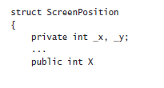
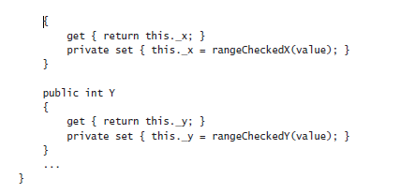
Property Accessibility
You can specify the accessibility of a property (public, private, or protected) when you declare it. However, it is possible within the property declaration to override the property accessibility for the get and set accessors.
For example, the version of the ScreenPosition structure shown here defines the set accessors of the X and Y properties as private. (The get accessors are public, because the properties are public.)

Slide 17
Contd…
You must observe some rules when defining accessors with different accessibility from one another:
You can change the accessibility of only one of the accessors when you define it. It wouldn’t make much sense to define a property as public only to change the accessibility of both accessors to private anyway!
The modifier must not specify an accessibility that is less restrictive than that of the property. For example, if the property is declared as private, you cannot specify the read accessor as public. (Instead, you would make the property public and make the write accessor private.)

Slide 18
Understanding the Property Restrictions
Properties look, act, and feel like fields when you read or write data using them. However, they are not true fields, and certain restrictions apply to them:
You can assign a value through a property of a structure or class only after the structure or class has been initialized. The following code example is illegal because the location variable has not been initialized (by using new):
ScreenPosition location;
location.X = 40; // compile-time error, location not assigned
You can’t use a property as a ref or an out argument to a method (although you can use a writable field as a ref or an out argument). This makes sense because the property doesn’t really point to a memory location but rather to an accessor method. For example:
MyMethod(ref location.X); // compile-time error
A property can contain at most one get accessor and one set accessor. A property cannot contain other methods, fields, or properties.
The get and set accessors cannot take any parameters. The data being assigned is passed to the set accessor automatically by using the value variable.
You can’t declare const properties. For example:
const int X { get { …... } set { ………….} } // compile-time error

Slide 19

Declaring Interface Properties
You encountered interfaces in Chapter 13, “Creating Interfaces and Defining Abstract Classes.” Interfaces can define properties as well as methods.
To do this, you specify the get or set keyword, or both, but replace the body of the get or set accessor with a semicolon.
For example:
Any class or structure that implements this interface must implement the X and Y properties with get and set accessor methods. For example:

Slide 20
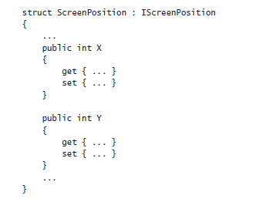
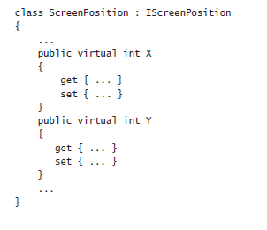
contd…
If you implement the interface properties in a class, you can declare the property implementations as virtual, which enables derived classes to override the implementations.
For example:

Slide 21
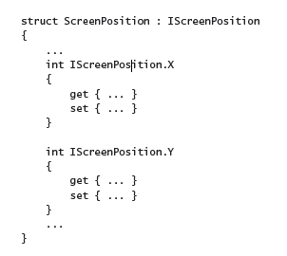
contd…
You can also choose to implement a property by using the explicit interface implementation syntax covered in Chapter 13. An explicit implementation of a property is nonpublic and nonvirtual (and cannot be overridden).
For example:

Slide 22
Replacing Methods with Properties
In Chapter 13 you created a drawing application that enabled the user to place circles and squares on a canvas in a window.
You factored the common functionality for the Circle and Square classes into an abstract class called DrawingShape.
The DrawingShape class provided the SetLocation and SetColor methods to enable the application to specify the position and color of a shape on the screen. In the following exercise, you will modify the DrawingShape class to expose the location and color of a shape as properties.
Use properties
Start Visual Studio 2015 if it is not already running.
Open the Drawing project, located in the \Microsoft Press\Visual CSharp Step By Step\Chapter 15\Windows X\Drawing Using Properties folder in your Documents folder.
Display the DrawingShape.cs file in the Code and Text Editor window.
This file contains the same DrawingShape class that you created in Chapter 13, except that, following the recommendations described earlier in this chapter, the size field has been renamed as _size, and the locX and locY fields have been renamed as _x and _y.

Slide 23
contd…
abstract class DrawingShape
{
protected int _size;
protected int _x = 0, _y = 0;
………...
}
4) Open the IDraw.cs file for the Drawing project in the Code and Text Editor window.
Recall that this interface specifies the SetLocation method, like this:
interface Idraw
{
SetLocation(int xCoord, in yCoord);
………….. ...
}
The purpose of this method is to set the _x and _y fields of the DrawingShape object to the values passed in. This method can be replaced with a pair of properties.
5) Delete this method and replace it with the definition of a pair of properties named X and Y, as shown below in bold:
interface Idraw
{
int X { get; set; }
int Y { get; set; }
….....
}

Slide 24
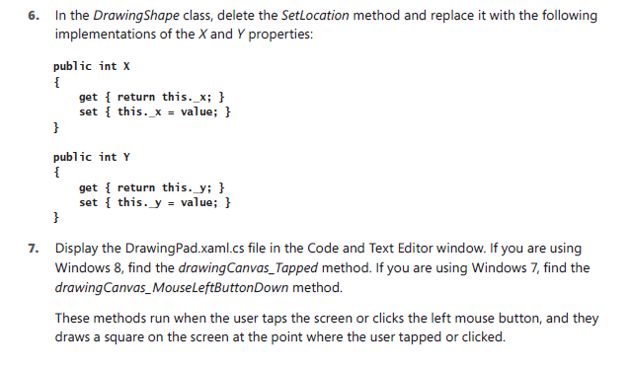
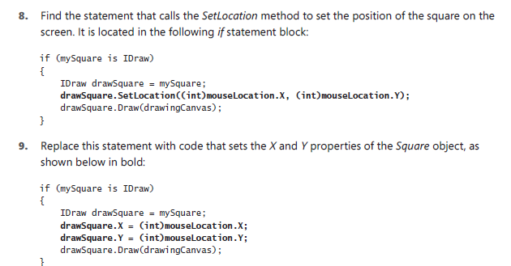
contd…

Slide 25
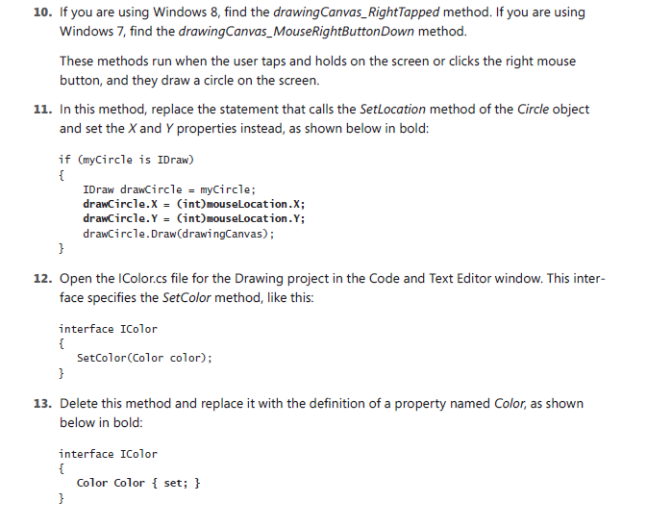
contd…

Slide 26
contd…
This is a write-only property, providing a set accessor but no get accessor. This is because the color is not actually stored in the DrawingShape class and is only specified as each shape is drawn; you cannot actually query a shape to find out which color it is.
14) Return to the DrawingShape class in the Code and Text Editor window. Replace the SetColor method in this class with the Color property shown below:
public Color Color
{
set
{
if (this.shape != null)
{
SolidColorBrush brush = new SolidColorBrush(value);
this.shape.Fill = brush;
}
}
}
15) Return to the DrawingPad.xaml.cs file in the Code and Text Editor window. In the drawingCanvas_Tapped method (Windows 8) or drawingCanvas_MouseLeftButtonDown method (Windows 7), modify the statement the sets the color of the Square object, as shown below in bold:
if (mySquare is IColor)
{
IColor colorSquare = mySquare;
colorSquare.Color = Colors.BlueViolet;
}

Slide 27
contd…
16) Similarly, in the drawingCanvas_RightTapped method (Windows 8) or drawingCanvas_MouseRightButtonDown method (Windows 7), modify the statement the sets the color of the Circle object:
if (myCircle is IColor)
{
IColor colorCircle = myCircle;
colorCircle.Color = Colors.HotPink;
}
17) On the DEBUG menu, click Start Debugging to build and run the project.
18) Verify that the application operates in the same manner as before. If you tap the screen or click the left mouse button on the canvas, the application should draw a square, and if you tap and hold or click the right mouse button, the application should draw a circle.

Slide 28
Generating Automatic Properties
As mentioned earlier in this chapter, the principal purpose of properties is to hide the implementation of fields from the outside world.
This is fine if your properties actually perform some useful work, but if the get and set accessors simply wrap operations that just read or assign a value to a field, you might be questioning the value of this approach.
However, there are at least two good reasons why you should define properties rather than exposing data as public fields even in these situations:
Compatibility with applications: Fields and properties expose themselves by using different metadata in assemblies. If you develop a class and decide to use public fields, any applications that use this class will reference these items as fields.
Although you use the same C# syntax for reading and writing a field that you use when reading and writing a property, the compiled code is actually quite different—the C# compiler just hides the differences from you.
If you later decide that you really do need to change these fields to properties (maybe the business requirements have changed, and you need to perform additional logic when assigning values), existing applications will not be able to use the updated version of the class without being recompiled.
This is awkward if you have deployed the application on a large number of users’ desktops throughout an organization. There are ways around this, but it is generally better to avoid getting into this situation in the first place.

Slide 29
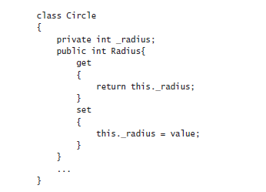
Contd….
Compatibility with interfaces If you are implementing an interface and the interface defines an item as a property, you must write a property that matches the specification in the interface, even if the property just reads and writes data in a private field. You cannot implement a property simply by exposing a public field with the same name.
The designers of the C# language recognized that programmers are busy people who should not have to waste their time writing more code than they need to. To this end, the C# compiler can generate the code for properties for you automatically, like this: class Circle
{
public int Radius{ get; set; }
……….....
}
In this example, the Circle class contains a property named Radius. Apart from the type of this property, you have not specified how this property works—the get and set accessors are empty. The C# compiler converts this definition to a private field and a default implementation that looks similar to this:

Slide 30
Contd….
So for very little effort, you can implement a simple property by using automatically generated code, and if you need to include additional logic later, you can do so without breaking any existing applications.
You should note, however, that you must specify both a get and a set accessor with an automatically generated property—an automatic property cannot be read-only or write-only.

Slide 31
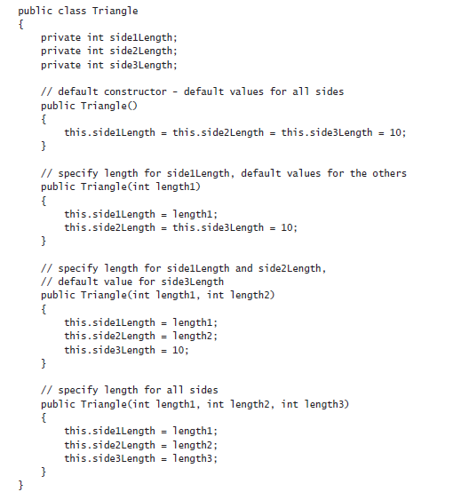
Initializing Objects by Using Properties
An object can have multiple constructors, and you can define constructors with varying parameters to initialize different elements in an object. For example, you could define a class that models a triangle like this:

Slide 32
Contd…
Depending on how many fields a class contains and the various combinations you want to enable for initializing the fields, you could end up writing a lot of constructors.
There are also potential problems if many of the fields have the same type: you might not be able to write a unique constructor for all combinations of fields.
For example, in the preceding Triangle class, you could not easily add a constructor that initializes only the side1Length and side3Length fields because it would not have a unique signature; it would take two int parameters, and the constructor that initializes side1Length and side2Length already has this signature.
One possible solution is to define a constructor that takes optional parameters and specify values for the parameters as named arguments when you create a Triangle object. However, a better and more transparent solution is to initialize the private fields to a set of default values and expose them as properties, like this:

Slide 33
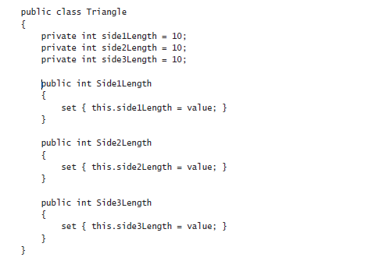
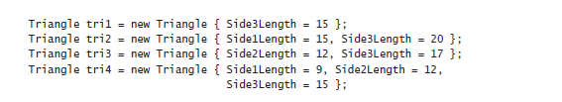
Contd…
When you create an instance of a class, you can initialize it by specifying the names and values for any public properties that have set accessors. For example, you can create Triangle objects and initialize any combination of the three sides, like this:

Slide 34

Contd…
This syntax is known as an object initializer. When you invoke an object initializer in this way, the C# compiler generates code that calls the default constructor and then calls the set accessor of each named property to initialize it with the value specified.
You can specify object initializers in combination with nondefault constructors as well.
For example, if the Triangle class also provided a constructor that took a single string parameter describing the type of triangle, you could invoke this constructor and initialize the other properties like this:
The important point to remember is that the constructor runs first and the properties are set afterward. Understanding this sequencing is important if the constructor sets fields in an object to specific values and the properties that you specify change these values.

Slide 35
Define automatic properties and use object initializers
1) In Visual Studio 2015, open the AutomaticProperties project, located in the \Microsoft Press\Visual CSharp Step By Step\Chapter 15\Windows X\AutomaticProperties folder in your Documents folder.
The AutomaticProperties project contains the Program.cs file, defining the Program class with the Main and doWork methods that you saw in previous exercises.
2)In Solution Explorer, right-click the AutomaticProperties project, point to Add, and then click Class. In the Add New Item—AutomaticProperties dialog box, type Polygon.cs in the Name text box, and then click Add.
The Polygon.cs file, holding the Polygon class, is created and added to the project and appears in the Code and Text Editor window.
3) Add the automatic properties NumSides and SideLength, shown here in bold, to the Polygon class:
class Polygon
{
public int NumSides { get; set; }
public double SideLength { get; set; }
}
4) Add the following default constructor shown in bold to the Polygon class. This constructor initializes the NumSides and SideLength fields with default values:

Slide 36
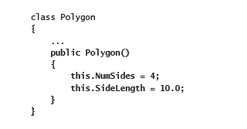
Contd…
In this exercise, the default polygon is a square with sides 10 units long.
5) Display the Program.cs file in the Code and Text Editor window.
6) Add the statements shown below in bold to the doWork method, replacing the // TODO: comment:
static void doWork()
{
Polygon square = new Polygon();
Polygon triangle = new Polygon { NumSides = 3 };
Polygon pentagon = new Polygon { SideLength = 15.5, NumSides = 5 };
}
These statements create Polygon objects. The square variable is initialized by using the default constructor. The triangle and pentagon variables are also initialized by using the default constructor, and then this code changes the value of the properties exposed by the Polygon class.

Slide 37
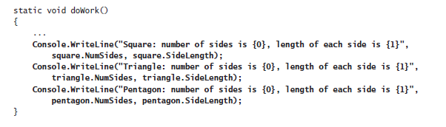
Contd…
7) Add the following code shown in bold to the end of the doWork method:
These statements display the values of the NumSides and SideLength properties for each Polygon object.
8) On the DEBUG menu, click Start Without Debugging.
Verify that the program builds and runs, writing the messages shown here to the console window:
Press the Enter key to close the application and return to Visual Studio 2015.

Slide 38
Chapter 16
Using Indexer

Slide 39
What Is an Indexer?
You can think of an indexer as a smart array in much the same way that you can think of a property as a smart field.
Where a property encapsulates a single value in a class, an indexer encapsulates a set of values. The syntax that you use for an indexer is exactly the same as the syntax that you use for an array.
The best way to understand indexers is to work through an example. First, you’ll consider a problem and examine a solution that doesn’t use indexers.
Then you’ll work through the same problem and look at a better solution that does use indexers. The problem concerns integers, or more precisely, the int type.
An Example That Doesn’t Use Indexers
You normally use an int to hold an integer value. Internally, an int stores its value as a sequence of 32 bits, where each bit can be either 0 or 1.
Most of the time, you don’t care about this internal binary representation; you just use an int type as a container that holds an integer value.
However, sometimes programmers use the int type for other purposes—some programs use an int as a set of binary flags and manipulate the individual bits within an int. If you are an old C hack like I am, what follows should have a very familiar feel!

Slide 40
Contd…
C# provides a set of operators that you can use to access and manipulate the individual bits in an int. These operators are as follows:
The NOT (~) operator: This is a unary operator that performs a bitwise complement. For example, if you take the 8-bit value 11001100 (204 decimal) and apply the ~ operator to it, you obtain the result 00110011 (51 decimal)—all the 1s in the original value become 0s, and all the 0s become 1s.
The left-shift (<<) operator: This is a binary operator that performs a left shift. The expression 204 << 2 returns the value 48. (In binary, 204 decimal is 11001100, and left-shifting it by two places yields 00110000, or 48 decimal.) The far-left bits are discarded, and zeros are introduced from the right. There is a corresponding right-shift operator, >>.
The OR (|) operator : This is a binary operator that performs a bitwise OR operation, returning a value containing a 1 in each position in which either of the operands has a 1. For example, the expression 204 | 24 has the value 220 (204 is 11001100, 24 is 00011000, and 220 is 11011100).
The AND (&) operator: This operator performs a bitwise AND operation. AND is similar to the bitwise OR operator, except that it returns a value containing a 1 in each position where both of the operands have a 1. So 204 & 24 is 8 (204 is 11001100, 24 is 00011000, and 8 is 00001000).

Slide 41
Contd…
The XOR (^) operator: This operator performs a bitwise exclusive OR operation, returning a 1 in each bit where there is a 1 in one operand or the other but not both. (Two 1s yield a 0—this is the “exclusive” part of the operator.) So 204 ^ 24 is 212 (11001100 ^ 00011000 is 11010100).
You can use these operators together to determine the values of the individual bits in an int. As an example, the following expression uses the left-shift (<<) and bitwise AND (&) operators to determine whether the sixth bit from the right of the byte variable named bits is set to 0 or to 1:
(bits & (1 << 5)) != 0
Suppose the bits variable contains the decimal value 42. In binary, this is 00101010. The decimal value 1 is 00000001 in binary, and the expression 1 << 5 has the value 00100000; the sixth bit is 1.
In binary, the expression bits & (1 << 5) is 00101010 & 00100000, and the value of this expression is binary 00100000, which is nonzero.
If the variable bits contains the value 65, or 01000001 in binary, the value of the expression is 01000001 & 00100000, which yields the binary result 00000000, or zero.
This is a fairly complicated example, but it’s trivial in comparison to the following expression, which uses the compound assignment operator &= to set the bit at position 6 to 0:
bits &= ~(1 << 5)

Slide 42
Contd…
Similarly, if you want to set the bit at position 6 to 1, you can use a bitwise OR (|) operator. The following complicated expression is based on the compound assignment operator |=:
bits |= (1 << 5)
The trouble with these examples is that although they work, they are fiendishly difficult to understand. They’re complicated, and the solution is a very low-level one: it fails to create an abstraction of the problem that it solves, and it is consequently very difficult to maintain co de that performs these kinds of operations.

Slide 43
The Same Example Using Indexers
Let’s pull back from the preceding low-level solution for a moment for a reminder of what the problem is. You’d like to use an int not as an int but as an array of bits.
Therefore, the best way to solve this problem is to use an int as if it were an array of bits! In other words, what you’d like to be able to write to access the bit 6 places from the right in the bits variable is an expression like this (remember that arrays start with index 0):
bits[5]
And to set the bit 4 places from the right to true, we’d like to be able to write this:
bits[3] = true
Unfortunately, you can’t use the square bracket notation on an int—it works only on an array or on a type that behaves like an array.
So the solution to the problem is to create a new type that acts like, feels like, and is used like an array of bool variables but is implemented by using an int.
You can achieve this feat by defining an indexer. Let’s call this new type IntBits. IntBits will contain an int value (initialized in its constructor), but the idea is that you’ll use IntBits as an array of bool variables.

Slide 44
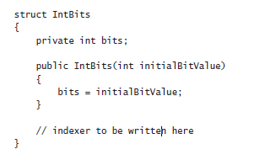
Contd…
To define the indexer, you use a notation that is a cross between a property and an array.
You introduce the indexer with the this keyword, specify the type of the value returned by the indexer, and also specify the type of the value to use as the index into the indexer between square brackets.
The indexer for the IntBits struct uses an integer as its index type and returns a Boolean value. It looks like this:

Slide 45
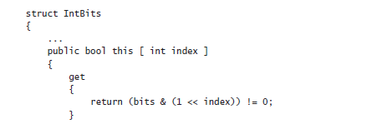
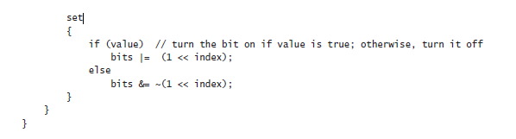
Contd…
Notice the following points:
An indexer is not a method—there are no parentheses containing a parameter, but there are square brackets that specify an index. This index is used to specify which element is being accessed.

Slide 46
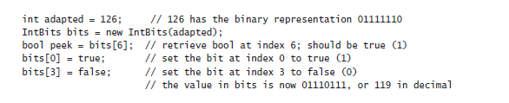
Contd…
All indexers use the this keyword. A class or structure can define at most one indexer (although it can be overloaded and have several implementations), and it is always named this.
Indexers contain get and set accessors just like properties. In this example, the get and set accessors contain the complicated bitwise expressions previously discussed.
The index specified in the indexer declaration is populated with the index value specified when the indexer is called. The get and set accessor methods can read this argument to determine which element should be accessed.
After you have declared the indexer, you can use a variable of type IntBits instead of an int and apply the square bracket notation, as shown in the next example:
This syntax is certainly much easier to understand. It directly and succinctly captures the essence of the problem.

Slide 47
Understanding Indexer Accessors
When you read an indexer, the compiler automatically translates your arraylike code into a call to the get accessor of that indexer. Consider the following example:
bool peek = bits[6];
This statement is converted to a call to the get accessor for bits, and the index argument is set to 6.
Similarly, if you write to an indexer, the compiler automatically translates your arraylike code into a call to the set accessor of that indexer, setting the index argument to the value enclosed in the square brackets. For example:
bits[3] = true;
This statement is converted to a call to the set accessor for bits where index is 3.
As with ordinary properties, the data you are writing to the indexer (in this case, true) is made available inside the set accessor by using the value keyword.
The type of value is the same as the type of indexer itself (in this case, bool).

Slide 48
Contd…
It’s also possible to use an indexer in a combined read/write context. In this case, the get and set accessors are both used. Look at the following statement, which uses the XOR operator (^) to invert the value of the bit at index 6 in the bits variable:
bits[6] ^= true;
This code is automatically translated into the following:
bits[6] = bits[6] ^ true;
This code works because the indexer declares both a get and a set accessor.

Slide 49
Comparing Indexers and Arrays
1) When you use an indexer, the syntax is deliberately very arraylike. However, there are some important differences between indexers and arrays:
2) Indexers can use non-numeric subscripts, such as a string as shown in the following example. Arrays can use only integer subscripts:
public int this [ string name ] { ... } // OK
3) Indexers can be overloaded (just like methods), whereas arrays cannot:
public Name this [ PhoneNumber number ] { ... }
public PhoneNumber this [ Name name ] { ... }
4) Indexers cannot be used as ref or out parameters, whereas array elements can:
IntBits bits; // bits contains an indexer
Method(ref bits[1]); // compile-time error

Slide 50
Indexers in Interfaces
You can declare indexers in an interface. To do this, specify the get keyword, the set keyword, or both, but replace the body of the get or set accessor with a semicolon.
Any class or structure that implements the interface must implement the indexer accessors declared in the interface. For example:
interface IRawInt
{
bool this [ int index ]
{
get;
set;
}
}
struct RawInt : IRawInt
{
... …….
public bool this [ int index ]
{
get { ... }
set { ... }
}
…………....
}

Slide 51
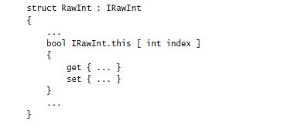
Contd…
If you implement the interface indexer in a class, you can declare the indexer implementations as virtual. This allows further derived classes to override the get and set accessors.
For example:
class RawInt : IRawInt
{
………….....
public virtual bool this [ int index ]
{
get { ... }
set { ... }
}
…………....
}
You can also choose to implement an indexer by using the explicit interface implementation syntax covered in Chapter 12, “Working with Inheritance.” An explicit implementation of an indexer is nonpublic and nonvirtual (and so cannot be overridden). For example:

Slide 52
Using Indexers in a Windows Application
In the following exercise, you will examine a simple phone book application and complete its implementation.
You will write two indexers in the PhoneBook class: one that accepts a Name parameter and returns a PhoneNumber, and another that accepts a PhoneNumber parameter and returns a Name.(The Name and PhoneNumber structures have already been written.)
You will also need to call these indexers from the correct places in the program.
Familiarize yourself with the application
1) Start Microsoft Visual Studio 2015 if it is not already running.
2) Open the Indexers project, located in the \Microsoft Press\Visual CSharp Step By Step\Chapter 16\Windows X\Indexers folder in your Documents folder.
This graphical application enables a user to search for the telephone number for a contact and also find the name of a contact that matches a given telephone number.
3) On the DEBUG menu, click Start Debugging.
The project builds and runs. A form appears, displaying two empty text boxes labeled Name and Phone Number.
The form also contains three buttons: one to add a name/phone number pair to a list of names and phone numbers held by the application, one to find a phone number when given a name, and one to find a name when given a phone number. These buttons currently do nothing.

Slide 53
Contd….
4) Return to Visual Studio 2015 and stop debugging.
5) Display the Name.cs file for the Indexers project in the Code and Text Editor window. Examine the Name structure. Its purpose is to act as a holder for names.
The name is provided as a string to the constructor. The name can be retrieved by using the read-only string property named Text. (The Equals and GetHashCode methods are used for comparing Names when searching through an array of Name values—you can ignore them for now.)
6) Display the PhoneNumber.cs file in the Code and Text Editor window, and examine the PhoneNumber structure. It is similar to the Name structure.
7) Display the PhoneBook.cs file in the Code and Text Editor window, and examine the PhoneBook class.

Slide 54
Contd….
This class contains two private arrays: an array of Name values called names, and an array of PhoneNumber values called phoneNumbers.
The PhoneBook class also contains an Add method that adds a phone number and name to the phone book. This method is called when the user clicks the Add button on the form.
The enlargeIfFull method is called by Add to check whether the arrays are full when the user adds another entry. This method creates two new bigger arrays, copies the contents of the existing arrays to them, and then discards the old arrays.
The Add method is deliberately kept simple and does not check whether a name or phone number has already been added to the phone book.
The PhoneBook class does not currently provide any functionality enabling a user to find a name or telephone number; you will add two indexers to provide this facility in the next exercise.

Slide 55
Introducing Generics
The Problem with the object Type
In Chapter 8, “Understanding Values and References,” you learned how to use the object type to refer to an instance of any class.
You can use the object type to store a value of any type, and you can define parameters by using the object type when you need to pass values of any type into a method.
A method can also return values of any type by specifying object as the return type.
Although this practice is very flexible, it puts the onus on the programmer to remember what sort of data is actually being used and can lead to run-time errors if the programmer makes a mistake.
In this chapter, you will learn about generics, a feature that has been designed to help you prevent this kind of mistake.

Slide 56
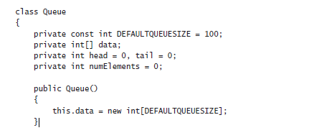
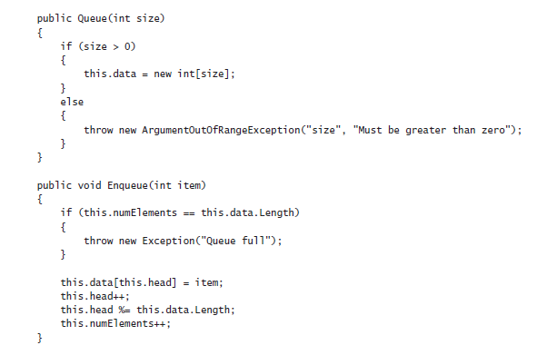
Contd…
To understand generics, it is worth looking in detail at the problem they are designed to solve.
Suppose that you needed to model a first-in, first-out structure such as a queue. You could create a class such as the following:

Slide 57
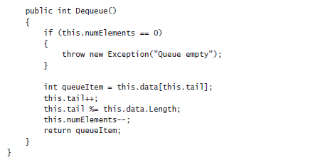
Contd…
This class uses an array to provide a circular buffer for holding the data. The size of this array is specified by the constructor.
An application uses the Enqueue method to add an item to the queue and the Dequeue method to pull an item off the queue.
The private head and tail fields keep track of where to insert an item into the array and where retrieve an item from the array.
The numElements field indicates how many items are in the array.
The Enqueue and Dequeue methods use these fields to determine where to store or retrieve an item from and perform some rudimentary error checking.
An application can create a Queue object and call these methods, as shown in the following code example. Notice that the items are dequeued in the same order that they are enqueued:

Slide 58
Contd…
Queue queue = new Queue(); // Create a new Queue
queue.Enqueue(100);
queue.Enqueue(-25);
queue.Enqueue(33);
Console.WriteLine("{0}", queue.Dequeue()); // Displays 100
Console.WriteLine("{0}", queue.Dequeue()); // Displays -25
Console.WriteLine("{0}", queue.Dequeue()); // Displays 33
Now, the Queue class works well for queues of ints, but what if you want to create queues of strings, or floats, or even queues of more complex types such as Circle (see Chapter 7, “Creating and Managing Classes and Objects”), or Horse, or Whale (see Chapter 12, “Working with Inheritance”)?
The problem is that the way in which the Queue class is implemented restricts it to items of type int, and if you try and enqueue a Horse, you will get a compile-time error:
Queue queue = new Queue();
Horse myHorse = new Horse();
queue.Enqueue(myHorse); // Compile-time error: Cannot convert from Horse to int

Slide 59
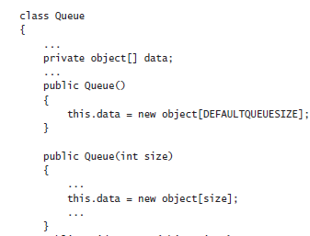
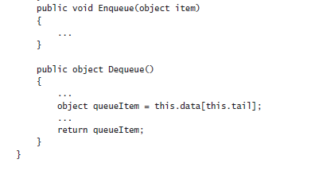
Contd…
One way around this restriction is to specify that the array in the Queue class contains items of type object, update the constructors, and modify the Enqueue and Dequeue methods to take an object parameter and return an object, like this:

Slide 60
Contd…
Remember that you can use the object type to refer to a value or variable of any type.
All reference types automatically inherit (either directly or indirectly) from the System.Object class in the Microsoft .NET Framework (in C#, object is an alias for System.Object).
Now, because the Enqueue and Dequeue methods manipulate objects, you can operate on queues of Circles, Horses, Whales, or any of the other classes you have seen in earlier exercises in this book.
However, it is important to notice that you have to cast the value returned by the Dequeue method to the appropriate type because the compiler will not perform the conversion from the object type automatically:
Queue queue = new Queue();
ouble d = new Double();
queue.Enqueue(myHorse); // Now legal – Horse is an object...Horse dequeued
Horse =(Horse)queue.Dequeue(); // Need to cast object back to a Horse
If you don’t cast the returned value, you will get the compiler error “Cannot implicitly convert type ‘object’ to ‘Horse.’” This requirement to perform an explicit cast denigrates much of the flexibility afforded by the object type. Furthermore, it is very easy to write code such as this:

Slide 61
Contd…
Queue queue = new Queue();
Horse myHorse = new Horse();
queue.Enqueue(myHorse);
………...
Circle myCircle = (Circle)queue.Dequeue(); // run-time error
Although this code will compile, it is not valid and throws a System.InvalidCastException exception at run time.
The error is caused by trying to store a reference to a Horse in a Circle variable when it is dequeued, and the two types are not compatible.
This error is not spotted until run time because the compiler does not have enough information to perform this check at compile time.
The real type of the object being dequeued becomes apparent only when the code runs.
Another disadvantage of using the object approach to create generalized classes and methods is that it can consume additional memory and processor time if the runtime needs to convert an object to a value type and back again.
Consider the following piece of code that manipulates a queue of int values:

Slide 62
Contd…
Queue queue = new Queue();
int myInt = 99;
queue.Enqueue(myInt); // box the int to an object
……………...
myInt = (int)queue.Dequeue(); // unbox the object to an int
The Queue data type expects the items it holds to be objects, and object is a reference type.
Enqueueing a value type, such as an int, requires it to be boxed to convert it to a reference type.
Similarly, dequeueing into an int requires the item to be unboxed to convert it back to a value type. See the sections titled “Boxing” and “Unboxing” in Chapter 8 for more details.
Although boxing and unboxing happen transparently, they add performance overhead because they involve dynamic memory allocations.
This overhead is small for each item, but it adds up when a program creates queues of large numbers of value types.

Slide 63
The Generics Solution
C# provides generics to remove the need for casting, improve type safety, reduce the amount of boxing required, and make it easier to create generalized classes and methods.
Generic classes and methods accept type parameters, which specify the types of objects that they operate on.
In C#, you indicate that a class is a generic class by providing a type parameter in angle brackets, like this:
class Queue<T>
{
……….....
}
The T in this example acts as a placeholder for a real type at compile time.
When you write code to instantiate a generic Queue, you provide the type that should be substituted for T (Circle, Horse, int, and so on).
When you define the fields and methods in the class, you use this same placeholder to indicate the type of these items, like this:

Slide 64
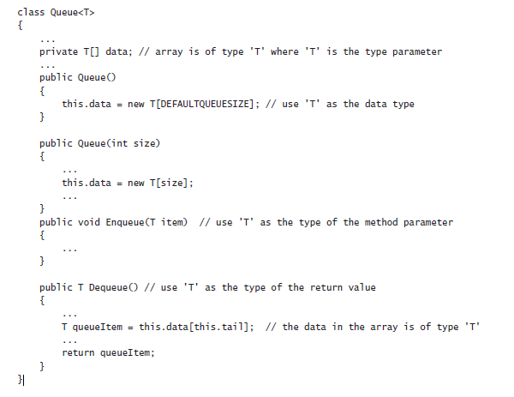
The Generics Solution

Slide 65
Contd…
The type parameter, T, can be any legal C# identifier, although the lone character T is commonly used. It is replaced with the type you specify when you create a Queue object.
The following examples create a Queue of ints, and a Queue of Horses:
Queue<int> intQueue = new Queue<int>();
Queue<Horse> horseQueue = new Queue<Horse>();
Additionally, the compiler now has enough information to perform strict type-checking when you build the application.
You no longer need to cast data when you call the Dequeue method, and the compiler can trap any type mismatch errors early:
intQueue.Enqueue(99);
int myInt = intQueue.Dequeue(); // no casting necessary
Horse myHorse = intQueue.Dequeue(); // compiler error: cannot implicitly convert type 'int' to 'Horse‘
You should be aware that this substitution of T for a specified type is not simply a textual replacement mechanism. Instead, the compiler performs a complete semantic substitution so that you can specify any valid type for T. Here are more examples:

Slide 66
Contd…
struct Person
{
……….....
}
……………...
Queue<int> intQueue = new Queue<int>();
Queue<Person> personQueue = new Queue<Person>();
The first example creates a queue of integers, while the second example creates a queue of Person values.
The compiler also generates the versions of the Enqueue and Dequeue methods for each queue. For the intQueue queue, these methods look like this:
public void Enqueue(int item);
public int Dequeue();
For the personQueue queue, these methods look like this:
public void Enqueue(Person item);
public Person Dequeue();
Contrast these definitions with those of the object-based version of the Queue class shown in the preceding section.
In the methods derived from the generic class, the item parameter to Enqueue is passed as a value type that does not require boxing.
Similarly, the value returned by Dequeue is also a value type that does not need to be unboxed. A similar set of methods is generated for the other two queues.

Slide 67
Contd…
The type parameter does not have to be a simple class or value type. For example, you can create a queue of queues of integers (if you should ever find it necessary) like this:
Queue<Queue<int>> queueQueue = new Queue<Queue<int>>();
A generic class can have multiple type parameters. For example, the generic Dictionary class defined in the System.Collections.Generic namespace in the .NET Framework class library expects two type parameters: one type for keys and another for the values.

Slide 68
Generics vs. Generalized Classes
It is important to be aware that a generic class that uses type parameters is different from a generalized class designed to take parameters that can be cast to different types.
For example, the object-based version of the Queue class shown earlier is a generalized class.
There is a single implementation of this class, and its methods take object parameters and return object types.
You can use this class with ints, strings, and many other types, but in each case, you are using instances of the same class and you have to cast the data you are using to and from the object type.
Compare this with the Queue<T> class. Each time you use this class with a type parameter (such as Queue<int> or Queue<Horse>), you cause the compiler to generate an entirely new class that happens to have functionality defined by the generic class.
This means that Queue<int> is a completely different type from Queue<Horse>, but they both happen to have the same behavior.
You can think of a generic class as one that defines a template that is then used by the compiler to generate new type-specific classes on demand.
The type-specific versions of a generic class (Queue<int>, Queue<Horse>, and so on) are referred to as constructed types, and you should treat them as distinctly different types (albeit ones that have a similar set of methods and properties).

Slide 69
Generics and Constraints
Occasionally, you will want to ensure that the type parameter used by a generic class identifies a type that provides certain methods.
For example, if you are defining a PrintableCollection class, you might want to ensure that all objects stored in the class have a Print method. You can specify this condition by using a constraint.
By using a constraint, you can limit the type parameters of a generic class to those that implement a particular set of interfaces, and therefore provide the methods defined by those interfaces.
For example, if the IPrintable interface defined the Print method, you could create the PrintableCollection class like this:
public class PrintableCollection<T> where T : IPrintable
When you build this class with a type parameter, the compiler checks to ensure that the type used for T actually implements the IPrintable interface, and if not, it stops with a compilation error.

Slide 70
Creating a Generic Class
The System.Collections.Generic namespace in the .NET Framework class library contains a number of generic classes readily available for you.
You can also define your own generic classes, which is what you will do in this section. Before you do this, let’s cover a bit of background theory.
The Theory of Binary Trees
In the following exercises, you will define and use a class that represents a binary tree.
A binary tree is a useful data structure used for a variety of operations, including sorting and searching through data very quickly. Volumes have been written on the minutiae of binary trees.
A binary tree is a recursive (self-referencing) data structure that can either be empty or contain three elements: a datum, which is typically referred to as the node, and two subtrees, which are themselves binary trees.
The two subtrees are conventionally called the left subtree and the right subtree because they are typically depicted to the left and right of the node, respectively.
Each left subtree or right subtree is either empty or contains a node and other subtrees. In theory, the whole structure can continue ad infinitum. The following image shows the structure of a small binary tree.

Slide 71
Contd….
The real power of binary trees becomes evident when you use them for sorting data. If you start with an unordered sequence of objects of the same type, you can construct an ordered binary tree and then walk through the tree to visit each node in an ordered sequence. The algorithm for inserting an item I into an ordered binary tree B is shown here:

Slide 72
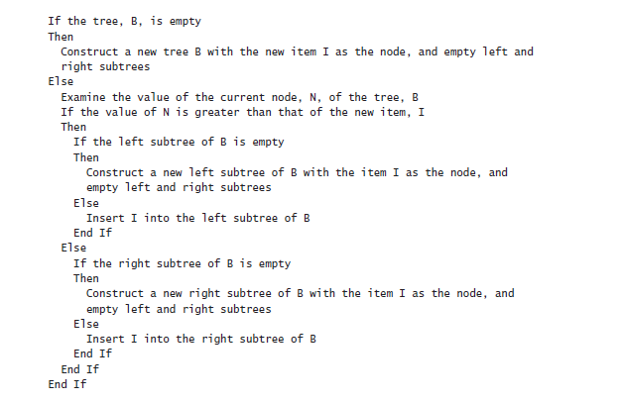
Contd….
Notice that this algorithm is recursive, calling itself to insert the item into the left or right subtree depending on how the value of the item compares with the current node in the tree.

Slide 73
Contd….
If you start with an empty binary tree and an unordered sequence of objects, you can iterate through the unordered sequence, inserting each object into the binary tree by using this algorithm, resulting in an ordered tree.
The next image shows the steps in the process for constructing a tree from a set of five integers.

Slide 74
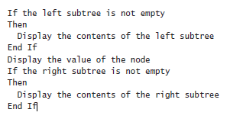
Contd….
After you have built an ordered binary tree, you can display its contents in sequence by visiting each node in turn and printing the value found. The algorithm for achieving this task is also recursive:
The following image shows the steps in the process for outputting the tree. Notice that the integers are now displayed in ascending order.

Slide 75
Contd….

Slide 76
Building a Binary Tree Class by Using Generics
In the following exercise, you will use generics to define a binary tree class capable of holding almost any type of data.
The only restriction is that the data type must provide a means of comparing values between different instances.
The binary tree class is a class that you might find useful in many different applications.
Therefore, you will implement it as a class library rather than as an application in its own right.
You can then reuse this class elsewhere without having to copy the source code and recompile it.
A class library is a set of compiled classes (and other types such as structures and delegates) stored in an assembly.
An assembly is a file that usually has the .dll suffix. Other projects and applications can make use of the items in a class library by adding a reference to its assembly and then bringing its namespaces into scope with using statements.
You will do this when you test the binary tree class.

Slide 77
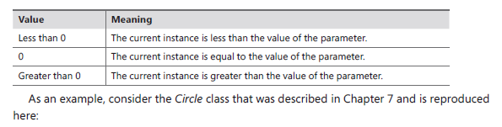
The System.IComparable and System.IComparable<T> Interfaces
The algorithm for inserting a node into a binary tree requires you to compare the value of the node that you are inserting against nodes already in the tree.
If you are using a numeric type, such as int, you can use the <, >, and == operators.
However, if you are using some other type, such as Mammal or Circle described in earlier chapters, how do you compare objects?
If you need to create a class that requires you to be able to compare values according to some natural (or possibly unnatural) ordering, you should implement the IComparable inter-face.
This interface contains a method called CompareTo, which takes a single parameter speci-fying the object to be compared with the current instance and returns an integer that indicates the result of the comparison, as summarized by the following table.

Slide 78
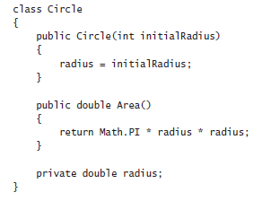
The System.IComparable and System.IComparable<T> Interfaces
You can make the Circle class “comparable” by implementing the System.IComparable inter-face and providing the CompareTo method.
In this example, the CompareTo method compares Circle objects based on their areas. A circle with a larger area is considered to be greater than a circle with a smaller area.

Slide 79
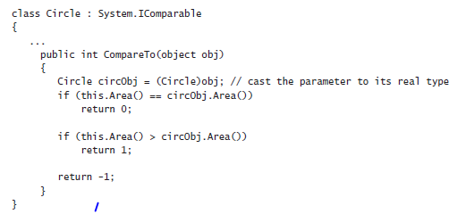
Contd….
If you examine the System.IComparable interface, you will see that its parameter is defined as an object. However, this approach is not type-safe.
To understand why this is so, consider what happens if you try to pass something that is not a Circle to the CompareTo method.
The System.IComparable interface requires the use of a cast to be able to access the Area method. If the parameter is not a Circle but some other type of object, this cast will fail.
However, the System namespace also defines the generic IComparable<T> interface, which contains the following method:
int CompareTo(T other);

Slide 80
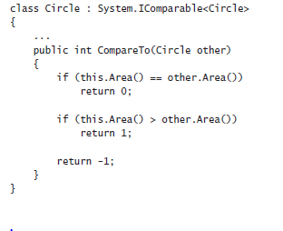
Contd….
Notice that this method takes a type parameter (T) rather than an object and, therefore, it is much safer than the nongeneric version of the interface.
The following code shows how you can implement this interface in the Circle class:
The parameter for the CompareTo method must match the type specified in the interface, IComparable<Circle>.
In general, it is preferable to implement the System.IComparable<T> interface rather than the System.IComparable interface. You can also implement both, just as many of the types in the .NET Framework do.

Slide 81
Create the Tree<TItem> class
1) Start Microsoft Visual Studio 2012 if it is not already running.
2) On the FILE menu, point to New, and then click Project.
3) In the New Project dialog box, in the Templates pane on the left, click Visual C#. In the middle pane, select the Portable Class Library template. In the Name text box, type BinaryTree.
In the Location text box, specify \Microsoft Press\Visual CSharp Step By Step\Chapter 17 under your Documents folder, and then click OK.
4) In the Add Portable Class Library dialog box, accept the default target platforms and click OK.
5) In Solution Explorer, right-click Class1.cs, click Rename, and change the name of the file to Tree.cs. Allow Visual Studio to change the name of the class as well as the name of the file when prompted.
6) In the Code and Text Editor window, change the definition of the Tree class to Tree<TItem>, as shown in bold type in the following code:
public class Tree<TItem>
{
}

Slide 82
Create the Tree<TItem> class
7) In the Code and Text Editor window, modify the definition of the Tree<TItem> class to specify that the type parameter TItem must denote a type that implements the generic IComparable<TItem> interface. The changes are highlighted below in bold.
The modified definition of the Tree<TItem> class should look like this:
public class Tree<TItem> where TItem : IComparable<TItem>
{
}
8) Add three public, automatic properties to the Tree<TItem> class: a TItem property called NodeData and two Tree<TItem> properties called LeftTree and RightTree, as follows in bold type:
public class Tree<TItem> where TItem : IComparable<TItem>
{
public TItem NodeData { get; set; }
public Tree<TItem> LeftTree { get; set; }
public Tree<TItem> RightTree { get; set; }
}

Slide 83
Create the Tree<TItem> class
9) Add a constructor to the Tree<TItem> class that takes a single TItem parameter called nodeValue. In the constructor, set the NodeData property to nodeValue, and initialize the LeftTree and RightTree properties to null, as shown in bold type in the following code:
public class Tree<TItem> where TItem : IComparable<TItem>
{
public Tree(TItem nodeValue)
{
this.NodeData = nodeValue;
this.LeftTree = null;
this.RightTree = null;
}
…………....
}
10) Add a public method called Insert to the Tree<TItem> class as shown in bold type in the following code. This method will insert a TItem value into the tree.
The method definition should look like this:
public class Tree<TItem> where TItem: IComparable<TItem>
{
……...
public void Insert(TItem newItem)
{
}
…………….....
}

Slide 84
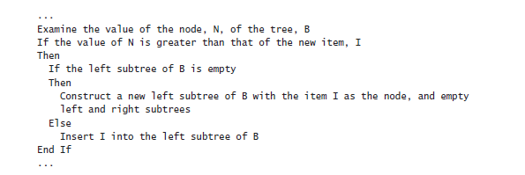
Create the Tree<TItem> class
The Insert method implements the recursive algorithm described earlier for creating an ordered binary tree.
The programmer will have used the constructor to create the initial node of the tree (there is no default constructor), so the Insert method can assume that the tree is not empty.
The part of the algorithm after checking whether the tree is empty is reproduced here to help you understand the code you will write for the Insert method in the following steps:
11) In the Insert method, add a statement that declares a local variable of type TItem, called currentNodeValue. Initialize this variable to the value of the NodeData property of the tree, as shown in bold:

Slide 85
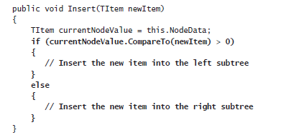
Create the Tree<TItem> class
public void Insert(TItem newItem)
{
TItem currentNodeValue = this.NodeData;
}
12) Add the following if-else statement shown in bold type to the Insert method after the definition of the currentNodeValue variable. This statement uses the CompareTo method of the IComparable<T> interface to determine whether the value of the current node is greater than the new item is:
13) After the // Insert the new item into the left subtree comment, add the following block of code:

Slide 86
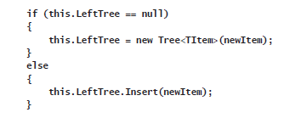
Create the Tree<TItem> class
These statements check whether the left subtree is empty. If so, a new tree is created using the new item and it is attached as the left subtree of the current node; otherwise, the new item is inserted into the existing left subtree by calling the Insert method recursively.
15) Add another public method called WalkTree to the Tree<TItem> class after the Insert method. This method walks through the tree, visiting each node in sequence, and generates a string representation of the data that the tree contains.
The method definition should look like this:
public string WalkTree()
{
}

Slide 87
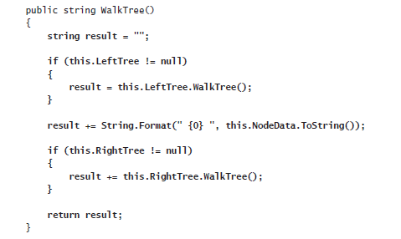
Create the Tree<TItem> class
16) Add the following statements shown in bold to the WalkTree method. These statements implement the algorithm described earlier for traversing a binary tree. As each node is visited, the node value is returned by the method to the string:
On the BUILD menu, click Build Solution. The class should compile cleanly, but correct any errors that are reported and rebuild the solution if necessary.
In the next exercise, you will test the Tree<TItem> class by creating binary trees of integers and strings.

Slide 88
Test the Tree<TItem> class
1) In Solution Explorer, right-click the BinaryTree solution, point to Add, and then click New Project.
2) Add a new project using the Console Application template. Name the project BinaryTreeTest. Set the Location to \Microsoft Press\Visual CSharp Step By Step\Chapter 17 under your Documents folder, and then click OK.
3) Ensure that the BinaryTreeTest project is selected in Solution Explorer. On the PROJECT menu, click Set as Startup Project.
The BinaryTreeTest project is highlighted in Solution Explorer. When you run the application, this is the project that will actually execute.
4) Ensure that the BinaryTreeTest project is still selected in Solution Explorer. On the PROJECT menu, click Add Reference. In the left pane of the Reference Manager - BinaryTreeTest dialog box, click Solution. In the middle pane, select the BinaryTree project, and then click OK.

Slide 89
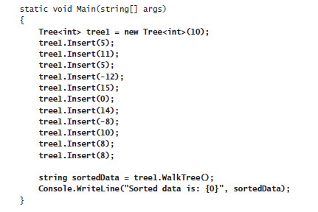
Test the Tree<TItem> class
The BinaryTree assembly is added to the list of references for the BinaryTreeTest project in Solution Explorer.
If you examine the References folder for the BinaryTreeTest project in Solution Explorer, you should see the BinaryTree assembly listed at the top. You will now be able to create Tree<TItem> objects in the BinaryTreeTest project.
5) In the Code and Text Editor window displaying the Program class, add the following using directive to the list at the top of the class:
using BinaryTree;
6) Add the statements in bold type in the following code to the Main method:

Slide 90
Test the Tree<TItem> class
These statements create a new binary tree for holding ints. The constructor creates an initial node containing the value 10.
The Insert statements add nodes to the tree, and the WalkTree method generates a string representing the contents of the tree, which should appear sorted in ascending order when this string is displayed.
7) On the BUILD menu, click Build Solution. Verify that the solution compiles, and correct any errors if necessary.
8) On the DEBUG menu, click Start Without Debugging.
Verify that the program runs and displays the values in the following sequence:
–12 –8 0 5 5 8 8 10 10 11 14 15
9) Press the Enter key to return to Visual Studio 2015.
10) Add the following statements shown in bold type to the end of the Main method in the Program class, after the existing code:

Slide 91
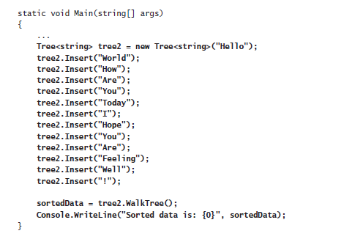
Test the Tree<TItem> class
11) On the BUILD menu, click Build Solution. Verify that the solution compiles, and correct any errors if necessary.
12) On the DEBUG menu, click Start Without Debugging.
Verify that the program runs and displays the integer values as before, followed by the strings in the following sequence:
! Are Are Feeling Hello Hope How I Today Well World You You

Slide 92
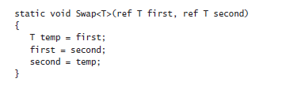
Creating a Generic Method
As well as defining generic classes, you can create generic methods.
With a generic method, you can specify the types of the parameters and the return type by using a type parameter in a manner similar to that used when defining a generic class.
In this way, you can define generalized methods that are type-safe and avoid the overhead of casting (and boxing, in some cases).
Generic methods are frequently used in conjunction with generic classes; you need them for methods that take generic types as parameters or that have a return type that is a generic type.
You define generic methods by using the same type parameter syntax that you use when creating generic classes. (You can also specify constraints.)
For example, the following generic Swap<T> method swaps the values in its parameters. Because this functionality is useful regardless of the type of data being swapped, it is helpful to define it as a generic method:

Slide 93

Contd…
You invoke the method by specifying the appropriate type for its type parameter. The following examples show how to invoke the Swap<T> method to swap over two ints and two strings:

Slide 94
Defining a Generic Method to Build a Binary Tree
In the previous exercise, you created a generic class for implementing a binary tree. The Tree<TItem> class provides the Insert method for adding data items to the tree.
However, if you want to add a large number of items, repeated calls to the Insert method are not very convenient.
In the following exercise, you will define a generic method called InsertIntoTree that you can use to insert a list of data items into a tree with a single method call.
You will test this method by using it to insert a list of characters into a tree of characters.
Write the InsertIntoTree method
Using Visual Studio 2015, create a new project by using the Console Application template. In the New Project dialog box, name the project BuildTree.
Set the Location to \Microsoft Press\Visual CSharp Step By Step\Chapter 17 under your Documents folder, select Create New Solution from the Solution drop-down list, and then click OK.

Slide 95
Contd…
2) On the PROJECT menu, click Add Reference. In the Reference Manager - BuildTree dialog box, click the Browse button (not the Browse tab in the left pane).
3) In the Select the Files to Reference dialog box, move to the folder \Microsoft Press\Visual CSharp Step By Step\Chapter 17\BinaryTree\BinaryTree\bin\Debug under your Documents folder, click BinaryTree.dll, and then click Add.
4) In the Reference Manager – BuildTree dialog box, verify that the BinaryTree.dll assembly is listed and then click OK.
The BinaryTree assembly is added to the list of references shown in Solution Explorer.
5) In the Code and Text Editor window displaying the Program.cs file, add the following using directive to the top of the Program.cs file:
using BinaryTree;
This namespace contains the Tree<TItem> class.
6) Add a method called InsertIntoTree to the Program class after the Main method. This should be a static void method that takes a Tree<TItem> parameter and a params array of TItem elements called data. The tree parameter should be passed by reference, for reasons that will be described in a later step.
The method definition should look like this:

Slide 96
Contd…
static void InsertIntoTree<TItem>(ref Tree<TItem> tree, params TItem[] data)
{
}
7) The TItem type used for the elements being inserted into the binary tree must implement the IComparable<TItem> interface. Modify the definition of the InsertIntoTree method and add the where clause shown in bold type in the following code:
static void InsertIntoTree<TItem>(ref Tree<TItem> tree,
params TItem[] data) where TItem : IComparable<TItem>
{
}
8) Add the following statements shown in bold type to the InsertIntoTree method. These statements iterate through the params list, adding each item to the tree by using the Insert method.
If the value specified by the tree parameter is null initially, a new Tree<TItem> is created; this is why the tree parameter is passed by reference.

Slide 97
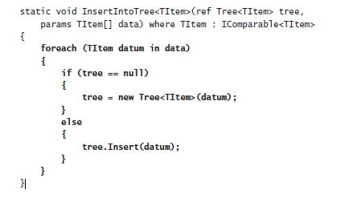
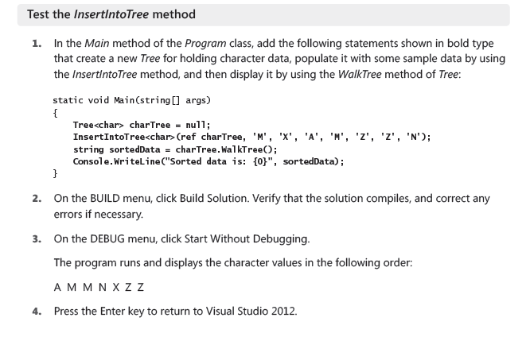
Contd…

Slide 98
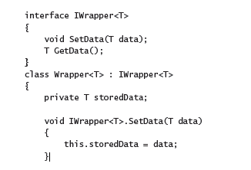

Variance and Generic Interfaces
In Chapter 8, you learned that you can use the object type to hold a value or reference of any other type. For example, the following code is completely legal:
string myString = "Hello";
object myObject = myString;
Remember that in inheritance terms, the String class is derived from the Object class, so all strings are objects.
Now consider the following generic interface and class:

Slide 99
Contd…
The Wrapper<T> class provides a simple wrapper around a specified type.
The IWrapper interface defines the SetData method that the Wrapper<T> class implements to store the data and the GetData method that the Wrapper<T> class implements to retrieve the data.
You can create an instance of this class and use it to wrap a string like this:
Wrapper<string> stringWrapper = new Wrapper<string>();
IWrapper<string> storedStringWrapper = stringWrapper;
storedStringWrapper.SetData("Hello");
Console.WriteLine("Stored value is {0}", storedStringWrapper.GetData());
The code creates an instance of the Wrapper<string> type. It references the object through the IWrapper<string> interface to call the SetData method. (The Wrapper<T> type implements its interfaces explicitly, so you must call the methods through an appropriate interface reference.)
The code also calls the GetData method through the IWrapper<string> interface. If you run this code, it outputs the message “Stored value is Hello”.
Now look at the following line of code:
IWrapper<object> storedObjectWrapper = stringWrapper;

Slide 100
Contd…
This statement is similar to the one that creates the IWrapper<string> reference in the previous code example, the difference being that the type parameter is object rather than string. Is this code legal?
Remember that all strings are objects (you can assign a string value to an object reference, as shown earlier), so in theory this statement looks promising.
However, if you try it, the statement will fail to compile with the message “Cannot implicitly convert type ‘Wrapper<string>‘ to ‘IWrapper<object>‘.”
You can try an explicit cast such as this:
IWrapper<object> storedObjectWrapper = (IWrapper<object>)stringWrapper;
This code compiles, but will fail at run time with an InvalidCastException exception. The problem is that although all strings are objects, the converse is not true. If this statement was allowed, you could write code like this, which ultimately attempts to store a Circle object in a string field:
IWrapper<object> storedObjectWrapper = (IWrapper<object>)stringWrapper;
Circle myCircle = new Circle();
storedObjectWrapper.SetData(myCircle);
The IWrapper<T> interface is said to be invariant. You cannot assign an IWrapper<A> object to a reference of type IWrapper<B>, even if type A is derived from type B. By default, C# implements this restriction to ensure the type safety of your code.

Slide 101
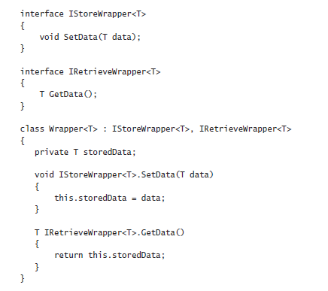
Covariant Interfaces
Suppose you defined the IStoreWrapper<T> and IRetrieveWrapper<T> interfaces shown next in place of IWrapper<T> and implemented these interfaces in the Wrapper<T> class, like this:
Functionally, the Wrapper<T> class is the same as before, except that you access the SetData and GetData methods through different interfaces:

Slide 102
Contd…
Wrapper<string> stringWrapper = new Wrapper<string>();
IStoreWrapper<string> storedStringWrapper = stringWrapper;
storedStringWrapper.SetData("Hello");
IRetrieveWrapper<string> retrievedStringWrapper = stringWrapper;
Console.WriteLine("Stored value is {0}", retrievedStringWrapper.GetData());
Now, is the following code legal?
IRetrieveWrapper<object> retrievedObjectWrapper = stringWrapper;
The quick answer is no, and it fails to compile with the same error as before. But if you think about it, although the C# compiler has deemed that this statement is not type safe, the reasons for assuming this are no longer valid.
The IRetrieveWrapper<T> interface only allows you to read the data held in the IWrapper<T> object by using the GetData method, and it does not provide any way to change the data.
In situations such as this where the type parameter occurs only as the return value of the methods in a generic interface, you can inform the compiler that some implicit conversions are legal and that it does not have to enforce strict type-safety.
You do this by specifying the out keyword when you declare the type parameter, like this:

Slide 103
Contd…
interface IRetrieveWrapper<out T>
{
T GetData();
}
This feature is called covariance. You can assign an IRetrieveWrapper<A> object to an IRetrieveWrapper<B> reference as long as there is a valid conversion from type A to type B, or type A derives from type B. The following code now compiles and runs as expected:
// string derives from object, so this is now legal
IRetrieveWrapper<object> retrievedObjectWrapper = stringWrapper;
You can specify the out qualifier with a type parameter only if the type parameter occurs as the return type of methods.
If you use the type parameter to specify the type of any method parameters, the out qualifier is illegal and your code will not compile.
Also, covariance works only with reference types. This is because value types cannot form inheritance hierarchies. So, the following code will not compile because int is a value type:

Slide 104
Contd…
Wrapper<int> intWrapper = new Wrapper<int>();
IStoreWrapper<int> storedIntWrapper = intWrapper; // this is legal
……....
// the following statement is not legal - ints are not objects
IRetrieveWrapper<object> retrievedObjectWrapper = intWrapper;
Contravariant Interfaces
Contravariance follows a similar principle to covariance except that it works in the opposite direction; it enables you to use a generic interface to reference an object of type B through a reference to type A as long as type B derives type A.
This sounds complicated, so it is worth looking at an example from the .NET Framework class library.
The System.Collections.Generic namespace in the .NET Framework provides an interface called IComparer, which looks like this:
public interface IComparer<in T>
{
int Compare(T x, T y);
}

Slide 105
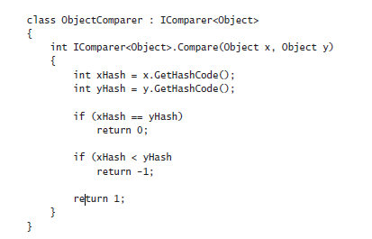
Contd…
A class that implements this interface has to define the Compare method, which is used to compare two objects of the type specified by the T type parameter.
The Compare method is expected to return an integer value: zero if the parameters x and y have the same value, negative if x is less than y, and positive if x is greater than y.
The following code shows an example that sorts objects according to their hash code. (The GetHashCode method is implemented by the Object class.
It simply returns an integer value that identifies the object. All reference types inherit this method and can override it with their own implementations.

Slide 106
Contd…
You can create an ObjectComparer object and call the Compare method through the IComparer<Object> interface to compare two objects, like this:
Object x = ......;
Object y = …...;
ObjectComparer objectComparer = new ObjectComparer();
IComparer<Object> objectComparator = objectComparer;
int result = objectComparator.Compare(x, y);
That’s the boring bit. What is more interesting is that you can reference this same object through a version of the IComparer interface that compares strings, like this:
IComparer<String> stringComparator = objectComparer;
At first glance, this statement seems to break every rule of type safety that you can imagine.
However, if you think about what the IComparer<T> interface does, this approach makes sense.
The purpose of the Compare method is to return a value based on a comparison between the parameters passed in. If you can compare Objects, you certainly should be able to compare Strings, which are just specialized types of Objects.
After all, a String should be able to do anything that an Object can do—that is the purpose of inheritance.

Slide 107
Contd…
This still sounds a little presumptive, however.
How does the C# compiler know that you are not going to perform any type-specific operations in the code for the Compare method that might fail if you invoke the method through an interface based on a different type?
If you revisit the definition of the IComparer interface, you can see the in qualifier prior to the type parameter:
public interface IComparer<in T>
{
int Compare(T x, T y);
}
The in keyword tells the C# compiler that either you can pass the type T as the parameter type to methods or you can pass any type that derives from T.
You cannot use T as the return type from any methods. Essentially, this enables you to reference an object either through a generic interface based on the object type or through a generic interface based on a type that derives from the object type.
Basically, if a type A exposes some operations, properties, or fields, then if type B derives from type A, it must also expose the same operations (which might behave differently if they have been overridden), properties, and fields. Consequently, it should be safe to substitute an object of type B for an object of type A.

