Slide 1
Unit 5
SYSTEM TESTING AND INTERACTION TESTING

Slide 2
Content
Threads, Basic concepts for requirements specification, Finding threads, Structural strategies and functional strategies for thread testing, SATM test threads, System testing guidelines, ASF (Atomic System Functions) testing example. Context of interaction, A taxonomy of interactions, Interaction, composition, and determinism, Client/Server Testing,

Slide 3
Contents
Threads.
Basic concepts for requirements specification.
Finding threads.

Slide 4
Threads
A scenario of normal usage
A system level test case

Slide 5
Threads Possibilities
Four candidate threads in our SATM system
1.Entry of a digit
2.Entry of a pin
3.A simple transaction
4.An session containing two or more transaction.
ASF: An atomic system function is an action that is observable at the system level in terms of port input and output events.

Slide 6
Basic concepts for requirements specification
Data: it is described in terms of variable, records, data structure.
1.Account and PIN
2. System developed in terms of CRUD
3.Relationship between data entities
Action: it have input and output

Slide 7
Device
Every system has port devices.
A port is the point at which an IO device is attached to a system.
Ex: Display screen, Withdraw doors, card and receipt slot.
Event: An event is a system level input that occurs on a port device.

Slide 8
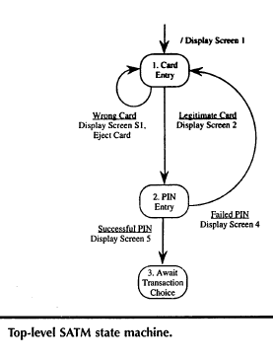
Finding Threads

Slide 9
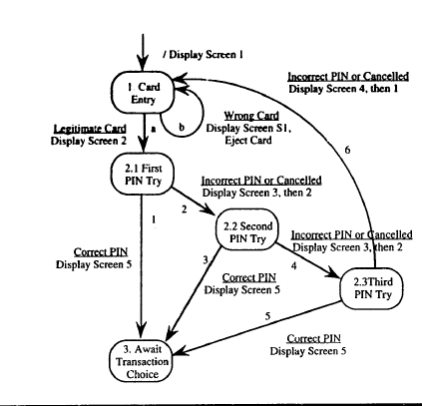

Slide 10
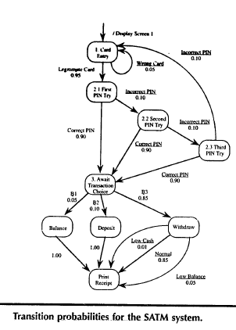

Slide 11
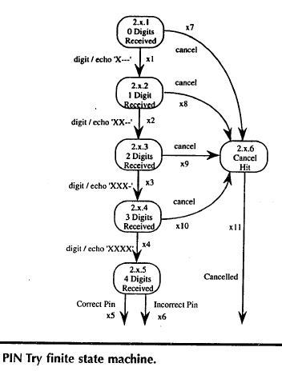

Slide 12
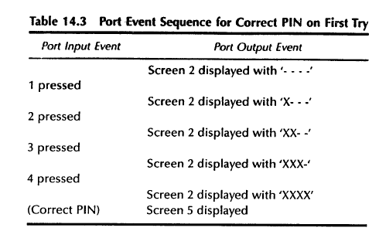

Slide 13
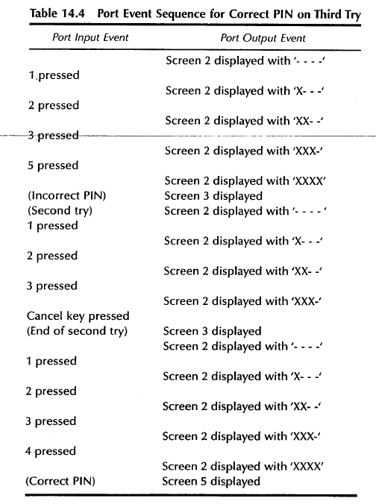

Slide 14
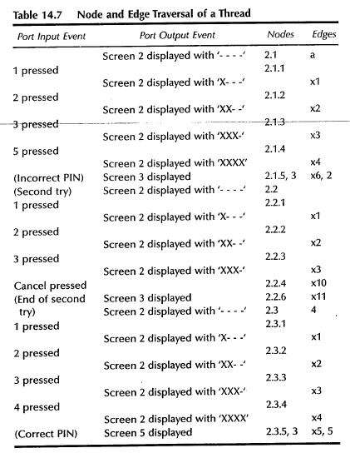

Slide 15
System Testing
Beyond unit testing

Slide 16
System Testing
Of the three levels of testing, system level testing is closest to everyday experience
  We evaluate a product with respect to our expectations
Concerned with the application’s externals
We tend to approach system testing from a functional standpoint rather than from a structural one

Slide 17
System Testing
Functional testing
  Objective: Assess whether the application does what it is supposed to do
  Basis: Behavioral/functional specification
  Test case: A sequence of Atomic System Functions

Slide 18
Atomic System Function
Atomic System Function (ASF): is an action that is observable at the system level in terms of port input and output events.
  It begins with a port input event,
  traverses one or more MM-Paths,
  and terminates with a port output event.

Slide 19
Atomic System Function
When viewed from the system level, there is no compelling reason to decompose an ASF into lower levels of detail (hence the atomicity)
For example in an ATM system
  Digit entry
  Card entry
  Cash dispensing
  PIN entry is probably too big

Slide 20
Atomic System Function
ASFs are an upper limit for MM-Paths:
  MM-Paths should not cross ASF boundaries
ASFs represent the seam between integration and system testing:
  they are the largest item to be tested during integration testing,
  and the smallest item for system testing

Slide 21
ASF Example
A
B
C
MM-path: Interleaved sequence of module exec path and messages
Module exec path: entry-exit path in the same module
Atomic System Function: port input, … {MM-paths}, … port output
Test cases: exercise ASFs

Slide 22
Threads
We view system testing in terms of threads of system level behavior.
Many possible views of a thread:
  a scenario of normal usage
  a system level test case
  a stimulus/response pair
  behavior that results from a sequence of system level inputs
  an interleaved sequence of port input and output events

Slide 23
Threads
  a sequence of transitions in a state machine description of a system
  an interleaved sequence of object messages and method executions
  a sequence of machine instructions
  a sequence of source instructions
  a sequence of atomic system functions

Slide 24
Thread Levels
Threads have distinct levels:
  Unit level thread is understood as an execution-time path of instructions or some path on a flow graph
  Integration level thread is a sequence of MM-paths that implement some atomic function. Usually denoted as a sequence of module executions and messages
  System level thread is a sequence of atomic system functions

Slide 25
Thread Levels
Since ASFs have port events as their inputs and outputs, the sequence of ASFs implies an interleaved sequence of port input/port output events.
Threads provide a unifying view of the three levels of testing:
  Unit testing tests individual functions
  Integration tests examine interaction among units
  System testing examines interactions among ASFs.

Slide 26
Thread Definitions
ASF Graph: a directed graph in which nodes are ASFs and edges represent sequential flow.
Source ASF: an ASF that appears as a source node in the ASF graph of a system
Sink ASF: an ASF that appears as sink node in the ASF graph.
System thread: a path from a source ASF to a sink ASF in the ASF graph of a system.

Slide 27
Basis Concepts for Requirements Specification
The objective is to discuss system testing with respect to a basis set of requirements specification constructs
Every system can be specified in terms of the following requirements specification constructs:
  Data
  Actions
  Ports
  Events
  Threads

Slide 28
Data
For a system that is described in terms of its data,
  the focus is on the information used/created by the system (described in terms of variables, data structures, fields, records, data stores, and files)
The data centered view is also starting point for many OO analysis methods.
Data refers to information that is either initialized, stored, updated or possibly destroyed.

Slide 29
Data
Data-centric systems are often specified in terms of CRUD actions (Create, Retrieve, Update, Delete)
Often, threads can be identified directly from the data model
Also possible to have read-only data (i.e. expected PIN pairs, etc.)
  this must be part of system initialization process
    if not, then there must be threads that create the data.
    Hence read-only data is an indicator of source ASFs.

Slide 30
Actions
Action-centered modeling is the most common requirements specification form.
  Actions have inputs and outputs and these can be either data or port events.
  Actions can also be decomposed in to lower level actions (i.e. typical data flow diagrams).
The input/output view of actions is the basis of functional testing

Slide 31
Devices
Every system has ports (and port devices):
  Sources and destinations of system level inputs and outputs.
If no physical port devices in system, much of system testing can be accomplished by moving the port boundary inward to the logical instances of port events.

Slide 32
Events
Events have some characteristics of data and some of actions
An event is a system level input which occurs at a port.
Events can be inputs to or outputs of actions:
  Can be either discrete or continuous
  Discrete events have a time duration and this can be critical in real-time systems.

Slide 33
Threads
Threads are the least frequently used of the fundamental constructs.
  Since threads are tested, it is up to the tester to find them in the interactions of the data, events, and actions.
Finding Threads
  A finite state machine model of the system is a good starting point to find threads since the paths are easily converted to threads.

Slide 34
Finding Threads
Usually, one deals with a hierarchy of state machines i.e. the card entry state of an ATM may be decomposed into lower levels that deal with details like:
  jammed cards,
  cards that are upside-down,
  checking the card against the list of cards for which service is offered, etc.).

Slide 35
Finding Threads
At this level, states correspond to states of processing, and transitions are caused by logical (rather than port) events.
Once the details of a macro-state are tested we continue with the next macro-state
Within the decomposition of the macro state we need to identify the port input and port output events

Slide 36
Finding Threads
The hierarchy of finite state machines multiplies the number of threads
Ideal to reach a state machine in which transitions are caused by actual port input events, and the actions on transitions are port output events
  Ggenerating the test cases for these threads is mechanical
  Just follow a path of transitions noting the inputs and outputs as they occur along the path

Slide 37
Structural Strategies for Thread Testing
Generating the threads may be easy, but to decide which one to test is complex
Encounter the same path explosion problem at system level as at unit level
Bottom Up Threads
  When state machines are organized in a hierarchy, it is possible to work bottom up

Slide 38
Structural Strategies for Thread Testing
As seen in unit testing, structural testing can be misleading
  The assumption is that path traversal uncovers faults and traversing a variety of paths reduces redundancy
A more serious flaw with these threads is that it is not really possible to execute them “by themselves” due to the hierarchical state machines.

Slide 39
Coverage Metrics
Since FSMs are directed graphs, use same test coverage metrics as at the unit level
The hierarchical relationship indicates that the upper level machine treats the lower level machine as a procedure that is entered and returned from

Slide 40
Coverage Metrics
Two fundamental choices are node coverage and edge coverage
  Node coverage is similar to statement coverage at unit level: bare minimum .
  Edge (state transition) coverage is more acceptable

Slide 41
INTERACTION TESTING
It is a relationship Interacts With among
Data
Events
Threads
Actions
Ports
The relationship is reflexive It is binary relation between Data & events Data & threads Events & threads

Slide 42
Properties of threads and processors
Textbook has two meanings for event Causes confusion, ambiguity, wordy explanations Use two words Use event for instant Use state or activity for duration Occurs between two e
Properties of threads and processors
Threads have duration
They are activities
At one time a processor can execute only one thread Events.
A processor is in a state of executing a thread  Timesharing, multiprocessing interleaves thread execution  Processor changes state for each thread  Here thread durations overlap in time

Slide 43
On one processor events can be simultaneous within the minimum resolution of time-grain markers .
BUT reality (hardware) puts an order on those events – puts them in a sequence.
- As far as we can tell it is a random choice
- At another occurrence the events may be ordered in a different sequence
- That is an essential difficulty of interaction testing

Slide 44
On different processors, events can occur simultaneously
Common events by definition must occur at the same time
Consider a two people colliding – the collision is a common event to the two people (processors)
Synchronous communication for processors start and end with common events

Slide 45
For a single processor
Input and output events occur during thread execution
From the perspective of a thread they cannot occur simultaneously, because they occur at instructions and instructions are executed sequentially
From the perspective of devices port events can be simultaneous
For each port events occur in time sequence

Slide 46
Threads occur only within one processor
Do not cross processor boundaries
Have trans-processor quiescence when threads reach processor boundaries
Analogous to crossing unit boundaries in integration testing

Slide 47
What we want is sane behaviour
This results from considering events to be in a linear sequence
For example synchronous communications takes into account message transmission time Break the communication into events such as Sender starts sending
Receiver starts receiving
Sender ends sending
Receiver ends receiving

Slide 48
Taxonomy of interactions
Static interactions in a single processor system Static interactions in multiprocessor system Dynamic interactions in a single processor system
Dynamic interactions in multiprocessor system

Slide 49
Given two propositions P and Q
They are contraries if both cannot be true
Sub-contraries if both cannot be false
Contradictories if exactly one is true
R is a subaltern of P if the truth of P guarantees the truth of R – i.e. P → R
Rules in a decision table, if correct, are contradictories

Slide 50
Static interactions in a single processor
Analogous to combinatorial circuits
Model with decision tables and unmarked event-driven Petri nets
Telephone system example
Call display and unlisted numbers are contraries
Both cannot be satisfied
Both could be waived

Slide 51
Data-data connectedness – Logical relationships
0-connected
Logically independent
2-connected
Sub-alternation
3-connected – bidirectional
Contraries
Contradictories
Sub-contraries

Slide 52
EXAMPLES
3-connected data-data
When data are deeply related, as in repetition and semaphores
1-connected data-event
Context-sensitive port input events

Slide 53
Dynamic, single processor interactions
Six potential interaction pairs
Combination pairs of
Data
Events Threads
Each interaction can exhibit 4 different graph connectedness attributes
Result is 24 sub-categories for these interactions IAT–31

Slide 54
Thread –thread interaction
Each thread can be represented by an EDPN
The symbolic names of the places and transitions correspond to those in the EDPN for the system
Synonyms in thread nets need to be resolved when they interact

Slide 55
Dynamic Multiprocessor Interactions
Problem here is threads and events occur in parallel
We have concurrent behaviour with a collection of communicating sequential processors (CSP)
Have non-deterministic behaviour
To fully understand need to learn the mathematics of CSP
Without that can only work through an example

Slide 56
Determinism
A system is deterministic if, given its inputs, we can always predict its outputs
A system is deterministic if it always produces the same outputs for a given set of inputs
(For a non-deterministic system it may be difficult to demonstrate different output
Process P chooses non-deterministically at every step whether to engage in event

Slide 57
a or b Process Q chooses non-deterministically once whether to engage only with event a or only with event b
P = (a → P) (b → P) Q = (a → Qa) (b → Qb) Qa = (a → Qa) Qb = (b → Qb)
P is deterministic ↔ ∀s : traces (P) • X ∈ refusals (P / s) ↔ X ∩ (P / s)1 = {} P1 = { e * 〈 e 〉 ∈ traces (P) }  A system is deterministic if at every step the system never refuses to engage in any external event appropriate at that step

Slide 58
P is deterministic ↔ ∀s : traces (P) • X ∈ refusals (P / s) ↔ X ∩ (P / s)1 = {} P1 = { e * 〈 e 〉 ∈ traces (P) }
P1 definition is the set of events in which P may engage on the first step
P / s is the process after P has engaged in all of the events in the trace s
A trace is a record of the external events in which a process has engaged
A refusal is a set of events in which a process refuses to engage

Slide 59
Client Server Complexities
Base system has program components Database, application, presentation (logical output) Have a centralized, fat server and distinction
Entire system includes above items plus Network
GUI May have homogeneous or heterogeneous processors

Slide 60
Client Server Testing
Extend notion of threads beyond an EDPN
CS transaction
A sequence of threads across EDPN boundaries
Client processor --> network --> application -->DBMS back again
Much of the system is stable – e.g. DBMS, existing application Should testing be needed Use functional testing – no source text

