Slide 1
Hirasugar Institute of Technology, Nidasoshi
Department of Computer Science & Engineering
ICT [Information and Communication Technology] Material
on
Management & Entrepreneurships for IT Industry (15CS51)
2018-19 Odd Semester
Dr.Parashuram Baraki
Professor & HOD
Dept of CS&E

Slide 2
Module 2 :Syllabus
Directing and controlling
meaning and nature of directing, leadership styles, motivation theories.
Communication- Meaning and importance, Coordination- meaning and importance
Controlling- meaning, steps in controlling, methods of establishing control

Slide 3

What is Direction ?
DIRECTING is said to be a process in which the managers instruct, guide and oversee the performance of the workers to achieve predetermined goals.
Directing is said to be the heart of management process. Planning, organizing, staffing have got no importance if direction function does not take place.

Slide 4
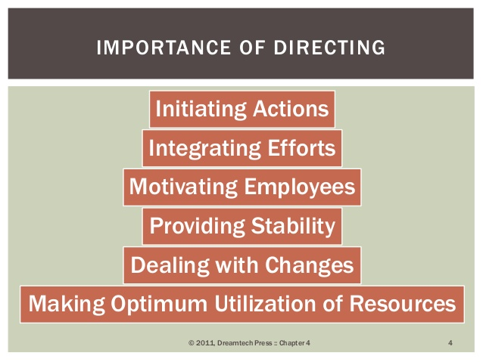

Slide 5
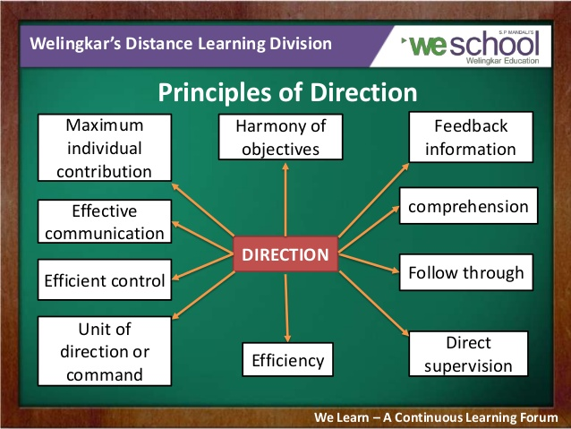

Slide 6
What is Leadership ?
Few Definitions
Leadership is the art of getting someone else to do something you want done because he wants to do it
– Dwight D. Eisenhower
Creates an inspiring vision of the future.
Motivates and inspires people to engage with that vision.
Manages delivery of the vision.
Coaches and builds a team, so that it is more effective at achieving the vision.

Slide 7


Leadership is the capacity and will to rally men and women to a common purpose and the character which inspires confidence- Bernard Montgomerv

Slide 8
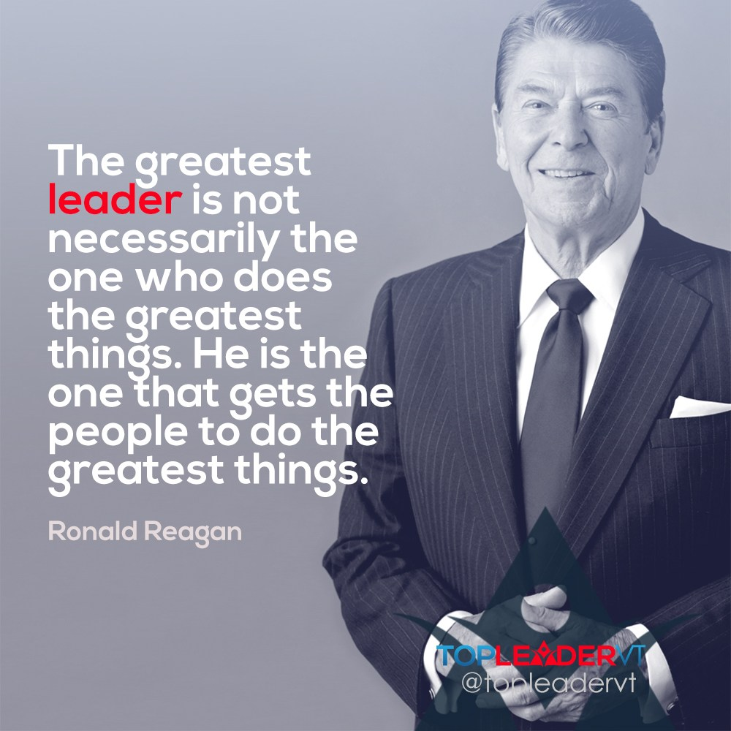

Slide 9
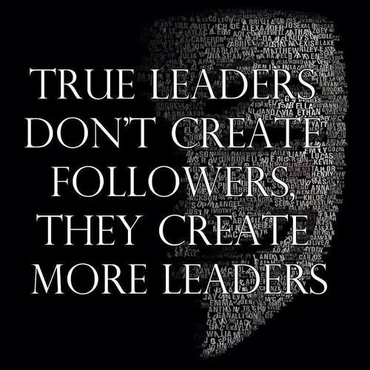

Slide 10

Thought :Experience the Experience: Living in the Present Moment

Slide 11
Leadership Styles
Autocratic
Democratic or Participative
Laissez-faire or free-rein style or Delegative

Slide 12
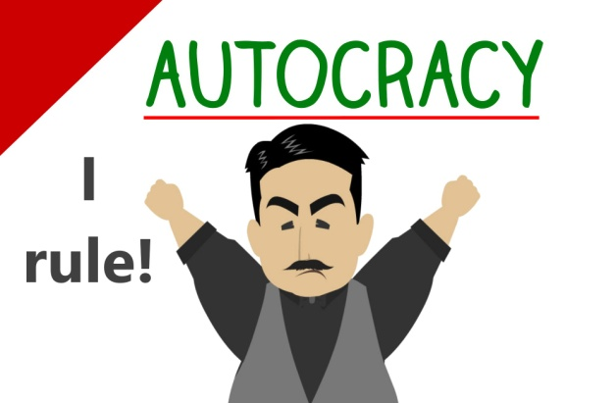
Autocratic
        (Authoritarian )
  1Tells employees what they want done and how to do it (without getting the advice from others).
  2 Works well if you don’t have much time to accomplish goals or if employees are well motivated.
  3 Generally, this style is not a good way to get the best performance from a team.

Slide 13
Democratic
  (Participative style)
  1The leader involves one or more employees/students in the decision making process (to determine what to do and how to do it).
  2 Leader maintains the final decision making authority.
  3 Allows everyone to be part of a team—everyone feels that they have participated and contributed.
  4 Encourages participation, delegates wisely, values group discussion.
  5 Motivates by empowering members to direct themselves and guides w/a loose reign.
  6Negative—everything is a matter of group discussion and decision—doesn’t really lead.

Slide 14

Laissez-Faire or Free Rein Leadership Style or Delegative
  Free Reign (laissez Faire)
  Leader allows employees/students to make the decisions.
  Leader is still responsible for the decisions.
  Employees analyze the situation and determine what needs to be done and how to do it. Leader sets priorities and delegates.
  Leader has little control. Team has little direction or motivation.

Slide 15

Motivation Theories
Achievement requires effort

Slide 16
What is motivation?
What can we learn from the needs theories of motivation?
What is the equity theory of motivation?
What are the insights of the expectancy theory of motivation?
What is the goal-setting theory of motivation?

Slide 17
What is Motivation?
Motivation
  Individual forces that account for the direction, level, and persistence of a person’s effort expended at work.
    Direction - an individual’s choice when presented with a number of possible alternatives.
    Level - the amount of effort a person puts forth.
    Persistence - the length of time a person sticks with a given action.

Slide 18
What is Motivation?
Types of motivation theories
  Content theories
    Focus on individual needs – that is, physiological or psychological deficiencies that we feel a compulsion to reduce or eliminate.
  Process theories
    Focus on the thoughts, or cognitive processes, that take place within the minds of people and that influence their behavior.

Slide 19
What is Motivation?
Motivation Across Cultures
  Motivation theories are largely developed from a North American perspective.
  They are subject to cultural limitations and contingencies.

Slide 20
What can We Learn From the Needs Theories of Motivation?
Maslow’s Hierarchy of Needs Theory
  Identifies five levels of individual needs.
  Assumes that some needs are more important than others and must be satisfied before the other needs can serve as motivators.

Slide 21
Figure :Higher-order and lower-order needs in Maslow’s hierarchy of needs.

Slide 22
What can We Learn From the Needs Theories of Motivation?
Existence:
Desire for physiological and material well-being
Relatedness:
Desire for satisfying interpersonal relationships
Growth:
Desire for continued personal growth and development.
Alderfer’s ERG Theory of Motivation

Slide 23
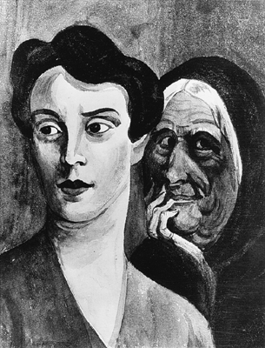
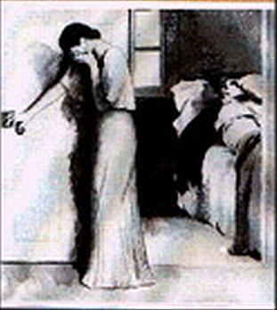
Thematic Apperception Test (T.A.T.)
Premise: We project our unconscious needs through stories
Notes:
What do you see?

Slide 24
What can We Learn From the Needs Theories of Motivation?
Acquired needs theory
  Need for achievement (nAch).
    The desire to do something better or more efficiently, to solve problems, or to master complex tasks.
  Need for affiliation (nAff).
    The desire to establish and maintain friendly and warm relations with others.
  Need for power (nPower).
    The desire to control others, to influence their behavior, or to be responsible for others.

Slide 25
What can We Learn From the Needs Theories of Motivation?
Two-Factor Theory
  Identifies two different factors as primary causes of job satisfaction and job dissatisfaction.
  Also known as the motivator-hygiene theory.

Slide 26
What can We Learn From the Needs Theories of Motivation?
Hygiene factors
  Sources of job dissatisfaction associated with job context.
  Job dissatisfaction results when hygiene factors are poor.
  Improving the hygiene factors only decreases job dissatisfaction.

Slide 27
What can We Learn From the Needs Theories of Motivation?
Motivator factors
  Sources of job satisfaction related to job content.
  Presence or absence of motivators is the key link to satisfaction.

Slide 28
Sources of dissatisfaction and satisfaction in Herzberg’s two-factor theory.
Hygiene Factors
Policies
Work conditions
Motivator Factors
Achievement
Responsibility
Salary
Supervision
Relationships
Status
Recognition
Meaningful work
Advancement
Growth

Slide 29
What is the Equity Theory of Motivation?
Equity Theory
Any perceived inequity
becomes a motivating state
of mind.
  People are motivated to behave in ways that restore equity in situations.
  Foundation of equity is social comparison.

Slide 30
What is the Equity Theory of Motivation?
Individual Outcomes
>
<
Others’ Outcomes
Individual Efforts
Others’ Efforts

Slide 31
What is the Equity Theory of Motivation?
Equity theory prediction:
  Negative inequity.
    Individual feels he/she has received relatively less than others in proportion to work inputs.
  Positive inequity.
    Individual feels he/she has received relatively more than others in proportion to work inputs.

Slide 32
What is the Equity Theory of Motivation?
Equity restoration behaviors.
  Change work inputs.
  Change the outcomes received.
  Leave the situation.
  Change the comparison person.
  Psychologically distort the comparisons.
  Take actions to change the inputs or outputs of the comparison person.

Slide 33
What is the Equity Theory of Motivation?
Steps for managing equity dynamics
  Recognize that equity comparisons are inevitable in the workplace.
  Anticipate felt negative inequities when rewards are given.
  Communicate clear evaluations for any rewards given.
  Communicate an appraisal of performance on which the reward is based.
  Communicate comparison points that are appropriate in the situation

Slide 34
Your experience…
You regularly work longer hours than anyone else in your department. Yet, you do not feel that you are being adequately recognized or rewarded. According to equity theory, you will most likely ….
Increase your efforts by working longer hours.
Ask for a raise or bonus.
Reduce your efforts by decreasing hours.
Frame the situation as a learning experience and beneficial for your future career.

Slide 35

What is the Equity Theory of Motivation?
Organizational justice
  How fair and equitable people view the practices of their workplace.

Slide 36
What is the Equity Theory of Motivation?
Distributive justice - degree to which all people are treated the same under a policy, regardless of race, ethnicity, gender, age or any other demographic characteristic.
Interactional justice - degree to which the people affected by a decision are treated with dignity and respect.
Procedural justice, degree to which the rules and procedures specified by policies are properly followed.

Slide 37
What is the Expectancy Theory of Motivation?
A person’s motivation is a multiplicative function of expectancy, instrumentality, and valence (M = E x I x V).

Slide 38

What is the Expectancy Theory of Motivation?
Expectancy
  effort will yield acceptable performance
Instrumentality
  performance will be rewarded
Valence
  value of the rewards is highly positive

Slide 39
Figure :Victor Vroom’s Expectancy Theory

Slide 40
What is the Expectancy Theory of Motivation?
Motivational implications of expectancy theory.
  Motivation is sharply reduced when, expectancy, instrumentality, or valence approach zero.
  Motivation is high when expectancy and instrumentality are high and valence is strongly positive.

Slide 41
What is the Expectancy Theory of Motivation?
Employees must possess the skills for task
Provide necessary training
Improve Instrumentality
Tie reward to performance
Observe and recognize
Improve Valence
Assure that reward is meaningful
Give rewards that have value
Assign reasonable tasks and goals
Improve Expectancy
Deliver as promised

Slide 42

What is the Goal-Setting Theory of Motivation?
Goal setting
  The process of developing, negotiating, and formalizing the targets or objectives that a person is responsible for accomplishing.

Slide 43
What is the Goal-Setting Theory of Motivation?
Difficult goals are more likely to lead to higher performance than are less difficult ones.
Specific goals are more likely to lead to higher performance than vague or very general ones.

Slide 44
What is the Goal-Setting Theory of Motivation?
Task feedback is likely to motivate people toward higher performance by encouraging the setting of higher performance goals.
Goals are most likely to lead to higher performance when people have the abilities and the feelings of self-efficacy required to accomplish.

Slide 45
What is the Goal-Setting Theory of Motivation?
Goals are most likely to motivate people toward higher performance when they are accepted by the individual, and there is commitment to them.

Slide 46

What is the Goal-Setting Theory of Motivation?
Management by Objectives
  Process of joint goal setting between a supervisor and a subordinate.

Slide 47
Figure: How the management by objectives process works.

Slide 48
Communication- Meaning and importance, Coordination- meaning and importance,
The exchange of information or passing of information, ideas or thought from one person to the other or from one end to the other is communication.
According to McFarland communication is, “a process of meaningful interaction among human beings. More specifically, it is the process by which meanings are perceived and understandings are reached among human beings.”
Newman and summer defined communication as “an exchange of facts, ideas, opinions or emotions by two or more persons.”

Slide 49
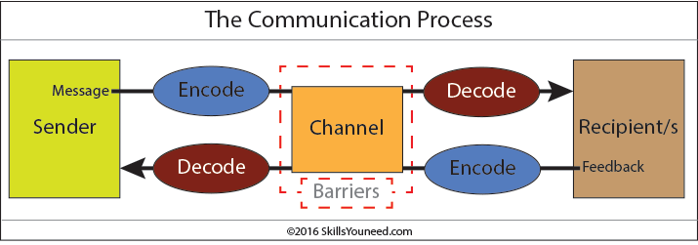

Slide 50
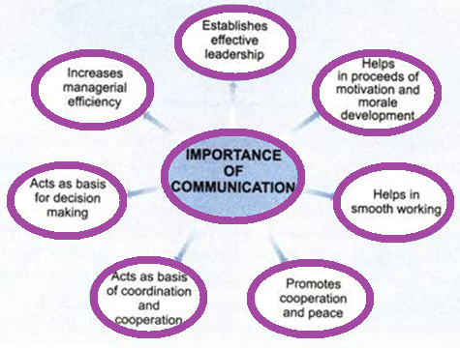
Importance of Communication

Slide 51
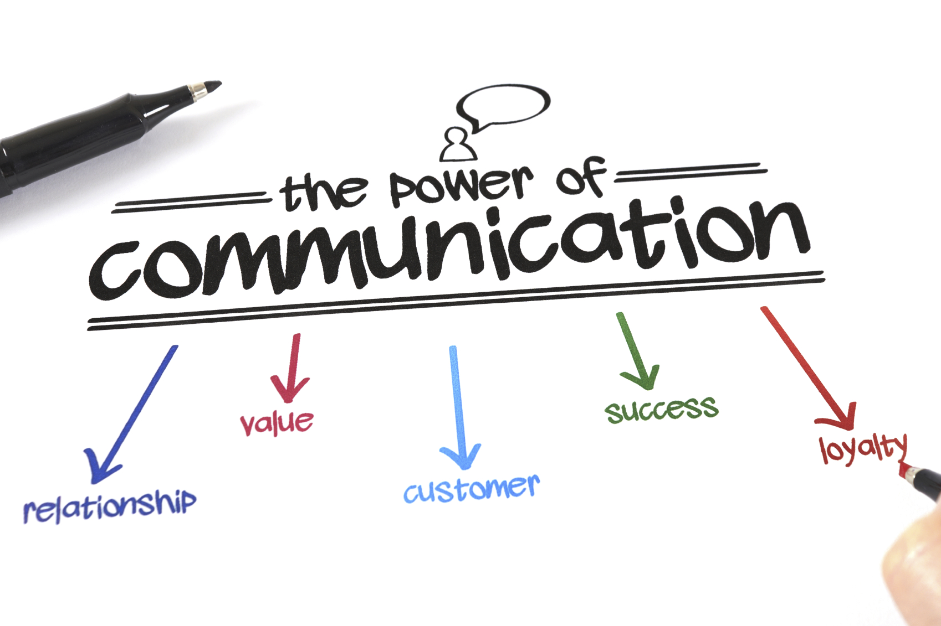

Slide 52
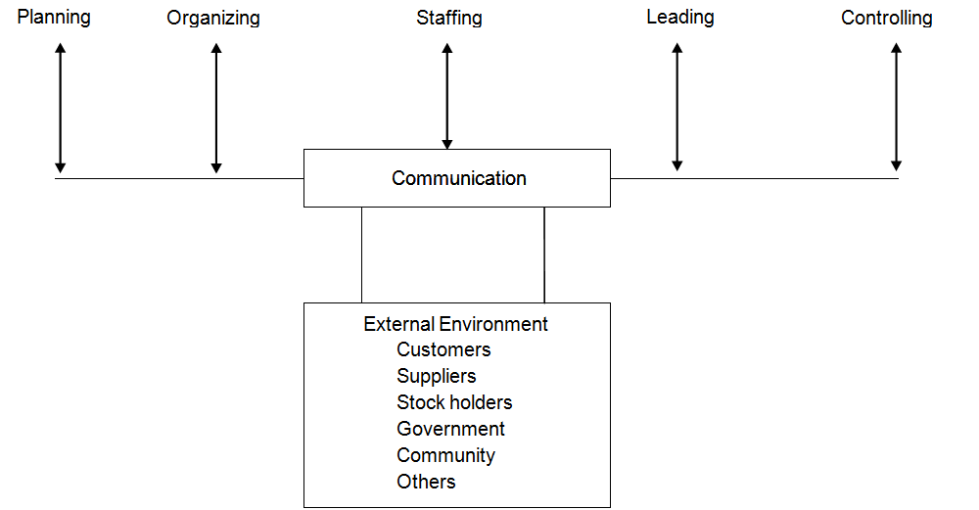
In any Organization

Slide 53
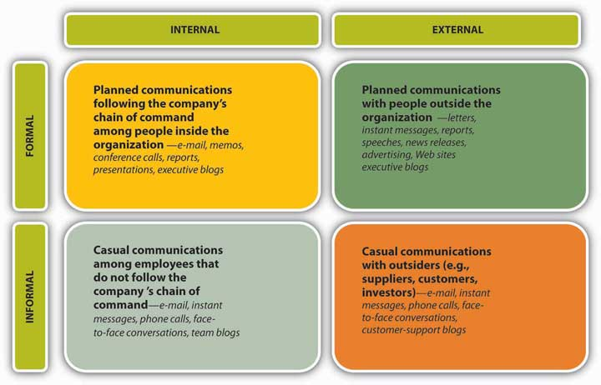
Communication Channels

Slide 54
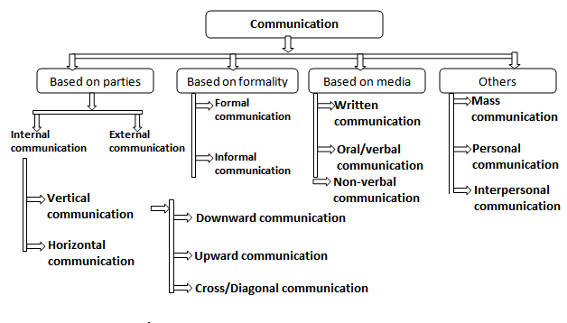

Slide 55
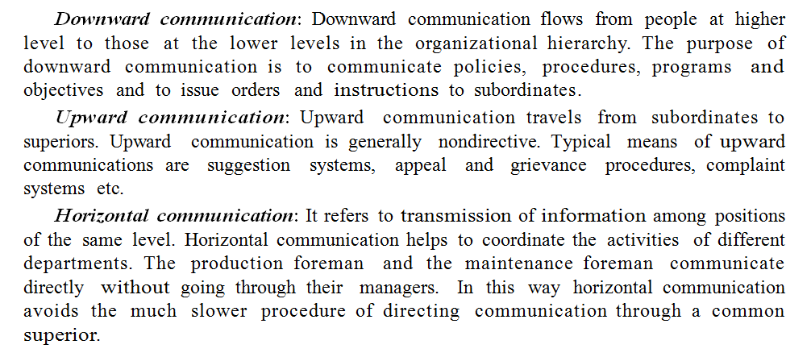
Types of Communication

Slide 56
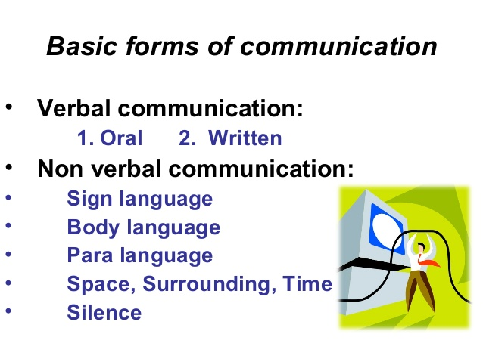

Slide 57

Coordination
According to Terry, “Coordination deals with the task of blending efforts in order to ensure successful attainment of an objective. It is accomplished by means of planning, organizing directing and controlling”.

Slide 58
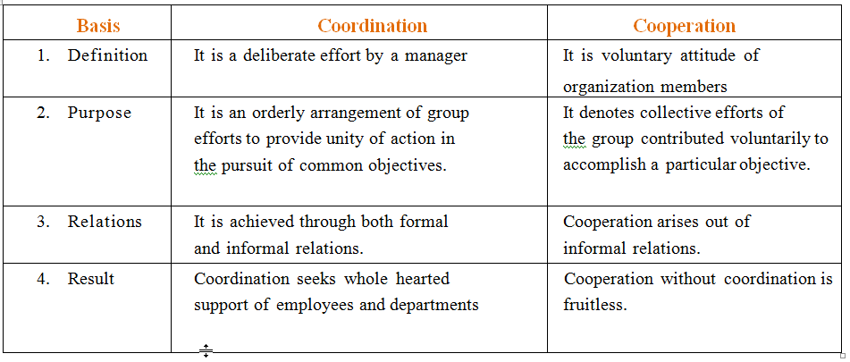

Slide 59
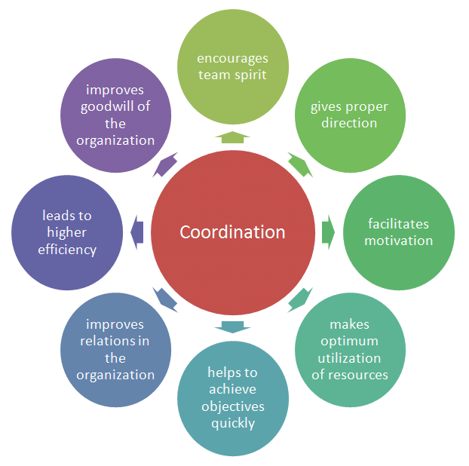

Slide 60
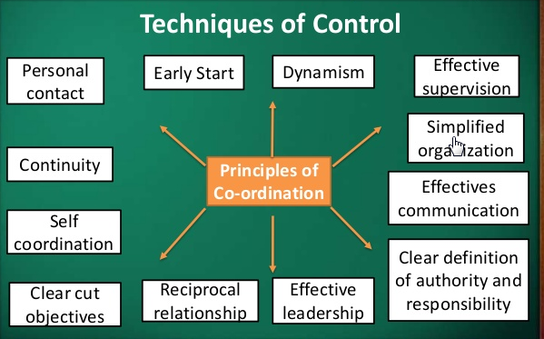

Slide 61
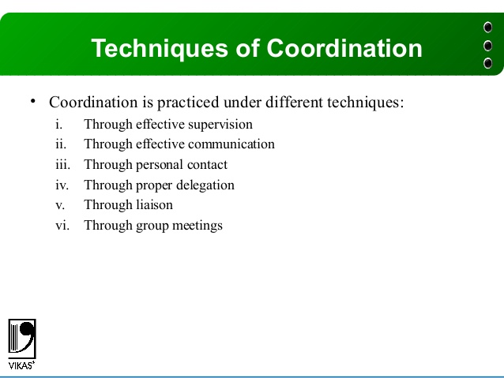

Slide 62
What is Controlling ?
According to E F L Brech, “Control is checking current performance against predetermined standards contained in the plans, with the view to ensuring adequate progress and satisfactory performance”. In the words of George R. Terry, “Controlling is determining what is being accomplished, that is, evaluating the performance and if necessary applying corrective measures so that the performance takes place according to plans

Slide 63
Steps in Controlling
Step 1 Establishment of standards: The first step in control process is the setting up of standards of performance.
A standard acts as a reference line or a basis of actual performance.
Standards should be set precisely and in quantitative terms. Standards expressed in vague or general terms such as “Costs should be reduced” or “rejections should be reduced”

Slide 64
Examples of Standards
Physical standards such as units of production per hour.
Cost standards, such as direct and indirect cost per unit.
Revenue standards such as sales per customer.
Capital standards such as rate of return of capital invested.
Intangible standards such as competency of managers and employees

Slide 65
Step 2 Measuring and comparing actual performance with standards:
The second step in the control process is measuring the actual performance of individuals, group or units and comparing it with the standards.
The quantitative measurement should be done in cases where standards have been set in numerical terms.

Slide 66
Step 3 Taking corrective Action : The final step in the control process is taking corrective action so that deviations may not occur again and the objectives of the organization are achieved. This will involve taking certain decisions by the management like re- planning or redrawing of goals or standards, reassignment or classification of duties. It may also necessitate reforming the process of selection and training of workers

Slide 67
Essentials of Sound Controlling System
Suitable: The control system should be appropriate to the nature and needs of the activity.
Timely and forward looking: The control system should be directed towards future. It should report all the deviations from the standards quickly in order to safeguard the future.

Slide 68
Objective and Comprehensible
Flexible
Economical
Control by Exceptions
Prescriptive and operational:
Acceptable to organization members

Slide 69
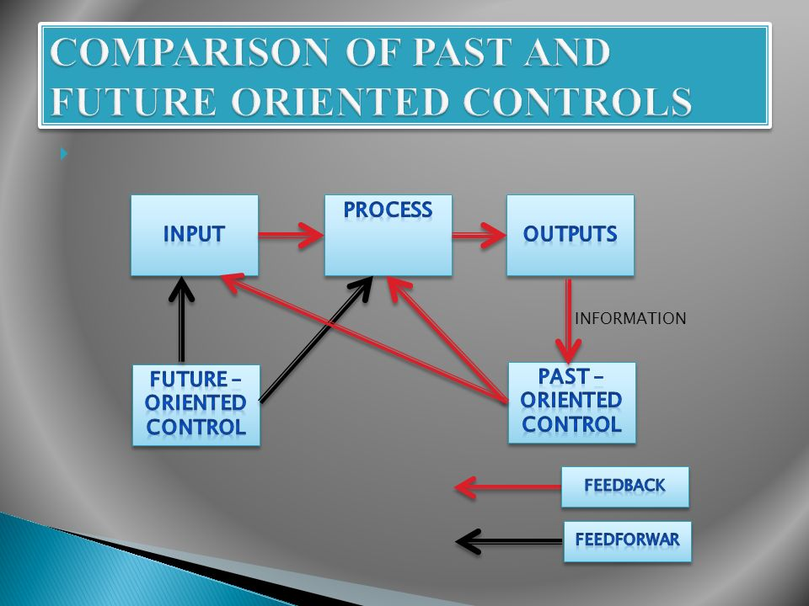
Control Methods
Past Oriented
Future Oriented

