Slide 1
High-Throughput Computing Task Programming/Computing
A task generally represents a program, which might require input files and produce output files as a result of its execution.
Applications are then constituted of a collection of tasks.
Organizing an application in terms of tasks for developing parallel and distributed computing applications.
A task is represented as a distinct unit of code, or a program, that can be separated and executed in a remote runtime environment.

Slide 2
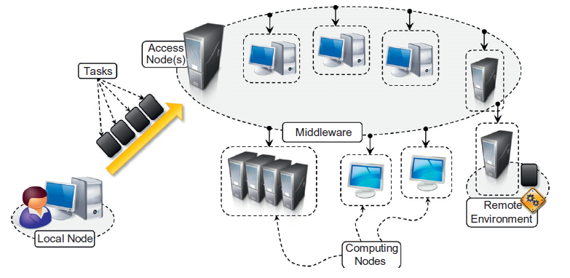
Task computing scenario

Slide 3
Middleware operations
Coordinating and scheduling tasks for execution on a set of remote nodes
Moving programs to remote nodes and managing their dependencies
Creating an environment for execution of tasks on the remote nodes
Monitoring each task’s execution and informing the user about its status
Access to the output produced by the task

Slide 4
Computing categories
High-performance computing(HPC) is the use of distributed computing facilities for solving problems that need large computing power.
The general profile of HPC applications is constituted by a large collection of compute-intensive tasks that need to be processed in a short period of time.
The metrics to evaluate HPC systems are floating-point operations per second(FLOPS), now tera-FLOPS or even peta-FLOPS

Slide 5
Computing categories
High-throughput computing(HTC) is the use of distributed computing facilities for applications requiring large computing power over a long period of time.
Many-task computing (MTC) MTC is similar to HTC, but it concentrates on the use of many computing resources over a short period of time to accomplish many computational tasks.

Slide 6
Frameworks for task computing
Condor is probably the most widely used and long-lived middleware for managing clusters, idle workstations, and a collection of clusters.
Globus Toolkit is a collection of technologies that enable grid computing.
Nimrod/G is a tool for automated modeling and execution of parameter sweep applications (parameter studies) over global computational grids.
Berkeley Open Infrastructure for Network Computing(BOINC) is framework for volunteer and grid computing.

Slide 7
Task-based application models : Embarrassingly parallel applications
embarrassingly parallel applications constitute a collection of tasks that are independent from each other and that can be executed in any order.
Frameworks and tools supporting embarrassingly parallel applications are the Globus Toolkit, BOINC, and Aneka.
E.g: image and video rendering task, scientific applications

Slide 8
Parameter sweep applications
Parameter sweep applications are a specific class of embarrassingly parallel applications for which the tasks are identical in their nature and differ only by the specific parameters used to execute them.
Parameter sweep applications are identified by a template task and a set of parameters.
the template task is often expressed as single file that composes together the commands provided
The commonly avail- able commands are:
Execute. Executes a program on the remote node
Copy. Copies a file to/from the remote node.
Substitute. Substitutes the parameter values with their placeholders inside a file.
Delete. Deletesafile.
For example, Nimrod/G is natively designed to support the execution of parameter sweep applications,
Aneka provides client-based tools for visually composing a template task, defining parameters.
E.g: evolutionary optimization algorithms, weather-forecasting models, computational fluid dynamics applications

Slide 9
Parameter sweep applications: Genetic algorithms

Slide 10
Nimrod/G task template definition

Slide 11
Aneka parameter sweep file
Files required to execute task

Slide 12
Message Passing Interface (MPI) Applications
Message Passing Interface(MPI) is a specification for developing parallel programs that communicate by exchanging messages.
MPI provides developers with a set of routines that:
Manage the distributed environment where MPI programs are executed
Provide facilities for point-to-point communication
Provide facilities for group communication
Provide support for data structure definition and memory allocation
Provide basic support for synchronization with blocking calls

Slide 13
MPI reference architecture

Slide 14
MPI program structure

Slide 15
Workflow applications with task dependencies
A workflow is the automation of a business process, in whole or part, during which documents, information or tasks are passed from one participant (a resource; human or machine) to another for action, according to a set of procedural rules.
structured execution of tasks that have dependencies on each other.
A scientific work flow is generally expressed by a directed a cyclic graph(DAG), which defines the dependencies among tasks or operations.
The nodes on the DAG represent the tasks to be executed in a workflow application; the arcs connecting the nodes identify the dependencies among tasks and the data paths that connect the tasks.

Slide 16
Sample Montage workflow

Slide 17
Workflow technologies Business Process Execution Language (BPEL)

