Slide 1
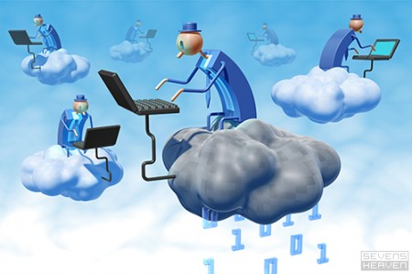

The Next Revolution in IT
The Big Switch in IT
Classical Computing
  Buy & Own
    Hardware, System Software, Applications often to meet peak needs.
  Install, Configure, Test, Verify
  Manage
  ..
  Finally, use it
  $$$$....$(High CapEx)
Cloud Computing
  Subscribe
  Use
  $ - pay for what you use, based on QoS
Every 18 months?

Slide 2
Overview
Computing is being transformed into a model consisting of services that are commoditized and delivered in a manner similar to utilities such as water, electricity, gas, and telephony.
Several computing paradigms, such as grid computing, have promised to deliver this utility computing vision.
Cloud computing is the most recent emerging paradigm promising to turn the vision of “computing utilities” into a reality.
Resources are made available through the Internet and offered on a pay-per-use basis from cloud computing vendors.

Slide 3
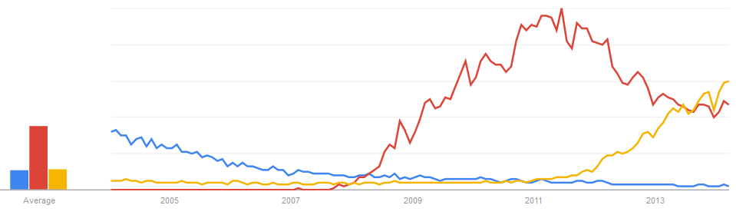
Interest over time
{grid, cloud, big data} computing
Legend:
Grid Computing
Cloud Computing
Big Data

Slide 4
“Computer Utilities” Vision:
Implications of the Internet
1969 – Leonard Kleinrock, Advanced Research Projects Agency Network (ARPANET) project
  “As of now, computer networks are still in their infancy, but as they grow up and become sophisticated, we will probably see the spread of “Computer Utilities”, which, like present electric and telephone utilities, will service individual homes and offices across the country”.
  During the last 44 years, several advances have taken place in both “computing” and “communications” areas that are turning the vision of “Computer Utilities” in to a reality.

Slide 5
computing services will be readily available on demand, just as other utility services such as water, electricity, tele- phone, and gas are available in today’s society.
In addition, consumers no longer need to invest heavily or encounter difficulties in building and maintaining complex IT infrastructure.
users access services based on their requirements without regard to where the services are hosted.
Cloud computing allows renting infrastructure, runtime environments, and services on a pay- per-use basis.
Chief information and technology officers of large enterprises see opportunities for scaling their infrastructure on demand and sizing it according to their business needs.
End users leveraging cloud computing services can access their documents and data anytime, anywhere, and from any device connected to the Internet.

Slide 6
Another view of Cloud Compting
“I don’t care where my servers are, who manages them, where my documents are stored, or where my applications are hosted. I just want them always available and access them from any device connected through Internet. And I am willing to pay for this service for as a long as I need it.”
Web 2.0 technologies play a central role in making cloud computing an attractive opportunity for building computing systems.
Service orientation allows cloud computing to deliver its capabilities.
virtualization confers on cloud computing the necessary degree of customization, control, and flexibility for building production and enterprise systems.

Slide 7
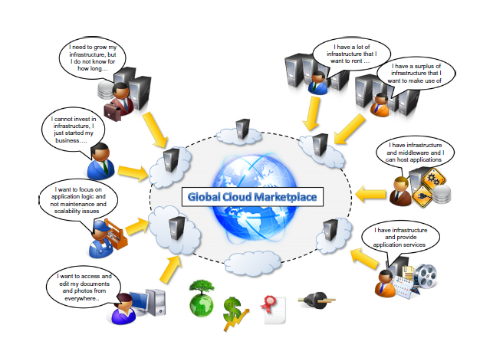
The vision of cloud computing

Slide 8
Defining a cloud
Definition given by Armbrust: “Cloud computing refers to both the applications delivered as services over the Internet and the hardware and system software in the datacenters that provide those services. “
It introduces the concept of everything as a service, mostly referred as XaaS.
U.S. National Institute of Standards and Technology (NIST): “Cloud computing is a model for enabling ubiquitous, convenient, on-demand network access to a shared pool of configurable computing resources (e.g., networks, servers, storage, applications, and services) that can be rapidly provisioned and released with minimal management effort or service provider interaction.”
According to Reese , we can define three criteria:
-The service is accessible via a Web browser (nonproprietary) or a Web services application programming interface (API).
-Zero capital expenditure is necessary to get started.
- You pay only for what you use as you use it.

Slide 9
Defining a cloud
Definition given by Buyya : “A cloud is a type of parallel and distributed system consisting of a collection of interconnected and virtualized computers that are dynamically provisioned and presented as one or more unified computing resources based on service-level agreements established through negotiation between the service provider and consumers. “

Slide 10
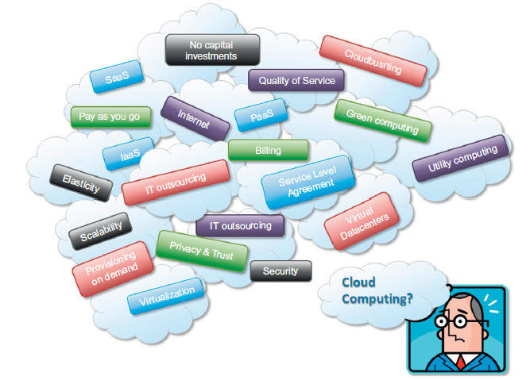
Cloud computing technologies, concepts, & ideas.

Slide 11
Market-Oriented Cloud Architecture: QoS negotiation and SLA-based Resource Allocation

Slide 12



Cloud to expand (lease more resources) with increase in demand
Multi-Clouds

Slide 13
Cloud to shrink (unlease resources) with decrease in demand

Slide 14

Many Cloud Offerings: Good, but new issues-“vendor lock in”, “scaling” across clouds
Nirvanix
Microsoft Azure
Citrix XenServer
Fujitsu
IBM Cloud
Manjrasoft Aneka
Amazon EC2
Google AppEngine
Complex decisions
to make?
Amazon S3

Slide 15
A Closer Look-Practical examples
Large enterprises can off load some of their activities to cloud-based systems. Recently, the New York Times has converted its digital library of past editions into a Web-friendly format.
By renting Amazon EC2 and S3 Cloud resources, the Times performed this task in 36 hours

Slide 16
A Closer Look-Practical examples
Small enterprises and start-ups can afford to translate their ideas into business results more quickly, without excessive up-front costs.
Animoto is a company that creates videos out of images, music, and video fragments submitted by users.
Animoto does not own a single server and bases its computing infrastructure entirely on Amazon Web Services

Slide 17
A Closer Look-Practical examples
System developers can concentrate on the business logic rather than dealing with the complexity of infrastructure management and scalability.
Little Fluffy Toys is a company in London that has developed a widget providing users with information about nearby bicycle rental services.
They used Google App engine.

Slide 18
A Closer Look-Practical examples
End users can have their documents accessible from everywhere and any device.
Apple iCloud is a service that allows users to have their documents stored in the Cloud and access them from any device users connect to it.

Slide 19
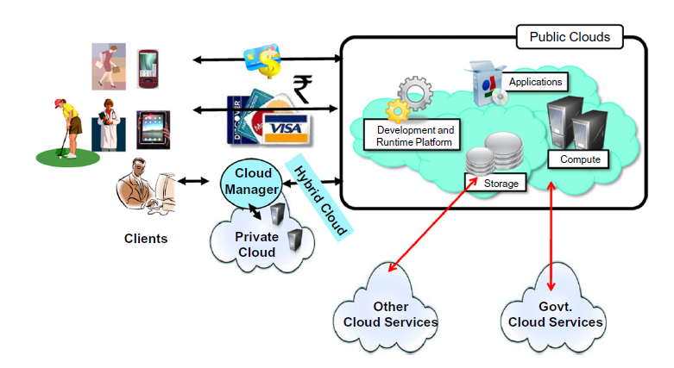
A bird’s-eye view of cloud computing.

Slide 20
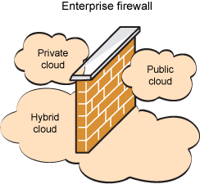
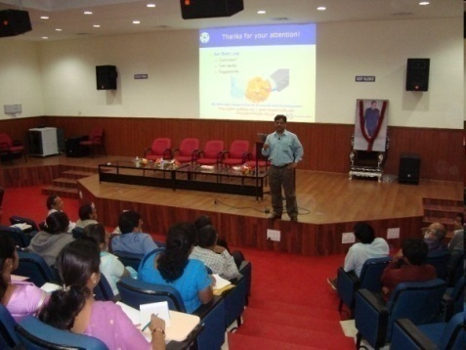

Cloud Deployment Models
Public/Internet Clouds
Private/Enterprise Clouds
Hybrid/Inter
Clouds
3rd party,
multi-tenant Cloud
infrastructure
& services:
* available on
subscription basis
Cloud model run
within a company’s
own Data Center /
infrastructure for
internal and/or
partners use.
Mixed usage of
private and public
Clouds: Leasing public
cloud services
when private cloud
capacity is
insufficient

Slide 21






Cloud Services
Infrastructure as a Service (IaaS)
  CPU, Storage: Amazon.com, Google Compute, ….
Platform as a Service (PaaS)
  Google App Engine, Microsoft Azure, Manjrasoft Aneka..
Software as a Service (SaaS)
  SalesForce.Com
Software as a Service (SaaS)
Platform as a Service (PaaS)
Infrastructure as a Service (IaaS)
....

Slide 22
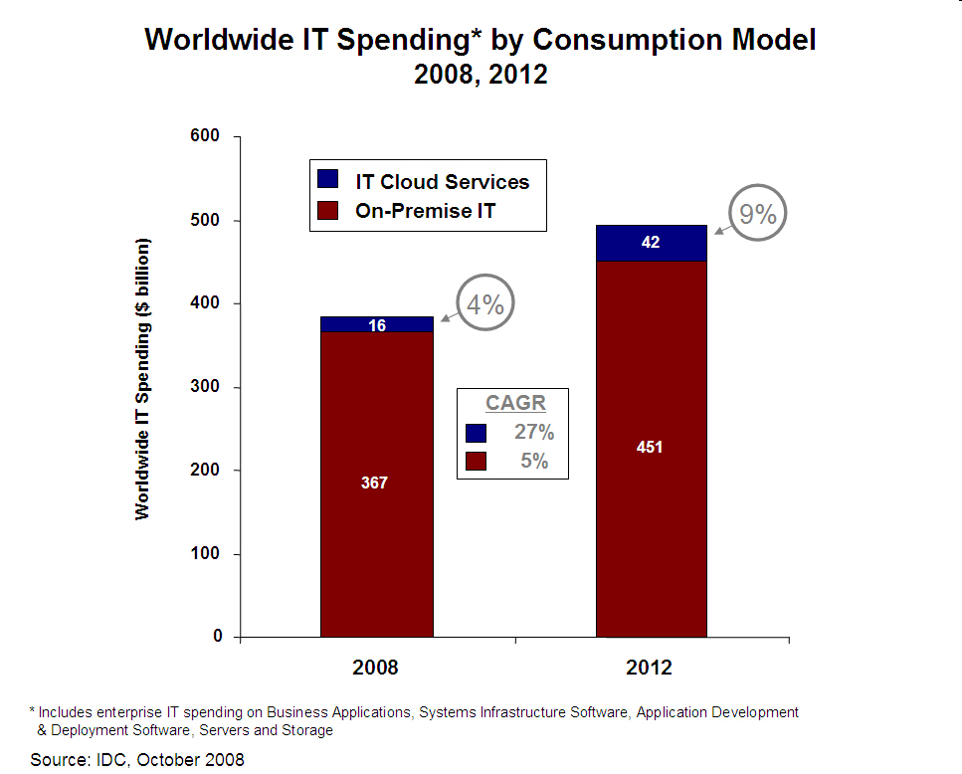
Cloud Biz Potential: a trillion $ business/year by 2020?
2000
600?
1000?
30%
50%
120?
15%
2016
2020?
2020?
Buyya’s Guestimate!

Slide 23
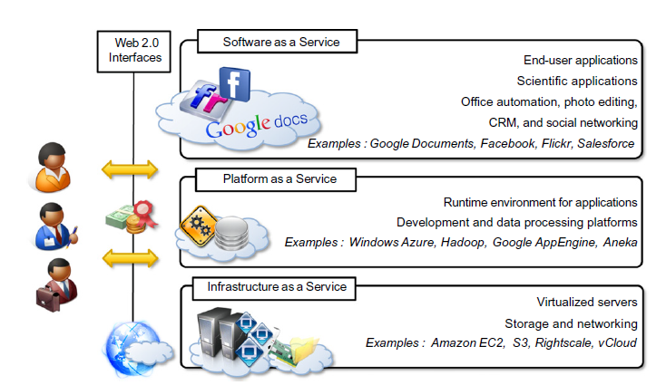
The cloud computing reference model

Slide 24
Characteristics and benefits
No up-front commitments
On-demand access
Nice pricing
Simplified application acceleration and scalability
Efficient resource allocation
Energy efficiency
Seamless creation and use of third-party services

Slide 25
Challenges ahead
Dynamic provisioning of cloud computing services and resources arises. For example, in the Infrastructure-as-a-Service domain, how many resources need to be provisioned, and for how long should they be used, in order to maximize the benefit?
Security in terms of confidentiality, secrecy, and protection of data in a cloud environment is another important challenge.
Different legislation about privacy in different countries may potentially create disputes as to the rights that third parties (including government agencies) have to your data.

Slide 26
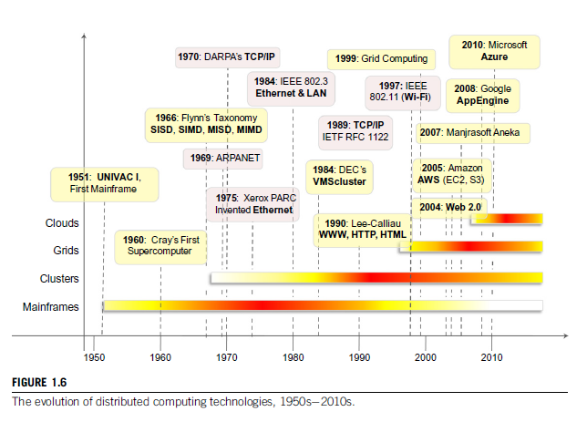
Historical developments

Slide 27
Virtualization
Virtualization is a core technology for cloud computing.
Allowing the abstraction of some of the fundamental elements for computing, such as hard- ware, runtime environments, storage, and networking.
Hardware virtualization: allows the coexistence of different software stacks on top of the same hardware.
Cloud computing solutions to deliver virtual servers on demand, such as Amazon EC2, RightScale, VMware vCloud.
Virtualization technologies are also used to replicate runtime environments for programs.
Applications in the case of process virtual machines (which include the foundation of technologies such as Java or .NET),instead of being executed by the operating system, are run by a specific pro- gram called a virtual machine.

Slide 28
Web 2.0
the Web encompasses a set of technologies and services that facilitate interactive information sharing, collaboration, user-centered design, and application composition.
Transforming the Web into a rich platform for application development and is known as Web 2.0.
Web 2.0 brings interactivity and flexibility into Webpages
XML, Asynchronous Java Script and XML(AJAX), Web Services.
Examples of Web2.0 applications are GoogleDocuments, GoogleMaps, Flickr, Facebook, Twitter, YouTube, de.li.cious, Blogger, and Wikipedia.
rich Internet applications(RIAs) are fundamental for making cloud services accessible to the wider public.

Slide 29
Service-oriented computing
Service orientation is the core reference model for cloud computing systems.
Service-orientedcomputing(SOC) supports the development of rapid, lowcost, flexible, interoperable, and evolvable applications and systems.
A service is supposed to be loosely coupled, reusable, programming language independent, and location transparent.
Services are composed and aggregated into a service-oriented architecture(SOA)

Slide 30
Service-oriented computing introduces and diffuses two important concepts.
Quality of service (QoS) identifies a set of functional and nonfunctional attributes that can be used to evaluate the behavior of a service from different perspectives
These could be performance metrics such as response time, or security attributes, transactional integrity, reliability, scalability, and availability.
QoS requirements are established between the client and the provider via an SLA
Software-as-a-Service: which deliver software services-based solutions across the wide area network from a central datacenter and make them available on a subscription or rental basis.

Slide 31
Utility-oriented computing
services in which resources such as storage, compute power, applications, and infrastructure are packaged and offered on a pay-per-use basis.
Building cloud computing environments : The creation of cloud computing environments encompasses both the development of applications and systems that leverage cloud computing solutions and the creation of frameworks, platforms, and infrastructures delivering cloud computing services.

Slide 32
Application development
Web applications.
Web 2.0 technologies: rich and complex applications, including enterprise applications
resource-intensive applications: These can be either data- intensive or compute-intensive applications.
For example, scientific applications can require huge computing capacity to perform large-scale experiments.

Slide 33
Infrastructure and system development
Distributed computing, virtualization, service orientation, and Web 2.0 form the core technologies enabling the provisioning of cloud services from anywhere on the globe.

Slide 34
Computing platforms and technologies
Amazon web services (AWS) : AWS offers comprehensive cloud IaaS services ranging from virtual compute, storage, and networking to complete computing stacks.
AWS is mostly known for its compute and storage-on- demand services, namely Elastic Compute Cloud(EC2) and Simple Storage Service(S3).
In EC2 it is possible to choose from a large variety of virtual hardware configurations, including GPU and cluster instances.
S3 is organized into buckets; these are containers of objects that are stored in binary form.
Users can store objects of any size, from simple files to entire disk images, and have them accessible from everywhere.

Slide 35
Google AppEngine
Google AppEngine is a scalable runtime environment mostly devoted to executing Web applications.
services include in-memory caching, scalable data store, job queues, messaging.
software development kit (SDK)
The languages currently supported are Python, Java, Node.js, C#, PHP and Go.

Slide 36
Microsoft Azure
Microsoft Azure is a cloud operating system and a platform for developing applications in the cloud.
It provides a scalable runtime environment for Web applications and distributed applications in general.
Currently, there are three types of role: Web role, worker role, and virtual machine role.

Slide 37
Hadoop
Apache Hadoop is an open-source framework that is suited for processing large data sets on commodity hardware.
Hadoop is an implementation of MapReduce, an application programming model developed by Google, which provides two fundamental operations for dataprocessing: map and reduce.
Yahoo!,the sponsor of the Apache Hadoop project

Slide 38
force.com and Salesforce.com
Force.com is a cloud computing platform for developing social enterprise applications.
SalesForce.com, a Software-as-a-Service solution for customer relationship management.
The platform provides complete support for developing applications, from the design of the data layout to the definition of business rules and workflows and the definition of the user interface.

Slide 39
Manjrasoft Aneka
Manjrasoft Aneka is a cloud application platform for rapid creation of scalable applications and their deployment on various types of clouds in a seamless and elastic manner.
It supports a collection of programming abstractions for developing applications and a distributed runtime environment that can be deployed on heterogeneous hardware (clusters, networked desktop computers, and cloud resources).
Developerscanchoosedifferentabstractionstodesigntheirapplication: tasks, distributed threads, and map-reduce.
Services manage most of the activities happening at runtime: scheduling, execution, accounting, billing, storage, and quality of service.

Slide 40
Virtualization
Virtualization is a large umbrella of technologies and concepts that are meant to provide an abstract environment—whether virtual hardware or an operating system—to run applications.
virtualization is often synonymous with hardware virtualization, which plays a fundamental role in efficiently delivering Infrastructure-as-a-Service (IaaS) solutions for cloud computing.

Slide 41
Why virtualization?
Increased performance and computing capacity: supercomputers can provide immense compute power that can accommodate the execution of hundreds or thousands of virtual machines.
Underutilized hardware and software resources.
Lack of space.
Greening initiatives.
Rise of administrative costs.

Slide 42
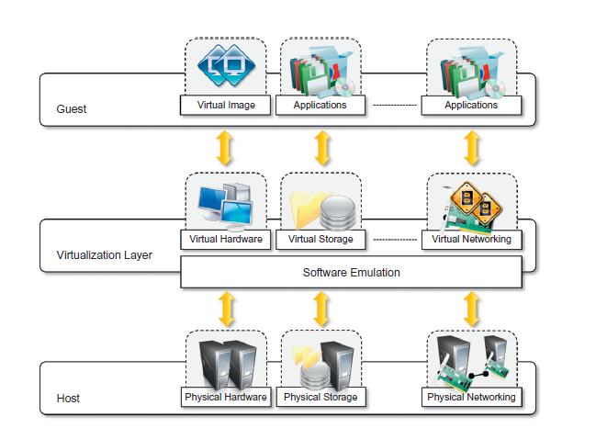
Characteristics of virtualized environments

Slide 43
Increased security :preventing some harmful operations from being performed
Resources exposed by the host can then be hidden or simply protected from the guest.
sensitive information that is contained in the host can be naturally hidden without the need to install com- plex security policies.
Both the JVM and the .NET runtime provide extensive security policies for customiz- ing the execution environment of applications.

Slide 44
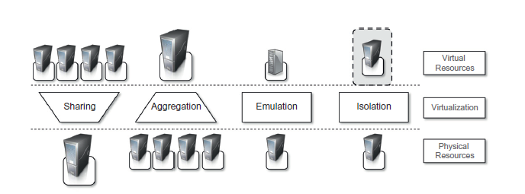
Managed execution:

Slide 45
Performance tuning :easier to control the performance of the guest by finely tuning the properties of the resources exposed through the virtual environment.
Portability: In the case of a hardware virtualization solution, the guest is packaged into a virtual image that, in most cases, can be safely moved and executed on top of different virtual machines. (JVM or the .NET runtime)

Slide 46
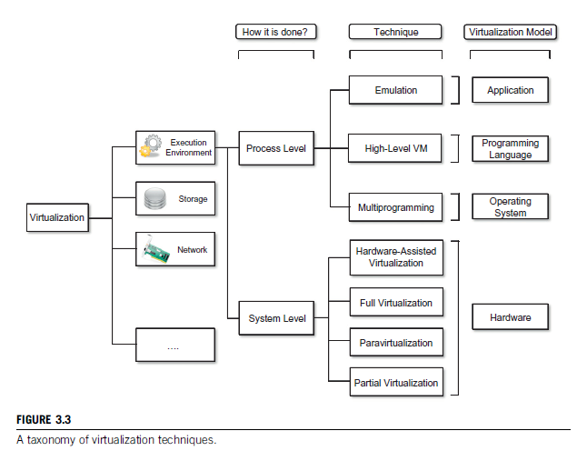
Taxonomy of virtualization techniques

Slide 47
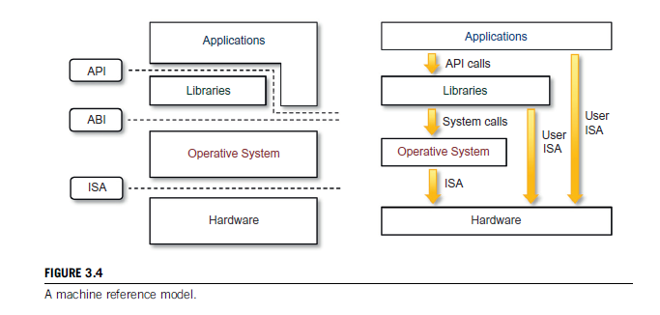
Machine reference model

Slide 48
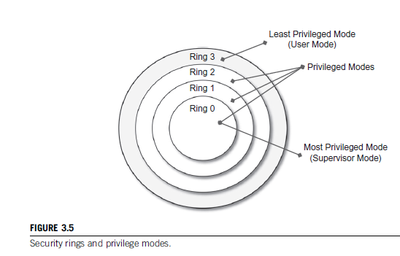
Security rings and privilege modes

Slide 49
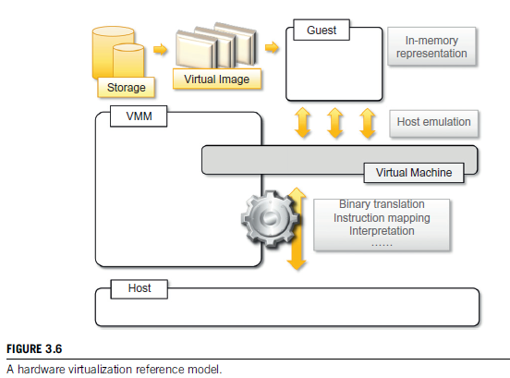
Hardware-level virtualization

Slide 50
Hypervisors
A fundamental element of hardware virtualization is the hypervisor, or virtual machine manager (VMM).
The hypervisor is generally a program or a combination of software and hardware that allows the abstraction of the underlying physical hardware.
It recreates a hardware environment in which guest operating systems are installed.
There are two major types of hypervisor: Type I and Type II.
Type I hypervisors run directly on top of the hardware.
Therefore, they take the place of the operating systems and interact directly with the ISA interface exposed by the underlying hardware.
This type of hypervisor is also called a native virtual machine since it runs natively on hardware.

Slide 51
Type II hypervisors require the support of an operating system to provide virtualization services.
This means that they are programs managed by the operating system, which interact with it through the ABI and emulate the ISA of virtual hardware for guest operating systems.
This type of hypervisor is also called a hosted virtual machine since it is hosted within an operating system.

Slide 52
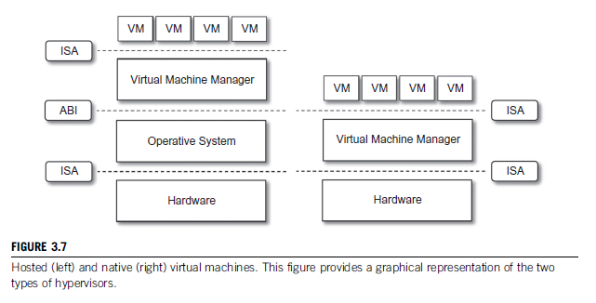

Slide 53
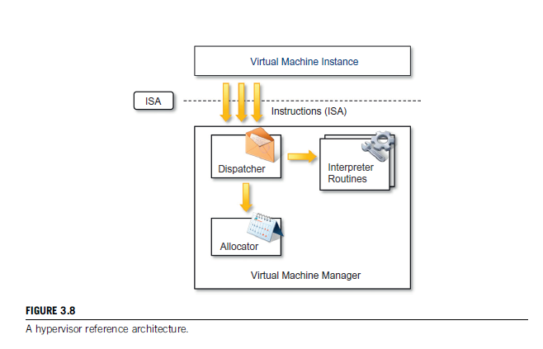
Virtual machine manager

Slide 54
Three properties have to be satisfied:
Equivalence. A guest running under the control of a virtual machine manager should exhibit the same behavior as when it is executed directly on the physical host.
Resource control. The virtual machine manager should be in complete control of virtualized resources.
Efficiency. A statistically dominant fraction of the machine instructions should be executed without intervention from the virtual machine manager.

Slide 55
Hardware virtualization techniques
Hardware-assisted virtualization:
  hardware provides architectural support for building a virtual machine manager able to run a guest operating system in complete isolation.
  This technique was originally introduced in the IBM System/370.
  E.g: x86-64 bit architecture introduced with IntelVT , AMD V
Full virtualization:
  Full virtualization refers to the ability to run a program, most likely an operating system, directly on top of a virtual machine and without any modification, as though it were run on the raw hardware.
  The advantage of full virtualization is complete isolation, which leads to enhanced security, ease of emulation of different architectures.
Paravirtualization:
  transparent virtualization solution that allows implementing thin virtual machine managers.
  E.g: VMWare, TRANGO, WindRiver, XtratuM
Partial virtualization: Partial virtualization provides a partial emulation of the underlying hardware, thus not allowing the complete execution of the guest operating system in complete isolation.

Slide 56
Operating system-level virtualization
Operating system-level virtualization offers the opportunity to create different and separated execution environments for applications that are managed concurrently.
there is no virtual machine manager or hypervisor, and the virtualization is done within a single operating system, where the OS kernel allows for multiple isolated user space instances.
The kernel is also responsible for sharing the system resources among instances.
E.g: FreeBSD Jails, IBM Logical Partition (LPAR), SolarisZones and Containers, Parallels Virtuozzo Containers, OpenVZ, iCore Virtual Accounts, Free Virtual Private Server (FreeVPS).

Slide 57
Programming language-level virtualization
Programming language-level virtualization is mostly used to achieve ease of deployment of applications, managed execution, and portability across different platforms and operating systems.
It consists of a virtual machine executing the byte code of a program, which is the result of the compilation process.
At runtime, the byte code can be either interpreted or compiled on the fly against the underlying hardware instruction set.
E.g: Java, Python, Groovy, Ruby, .NET Framework

Slide 58
Application-level virtualization
Application-level virtualization is a technique allowing applications to be run in runtime environments that do not natively support all the features required by such applications.
applications are not installed in the expected runtime environment but are run as though they were.
Such emulation is performed by a thin layer—a program or an operating system component that is in charge of executing the application.
Interpretation. In this technique every source instruction is interpreted by an emulator for executing native ISA instructions, leading to poor performance.
Binary translation. In this technique every source instruction is converted to native instructions with equivalent functions.
E.g: Application virtualization : Wine

Slide 59
Storage virtualization
Storage virtualization is a system administration practice that allows decoupling the physical organization of the hardware from its logical representation.
Using this technique, users do not have to be worried about the specific location of their data, which can be identified using a logical path.
E.g: storage area networks(SANs): use a network-accessible device through a large band width connection to provide storage facilities.

Slide 60
Network virtualization
Network virtualization combines hardware appliances and specific software for the creation and management of a virtual network.
Network virtualization can aggregate different physical networks into a single logical network(external network virtualization)
Provide network-like functionality to an operating system partition(internal network virtualization).
The result of external network virtualization is generally a virtual LAN(VLAN).
Internal network virtualization is generally applied together with hardware and operating system-level virtualization.
The guest can share the same net- work interface of the host and use Network Address Translation (NAT) to access the network.

Slide 61
Desktop virtualization
Desktop virtualization abstracts the desktop environment available on a personal computer inorder to provide access to it using a client/server approach.
Sun Virtual Desktop Infrastructure (VDI), Parallels Virtual Desktop Infrastructure (VDI), Citrix Xen Desktop..

Slide 62
Virtualization and cloud computing
Virtualization in cloud computing allows the customization, security, isolation, and manageability that are fundamental for delivering IT services on demand.
Virtualization technologies are primarily used to offer configurable computing environments and storage.
Hardware (Infrastructure-as-a-Service) and programming language(Platform-as-a-Service) virtualization are the techniques adopted in cloud computing systems.

Slide 63
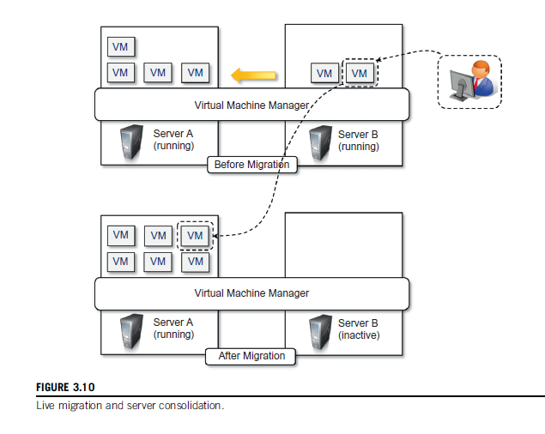
server consolidation virtual machine migration

Slide 64
Pros and cons of virtualization
Pros
Managed execution and isolation: building secure and controllable computing environments.
Portability:
more efficient use of resources.

Slide 65
Cons
Performance degradation: Since virtualization interposes an abstraction layer between the guest and the host, the guest can experience increased latencies.
Inefficiency and degraded user experience
Security holes and new threats

Slide 66
Xen: paravirtualization
Xen is an open-source initiative implementing a virtualization platform based on paravirtualization.
Xen-based technology is used for either desktop virtualization or server virtualization.
Xen Cloud Platform (XCP)
Xen Hypervisor, which constitutes the core technology of Xen.

Slide 67
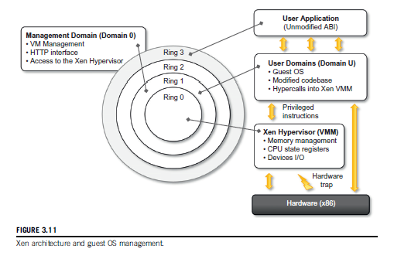
Architecture of Xen

Slide 68
VMware: full virtualization
VMware’s technology is based on the concept of full virtualization, where the underlying hardware is replicated and made available to the guest operating system, which runs unaware of such abstraction layers and does not need to be modified.
VMware implements full virtualization either in the desktop environment, by means of Type II hypervisors, or in the server environment, by means of Type I hypervisors.

Slide 69
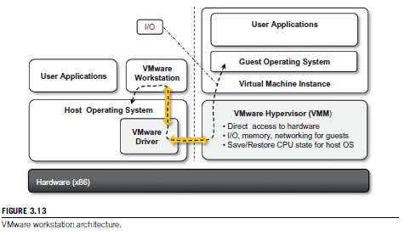
End-User (Desktop) Virtualization

Slide 70
VMware Player is a reduced version of VMware Workstation that allows creating and playing virtual machines in a Windows or Linux operating environment.
VMware ACE, a similar product to VMware Workstation, creates policy-wrapped virtual machines for deploying secure corporate virtual environments on end-user computers.
VMware ThinApp is a solution for application virtualization.

Slide 71
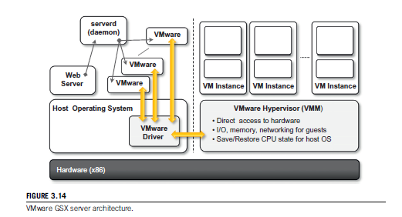
Server Virtualization

Slide 72
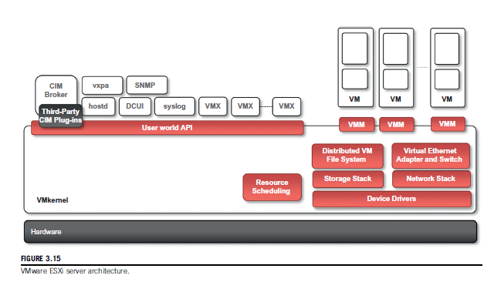
Common Information model (CIM)
Direct Client User Interface ( DCUI)

Slide 73
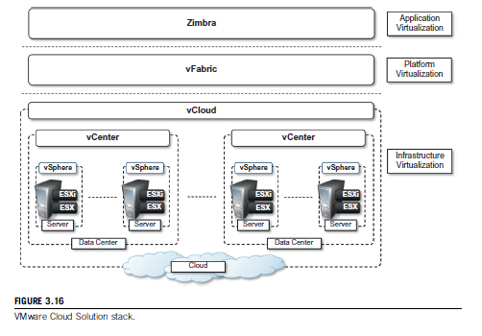

Slide 74
Microsoft Hyper-V
Hyper-V is an infrastructure virtualization solution developed by Microsoft for server virtualization.
Hyper-V is currently shipped as a component of Windows Server 2008 R2.
it uses a hypervisor-based approach to hardware virtualization.

Slide 75
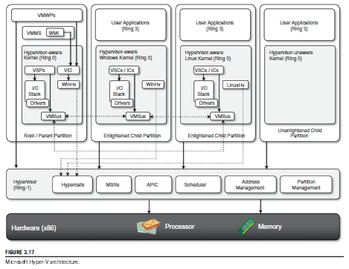
Memory Service Routine, Advanced Programmable Interrupt Controller

Slide 76
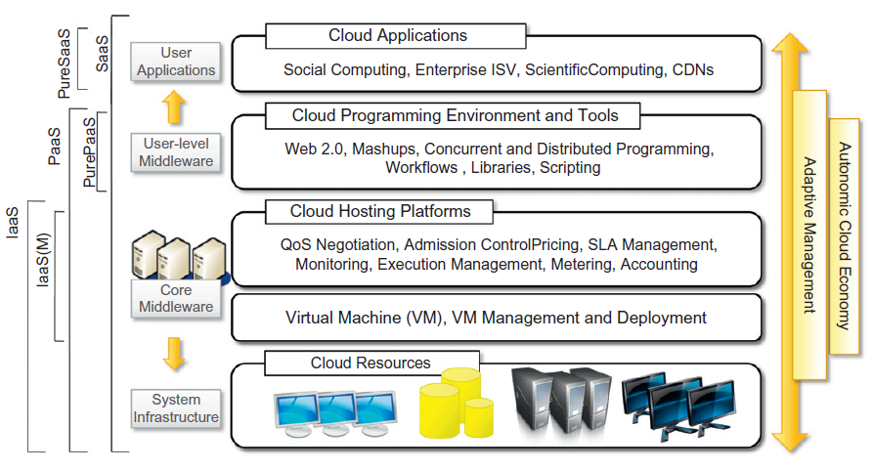
Cloud Computing Architecture

Slide 77
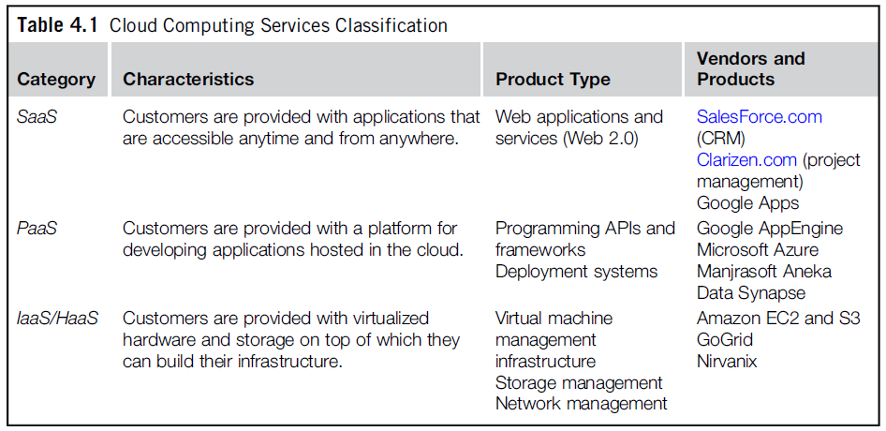

Slide 78
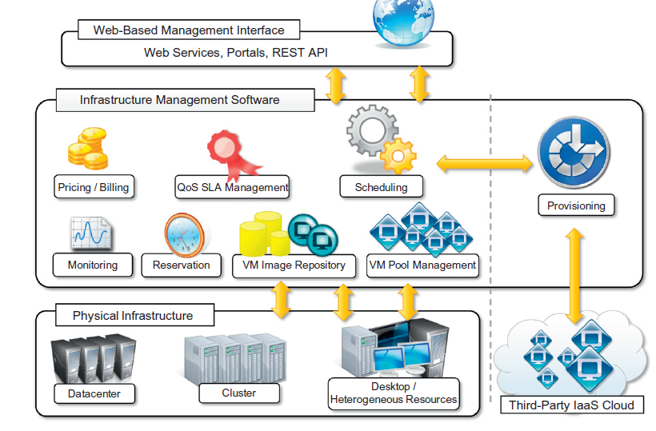
Infrastructure- and hardware-as-a-service

Slide 79
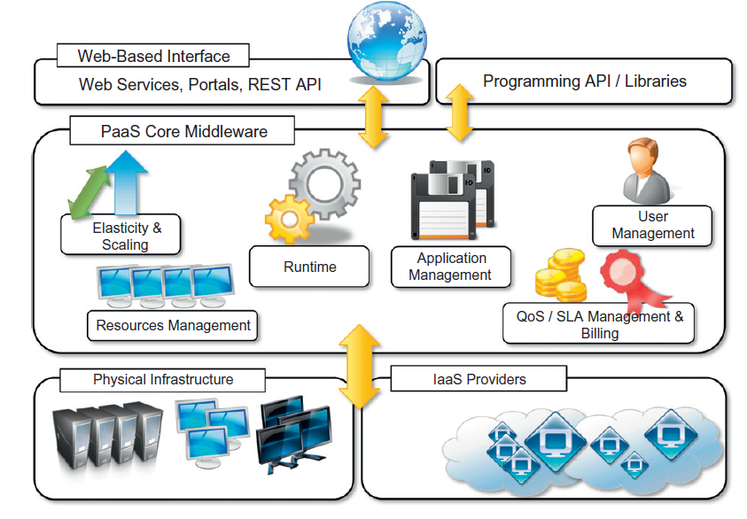
Platform as a service

Slide 80
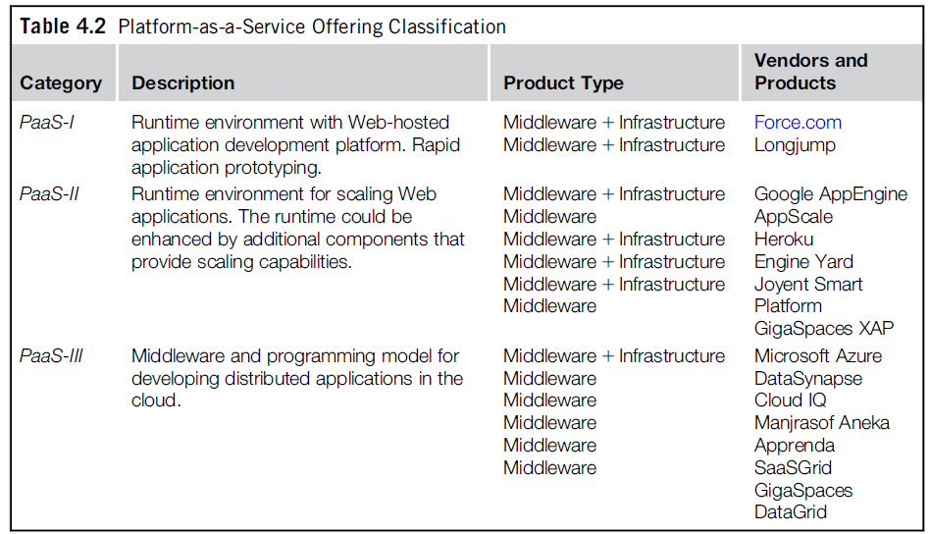

Slide 81
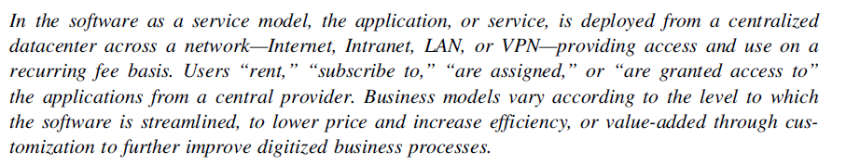
Software as a service
Software-as-a-Service (SaaS) is a software delivery model that provides access to applications through the Internet as a Web-based service.
“one-to-many” software delivery model, whereby an application is shared across multiple users.
CRM and ERP applications that constitute common needs for almost all enterprises.
Software Information & Industry Association (SIIA)

Slide 82
Core characteristics of SaaS
The product sold to customer is application access.
The application is centrally managed.
The service delivered is one-to-many.
The service delivered is an integrated solution delivered on the contract .

Slide 83
Benefits of SaaS
Software cost reduction and total cost of ownership (TCO) were paramount
Service-level improvements
Rapid implementation
Standalone and configurable applications
Subscription and pay-as-you-go (PAYG) pricing

Slide 84
Types of clouds
Public clouds. The cloud is open to the wider public.
Private clouds. The cloud is implemented within the private premises of an institution and generally made accessible to the members of the institution or a subset of them.
Hybrid or heterogeneous clouds. The cloud is a combination of the two previous solutions.
Community clouds. The cloud is characterized by a multi-administrative domain involving different deployment models(public, private, and hybrid),and it is specifically designed to address the needs of a specific industry.

Slide 85
Public cloud is multi-tenancy, serve a magnitude of user not single user
Public cloud can offer any kind of service: Infrastructure, platform, applications.
Amazon EC2 is a public cloud that provides infrastructure as a service
Google AppEngine is a public cloud that provides an application development platform as a service;
SalesForce.com is a public cloud that provides software as a service.
Public clouds can be composed of geographically dispersed datacenters to share the load of users and better serve them according to their locations.
Amazon Web Services has datacenters installed in the United States, Europe, Singapore, and Australia;

Slide 86
Advantages of using a private cloud computing infrastructure
Customer information protection
Infrastructure ensuring SLAs.

Slide 87
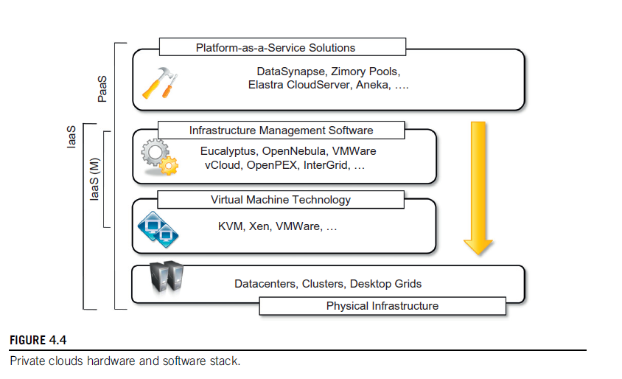

Slide 88
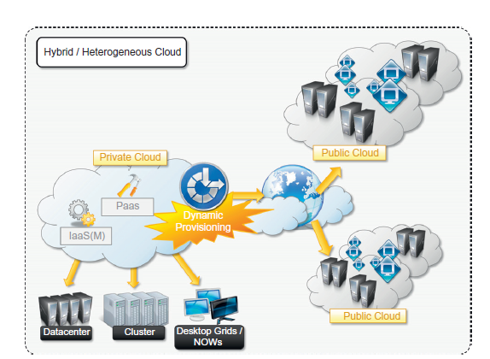
Hybrid clouds

Slide 89
Community clouds
Community clouds are distributed systems created by integrating the services of different clouds to address the specific needs of an industry, a community, or a business sector.
NIST: The infrastructure is shared by several organizations and supports a specific community that has shared concerns (e.g., mission, security requirements, policy, and compliance considerations). It may be managed by the organizations or a third party and may exist on premise or off premise.

Slide 90
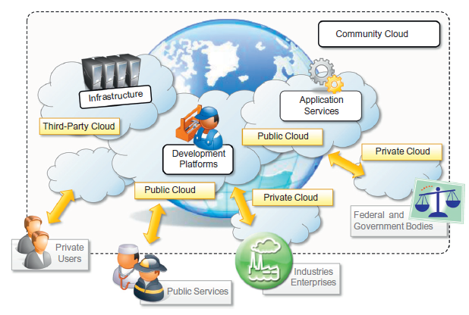

Slide 91
sectors for community clouds
Media industry.
Health care industry.
Energy and other core industries.
Public sector.
Scientific research.

Slide 92
Benefits of community clouds
Openness. Removing the dependency on cloud vendors.
Community
Graceful failures: no single point of failure.
Convenience and control
Environmental sustainability.

Slide 93
Economics of the cloud
cloud computing allows:
  pay-as-you-go model
  Reducing the capital costs associated to the IT infrastructure
  Eliminating the depreciation or lifetime costs associated with IT capital assets
  Replacing software licensing with subscriptions
  Cutting the maintenance and administrative costs of IT resources

Slide 94
Pricing models introduced by cloud computing
Tiered pricing
  Cloud services are offered in several tiers.
  which offers a fixed computing specification and SLA at a specific price per unit of time.
  E.g: Amazon for pricing the EC2 service, which makes available different server configurations in terms of computing capacity (CPU type and speed, memory) that have different costs per hour.
Per-unit pricing
  revenue for the cloud provider is determined in terms of units of specific services, such as data transfer and memory allocation.
  E.g: GoGrid, which makes customers pay according to RAM/hour units for the servers deployed in the GoGrid cloud.

Slide 95
Pricing models introduced by cloud computing
Subscription-based pricing
  This is the model used mostly by SaaS providers
  Users pay a periodic subscription fee for use of the software or the specific component services that are integrated in their applications.

Slide 96
Open challenges
interoperation between different clouds
the creation of standards
Security, trust, and privacy
Scalability
Fault tolerance

Slide 97
Aneka: Cloud Application Platform
Aneka is Manjrasoft Pty. Ltd.’s solution for developing, deploying, and managing cloud applications.
Services: coordinating the execution of applications, helping administrators monitor the status of the cloud, and providing integration with existing cloud technologies.
Aneka’s key advantages is its extensible set of application programming interfaces (APIs) associated with different types of programming models—such as Task, Thread, and MapReduce—used for developing distributed applications.
supporting different types of cloud deployment models: public, private, and hybrid.
Aneka is a pure PaaS solution for cloud computing.

Slide 98
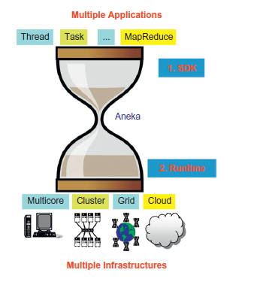

Slide 99
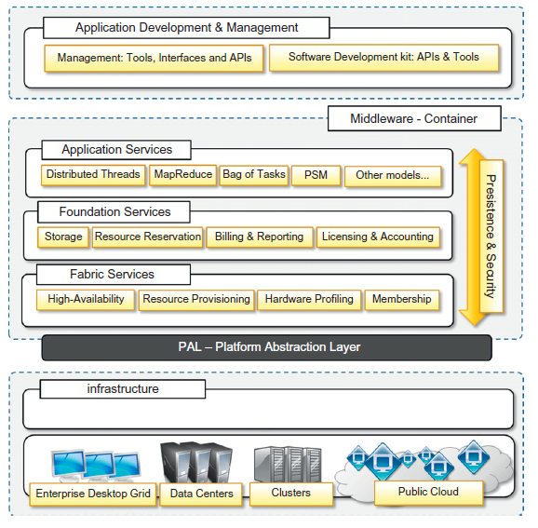
Framework overview

Slide 100
Aneka: Services
Elasticity and scaling: Aneka supports dynamically upsizing and downsizing of the infrastructure available for applications.
Run time management. : The runtime machinery is responsible for keeping the infrastructure up and running and serves as a hosting environment for services.
Resource management: Resources are added and removed dynamically according to application needs and user requirements.
Application management: execution, monitoring, and storage management.
User management : define users, groups, and permissions.
QoS/SLA management and billing : Within a cloud environment, application execution is metered and billed.

Slide 101
Anatomy of the Aneka container
The Aneka container constitutes the building blocks of Aneka Clouds.
The container, the unit of deployment in Aneka Clouds, is a lightweight software layer designed to host services and interact with the underlying operating system and hardware.
The services installed in the Aneka container can be classified into three major categories:
  Fabric Services
  Foundation Services
  Application Services

Slide 102
Platform Abstraction Layer (PAL)
The core infrastructure of the system is based on the .NET technology and allows the Aneka container to be portable over different platforms and operating systems.
PAL representing the interface to the underlying operating system and hardware.
It provides a uniform view of the software and hardware environment in which the container is running.

Slide 103
PAL Features:
Uniform and platform-independent implementation interface for accessing the hosting platform.
Uniform access to extended and additional properties of the hosting platform.
Uniform and platform-independent access to remote nodes.
Uniform and platform-independent management interfaces.
The PAL is a small layer of software that comprises a detection engine, which automatically configures the container at boot time, with the platform-specific component

Slide 104
collectible data that are exposed by the PAL
Number of cores, frequency, and CPU usage .
Memory size and usage
Aggregate available disk space
Network addresses and devices attached to the node

Slide 105
Fabric services
Fabric Services define the lowest level of the software stack representing the Aneka Container.
They provide access to the resource-provisioning subsystem and to the monitoring facilities implemented in Aneka.

Slide 106
Profiling and monitoring
Profiling and monitoring services are mostly exposed through the Heartbeat, Monitoring, and Reporting Services.
Heartbeat Service periodically collects the dynamic performance information about the node and publishes this information to the membership service in the Aneka Cloud.
basic information about memory, disk space, CPU, operating system, and installed software in the system is collected.
A specific component, called Node Resolver, is incharge of collecting these data and making them available to the Heartbeat Service.

Slide 107
The Reporting Service manages the store for monitored data and makes them accessible to other services or external applications for analysis purposes.

Slide 108
Resource management
resource membership, resource reservation, and resource provisioning
Membership Catalogue: it keeps track of the basic node information for all the nodes that are connected or disconnected.

Slide 109
Foundation services
Foundation Services provide a uniform approach to managing distributed applications and allow developers to concentrate only on the logic that distinguishes a specific programming model from the others.
Storage management for applications
  centralized file storage: used for the execution of compute- intensive applications.
  distributed file system: which is more suitable for the execution of data-intensive applications.
Accounting, billing, and resource pricing
Resource reservation: allows reserving resources for exclusive use by specific applications.
  Resource Reservation
  Allocation Service

Slide 110
Application services
Application Services manage the execution of applications and constitute a layer that differentiates according to the specific programming model used for developing distributed applications on top of Aneka.
the Scheduling Service and the Execution Service.

Slide 111
Application services : Scheduling
planning the execution of distributed applications on top of Aneka and governing the allocation of jobs composing an application to nodes.
Common tasks that are performed by the scheduling –
  Job to node mapping
  Rescheduling of failed jobs
  Job status monitoring
  Application status monitoring

Slide 112
Application services : Execution
Execution Services control the execution of single jobs that compose applications.
setting up the runtime environment hosting the execution of jobs.
common operations
  Unpacking the jobs received from the scheduler
  Retrieval of input files required for job execution
  execution of jobs
  Submission of output files at the end of execution
  Execution failure management
  Performance monitoring
  Packing jobs and sending them back to the scheduler

Slide 113
Programming model in Aneka Cloud
Task Model: an application is modeled as a collection of tasks that are independent from each other and whose execution can be sequenced in any order.
Thread Model: This model provides an extension to the classical multithreaded programming to a distributed infrastructure.
Map Reduce Model. This is an implementation of MapReduce as proposed by Google on top of Aneka.

Slide 114
Building Aneka clouds
Aneka is primarily a platform for developing distributed applications for clouds.
As a software platform it requires infrastructure on which to be deployed; this infrastructure needs to be managed.
Aneka supports various deployment models for public, private, and hybrid clouds.

Slide 115
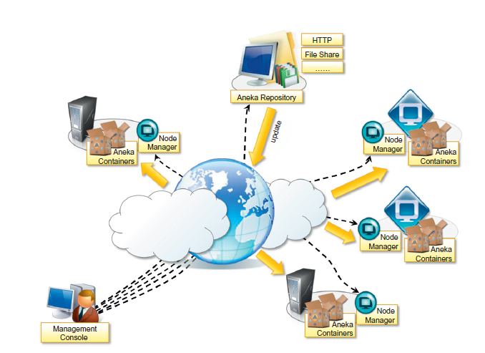
Infrastructure organization
Libraries
manage multiple repositories and select the one that best suits the specific deployment.

Slide 116
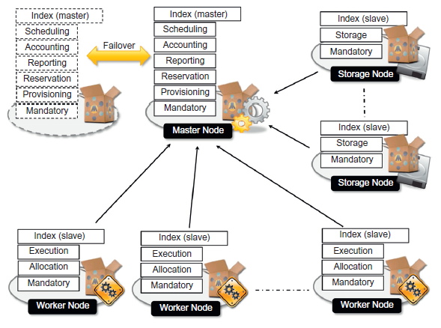
Logical organization of an Aneka cloud.

Slide 117
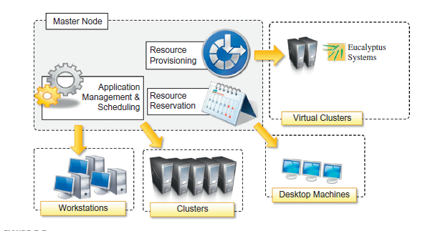
Private cloud deployment mode

Slide 118
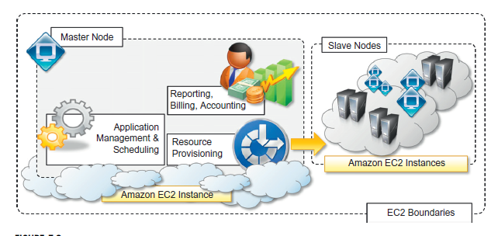
Public cloud deployment mode

Slide 119
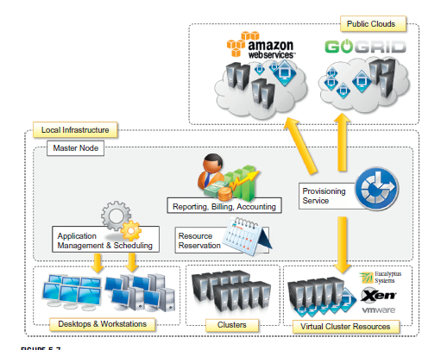
Hybrid cloud deployment mode

Slide 120
Cloud programming and management
Aneka’s primary purpose is to provide a scalable middleware product in which to execute distributed applications.
Application development, Deployment and management.
Aneka provides developers with a comprehensive and extensible set of APIs and administrators with powerful and intuitive management tools.

Slide 121
Aneka SDK
Aneka provides APIs for developing applications on top of existing programming models.
SDK provides support for both programming models and services by means of the Application Model and the Service Model.

Slide 122
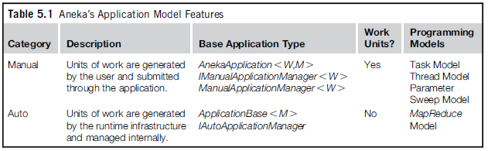
Application model
Each distributed application running on top of Aneka is an instance of the ApplicationBase, <M> class, where M identifies the specific type of application manager used to control the application.

Slide 123
Service model
The Aneka Service Model defines the basic requirements to implement a service that can be hosted in an Aneka Cloud.
Service that is hosted in the container must be compliant with the IService interface, which exposes the following methods and properties:
  Name and status
  Control operations such as Start, Stop, Pause, and Continue methods.
  Message handling by means of the HandleMessage method.

Slide 124
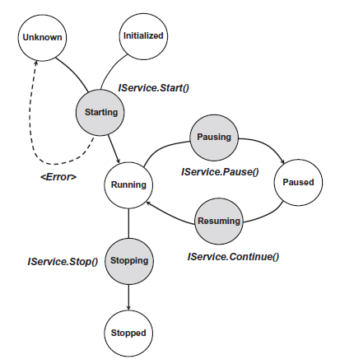
Service life cycle

Slide 125
ServiceBase class
This class is the base class of several services in the framework and provides some built-in features:
  Implementation of the basic properties exposed by Iservice.
  Implementation of the control operations with logging capabilities and state control.
  Built-in infrastructure for delivering a service specific client
  Support for service monitoring

Slide 126
Aneka uses a strongly typed message-passing communication model, whereby each service defines its own messages.
developers who implement new services in Aneka need also to define the type of messages that the services will use to communicate with services and clients.
class Message defining common properties such as:
  Source node and target node
  Source service and target service
  Security credentials

Slide 127
Management tools
Aneka is a pure PaaS implementation and requires virtual or physical hardware to be deployed.
Infrastructure management: Virtual hardware is generally managed by means of the Resource Provisioning Service, which acquires resources on demand according to the need of applications.

Slide 128
Platform management
platform management are mostly concerned with the logical organization and structure of Aneka Clouds.
It is possible to partition the available hardware into several Clouds variably configured for different purposes.
Services: such as Cloud monitoring, resource provisioning and reservation, user management, and application profiling.

Slide 129
Application management
The management APIs provide administrators with monitoring and profiling features that help them track the usage of resources and relate them to users and applications.

