Slide 1
Data-Intensive Computing
Data-intensive computing focuses on class of applications that deal with a large amount of data.
Several application fields, ranging from computational science to social networking, produce large volumes of data that need to be efficiently stored, made accessible, indexed, and analyzed.

Slide 2
What is data-intensive computing?
Data-intensive computing is concerned with production, manipulation, and analysis of large-scale data in the range of hundreds of megabytes(MB)to petabytes(PB)and beyond
Application domains:
scientific simulations and experiments
produce, analyze, and process huge volumes of data
Hundreds of gigabytes of data are produced every second by telescopes mapping the sky
the collection of images of the sky easily reaches the scale of petabytes over a year
Bioinformatics applications
Earthquake simulators process a massive amount of data, which is produced as a result of recording the vibrations of the Earth across the entire globe.
Customer data for any telecom company would easily be in the range of 10 to 100 tera- bytes.
Google, which is reported to process about 24 peta- bytes of information per day and to sort petabytes of data in hours.
Social networking and gaming

Slide 3
Characterizing data-intensive computations (Research Issues)

Slide 4
Challenges ahead
Scalable algorithms that can search and process massive datasets .
New metadata management technologies that can scale to handle complex, heterogeneous, and distributed data sources
Advances in high-performance computing platforms
High-performance, highly reliable, petascale distributed file systems
New approaches to software mobility for delivering algorithms that are able to move the computation to where the data are located.
Specialized hybrid interconnection architectures
Flexible and high-performance software integration techniques

Slide 5
Technologies for data-intensive computing
Storage systems
Growing of popularity of Big Data: scientific computing, enterprise applications, media entertainment, natural language processing, and social network analysis.
Growing importance of data analytics in the business chain : Facebook, which concentrate their focus on the management of user profiles, interests, and connections among people.
Presence of data in several forms, not only structured.

Slide 6
High-performance distributed file systems and storage clouds
Lustre. It is a massively parallel distributed file system that covers the needs of a small workgroup of clusters to a large-scale computing cluster.
IBM General Parallel File System(GPFS). GPFS is the high-performance distributed file system developed by IBM that provides support for the RS/6000 super computer and Linux computing clusters.
Google File System(GFS). GFS is the storage infrastructure that supports the execution of distributed applications in Google’s computing cloud
Amazon Simple Storage Service(S3). Amazon S3 is the online storage service provided by Amazon.

Slide 7
NoSQL systems
The term Not Only SQL (NoSQL) was originally coined in 1998 to identify a relational database that did not expose a SQL interface to manipulate and query data but relied on a set of UNIX shell scripts and commands to operate on text files containing the actual data.

Slide 8
NoSQL systems
Document stores (Apache Jackrabbit, Apache CouchDB, SimpleDB, Terrastore).
Graphs (AllegroGraph, Neo4j, FlockDB, Cerebrum).
Key-value stores: key-value stores on disk, key-value caches in RAM.
Multi value databases (OpenQM, RocketU2, OpenInsight).
Object databases (ObjectStore,JADE,ZODB).
Tabular stores (GoogleBigTable, HadoopHBase, Hypertable).
Tuple stores (ApacheRiver).

Slide 9
Apache CouchDB and MongoDB
Apache CouchDB and MongoDB are two examples of document stores.
primary objects are documents organized into a collection of key-value fields.
The value of each field can be of type string, integer, float, date, or an array of values.
Both allow querying and indexing data by using the MapReduce programming model, expose JavaScript as a base language for data querying and manipulation rather than SQL.
CouchDB ensures ACID properties on data.

Slide 10
Amazon Dynamo
Dynamo is the distributed key-value store that supports the management of information of several of the business services offered by Amazon Inc.
thousands of servers and network components build an infrastructure serving 10 million requests per day.
Dynamo provides a simplified interface based on get/put semantics, where objects are stored and retrieved with a unique identifier (key).

Slide 11
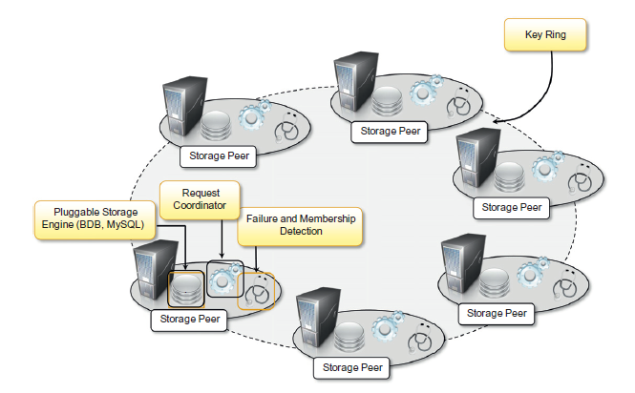
Amazon Dynamo architecture

Slide 12
Google Bigtable

Slide 13
The MapReduce programming model
MapReduce is a programming platform Google introduced for processing large quantities of data.
It expresses the computational logic of an application in two simple functions: map and reduce.
MapReduce model is expressed as
map(K1,V1)→ list(k2,v2)
reduce(k2,list(v2))→list(v2)
The map function reads a key-value pair and produces a list of key-value pairs of different types.
The reduce function reads a pair composed of a key and a list of values and produces a list of values of the same type.

Slide 14
MapReduce computation workflow

Slide 15
Google MapReduce infrastructure overview.

Slide 16
Aneka MapReduce infrastructure

Slide 17
Programming abstractions
Aneka Map Reduce APIs provide developers with base classes for developing Mapper and Reducer types.
Application class— MapReduceApplication
Three classes are of interest for application development: Mapper<K,V>, Reducer<K,V>, and MapReduceApplication<M,R>.
Mapper<K,V> and Reducer<K,V> constitute the starting point of the application design and implementation.
The submission and execution of a MapReduce job is performed through the class MapReduceApplication<M,R>.

Slide 18
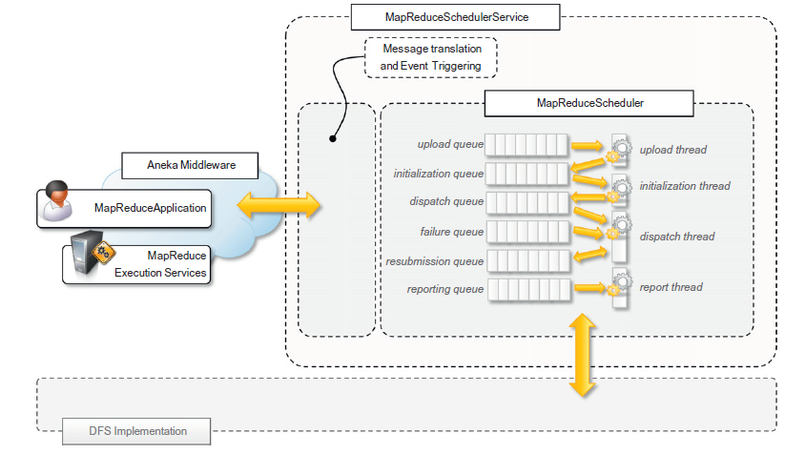
MapReduce Scheduling Service architecture

Slide 19
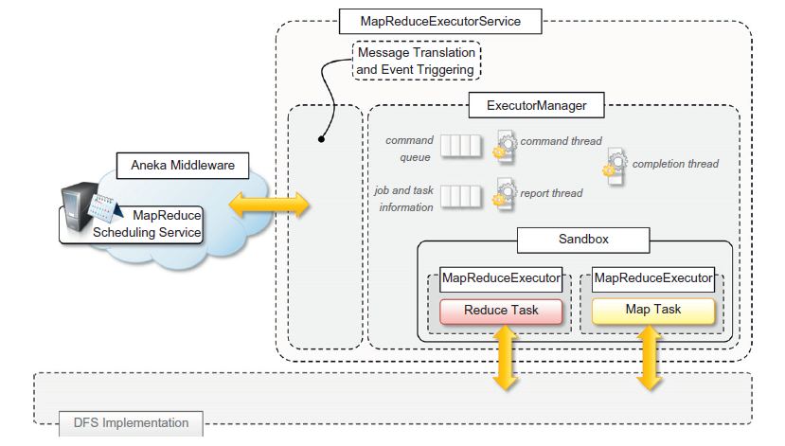
MapReduce Execution Service architecture

Slide 20
Aneka MapReduce data file format.

