Slide 1
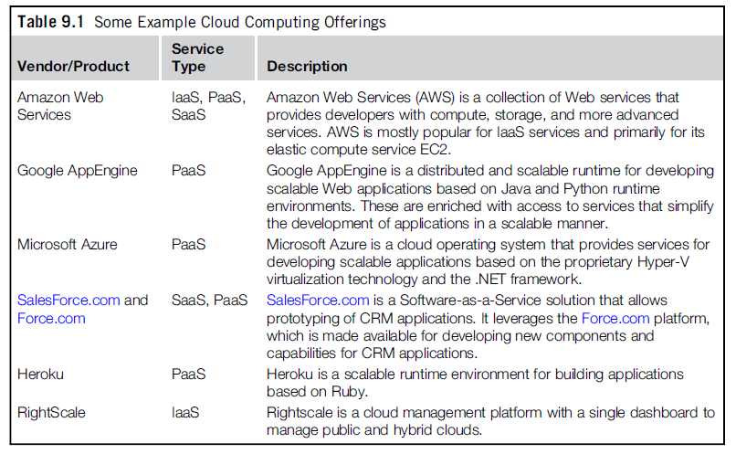
Cloud Platforms in Industry

Slide 2
Amazon web services (AWS)
Amazon Web Services (AWS) provides elastic infrastructure scalability, messaging, and data storage.
The platform is accessible through SOAP (Simple Object Access Protocol) or RESTful (Representational State Protocol )Web service interfaces and provides a Web-based console.
Expenses computed on a pay-as-you-go basis
Amazon Elastic Compute (EC2) and Amazon Simple Storage Service(S3).

Slide 3
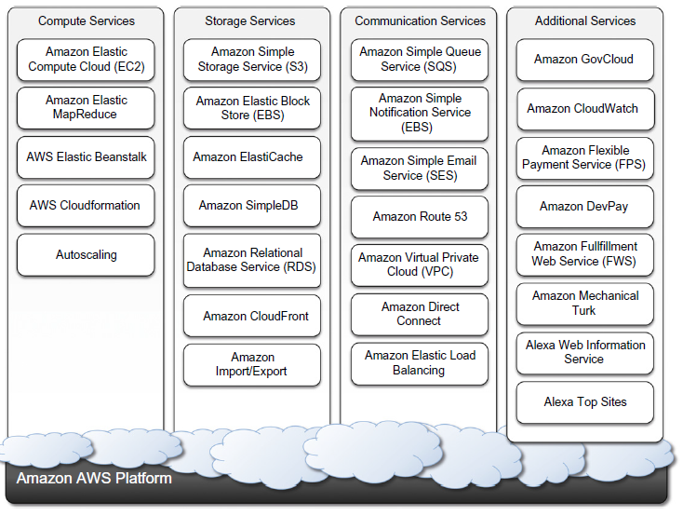
Services available in the AWS ecosystem.

Slide 4
AWS: Compute services
The fundamental service in this space is Amazon EC2, which delivers an IaaS solution.
Amazon EC2 allows deploying servers in the form of virtual machines created as instances of a specific image.
Amazon machine images:
  Amazon Machine Images(AMIs) are templates from which it is possible to create a virtual machine.
  They are stored in Amazon S3 and identified by a unique identifier in the form of ami-xxxxxx.
  An AMI contains a physical file system layout with a predefined operating system installed.
  Amazon Ram disk Image (ARI, id: ari-yyyyyy) and the Amazon Kernel Image (AKI, id: aki-zzzzzz),
  Once an AMI is created, it is stored in an S3 bucket

Slide 5
AWS: EC2 instances
EC2 instances represent virtual machines, created using AMI as templates, by selecting the number of cores, their computing power, and the installed memory.
The processing power is expressed in terms of virtual cores and EC2 Compute Units (ECUs).
One ECU is defined as giving the same performance as a 1.0-1.2 GHz 2007 Opteron or 2007 Xeon processor.

Slide 6
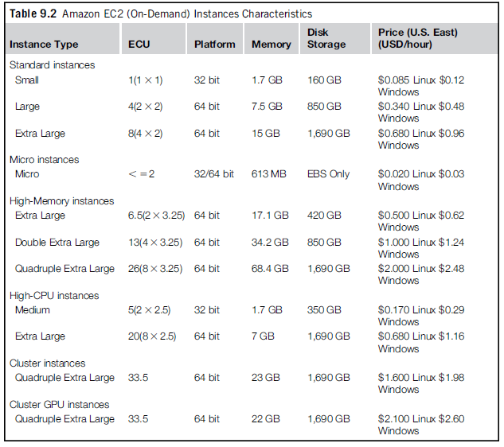
Available configurations for EC2 instances

Slide 7
AWS:EC2 environment
The EC2 environment is in charge of allocating addresses, attaching storage volumes, and configuring security in terms of access control and network connectivity.
instances are created with an internal IP address, which makes them capable of communicating within the EC2 network and accessing the Internet as clients.
EC2 instances are also given a domain name that generally is in the form ec2-xxx-xxx-xxx.compute-x .amazonaws.com,
where xxx-xxx-xxx normally represents the four parts of the external IP address separated by a dash.
compute-x gives information about the availability zone where instances are deployed.

Slide 8
AWS: EC2:Advanced compute services
AWS Cloud Formation: Cloud Formation introduces the concepts of templates, which are formatted text files that describe the resources needed to run an application.
Services: S3, SimpleDB, SQS, SNS, Route 53, Elastic Beanstalk
AWS elastic beanstalk: AWS Elastic Beanstalk constitutes a simple and easy way to package applications and deploy them on the AWS Cloud.
Amazon elastic MapReduce : cloud computing platform for MapReduce applications. It utilizes Hadoop as the MapReduce engine,

Slide 9
AWS: Storage services: Simple Storage Service(S3): S3 Key Concepts
S3 has been designed to provide a simple storage service that’s accessible through a Representational State Transfer (REST) interface.
The storage is organized in a two-level hierarchy .( Buckets, Objects)
Stored objects cannot be manipulated (renaming, modifying, or relocating) like standard files.
Content is not immediately available to users .
Requests will occasionally fail.

Slide 10
AWS:S3 Key Concepts: Resource naming
Buckets, objects are represented by uniform resource identifiers(URIs) under the s3.amazonaws.com domain.
three different ways of addressing a bucket:
  Canonical form: http://s3.amazonaws.com/bukect_name/
  Sub domain form: http://bucketname.s3.amazon.com/
  Virtual hosting form: http://bucket-name.com/
Object ACL: http://s3.amazonaws.com/bukect_name/object_name?acl
Bucket server logging: http://s3.amzonaws.com/bucket_name?logging

Slide 11
AWS:S3 Key Concepts: Buckets
A bucket is a container of objects.
Buckets are top- level elements of the S3 storage architecture and do not support nesting. That is, it is not possible to create “subbuckets”.
A bucket is located in a specific geographic location.
Once a bucket is created, all the objects that belong to the bucket will be stored in the same availability zone of the bucket
Users create a bucket by sending a PUT request to http://s3.amazonaws.com/ with the name of the bucket.
The content of a bucket can be listed by sending a GET request specifying the name of the bucket.
Once created, the bucket cannot be renamed or relocated.
Deletion of a bucket is performed by a DELETE request .

Slide 12
AWS:S3 Key Concepts: Objects and metadata
Objects constitute the content elements stored in S3.
An object is identified by a name that needs to be unique within the bucket.
The name cannot be longer than 1,024 bytes when encoded in UTF-8, and it allows almost any character.
Users create an object via a PUT request that specifies the name of the object together with the bucket name, its contents.
Maximum size of an object is 5 GB.
it cannot be modified, renamed, or moved into another bucket.
Deleting an object is performed via a DELETE request.
Objects can be tagged with metadata.

Slide 13
AWS:S3 Key Concepts: Access control and security
Amazon S3 allows controlling the access to buckets and objects by means of Access Control Policies(ACPs).
An ACP is a set of grant permissions are attached to a resource expressed by means of an XML configuration file.
A policy allows defining up to 100 access rules.
READ allows the grantee to retrieve an object.
WRITE allows the grantee to add an object to a bucket .
READ_ACP allows the grantee to read the ACP of a resource.
WRITE_ACP allows the grantee to modify the ACP of a resource.
FULL_CONTROL grants all of the preceding permissions

Slide 14
AWS:S3 Key Concepts: Amazon elastic block store
The Amazon Elastic Block Store (EBS) allows AWS users to provide EC2 instances with persistent storage.
They accommodate up to 1 TB of space.
Currently, Amazon charges $0.10/GB/month of allocated storage and $0.10 per 1 million requests made to the volume.

Slide 15
AWS:S3 Key Concepts: Amazon ElastiCache
ElastiCache is an implementation of an elastic in-memory cache based on a cluster of EC2.
It provides fast data access from other EC2 instances through a Memcached-compatible protocol.

Slide 16
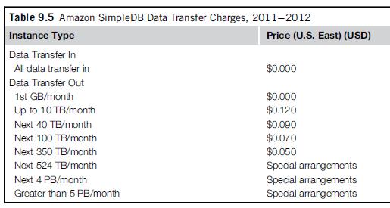
AWS:S3 Key Concepts: Structured storage solutions
RDBMS have been the common data back-end for a wide range of applications.
Amazon provides applications with structured storage: Amazon Relational Data Storage(RDS), and Amazon SimpleDB.

Slide 17
AWS:S3 Key Concepts: Amazon CloudFront
CloudFront is an implementation of a content delivery network.
AWS provides users with simple Web service APIs to manage CloudFront.
DNS domain under the Cloudfront.net domain name(i.e.,my-distribution.Cloudfront.net).
The content that can be delivered through CloudFront is static (HTTP and HTTPS) or streaming (Real Time Messaging Protocol, or RMTP).

Slide 18
AWS: Communication services
Amazon provides the communication among existing applications and services residing within the AWS infrastructure.
Two major categories: virtual networking and messaging.

Slide 19
AWS: Communication services: Virtual networking
comprises a collection of services that allow AWS users to control the connectivity to and between compute and storage services.
Amazon Virtual Private Cloud(VPC) and Amazon DirectConnect provide connectivity solutions.
VPC: Prepared templates include public subnets, isolated networks, private networks accessing Internet through network address translation (NAT), and hybrid networks.
Amazon Direct Connect allows AWS users to create dedicated networks between the user private network and Amazon Direct Connect locations, called ports.
Amazon Route 53 implements dynamic DNS services that allow AWS resources to be reached through domain names different from the amazon.com domain.

Slide 20
AWS: Communication services: Messaging
The three different types of messaging services offered are Amazon Simple Queue Service (SQS), Amazon Simple Notification Service(SNS), and Amazon Simple Email Service(SES).
SQS: exchanging messages between applications by means of message queues, hosted within the AWS infrastructure.
Amazon SNS provides a publish-subscribe method for connecting heterogeneous applications.
Amazon SES provides AWS users with a scalable email service.

Slide 21
Google AppEngine
Google AppEngine is a PaaS implementation that provides services for developing and hosting scalable Web applications.

Slide 22
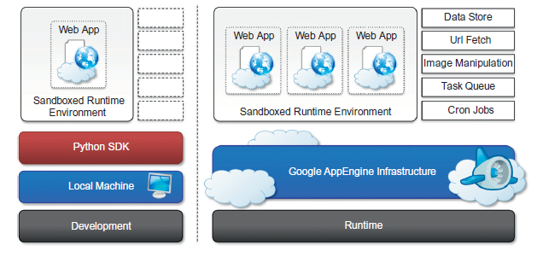
Google AppEngine: Architecture

Slide 23
Google AppEngine: Runtime environment
The runtime environment represents the execution context of applications hosted on AppEngine.
Supported runtimes : Java, Python, and Go.
Java ServerPages(JSP),
Python 2.5.2 interpreter
Python Web application framework, called webapp, simplifying the development of Web applications.
Go that is supported by AppEngine is r58.1.

Slide 24
Google AppEngine: Storage
AppEngine provides in memory-cache, storage for semistructured data, and long-term storage for static data.
Static file servers: Static data of web applications can be hosted on static file servers, since they are not frequently modified.
DataStore : DataStore is a service that allows developers to store semistructured data.
DataStore can be considered as a large object database in which to store objects that can be retrieved by a specified key.

Slide 25
Google AppEngine: Application services
UrlFetch : provide developers with the capability of retrieving a remote resource through HTTP/HTTPS .
MemCache: optimized for fast access and provides developers with a volatile store for the objects that are frequently accessed.
Mail and instant messaging: AppEngine provides developers with the ability to send and receive mails through Mail. The service allows sending email on behalf of the application to specific user accounts.
AppEngine provides also another way to communicate with the external world: the Extensible Messaging and Presence Protocol (XMPP) ,Google Talk .
Account management : allowing developers to leverage Google account management by means of Google Accounts.
Image manipulation : AppEngine allows applications to perform image resizing, rotation, mirroring, and enhancement by means of Image Manipulation.

Slide 26
Google AppEngine: Compute services
Task queues:
  Task Queues allow applications to submit a task for a later execution.
  The service allows users to have up to 10 queues that can execute tasks at a configurable rate.
Cron jobs
  It is possible to schedule the required operation at the desired time by using the CronJobs service.

Slide 27
Google AppEngine: Application life cycle
AppEngine provides support for almost all the phases characterizing the life cycle of an application: testing and development, deployment, and monitoring.
Java SDK , Google Web Toolkit, and Google AppEngine plug-ins into Eclipse, servlet
Python SDK:
  The Python SDK allows developing Web applications for AppEngine with Python 2.5.
  It provides a stand alone tool,called GoogleApp EngineLauncher, for managing Web applications locally and deploying them to AppEngine.

Slide 28
Microsoft Azure
Microsoft Windows Azure is a cloud operating system built on top of Microsoft datacenters’ infrastructure .
Services range from compute, storage, and networking to application connectivity, access control, and business intelligence.
integrates the scalability features into the common Microsoft technologies such as Microsoft Windows Server 2008, SQL Server, and ASP.NET.

Slide 29
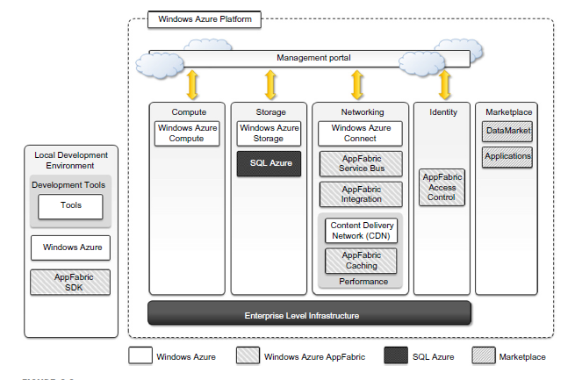
Azure core concepts

Slide 30
Microsoft Azure :Compute services
Web role, Worker role, Virtual Machine (VM) role.
Web role:
  The Web role is designed to implement scalable Web applications.
  They are hosted on the IIS 7 Web Server.
  the .NET technology natively supports Web roles; developers can directly develop their applications in Visual Studio, test them locally, and upload to Azure.
  It is possible to develop ASP.NET.
  IIS 7 also supports the PHP runtime environment by means of the FastCGI module.

Slide 31
Microsoft Azure :Compute services
Worker role:
  Worker roles are designed to host general compute services on Azure.
  They can be used to quickly provide compute power or to host services .
  the .NET technology provides complete support for Worker role
  For example, Worker roles can be used to host Tomcat and serve JSP-based applications.

Slide 32
Microsoft Azure :Compute services
Virtual Machine role:
  The Virtual Machine role is based on the Windows Hyper-V virtualization technology.

Slide 33
Microsoft Azure :Storage services
Blobs:
  Azure allows storing large amount of data in the form of binary large objects(BLOBs) by means of the blobs service.
  This service is optimal to store large text or binary files.
  Block blobs. Block blobs are composed of blocks and are optimized for sequential access; therefore they are appropriate for media streaming. Currently, blocks are of 4 MB, and a single block blob can reach 200 GB in dimension.
  Page blobs. Page blobs are made of pages that are identified by an offset from the beginning of the blob.
  This type of blob is optimized for random access
  Currently, the maximum dimension of a page blob can be 1 TB.

Slide 34
Microsoft Azure :Storage services
Azure drive: Page blobs can be used to store an entire file system in the form of a single Virtual Hard Drive (VHD) file.
Tables: Tables constitute a semi structured storage solution, allowing users to store information in the form of entities with a collection of properties.
Currently, a table can contain up to 100 TB of data, and rows can have up to 255 properties, with a maximum of 1 MB for each row.

Slide 35
Microsoft Azure :Storage services
Queues :Queue storage allows applications to communicate by exchanging messages through durable queues.
Applications enter messages into a queue, and other applications can read them in a first-in, first-out (FIFO) style.

Slide 36
Microsoft Azure: AppFabric
AppFabric is a comprehensive middleware for developing, deploying, and managing applica- tions on the cloud.
AppFabric implements an optimized infrastructure supporting scaling out and high availability;
it also provides communication, authentication and authorization, and data access.

Slide 37
Windows Azure virtual network
Networking services for applications are offered under the name Windows Azure Virtual Network, which includes Windows Azure Connect and Windows Azure Traffic Manager.
Windows Azure Connect allows easy setup of IP-based network connectivity.
Windows Azure Traffic Manager provides load-balancing features for services listening to the HTTP or HTTPS ports and hosted on multiple roles.

Slide 38
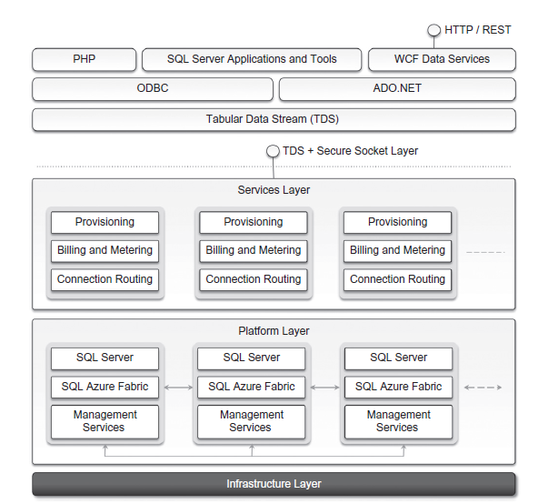
SQL Azure
SQL Azure is a relational database service hosted on Windows Azure and built on the SQL Server technologies.

Slide 39
Cloud Applications: Healthcare:
ECG analysis in the cloud
ECG activity produces a specific waveform that is repeated over time and that represents the heartbeat.
Cloud computing technologies allow the remote monitoring of a patient’s heartbeat data, data analysis in minimal time.
This way a patient at risk can be constantly monitored without going to a hospital for ECG analysis.

Slide 40
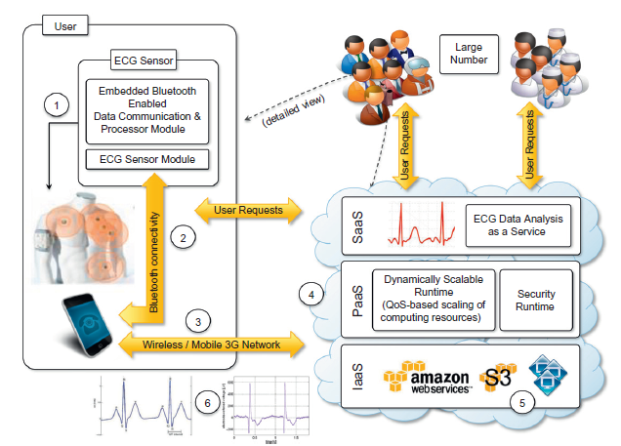

Slide 41
Biology: protein structure prediction
Protein structure prediction is a computationally intensive task for the design of new drugs for the treatment of diseases.
The computational power required for protein structure prediction can now be acquired on demand, without owning a cluster, parallel and distributed computing facilities.

Slide 42
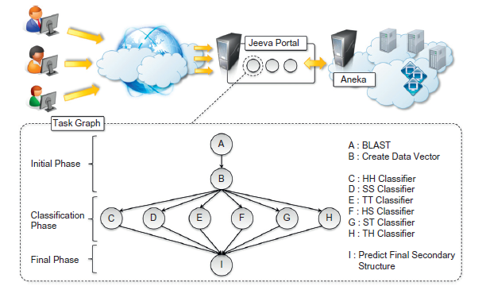
Protein structure prediction: JEEVA

Slide 43
Geoscience: satellite image processing
Geoscience applications collect, produce, and analyze massive amounts of geospatial and non-spatial data.
Satellite remote sensing generates hundreds of gigabytes of raw images that need to be further processed to become the basis of several different GIS products.
Large images need to be moved from a ground station’s local storage to compute facilities, where several transformations and corrections are applied.
Cloud computing provides the appropriate infrastructure to support such application scenarios.

Slide 44
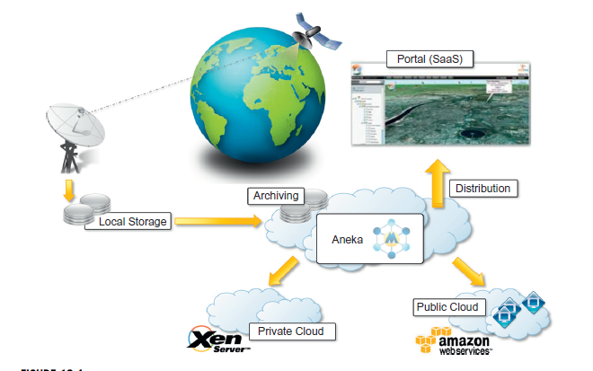

Slide 45
Business and consumer applications :
Customer Relationship Management(CRM)
Enterprise Resource Planning(ERP): finance and accounting, human resources, manufacturing, supply chain management, project management

Slide 46
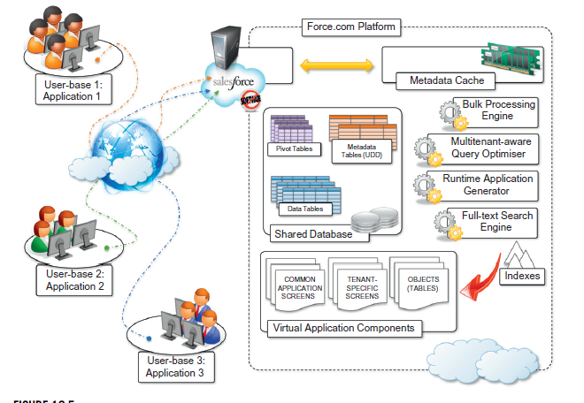
Salesforce.com

Slide 47
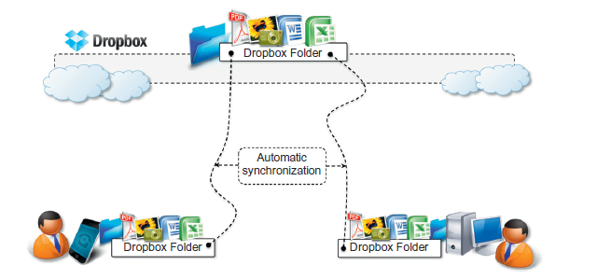
Dropbox and iCloud

Slide 48
Google docs
GoogleDocs is a SaaS application that delivers the basic office automation capabilities with support for collaborative editing over the Web.
Google Docs allows users to create and edit text documents, spreadsheets, presentations, forms, and drawings.

Slide 49
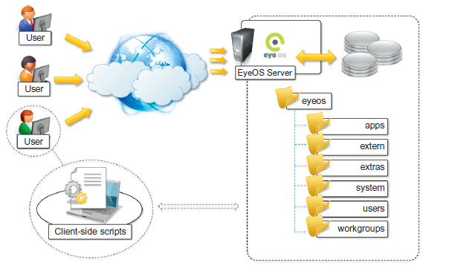
Cloud desktops: EyeOS and XIOS/3

Slide 50
Social networking : Facebook
Facebook is based on LAMP (Linux, Apache, MySQL, and PHP).

Slide 51
Media applications
Animoto: The Website provides users with a very straightforward interface for quickly creating videos out of images, music, and video fragments submitted by users.
A proprietary artificial intelligence (AI) engine, which selects the animation and transition effects according to pictures and music, drives the rendering operation.

Slide 52
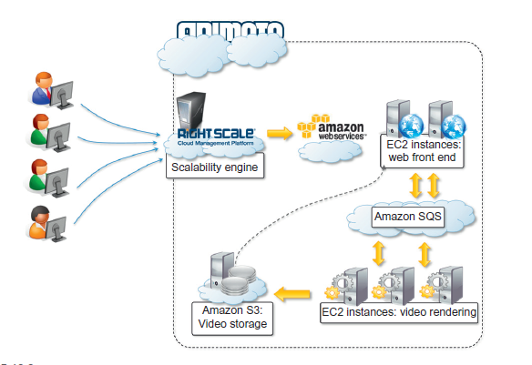
Animoto reference architecture.

Slide 53
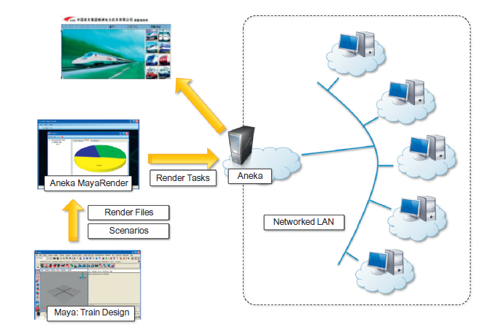
Maya rendering with Aneka

Slide 54
Video encoding on the cloud: Encoding.com
Multiplayer online gaming

