Slide 1
S. J. P. N. TRUST’S HIRASUGAR INSTITUTE OF TECHNOLOGY, NIDASOSHI Accredited at 'A' Grade by NAAC Programmes Accredited by NBA: CSE, ECE, EEE & ME.
Department of Computer Science & Engineering
Course: Web Technology & It’s Applications (18CS71)
Module 2: Introduction to HTML Tables, Forms & Advanced CSS
Prof. C. R. Belavi
Asst. Prof. , Dept. of Computer Science & Engg.,
Hirasugar Institute of Technology, Nidasoshi

Slide 2
Introducing Tables

Slide 3
HTML Tables
A grid of cells
A table in HTML is created using the <table> element
Tables can be used to display:
Many types of content
Calendars, financial data, lists, etc…
Any type of data
Images
Text
Links
Other tables

Slide 4
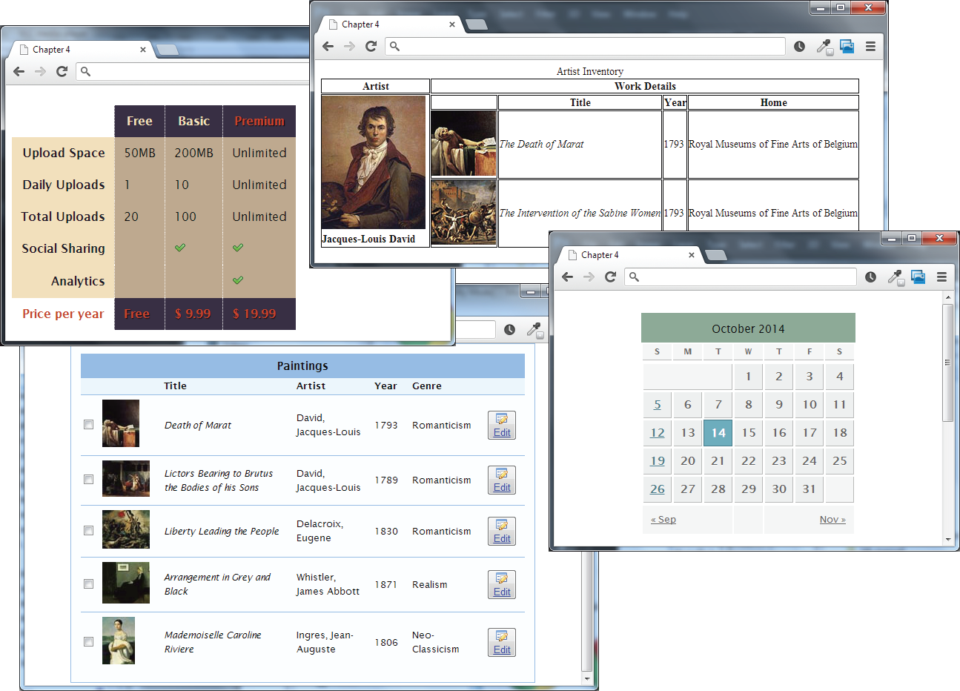
HTML Tables
Example usages

Slide 5
Tables Basics
Rows and cells
an HTML <table> contains any number of rows (<tr>)
each row contains any number of table data cells (<td>)
Content goes inside of <td></td> tags
<table>
<tr> <td>The Death of Marat </td> </tr> </table>
content

Slide 6
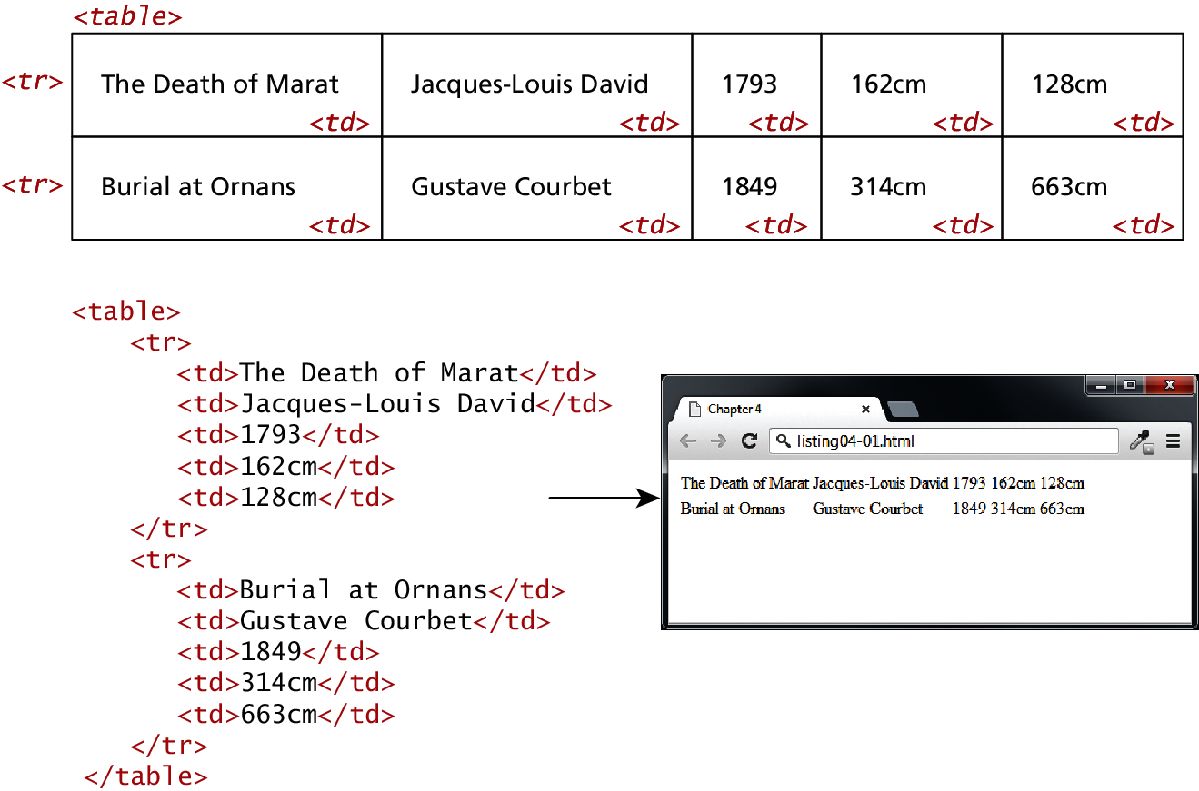
A basic Example

Slide 7
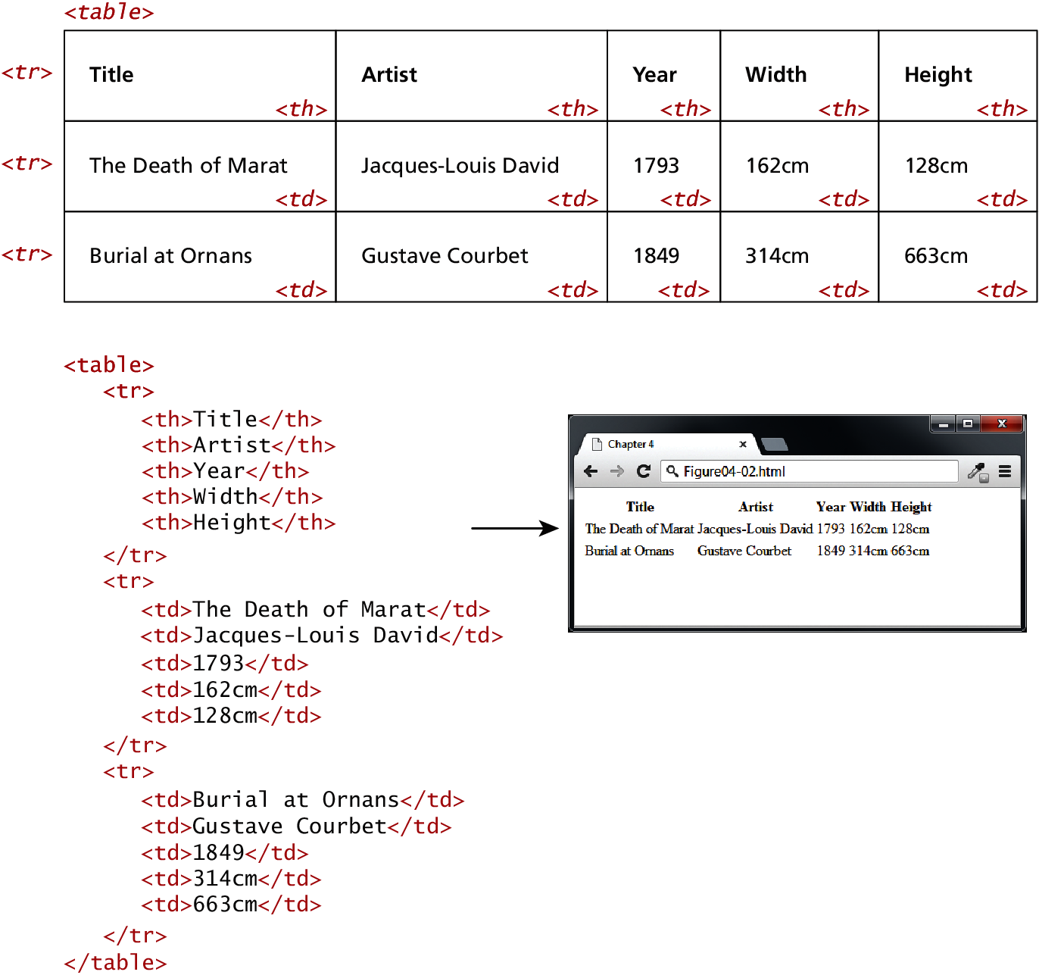
With Table Headings
th

Slide 8
Why Table Headings
A table heading <th>
Browsers tend to make the content within a <th> element bold
<th> element for accessibility (it helps those using screen readers)
Provides some semantic info about the row being a row of headers

Slide 9
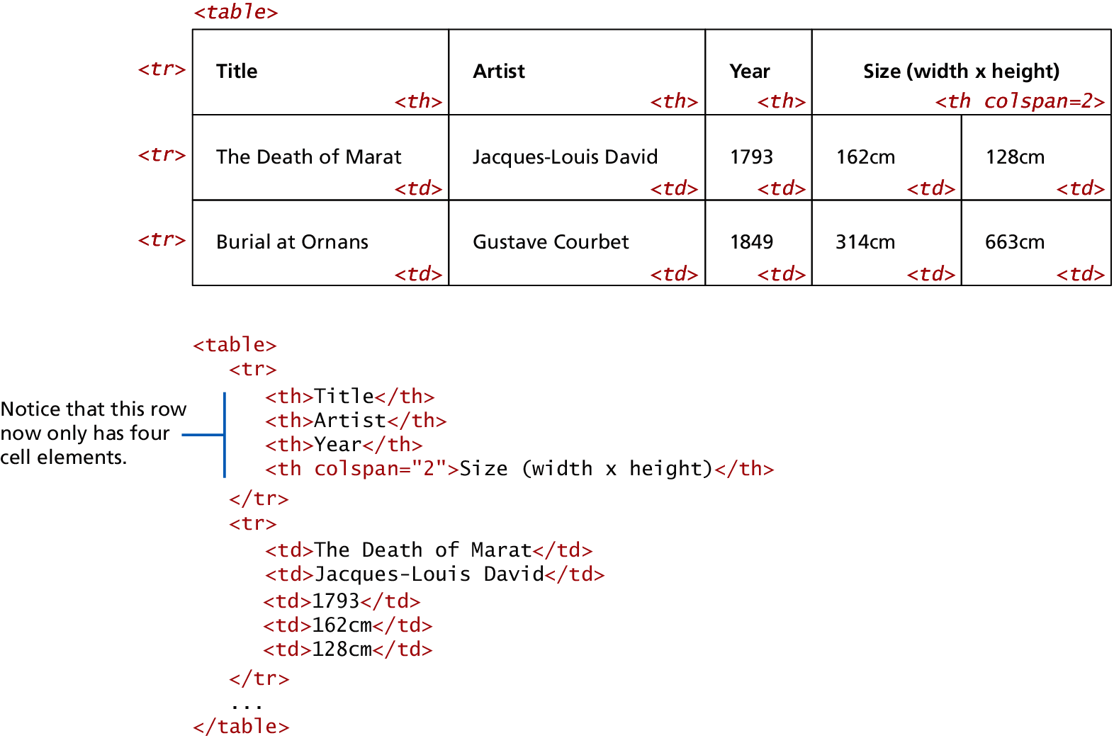
Spanning Rows and Columns
Span Span Span a Row
Each row must have the same number of <td> or <th> containers. If you want a given cell to cover several columns or rows,
use the colspan or rowspan attributes

Slide 10
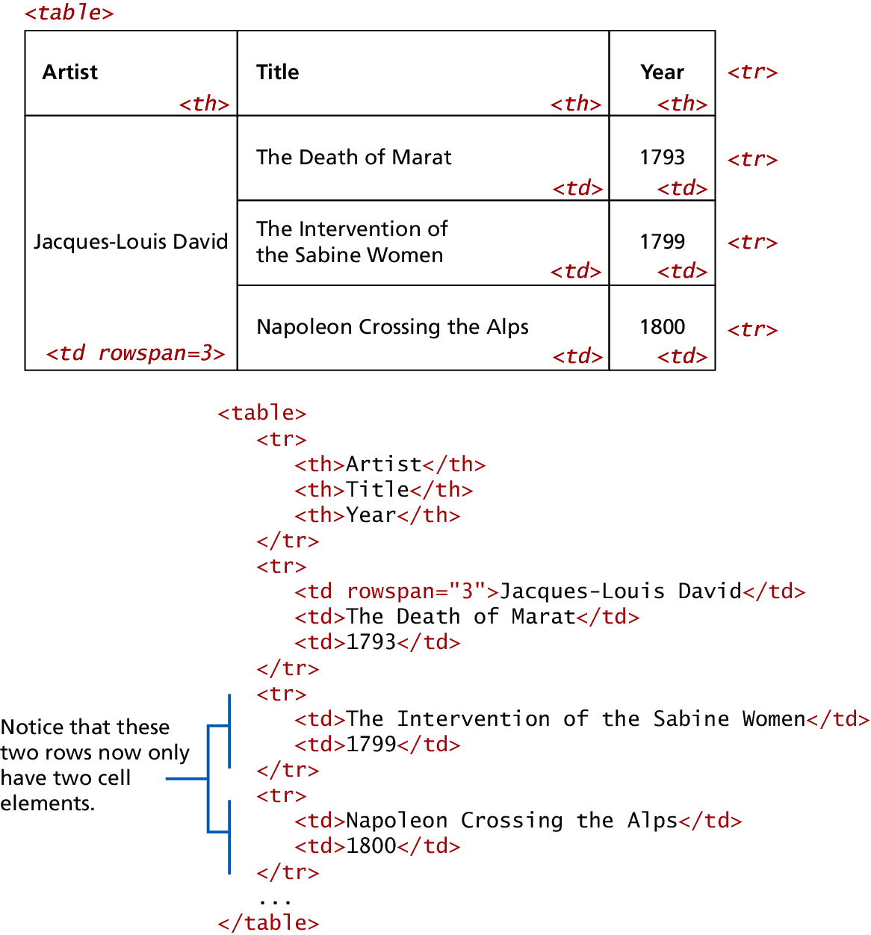
Using Tables for Layout
It works in many situations
Popular in 1990s
Results in table bloat
Not semantic
Larger HTML pages
Browser quirks

Slide 11
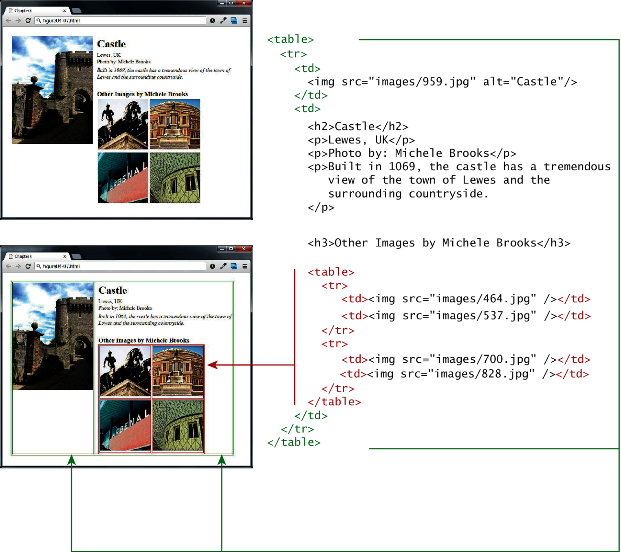
Example Table layouts

Slide 12
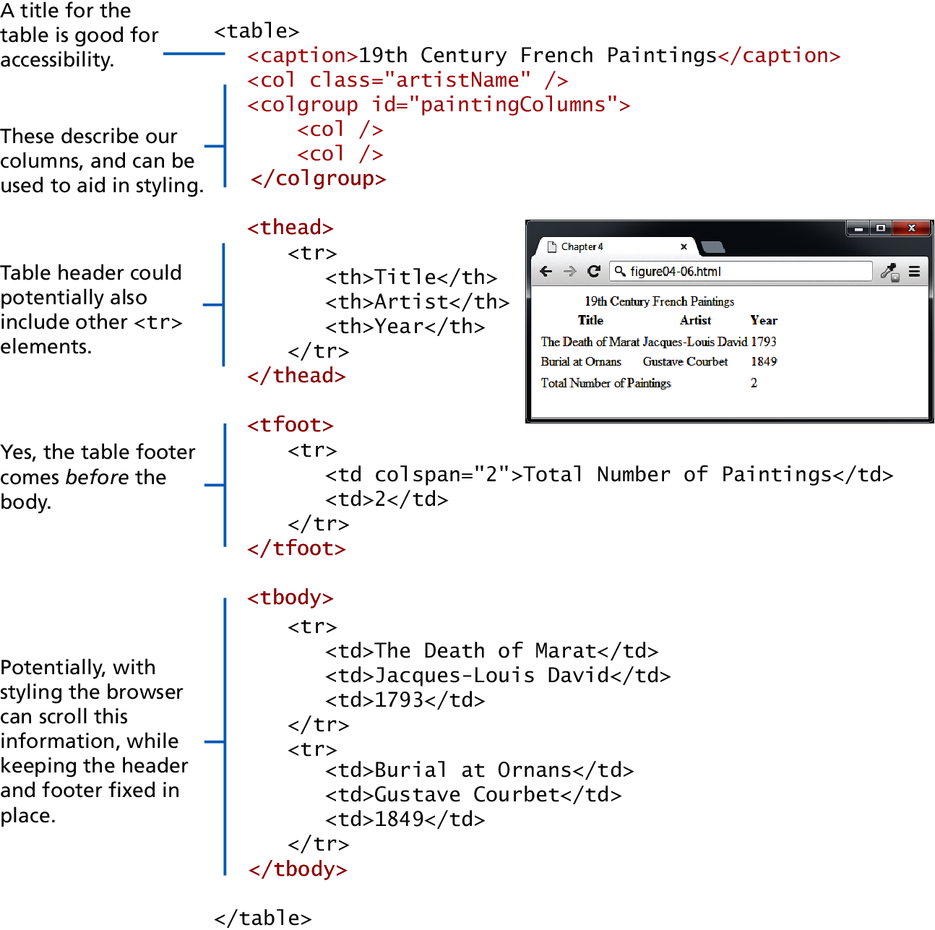
Additional table tags
<caption>
<col>,<colgroup>
<thead>
<tfoot>
<tbody>

Slide 13
Styling Tables
The old way’s deprecated
In HTML5 it is left to CSS, However legacy support for deprecated HTML attributes still exist
width, height—for setting the width and height of cells
cellspacing—for adding space between every cell in the table
cellpadding—for adding space between the content of the cell and its border
bgcolor—for changing the background color of any table element
background—for adding a background image to any table element
align—for indicating the alignment of a table in relation to the surrounding container

Slide 14
Styling Tables
Borders

Slide 15
Styling Tables
Padding and spacing

Slide 16
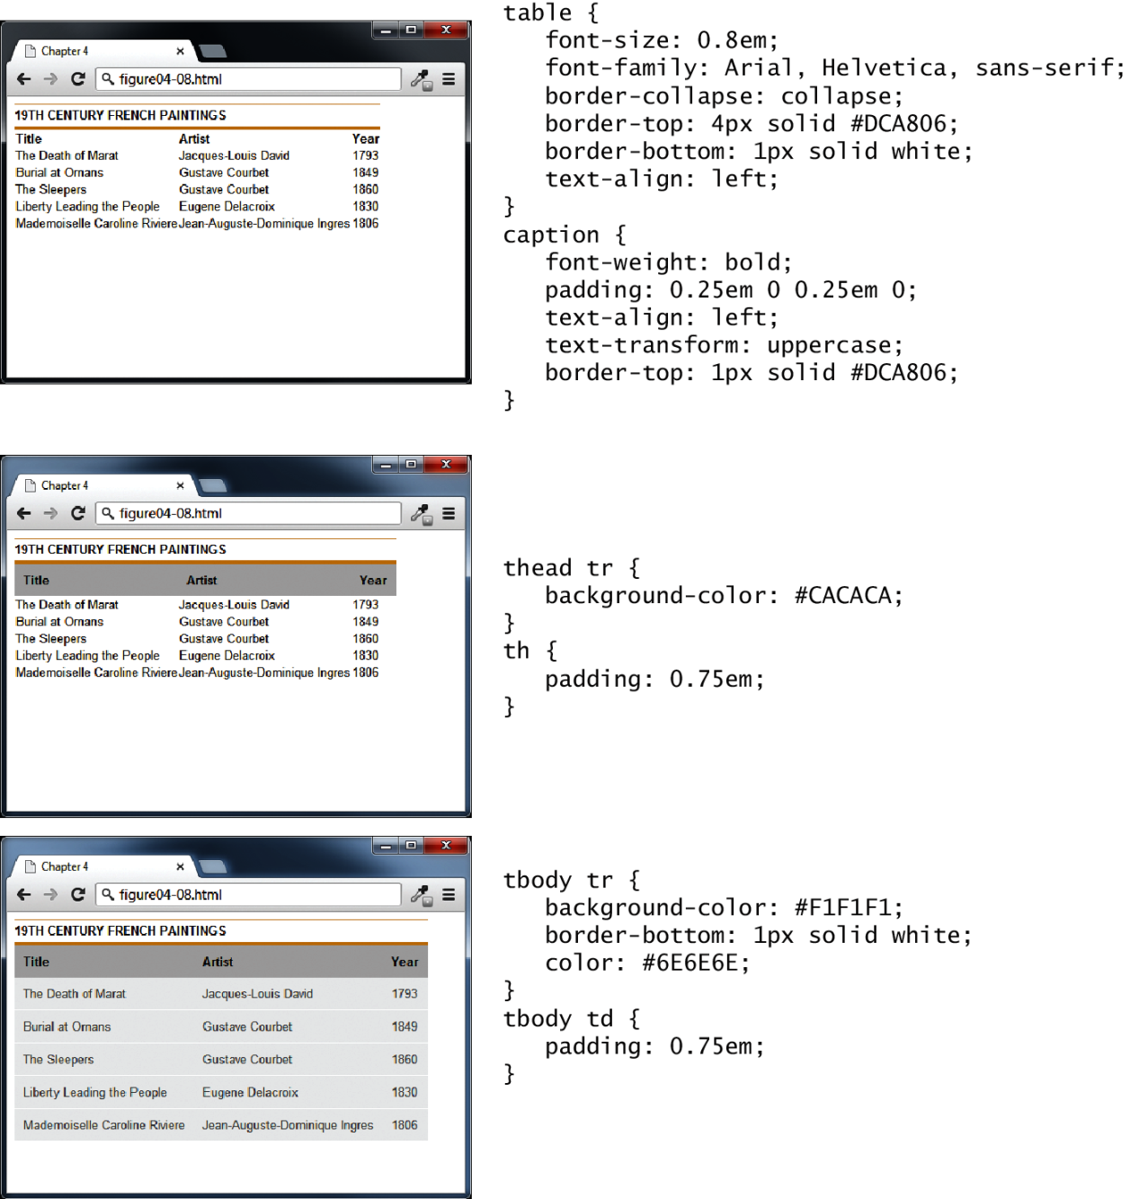
Styling Tables
Examples

Slide 17
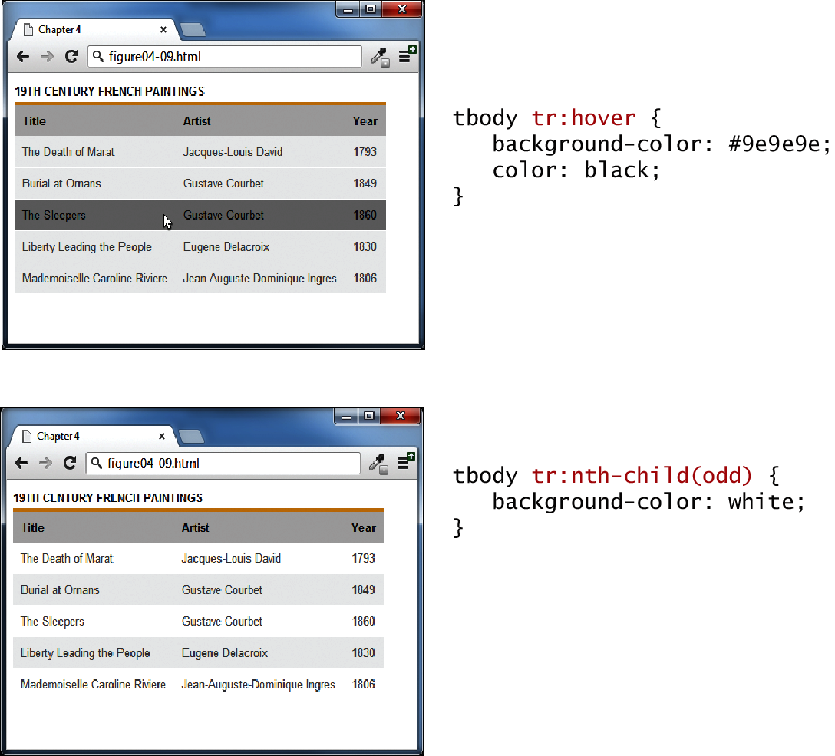
Nth-Child
Nifty Table styling tricks: hover effect and zebra-stripes

Slide 18
INTRODUCING FORMS

Slide 19
HTML Forms
Richer way to interact with server
Forms provide the user with an alternative way to interact with a web server.
Forms provide rich mechanisms like:
Text input
Password input
Options Lists
Radio and check boxes

Slide 20
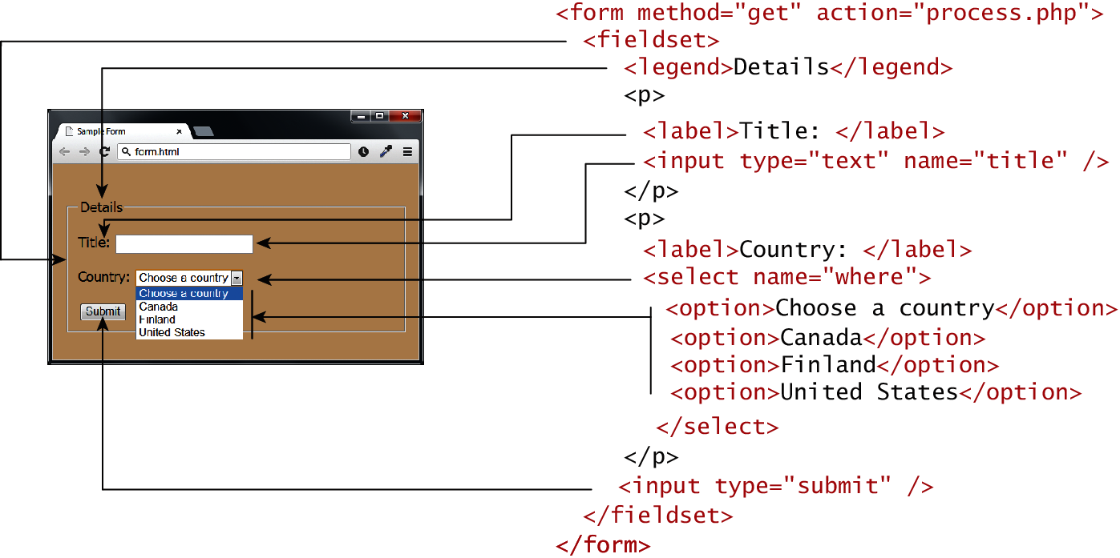
Form Structure

Slide 21
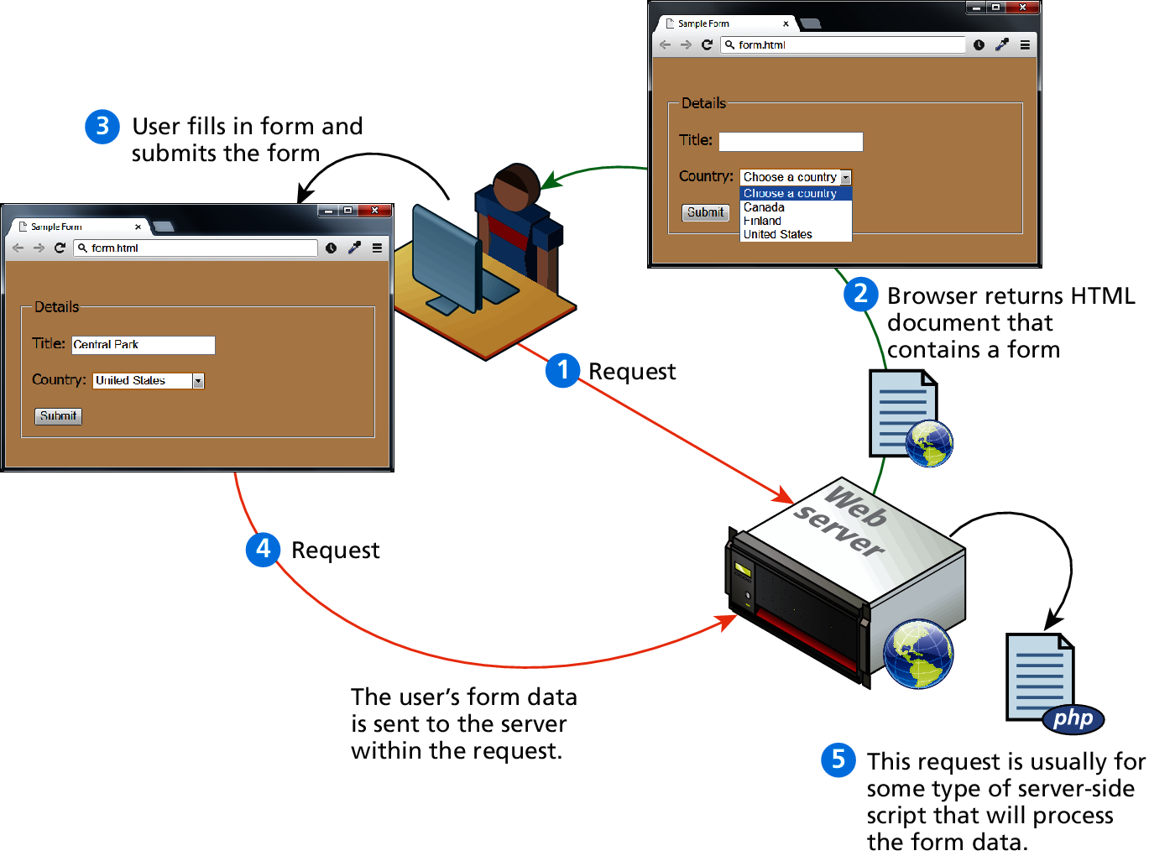
How forms interact with servers

Slide 22
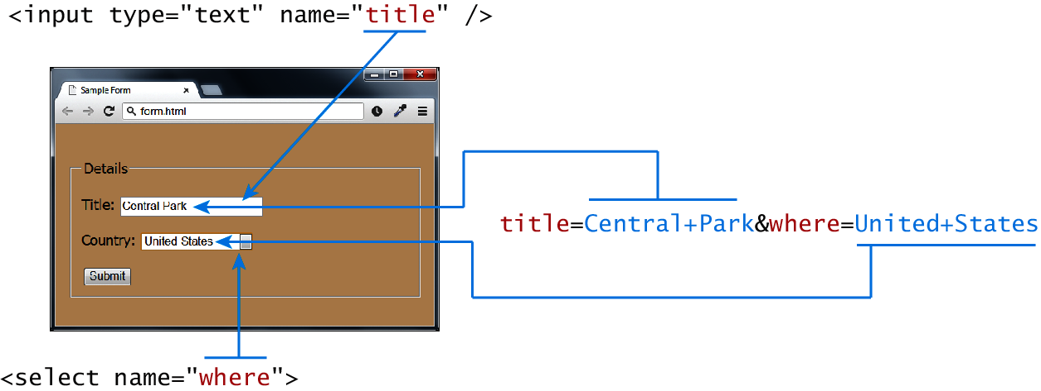
Query Strings
At the end of the day, another string

Slide 23
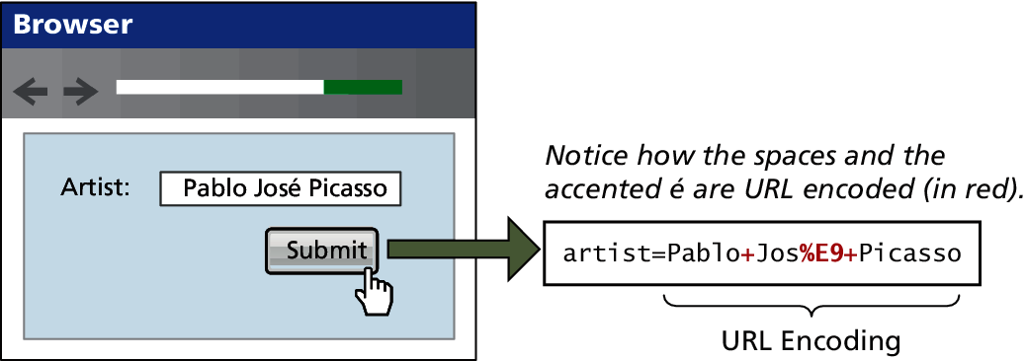
URL encoding
Special symbols

Slide 24
<form> element
Two essential features of any form, namely the action and the method attributes.
The action attribute specifies the URL of the server-side resource that will process the form data
The method attribute specifies how the query string data will be transmitted from the browser to the server.
GET
POST

Slide 25
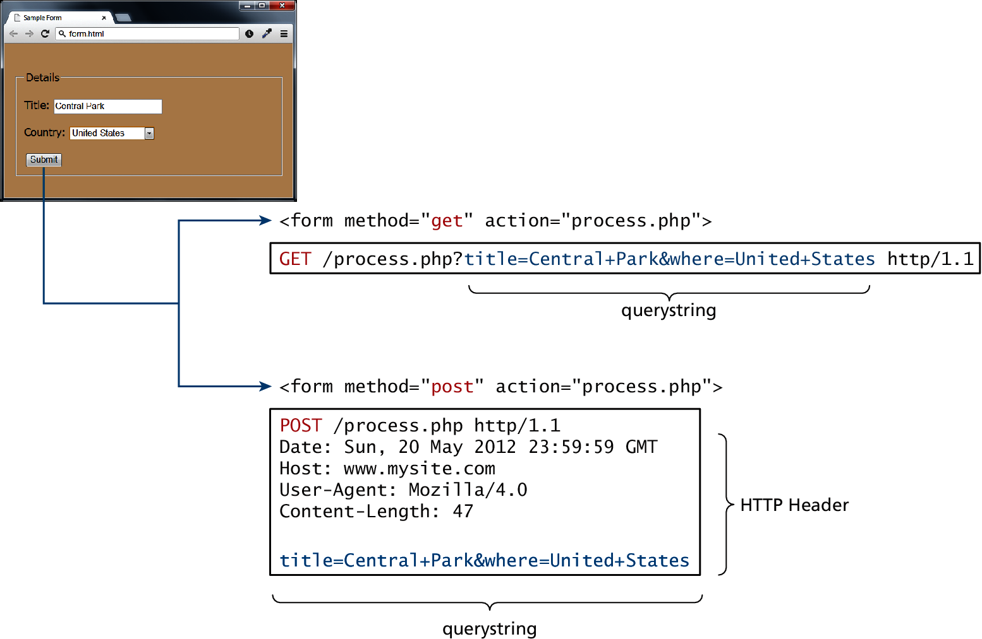
GET vs POST

Slide 26
GET vs POST
Advantages and Disadvantages
GET
Data can be clearly seen in the address bar.
Data remains in browser history and cache.
Data can be bookmarked
Limit on the number of characters in the form data returned.
POST
Data can contain binary data.
Data is hidden from user.
Submitted data is not stored in cache, history, or bookmarks.

Slide 27
Forms Control Elements

Slide 28
Form-Related HTML Elements
Type | Description
<button> | Defines a clickable button.
<datalist> | An HTML5 element form defines lists to be used with other form elements.
<fieldset> | Groups related elements in a form together.
<form> | Defines the form container.
<input> | Defines an input field. HTML5 defines over 20 different types of input.
<label> | Defines a label for a form input element.
<legend> | Defines the label for a fieldset group.
<option> | Defines an option in a multi-item list.
<optgroup> | Defines a group of related options in a multi-item list.
<select> | Defines a multi-item list.
<textarea> | Defines a multiline text entry box.

Slide 29
Text Input Controls
Type | Description
text | Creates a single line text entry box. <input type="text" name="title" />
textarea | Creates a multiline text entry box. <textarea rows="3" ... />
password | Creates a single line text entry box for a password <input type="password" ... />
search | Creates a single-line text entry box suitable for a search string. This is an HTML5 element. <input type="search" … />
email | Creates a single-line text entry box suitable for entering an email address. This is an HTML5 element. <input type="email" … />
tel | Creates a single-line text entry box suitable for entering a telephone. This is an HTML5 element. <input type="tel" … />
url | Creates a single-line text entry box suitable for entering a URL. This is an HTML5 element. <input type="url" … />

Slide 30
Text Input Controls
Classic

Slide 31
Text Input Controls
HTML5

Slide 32
HTML5 advanced controls
Pattern attribute
datalist

Slide 33
Select Lists
Chose an option, any option.
<select> element is used to create a multiline box for selecting one or more items
The options are defined using the <option> element
can be hidden in a dropdown or multiple rows of the list can be visible
Option items can be grouped together via the <optgroup> element.

Slide 34
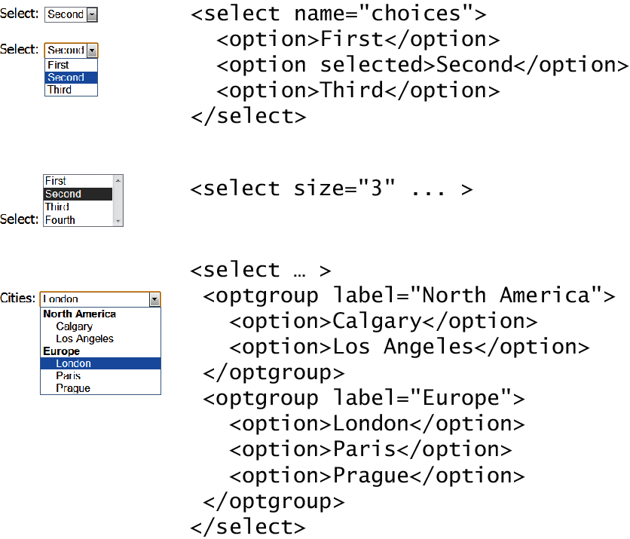
Select Lists
Select List Examples

Slide 35
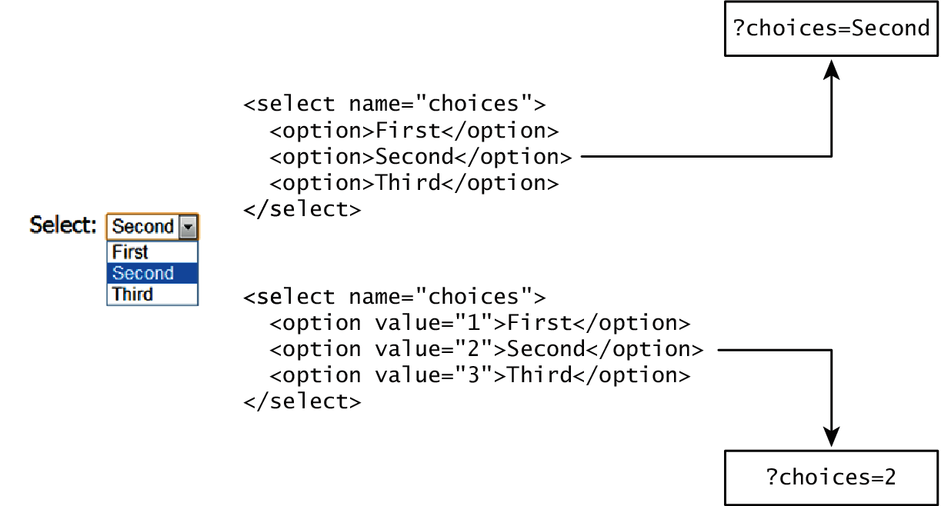
Which Value to send
Select Lists Cont.
The value attribute of the <option> element is used to specify what value will be sent back to the server.
The value attribute is optional; if it is not specified, then the text within the container is sent instead

Slide 36
Radio Buttons
Radio buttons are useful when you want the user to select a single item from a small list of choices and you want all the choices to be visible
radio buttons are added via the <input type="radio"> element
The buttons are mutually exclusive (i.e., only one can be chosen) by sharing the same name attribute
The checked attribute is used to indicate the default choice
the value attribute works in the same manner as with the <option> element

Slide 37
Radio Buttons

Slide 38
Checkboxes
Checkboxes are used for getting yes/no or on/off responses from the user.
checkboxes are added via the <input type="checkbox”> Element
You can also group checkboxes together by having them share the same name attribute
Each checked checkbox will have its value sent to the server
Like with radio buttons, the checked attribute can be used to set the default value of a checkbox

Slide 39
Checkboxes

Slide 40
Button Controls
Type | Description
<input type="submit"> | Creates a button that submits the form data to the server.
<input type="reset"> | Creates a button that clears any of the user’s already entered form data.
<input type="button"> | Creates a custom button. This button may require Javascript for it to actually perform any action.
<input type="image"> | Creates a custom submit button that uses an image for its display.
<button> | Creates a custom button. The <button> element differs from <input type="button"> in that you can completely customize what appears in the button; using it, you can, for instance, include both images and text, or skip server-side processing entirely by using hyperlinks. You can turn the button into a submit button by using the type="submit" attribute.

Slide 41
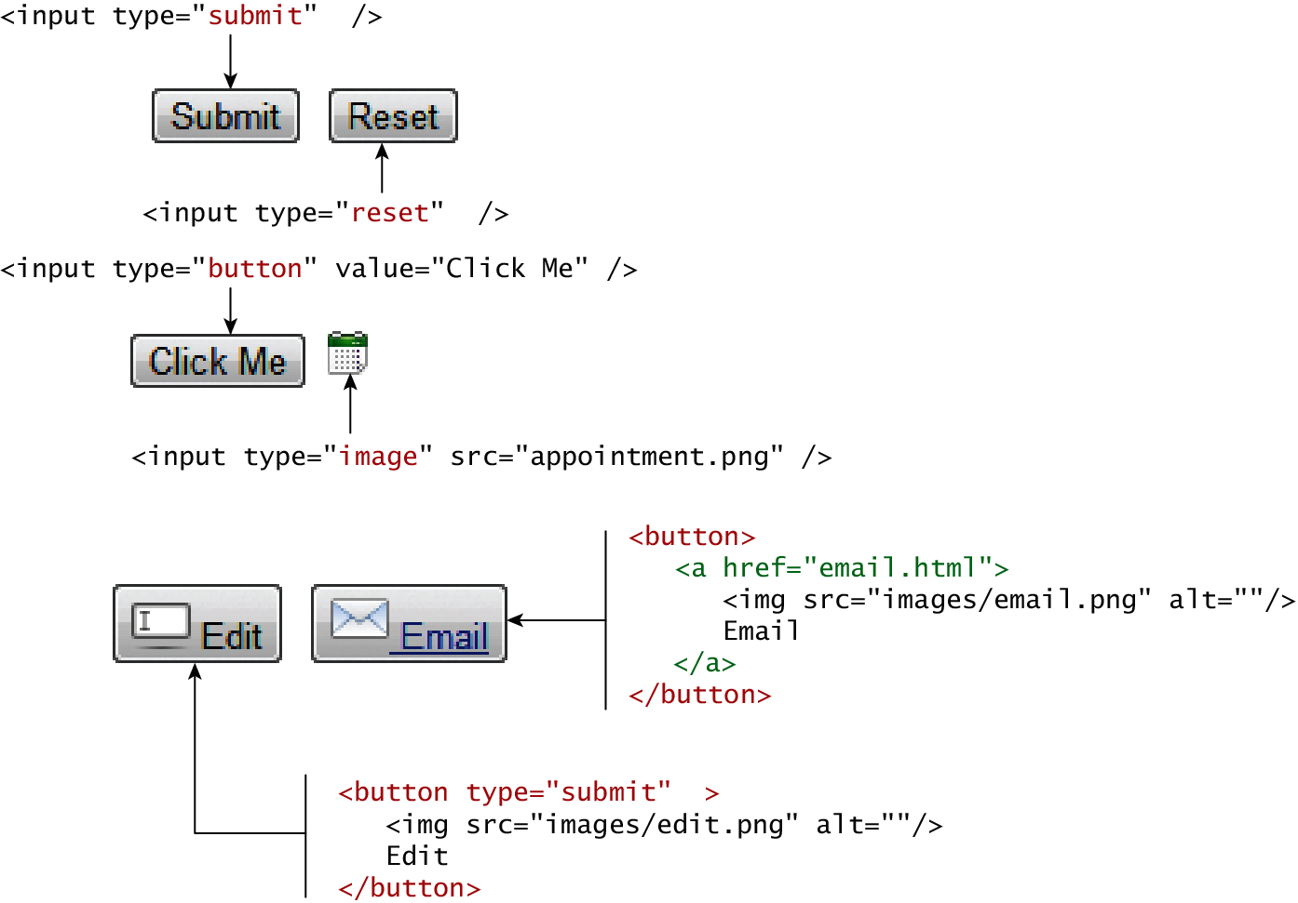
Button Controls

Slide 42
Specialized Controls
I’m so special
<input type=hidden>
<input type=file>

Slide 43
Number and Range
Typically input values need be validated. Although server side validation is required, optional client side pre-validation is good practice.
The number and range controls Added in HTML5 provide a way to input numeric values that eliminates the need for JavaScript numeric validation!!!

Slide 44
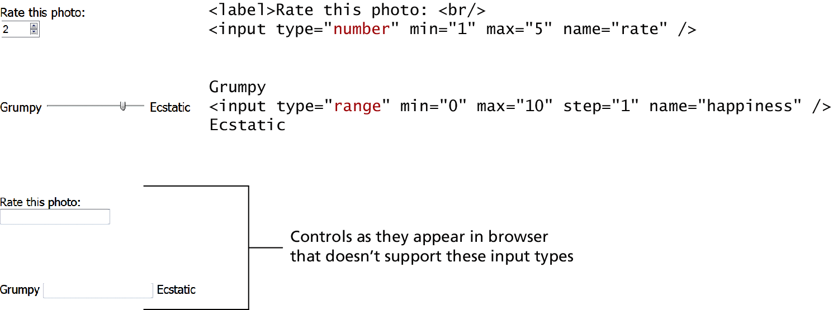
Number and Range

Slide 45
Color

Slide 46
Date and Time Controls
Dates and times often need validation when gathering this information from a regular text input control.
From a user’s perspective, entering dates can be tricky as well: you probably have wondered at some point in time when entering a date into a web form, what format to enter it in, whether the day comes before the month, whether the month should be entered as an abbreviation or a number, and so on.

Slide 47
HTML5 Date and Time Controls

Slide 48
HTML5 Date and Time Controls

Slide 49
HTML Controls
Type | Description
date | Creates a general date input control. The format for the date is "yyyy-mm-dd".
time | Creates a time input control. The format for the time is "HH:MM:SS", for hours:minutes:seconds.
datetime | Creates a control in which the user can enter a date and time.
datetime-local | Creates a control in which the user can enter a date and time without specifying a time zone.
month | Creates a control in which the user can enter a month in a year. The format is "yyyy-mm".
week | Creates a control in which the user can specify a week in a year. The format is "yyyy-W##".

Slide 50
Other Controls
You mean there’s more
The <progress> and <meter> elements can be used to provide feedback to users,
but requires JavaScript to function dynamically.
The <output> element can be used to hold the output from a calculation.
The <keygen> element can be used to hold a private key for public-key encryption

Slide 51
Table and form accessibility

Slide 52
Web Accessibility
Not all web users are able to view the content on web pages in the same manner
The term web accessibility refers to the assistive technologies, various features of HTML that work with those technologies, and different coding and design practices that can make a site more usable for people with visual, mobility, auditory, and cognitive disabilities
In order to improve the accessibility of websites, the W3C created the Web Accessibility Initiative (WAI)
Web Content Accessibility Guidelines

Slide 53
Web Content Accessibility Guidelines
Provide text alternatives for any non-text content so that it can be changed into other forms people need, such as large print, braille, speech, symbols, or simpler language.
Create content that can be presented in different ways (for example simpler layout) without losing information or structure.
Make all functionality available from a keyboard.
Provide ways to help users navigate, find content, and determine where they are.

Slide 54
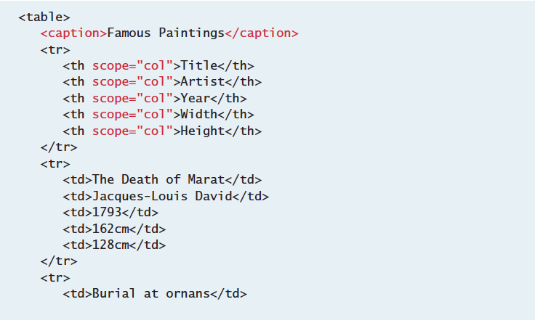
Accessible Tables
Describe the table’s content using the <caption> element
Connect the cells with a textual description in the header

Slide 55
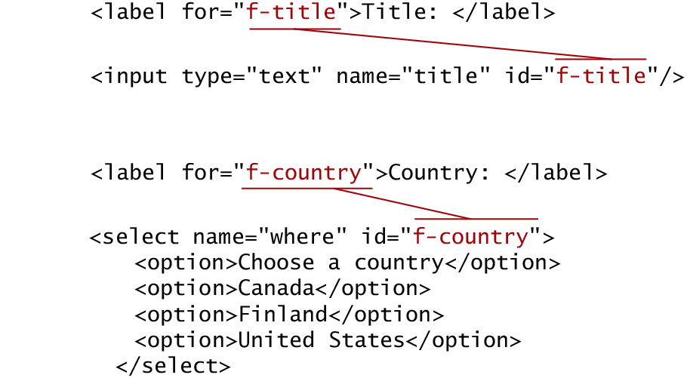
Accessible Forms
Recall the <fieldset>, <legend>, and <label> elements.
Each <label> element should be associated with a single input element.

Slide 56
MICROFORMATS

Slide 57
Microformats
A microformat is a small pattern of HTML markup and attributes to represent common blocks of information such as people, events, and news stories so that the information in them can be extracted and indexed by software agents

Slide 58
Microformat

