Slide 1
S. J. P. N. TRUST’S HIRASUGAR INSTITUTE OF TECHNOLOGY, NIDASOSHI Accredited at 'A' Grade by NAAC Programmes Accredited by NBA: CSE, ECE, EEE & ME.
Department of Computer Science & Engineering
Course: Web Technology & It’s Applications (18CS71)
Module 5: Managing State, jQuery, AJAX, MVC
Prof. C. R. Belavi
Asst. Prof. , Dept. of Computer Science & Engg.,
Hirasugar Institute of Technology, Nidasoshi

Slide 2
State in Web Applications
Not like a desktop application

Slide 3
State in Web Applications
Not like a desktop application
Unlike the unified single process that is the typical desktop application, a web application consists of a series of disconnected HTTP requests to a web server where each request for a server page is essentially a request to run a separate program.
The HTTP protocol does not, without programming intervention, distinguish two requests by one source from two requests from two different sources

Slide 4
State in Web Applications
What’s the issue?

Slide 5
State in Web Applications
What’s the desired outcome

Slide 6
State in Web Applications
How do we reach our desired outcome?
What mechanisms are available within HTTP to pass information to the server in our requests?
In HTTP, we can pass information using:
Query strings
Cookies

Slide 7
Passing Information via Query Strings

Slide 8
Info in Query Strings
Recall GET and POST

Slide 9
Passing Information via the URL Path

Slide 10
Passing Info via URL Path
An Idealized looking link structure
Dynamic URLs (i.e., query string parameters) are a pretty essential part of web application development.
How can we do without them?
The answer is to rewrite the dynamic URL into a static one (and vice versa). This process is commonly called URL rewriting.

Slide 11
URL rewriting
Search Engine (Fine… and Human) Friendly
We can try doing our own rewriting. Let us begin with the following URL with its query string information:
www.somedomain.com/DisplayArtist.php?artist=16
One typical alternate approach would be to rewrite the URL to:
www.somedomain.com/artists/16.php
Notice that the query string name and value have been turned into path names. One could improve this to make it more SEO friendly using the following:
www.somedomain.com/artists/Mary-Cassatt

Slide 12
URL rewriting
Search Engine (Fine… and Human) Friendly

Slide 13
URL rewriting in Apache
You are not yet ready grasshoper
The mod_rewrite module uses a rule-based rewriting engine that utilizes Perl compatible regular expressions to change the URLs so that the requested URL can be mapped or redirected to another URL internally.
Look in Chapter 19 for details on Apache and URL rewriting.

Slide 14
URL rewriting in Apache
You are not yet ready grasshoper
The mod_rewrite module uses a rule-based rewriting engine that utilizes Perl compatible regular expressions to change the URLs so that the requested URL can be mapped or redirected to another URL internally.
Look in Chapter 19 for details on Apache and URL rewriting.

Slide 15
Cookies

Slide 16
Cookies
Cookies are a client-side approach for persisting state information.
They are name=value pairs that are saved within one or more text files that are managed by the browser.

Slide 17
Cookies
How do they Work?
While cookie information is stored and retrieved by the browser, the information in a cookie travels within the HTTP header.
Sites that use cookies should not depend on their availability for critical features
The user can delete cookies or tamper with them

Slide 18
Cookies
How do they Work?

Slide 19
Cookies
Chocolate and peanut butter
Two kinds of Cookie
A session cookie has no expiry stated and thus will be deleted at the end of the user browsing session.
Persistent cookies have an expiry date specified;

Slide 20
Using Cookies
Writing a cookie
It is important to note that cookies must be written before any other page output.

Slide 21
Using Cookies
Reading a cookie

Slide 22
Using Cookies
Common usages
In addition to being used to track authenticated users and shopping carts, cookies can implement:
“Remember me” persistent cookie
Store user preferences
Track a user’s browsing behavior

Slide 23
Session State

Slide 24
Session State
Visual

Slide 25
Session State
All modern web development environments provide some type of session state mechanism.
Session state is a server-based state mechanism that lets web applications store and retrieve objects of any type for each unique user session.
Session state is ideal for storing more complex objects or data structures that are associated with a user session.
In PHP, session state is available to the via the $_SESSION variable
Must use session_start() to enable sessions.

Slide 26
Session State
Accessing State

Slide 27
Session State
Checking Session existance

Slide 28
Session State
Checking Session existence

Slide 29
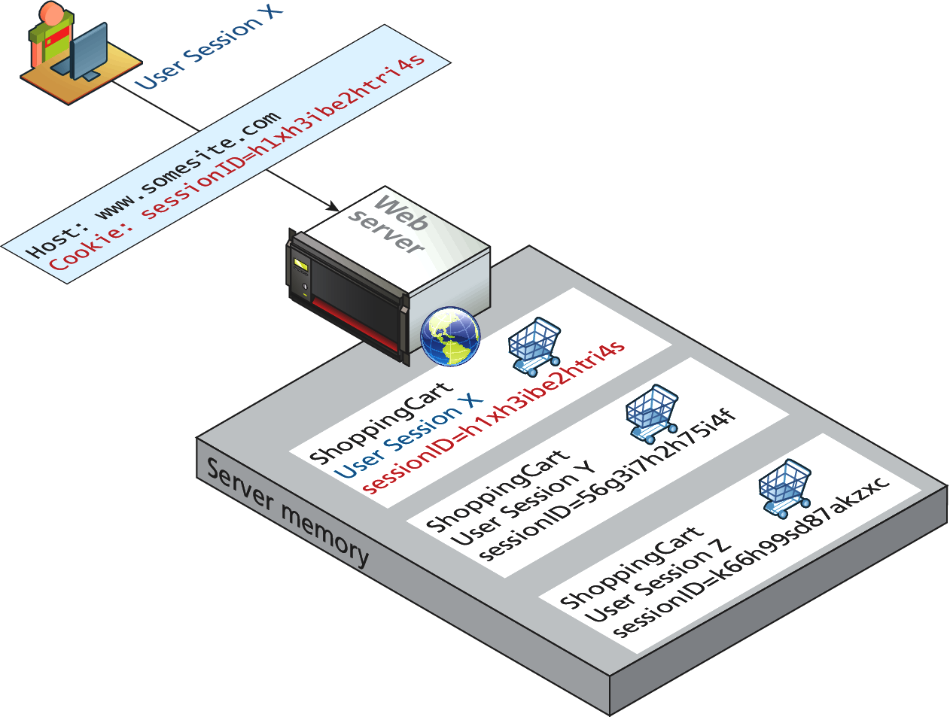
How does state session work?
It’s magic right?
Sessions in PHP are identified with a unique 32-byte session ID.
This is transmitted back and forth between the user and the server via a session cookie

Slide 30
How does state session work?
It’s magic right?
For a brand new session, PHP assigns an initially empty dictionary-style collection that can be used to hold any state values for this session.
When the request processing is finished, the session state is saved to some type of state storage mechanism, called a session state provider
When a new request is received for an already existing session, the session’s dictionary collection is filled with the previously saved session data from the session state provider.

Slide 31
HTML5 Web Storage

Slide 32
Web Storage
HTML5 only
Web storage is a new JavaScript-only API introduced in HTML5.4
It is meant to be a replacement (or perhaps supplement) to cookies, in that web storage is managed by the browser;
unlike cookies, web storage data is not transported to and from the server with every request and response.
In addition, web storage is not limited to the 4K size barrier of cookies;

Slide 33
Web Storage
Two types
Just as there were two types of cookies, there are two types of global web storage:
The localStorage object is for saving information that will persist between browser sessions.
The sessionStorage object is for information that will be lost once the browser session is finished.

Slide 34
Using Web Storage
JavaScript code for writing information to web storage

Slide 35
Using Web Storage
JavaScript code for reading information from web storage

Slide 36
Using Web Storage
Why would you do it?
A better way to think about web storage is not as a cookie replacement but as a local cache for relatively static items available to JavaScript
One practical use of web storage is to store static content downloaded asynchronously such as XML or JSON from a web service in web storage, thus reducing server load for subsequent requests by the session.

Slide 37
Using Web Storage
How would you do it?

Slide 38
Advanced JavaScript & JQuery

Slide 39
JavaSCript Pseudo-Classes

Slide 40
Using Object Literals
Without Classes
An object can be instantiated using object literals.
Object literals are a list of key-value pairs with colons between the key and value with commas separating key-value pairs.
Object literals are also known as Plain Objects in jQuery.

Slide 41
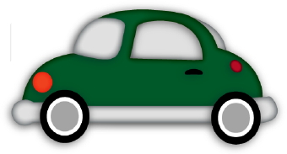
Object Oriented Design
Without Classes
JavaScript has no formal class mechanism.
Simple Variable
var car = "Fiat";
Then this
var car = {type:"Fiat", model:500, color:"white"};
Properties
car.name = Fiat car.model = 500 car.weight = 850kg car.color = white
Methods:
car.start() car.drive() car.brake() car.stop()

Slide 42
Using Object Literals
Consider a die (single dice)
//define a 6 faced dice, with a red color.
var oneDie = { color : "FF0000",
faces : [1,2,3,4,5,6]
};
These elements can be accessed using dot notation.
For instance
oneDie.color="0000FF";

Slide 43
Emulate Classes with functions
We told you this would get weird
Use functions to encapsulate variables and methods together.
Instantiation looks much like in PHP:
var oneDie = new Die("0000FF");

Slide 44
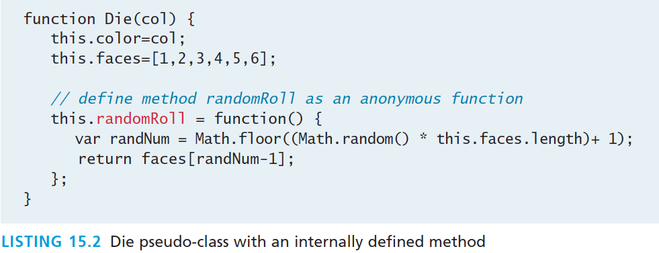
Emulate Classes with functions
Add methods to the object – mimic methods
One technique for adding a method inside of a class definition is by assigning an anonymous function to a variable
var oneDie = new Die("0000FF"); console.log(oneDie.randomRoll() + " was rolled");

Slide 45
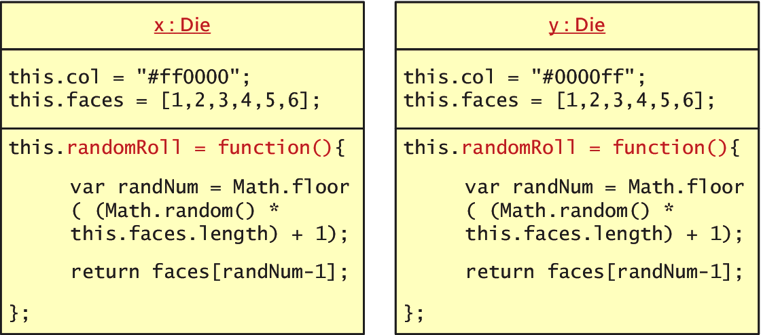
Emulate Classes with functions
Not very efficient
Defining methods as we have shown is not a memory-efficient
each inline method is redefined for each new object

Slide 46
Using Prototypes
Prototypes
So you can use a prototype of the class.
Prototypes are used to make JavaScript behave more like an object-oriented language.
The prototype properties and methods are defined once for all instances of an object.
Every object has a prototype

Slide 47
Using Prototypes
moving the randomRoll() function into the prototype.

Slide 48
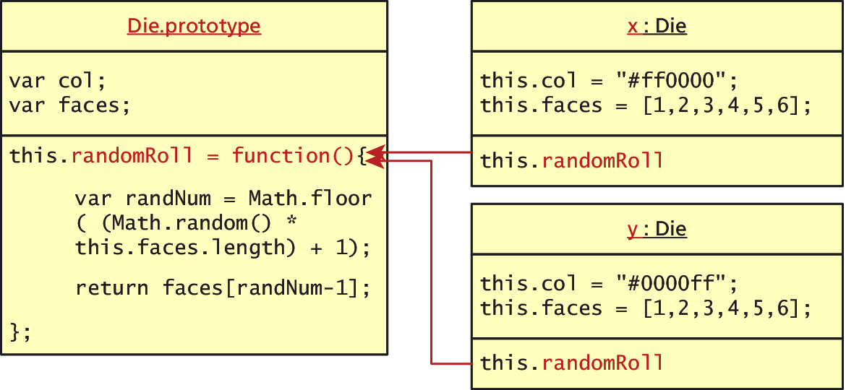
Using Prototypes
No duplication of methods
Since all instances of a Die share the same prototype object, the function declaration only happens one time and is shared with all Die instances.
A prototype is an object from which other objects inherit.

Slide 49
More about Prototypes
Extend any Object
Every object (and method) in JavaScript has a prototype.
In addition to using prototypes for our own pseudo-classes, prototypes enable you to extend existing classes by adding to their prototypes
Below we extend String:

Slide 50
More about Prototypes
Extending String, for example
Now any new instances of String will have this method available to them while existing strings will not.
Now we can use the new method in all new Strings.
The following example will output
Hello World has 3 letter l's.
var hel = new String("Hello World”); console.log(hel + "has" + hel.countChars("l") + " letter l's");

Slide 51
jQuery Foundations

Slide 52
jQuery
Framework
A library or framework is software that you can utilize in your own software, which provides some common implementations of standard ideas.
Many developers find that once they start using a framework like jQuery, there’s no going back to “pure” JavaScript because the framework offers so many useful shortcuts and succinct ways of doing things

Slide 53
jQuery
A 1 slide history
In August 2005 jQuery founder John Resig was looking into how to better combine CSS selectors with succinct JavaScript notation.
Within 1 year AJAX and animations were added
Additional modules
jQuery UI extension
mobile device support
Continues to improve.

Slide 54
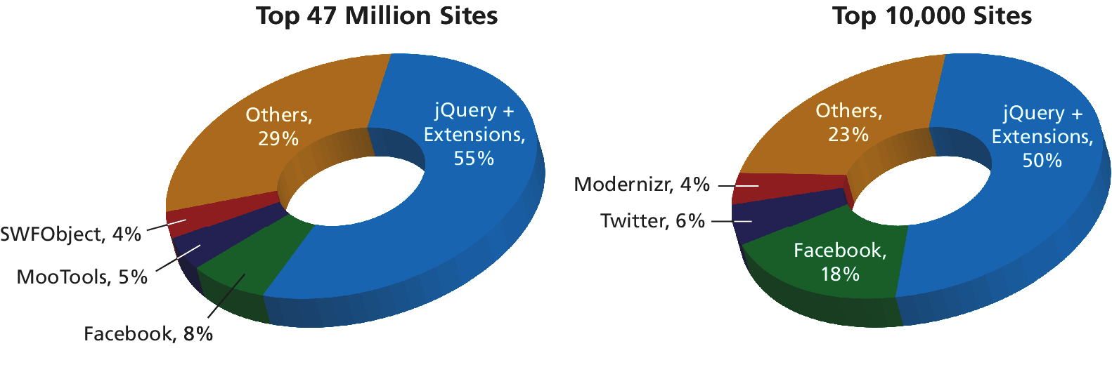
jQuery
Not the only one, but a popular one
jQuery is now the most popular JavaScript library currently in use as supported by the statistics from BuiltWith.com

Slide 55
Including jQuery
Let’s get started
You must either:
link to a locally hosted version of the library
Use an approved third-party host, such as Google, Microsoft, or jQuery itself

Slide 56
Including jQuery
Content Delivery Network
Using a third-party content delivery network (CDN) is advantageous for several reasons.
The bandwidth of the file is offloaded to reduce the demand on your servers.
The user may already have cached the third-party file and thus not have to download it again, thereby reducing the total loading time.
A disadvantage to the third-party CDN is that your jQuery will fail if the third-party host fails (unlikely but possible)

Slide 57
Including jQuery
Content Delivery Network and fallback

Slide 58
jQuery Selectors
Should ring a bell
When discussing basic JavaScript we introduced the getElementByID() and querySelector() selector functions in JavaScript.
Although the advanced querySelector() methods allow selection of DOM elements based on CSS selectors, it is only implemented in newest browsers
jQuery introduces its own way to select an element, which under the hood supports a myriad of older browsers for you!

Slide 59
jQuery Selectors
The easiest way to select an element yet
The relationship between DOM objects and selectors is so important in JavaScript programming that the pseudo-class bearing the name of the framework,
jQuery()
Is reserved for selecting elements from the DOM.
Because it is used so frequently, it has a shortcut notation and can be written as
$()

Slide 60
Basic Selectors
All the way back to CSS
The four basic selectors are:
$("*") Universal selector matches all elements (and is slow).
$("tag") Element selector matches all elements with the given element name.
$(".class") Class selector matches all elements with the given CSS class.
$("#id") Id selector matches all elements with a given HTML id attribute.

Slide 61
Basic Selectors
All the way back to CSS
For example, to select the single <div> element with id="grab" you would write:
var singleElement = $("#grab");
To get a set of all the <a> elements the selector would be:
var allAs = $("a");
These selectors replace the use of getElementById() entirely.

Slide 62
More CSS Selectors
jQuery’s selectors are powerful indeed
In addition to these basic selectors, you can use the other CSS selectors that were covered in Chapter 3 on CSS:
attribute selectors,
pseudo-element selectors, and
contextual selectors

Slide 63
More CSS Selectors
jQuery’s selectors are powerful indeed

Slide 64
Attribute Selector
Really a review of CSS
Recall from CSS that you can select
by attribute with square brackets
[attribute]
Specify a value with an equals sign
[attribute=value]
Search for a particular value in the beginning, end, or anywhere inside a string
[attribute^=value]
[attribute$=value]
[attribute*=value]

Slide 65
Attribute Selector
Really a review of CSS
Consider a selector to grab all <img> elements with an src attribute beginning with /artist/ as:
var artistImages = $("img[src^='/artist/']");

Slide 66
Pseudo-Element Selector
Not to be confused with the pseudo-classes in JavaScript
pseudo-element selectors are also from CSS and allow you to append to any selector using the colon and one of
:link
:visited
:focus
:hover
:active
:checked
:first-child, :first-line, and :first-letter

Slide 67
Pseudo-Element Selector
Not to be confused with the pseudo-classes in JavaScript
Selecting all links that have been visited, for example, would be specified with:
var visitedLinks = $("a:visited");

Slide 68
Contextual Selector
Put it into context
Contextual selectors are also from CSS. Recall that these include:
descendant (space)
child (>)
adjacent sibling (+)
and general sibling (~).
To select all <p> elements inside of <div> elements you would write
var para = $("div p");

Slide 69
Content Filters
Above and Beyond CSS
The content filter is the only jQuery selector that allows you to append filters to all of the selectors you’ve used thus far and match a particular pattern.
Select elements that have:
a particular child using :has()
have no children using :empty
match a particular piece of text with :contains()

Slide 70
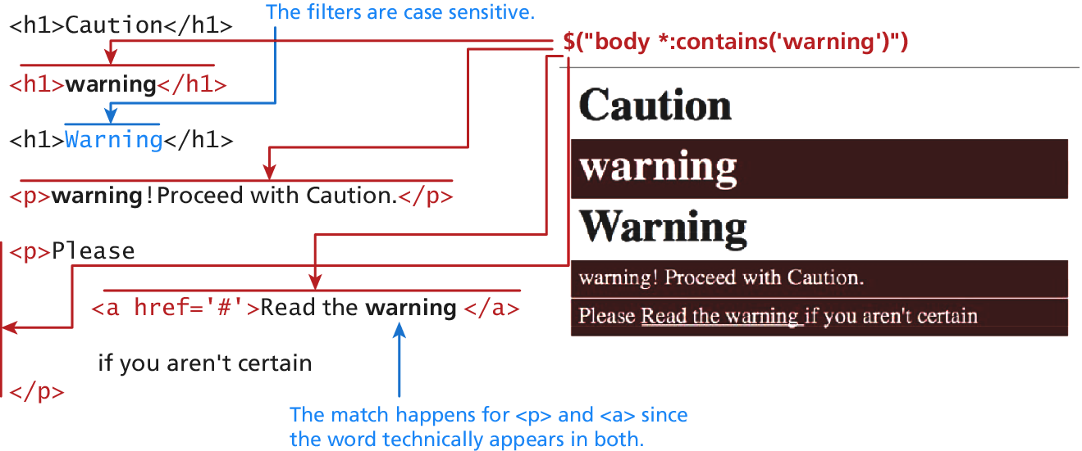
Content Filters
Above and Beyond CSS
$("body *:contains('warning')”)

Slide 71
Form Selectors
[m1]Au: I HAVEN’T TAGGED COMMAS IN THESE LISTS. Please check other lists in this table below.
Above and Beyond CSS
Selector | CSS Equivalent | Description
$(:button) | $("button, input[type='button']") | Selects all buttons
$(:checkbox) | $('[type=checkbox]‘) | Selects all checkboxes
$(:checked) | No Equivalent | Selects elements that are checked. This includes radio buttons and checkboxes.
$(:disabled) | No Equivalent | Selects form elements that are disabled.
$(:enabled) | No Equivalent | Opposite of :disabled
$(:file) | $('[type=file]') | Selects all elements of type file
$(:focus) | $( document.activeElement ) | The element with focus
$(:image) | $('[type=image]') | Selects all elements of type image
$(:input) | No Equivalent | Selects all <input>, <textarea>, <select>, and <button> elements.
$(:password) | $('[type=password]') | Selects all password fields
$(:radio) | $('[type=radio]') | Selects all radio elements
$(:reset) | $('[type=reset]') | Selects all the reset buttons
$(:selected) | No Equivalent | Selects all the elements that are currently selected of type <option>. It does not include checkboxes or radio buttons.
$(:submit) | $('[type=submit]') | Selects all submit input elements
$(:text) | No Equivalent | Selects all input elements of type text. $('[type=text]') is almost the same, except that $(:text) includes <input> fields with no type specified.

Slide 72
jQuery Attributes
Back to HTML now.
In order to understand how to fully manipulate the elements you now have access to, one must understand an element’s attributes and properties.
The core set of attributes related to DOM elements are the ones specified in the HTML tags.
The href attribute of an <a> tag
The src attribute of an <img>
The class attribute of most elements

Slide 73
jQuery Attributes
And some examples
In jQuery we can both set and get an attribute value by using the attr() method on any element from a selector.
// var link is assigned the href attribute of the first <a> tag var link = $("a").attr("href");
// change all links in the page to http://funwebdev.com $("a").attr("href","http://funwebdev.com");
// change the class for all images on the page to fancy $("img").attr("class","fancy");

Slide 74
HTML Properties
Full circle
Many HTML tags include properties as well as attributes, the most common being the checked property of a radio button or checkbox.
The prop() method is the preferred way to retrieve and set the value of a property although, attr() may return some (less useful) values.
<input class ="meh" type="checkbox" checked="checked">
Is accessed by jQuery as follows:
var theBox = $(".meh"); theBox.prop("checked"); // evaluates to TRUE theBox.attr("checked"); // evaluates to "checked"

Slide 75
Changing CSS
With jQuery
jQuery provides the extremely intuitive css() methods.
To get a css value use the css() method with 1 parameter:
$color = $("#colourBox").css("background-color"); // get the color
To set a CSS variable use css() with two parameters: the first being the CSS attribute, and the second the value.
// set color to red $("#colourBox").css("background-color", "#FF0000");

Slide 76
Shortcut Methods
With jQuery
The html() method is used to get the HTML contents of an element. If passed with a parameter, it updates the HTML of that element.
The val() method returns the value of the element.
The shortcut methods addClass(className) / removeClass(className) add or remove a CSS class to the element being worked on. The className used for these functions can contain a space-separated list of classnames to be added or removed.
The hasClass(classname) method returns true if the element has the className currently assigned. False, otherwise.

Slide 77
jQuery Listeners
Set up after page load
In JavaScript, you learned why having your listeners set up inside of the window.onload() event was a good practice.
With jQuery we do the same thing but use the $(document).ready() event

Slide 78
jQuery Listeners
Listener Management
While pure JavaScript uses the addEventListener() method, jQuery has on() and off() methods as well as shortcut methods to attach events.

Slide 79
Modifying the DOM
Creating Nodes

Slide 80
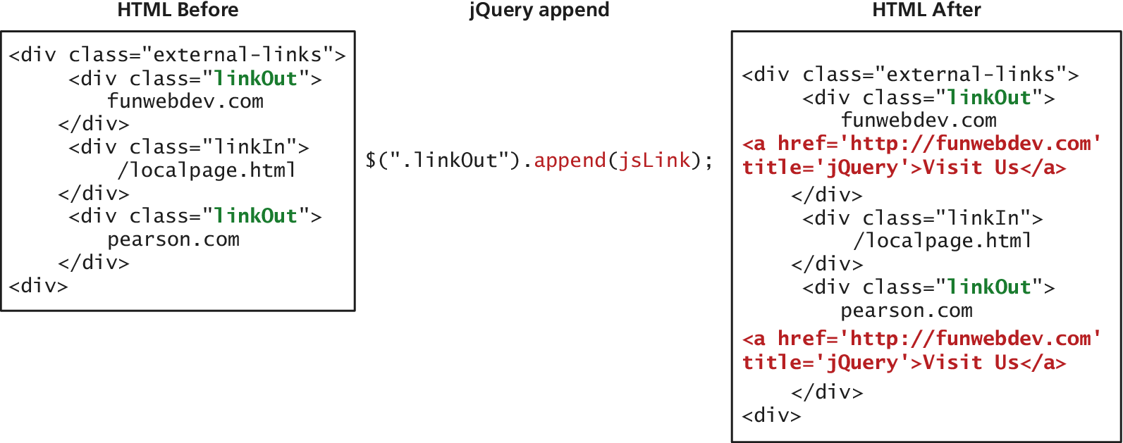
Modifying the DOM
Appending DOM Elements
The append() method takes as a parameter an HTML string, a DOM object, or a jQuery object. That object is then added as the last child to the element(s) being selected.

Slide 81
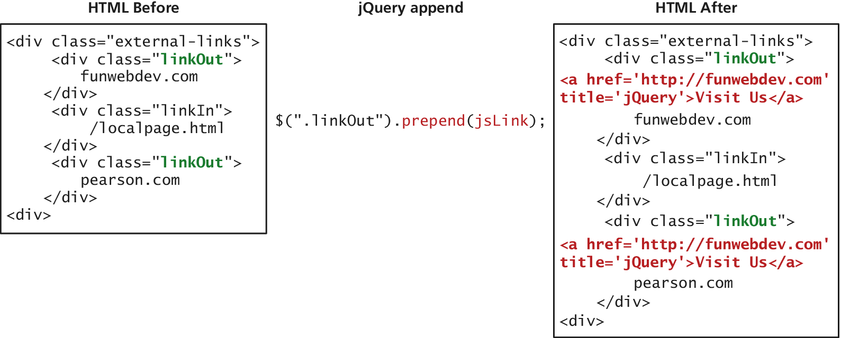
Modifying the DOM
Prepending DOM Elements
The prepend() and prependTo() methods operate in a similar manner except that they add the new element as the first child rather than the last.

Slide 82
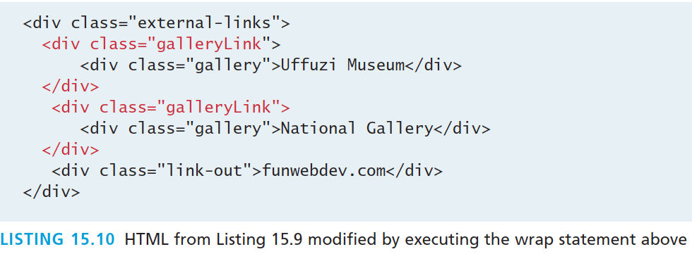
Modifying the DOM
Wrapping Existing DOM in New Tags
$(".gallery").wrap('<div class="galleryLink"/>');

Slide 83
Modifying the DOM
Wrapping Existing DOM in New Tags
A more advanced technique might make use of the content of each div being modified. In that case we use a callback function in place of a simple element.
The wrap() method is a callback function, which is called for each element in a set (often an array).
Each element then becomes this for the duration of one of the wrap() function’s executions, allowing the unique title attributes as shown in Listing 15.12.

Slide 84
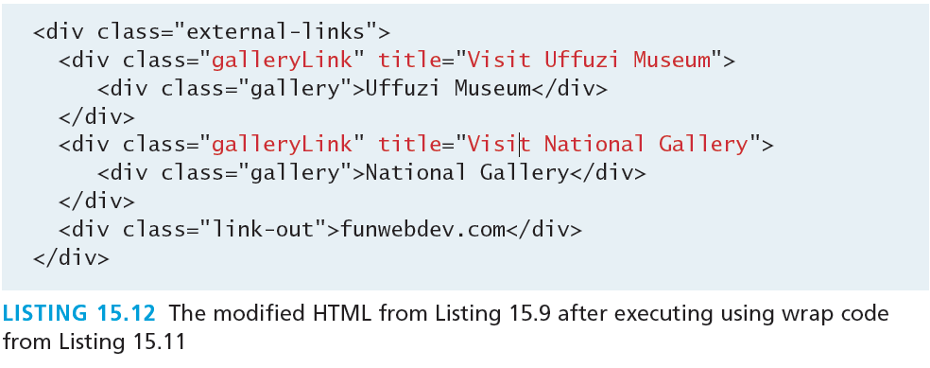
Modifying the DOM
Wrapping Existing DOM in New Tags

Slide 85
AJAX
Section 3 of 6

Slide 86
AJAX
Asynchronous JavaScript with XML
Asynchronous JavaScript with XML (AJAX) is a term used to describe a paradigm that allows a web browser to send messages back to the server without interrupting the flow of what’s being shown in the browser.

Slide 87
AJAX
UML of an asynchronous request

Slide 88
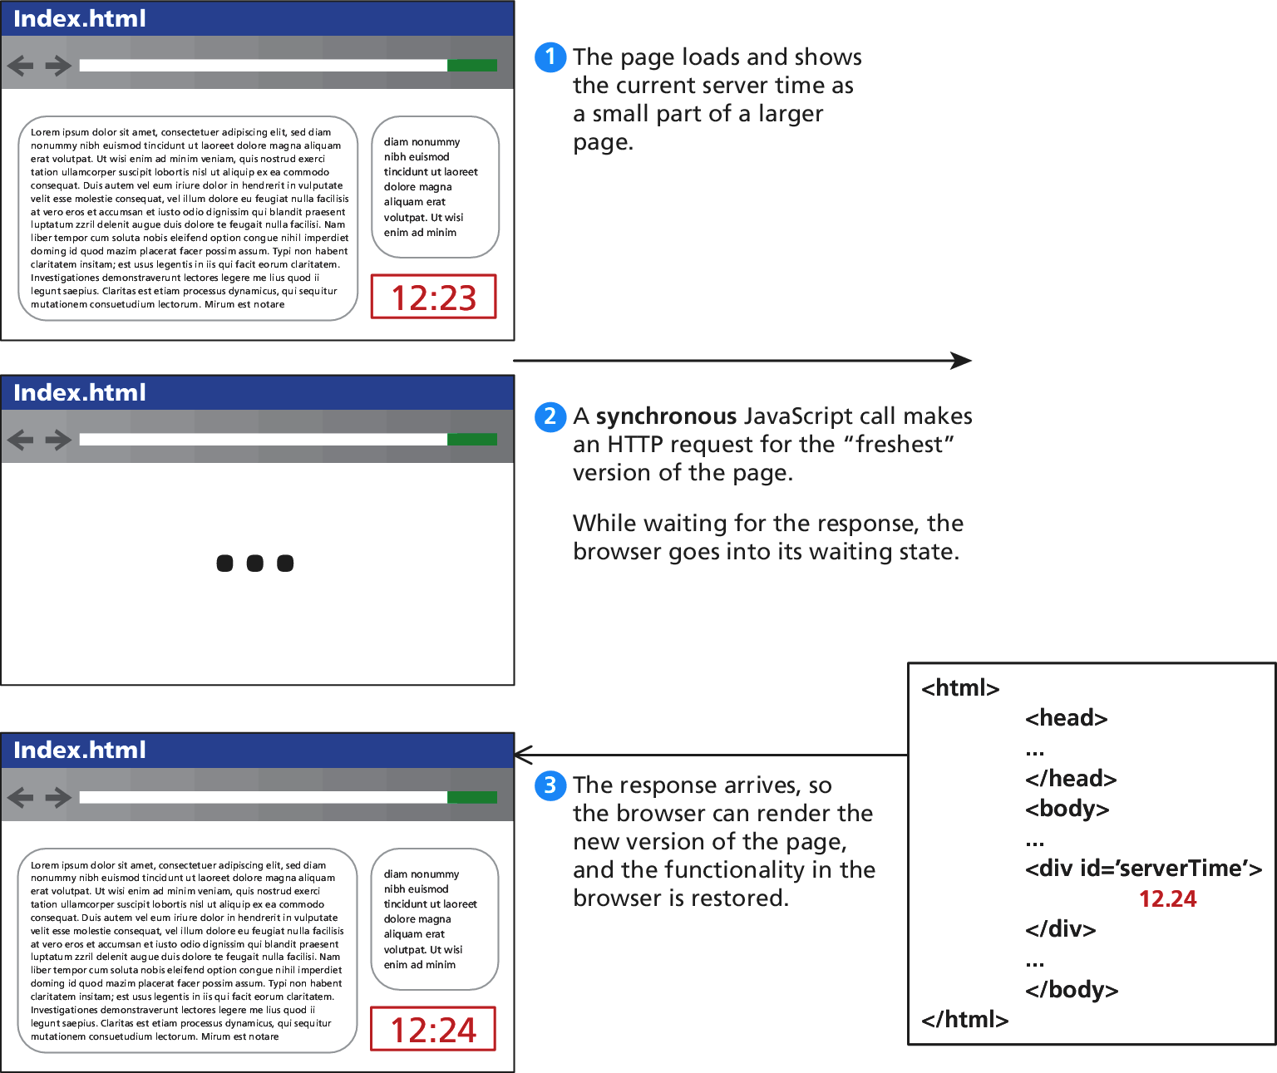
AJAX
Consider a webpage that displays the server’s time

Slide 89
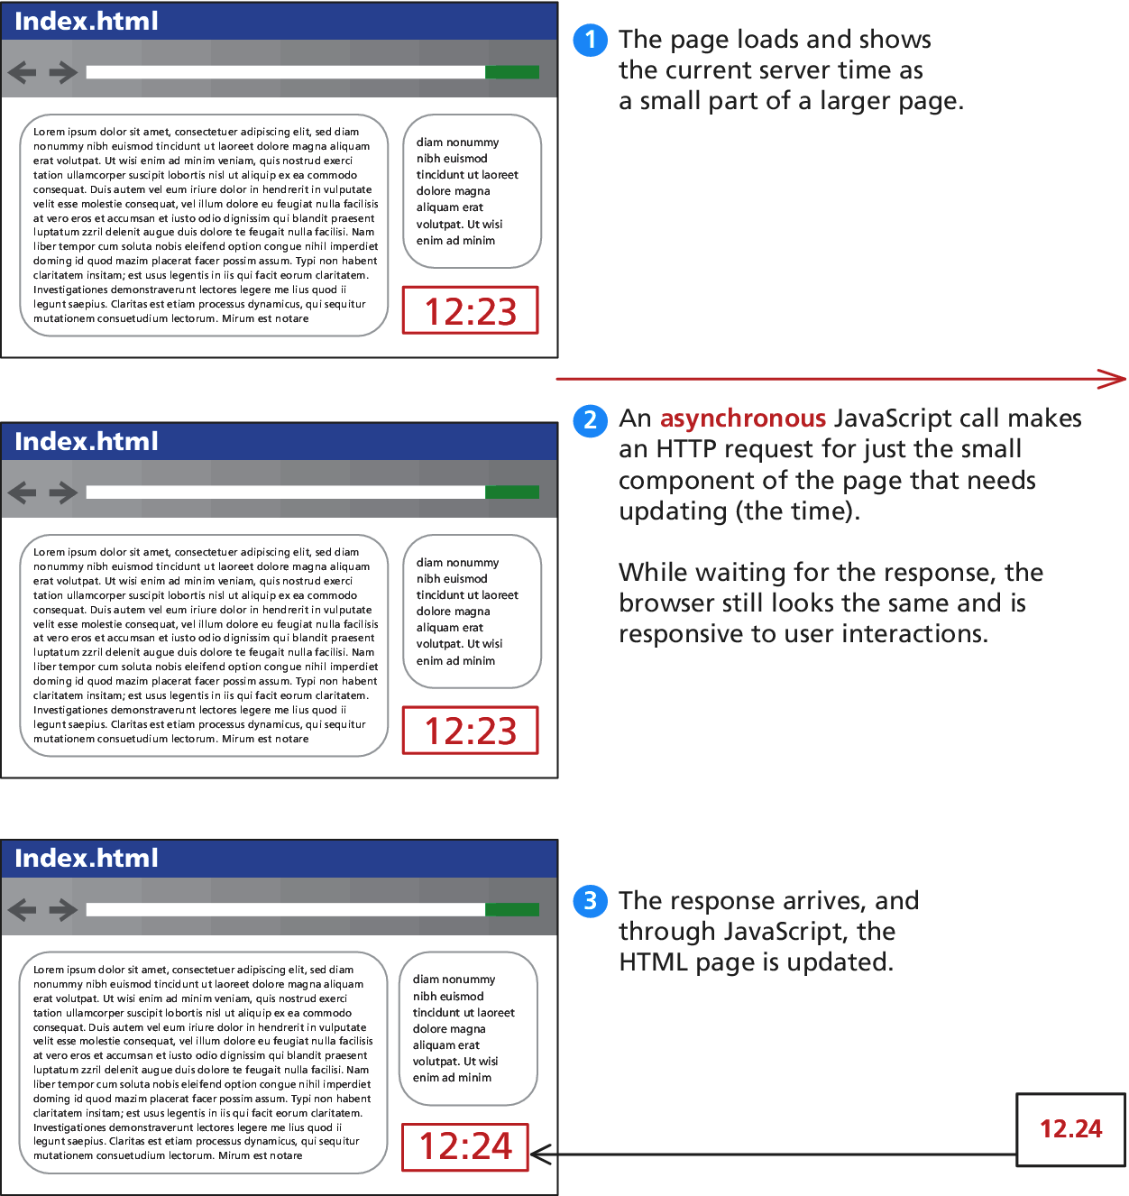
AJAX
Consider a webpage that displays the server’s time

Slide 90
AJAX
Making Asynchronous requests
jQuery provides a family of methods to make asynchronous requests. We will start simple and work our way up.
Consider the very simple server time example we just saw. If currentTime.php returns a single string and you want to load that value asynchronously into the <div id="timeDiv"> element, you could write:
$("#timeDiv").load("currentTime.php");

Slide 91
AJAX
GET Requests
$.get("/vote.php?option=C");

Slide 92
AJAX
GET Requests – formal definition
jQuery.get ( url [, data ] [, success(data, textStatus, jqXHR) ] [, dataType ] )
url is a string that holds the location to send the request.
data is an optional parameter that is a query string or a Plain Object.
success(data,textStatus,jqXHR) is an optional callback function that executes when the response is received.
data holding the body of the response as a string.
textStatus holding the status of the request (i.e., “success”).
jqXHR holding a jqXHR object, described shortly.
dataType is an optional parameter to hold the type of data expected from the server.

Slide 93
AJAX
GET Requests – an example

Slide 94
AJAX
The jqXHR Object
All of the $.get() requests made by jQuery return a jqXHR object to encapsulate the response from the server.
In practice that means the data being referred to in the callback from Listing 15.13 is actually an object with backward compatibility with XMLHttpRequest.

Slide 95
AJAX
jqXHR - XMLHttpRequest compatibility
abort() stops execution and prevents any callback or handlers from receiving the trigger to execute.
getResponseHeader() takes a parameter and gets the current value of that header.
readyState is an integer from 1 to 4 representing the state of the request. The values include 1: sending, 3: response being processed, and 4: completed.
responseXML and/or responseText the main response to the request.
setRequestHeader(name, value) when used before actually instantiating the request allows headers to be changed for the request.
status is the HTTP request status codes (200 = ok)
statusText is the associated description of the status code.

Slide 96
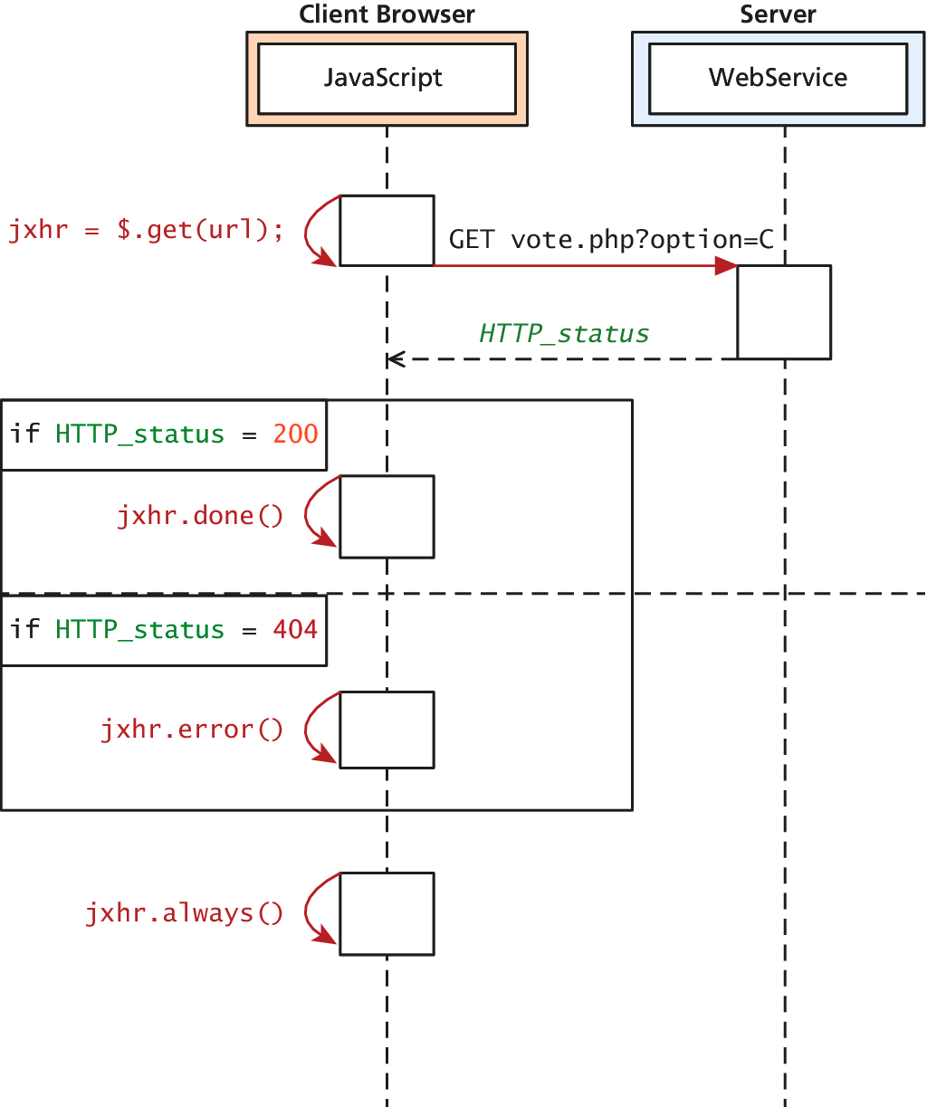
jqXHR
Actually quite easy to use
jqXHR objects have methods
done()
fail()
always()
which allow us to structure our code in a more modular way than the inline callback

Slide 97
jqXHR
Very modular code

Slide 98
POST requests
Via jQuery AJAX
POST requests are often preferred to GET requests because one can post an unlimited amount of data, and because they do not generate viewable URLs for each action.
GET requests are typically not used when we have forms because of the messy URLs and that limitation on how much data we can transmit.
With POST it is possible to transmit files, something which is not possible with GET.

Slide 99
POST requests
Via jQuery AJAX
The HTTP 1.1 definition describes GET as a safe method meaning that they should not change anything, and should only read data.
POSTs on the other hand are not safe, and should be used whenever we are changing the state of our system (like casting a vote). get() method.
POST syntax is almost identical to GET.
jQuery.post ( url [, data ] [, success(data, textStatus, jqXHR) ] [, dataType ] )

Slide 100
POST requests
Via jQuery AJAX
If we were to convert our vote casting code it would simply change the first line from
var jqxhr = $.get("/vote.php?option=C");
to
var jqxhr = $.post("/vote.php", "option=C");

Slide 101
POST requests
Serialize() will seriously help
serialize() can be called on any form object to return its current key-value pairing as an & separated string, suitable for use with post().
var postData = $("#voteForm").serialize();
$.post("vote.php", postData);

Slide 102
Ajax
You have complete control
It turns out both the $.get() and $.post() methods are actually shorthand forms for the jQuery().ajax() method
The ajax() method has two versions. In the first it takes two parameters: a URL and a Plain Object, containing any of over 30 fields.
A second version with only one parameter is more commonly used, where the URL is but one of the key-value pairs in the Plain Object.

Slide 103
Ajax
More verbose
The one line required to post our form using get() becomes the more verbose code

Slide 104
Ajax
You have complete control
To pass HTTP headers to the ajax() method, you enclose as many as you would like in a Plain Object. To illustrate how you could override User-Agent and Referer headers in the POST

Slide 105
CORS
Cross Origin Resource Sharing
Since modern browsers prevent cross-origin requests by default (which is good for security), sharing content legitimately between two domains becomes harder.
Cross-origin resource sharing (CORS) uses new headers in the HTML5 standard implemented in most new browsers.
If a site wants to allow any domain to access its content through JavaScript, it would add the following header to all of its responses.
Access-Control-Allow-Origin: *

Slide 106
CORS
Cross Origin Resource Sharing
A better usage is to specify specific domains that are allowed, rather than cast the gates open to each and every domain. To allow our domain to make cross site requests we would add the header:
Access-Control-Allow-Origin: www.funwebdev.com
Rather than the wildcard *.

Slide 107
Asynchronous File Transmission

Slide 108
Asynchronous File Transmission
A Primer
Consider a simple form as defined below:

Slide 109
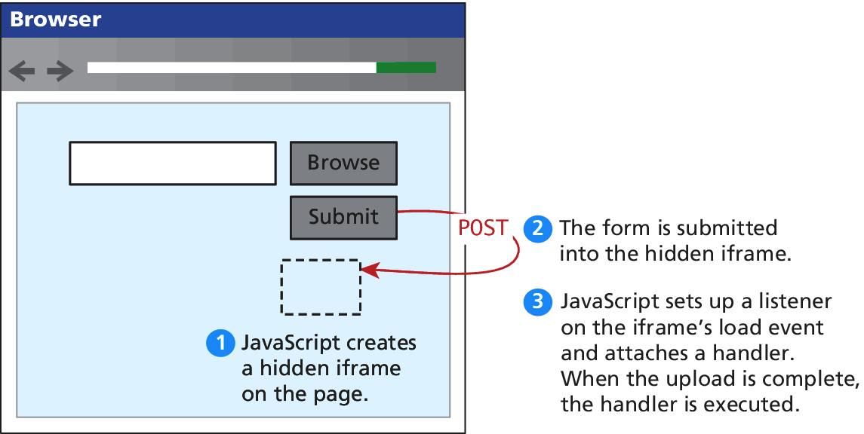
Asynchronous File Transmission
The old iFrame technique
The original workaround to allow the asynchronous posting of files was to use a hidden <iframe> element to receive the posted files.

Slide 110
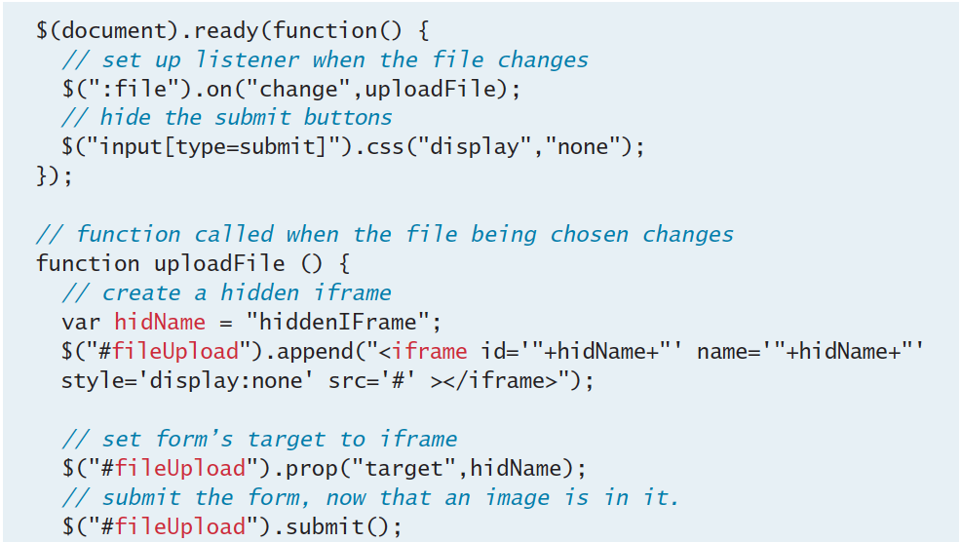
Asynchronous File Transmission
The old iFrame technique

Slide 111
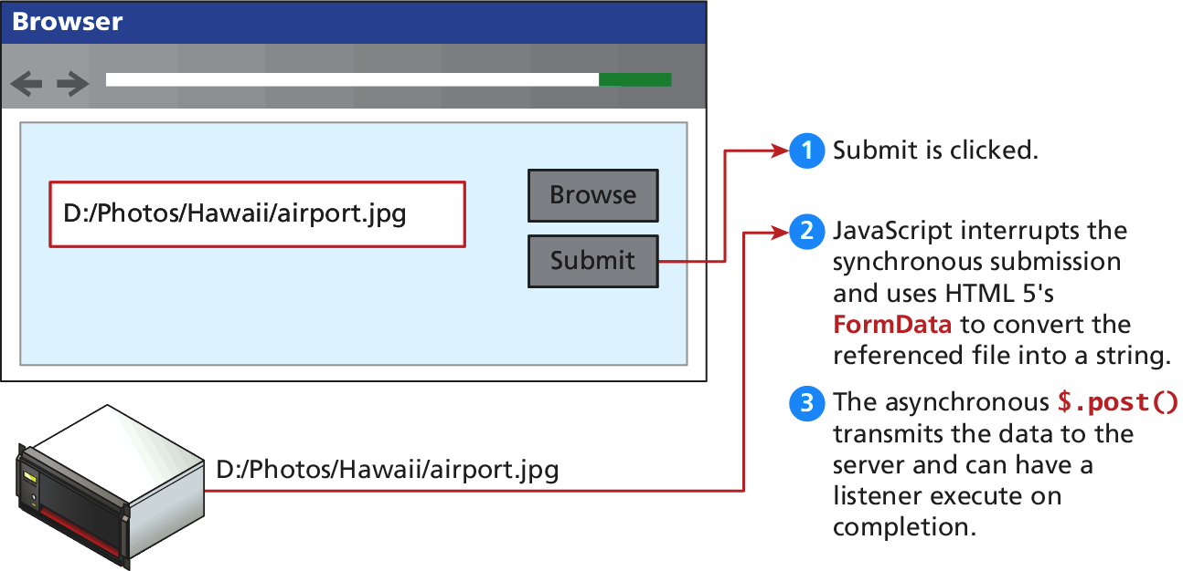
Asynchronous File Transmission
New Form Data technique
Using the FormData interface and File API, which is part of HTML5, you no longer have to trick the browser into posting your file data asynchronously.

Slide 112
Asynchronous File Transmission
New Form Data technique

Slide 113
Asynchronous File Transmission
Advanced modern technique
When we consider uploading multiple files, you may want to upload a single file, rather than the entire form every time. To support that pattern, you can access a single file and post it by appending the raw file to a FormData object.
The advantage of this technique is that you submit each file to the server asynchronously as the user changes it; and it allows multiple files to be transmitted at once.

Slide 114
Asynchronous File Transmission
Advanced modern technique

Slide 115
Animation

Slide 116
Animation
Hide() and Show()
The hide() and show() methods can be called with no arguments to perform a default animation. Another version allows two parameters: the duration of the animation (in milliseconds) and a callback method to execute on completion.

Slide 117
Animation
fadeIn() and fadeOut()
The fadeIn() and fadeOut() shortcut methods control the opacity of an element. The parameters passed are the duration and the callback, just like hide() and show(). Unlike hide() and show(), there is no scaling of the element, just strictly control over the transparency.

Slide 118
Animation
SlideUp() and SlideDown()
slideUp() and slideDown() do not touch the opacity of an element, but rather gradually change its height.
email icon from http://openiconlibrary.sourceforge.net.

Slide 119
Animation
Toggle()
As you may have seen, the shortcut methods come in pairs, which make them ideal for toggling between a shown and hidden state. Using a toggle method means you don’t have to check the current state and then conditionally call one of the two methods;
To toggle between the visible and hidden states you can use the toggle() methods.
To toggle between fading in and fading out, use the fadeToggle() method
To toggle between the two sliding states can be achieved using the slideToggle() method.

Slide 120
Raw Animation
Full control
The animate() method has several versions, but the one we will look at has the following form:
.animate( properties, options );
The properties parameter contains a Plain Object with all the CSS styles of the final state of the animation.
The options parameter contains another Plain Object with any of the following options set:

Slide 121
Raw Animation
Options parameter
always is the function to be called when the animation completes or stops with a fail condition. This function will always be called (hence the name).
done is a function to be called when the animation completes.
duration is a number controlling the duration of the animation.
fail is the function called if the animation does not complete.
progress is a function to be called after each step of the animation.

Slide 122
Raw Animation
Options parameter
queue is a Boolean value telling the animation whether to wait in the queue of animations or not. If false, the animation begins immediately.
step is a function you can define that will be called periodically while the animation is still going.
Advanced options called easing and specialEasing allow for advanced control over the speed of animation.

Slide 123
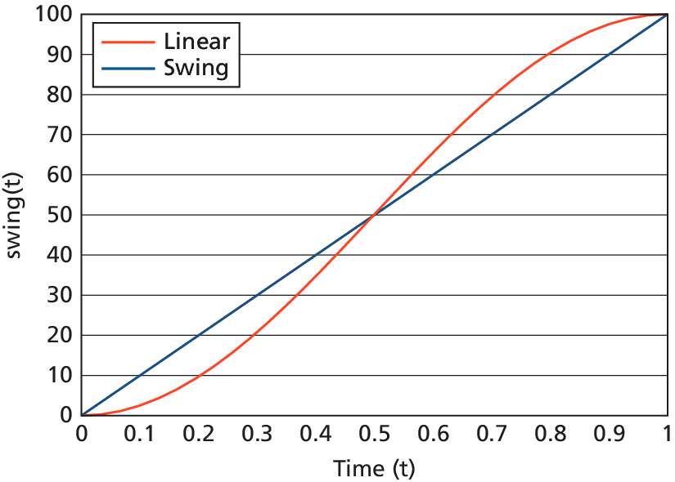
Raw Animation
Easing functions – advanced animation
In web development, easing functions are used to simulate that natural type of movement. They are mathematical equations that describe how fast or slow the transitions occur at various points during the animation.
Included in jQuery are
linear
swing
easing functions.

Slide 124
Raw Animation
Easing functions – advanced animation
For example, the function defining swing for values of time t between 0 and 1 is
The jQuery UI extension provides over 30 easing functions, including cubic functions and bouncing effects, so you should not have to define your own.

Slide 125
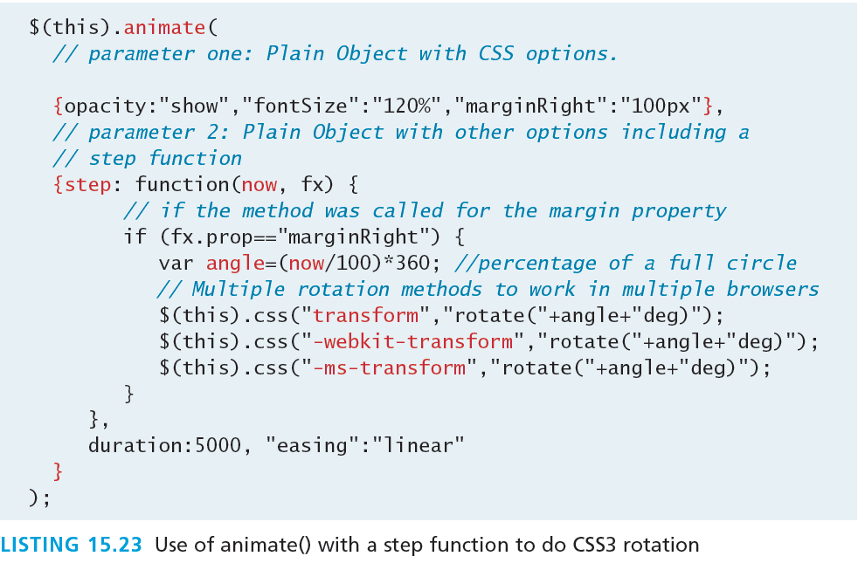
Advanced example
rotating

Slide 126
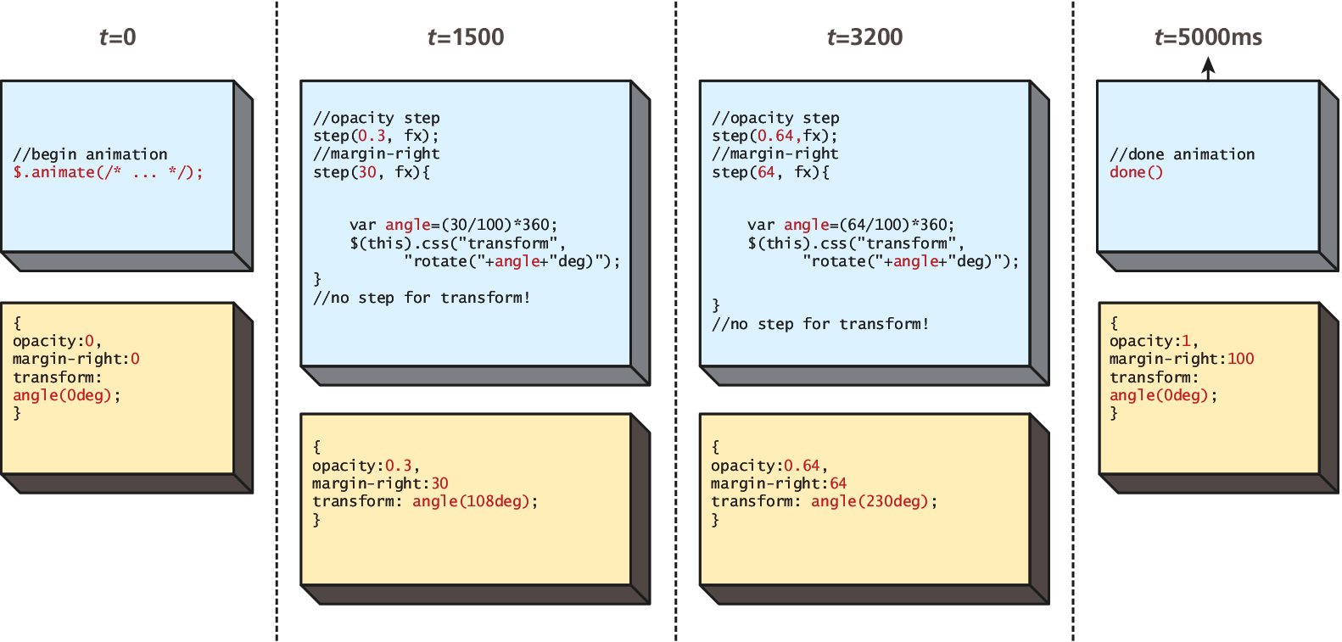
Raw Animation
Rotating

Slide 127
BackBone MVC Frameworks

Slide 128
Backbone
Another framework
Backbone is an MVC framework that further abstracts JavaScript with libraries intended to adhere more closely to the MVC model
This library is available from http://backbonejs.org and relies on the underscore library, available from http://underscorejs.org/.
Include with:
<script src="underscore-min.js"></script>
<script src="backbone-min.js"></script>

Slide 129
Backbone
Models
In Backbone, you build your client scripts around the concept of models.
Backbone.js defines models as
the heart of any JavaScript application, containing the interactive data as well as a large part of the logic surrounding it: conversions, validations, computed properties, and access control.
The Models you define using Backbone must extend Backbone.Model

Slide 130
Backbone
Collections
In addition to models, Backbone introduces the concept of Collections, which are normally used to contain lists of Model objects.
These collections have advanced features and like a database can have indexes to improve search performance.
A collection is defined by extending from Backbone’s Collection object.

Slide 131
Backbone
Views
Views allow you to translate your models into the HTML that is seen by the users.
They attach themselves to methods and properties of the Collection and define methods that will be called whenever Backbone determines the view needs refreshing.
You must always override the render() method since it defines the HTML that is output.

Slide 132
Backbone
Example

Slide 133
Backbone
A Model Example

Slide 134
Backbone
A Collection Example

Slide 135
Backbone
A View Example

Slide 136
Backbone
Bring it all together

