Slide 1
UNIT 4
Levels of Testing,
Integration Testing

Slide 2
contents
Levels of Testing, Integration Testing: Traditional view of testing levels, Alternative life-cycle models, The SATM system, Separating integration and system testing. A closer look at the SATM system, Decomposition-based,call graph-based, Path-based integrations.

Slide 3
Goals/Purpose of Integration Testing
• Presumes previously tested units
• Not system testing
• Tests functionality "between" unit and system levels
• Basis for test case identification?

Slide 4
Testing Level Assumptions and Objectives
• Unit assumptions
– All other units are correct
– Compiles correctly
• Integration assumptions
– Unit testing complete
• System assumptions
– Integration testing complete
– Tests occur at port boundary
• Unit goals
– Correct unit function
– Coverage metrics satisfied
• Integration goals
– Interfaces correct
– Correct function across units
– Fault isolation support
• System goals
– Correct system functions
– Non-functional
requirements tested
– Customer satisfaction.

Slide 5
The software process
A structured set of activities required to develop a
software system
  Specification;
  Design;
  Validation;
  Evolution.
A software process model is an abstract representation of a process. It presents a description of a process from some particular perspective.

Slide 6
Approaches to Integration Testing
(“source” of test cases)
• Functional Decomposition (most commonly described in
the literature)
– Top-down
– Bottom-up
– Sandwich
– “Big bang”
• Call graph
– Pairwise integration
– Neighborhood integration
• Paths
– MM-Paths
– Atomic System Functions

Slide 7
Waterfall model

Slide 8
Waterfall model phases
Requirements analysis and definition
System and software design
Implementation and unit testing
Integration and system testing
Operation and maintenance
The main drawback of the waterfall model is the difficulty of accommodating change after the process is underway. One phase has to be complete before moving onto the next phase.

Slide 9
Evolutionary development

Slide 10
Evolutionary development
Problems
  Lack of process visibility;
  Systems are often poorly structured;
  Special skills (e.g. in languages for rapid prototyping) may be required.
Applicability
  For small or medium-size interactive systems;
  For parts of large systems (e.g. the user interface);
  For short-lifetime systems.

Slide 11
Spiral development
Process is represented as a spiral rather than as a sequence of activities with backtracking.
Each loop in the spiral represents a phase in the process.
No fixed phases such as specification or design - loops in the spiral are chosen depending on what is required.
Risks are explicitly assessed and resolved throughout the process.

Slide 12
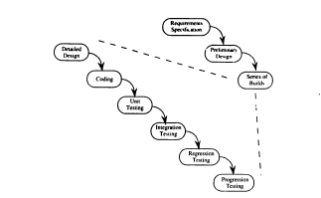
Waterfall spin-offs

Slide 13
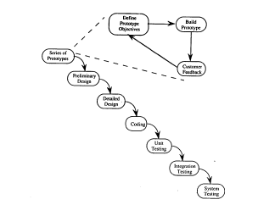

Slide 14
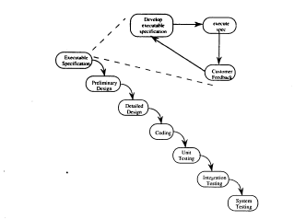

Slide 15
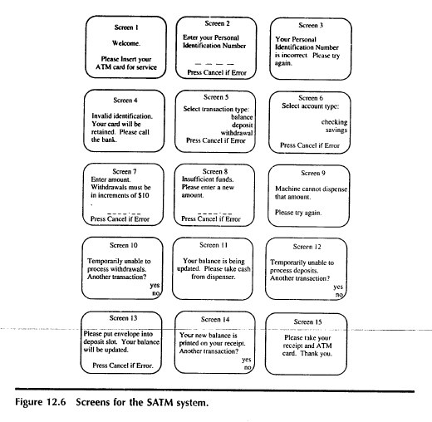

Slide 16
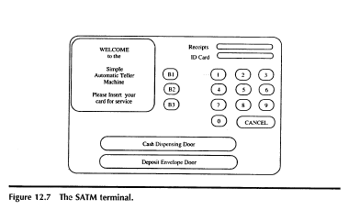

Slide 17
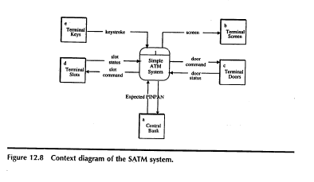

Slide 18
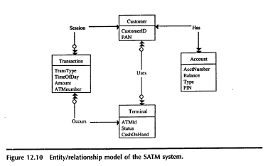

Slide 19
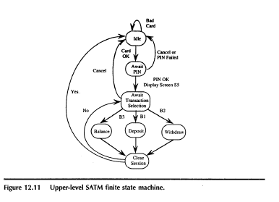

Slide 20
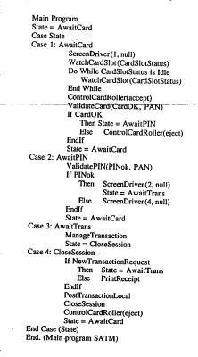
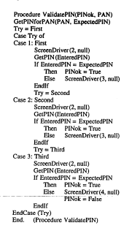

Slide 21
System Testing
Contents
1.System Testing Overview
2.Functional system Testing
3.Non-functional system Testing

Slide 22
System Testing overview
Testing complete system.
It is done by independent Tester.
Bring in customer perspective in testing.
Objective is to find product level defects and in building the confidence before the product is released to the customer.
Provide a fresh pair of eyes to discover defects not found earlier by testing.

Slide 23
Contents
A closer look at the SATM system
Decomposition based Integration

Slide 24
Closer look at SATM SYSTEM
The unit Calling graph is the directed graph in which nodes are program units and edges corresponds to program calls.

Slide 25
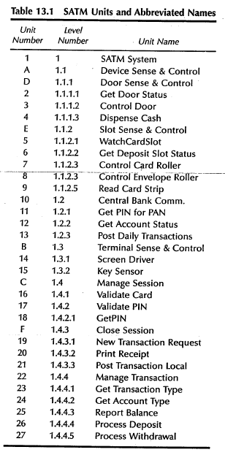
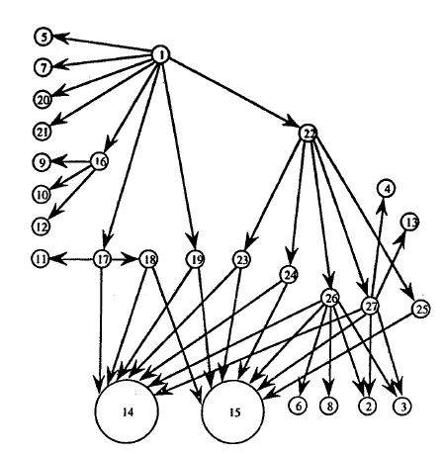

Slide 26
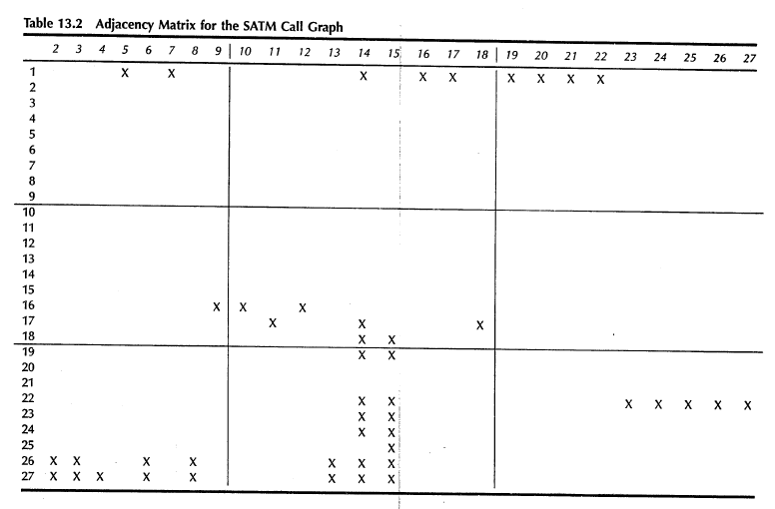

Slide 27
Decomposition Based Integration
The goal is to interface Among Separately tested units.
We can obtain four integration strategies based on functional decomposition tree
1.Top down
2.Bottom Up
3.Sandwich
4.Big bang

Slide 28
Top down
Top down integration begin with the main program.
Any lower level unit that is called by main program appear to be stub
Stub: they are piece of throwaway code that emulate a called unit
It follows breadth first traversal

Slide 29
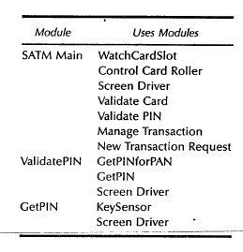
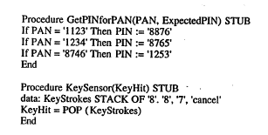

Slide 30
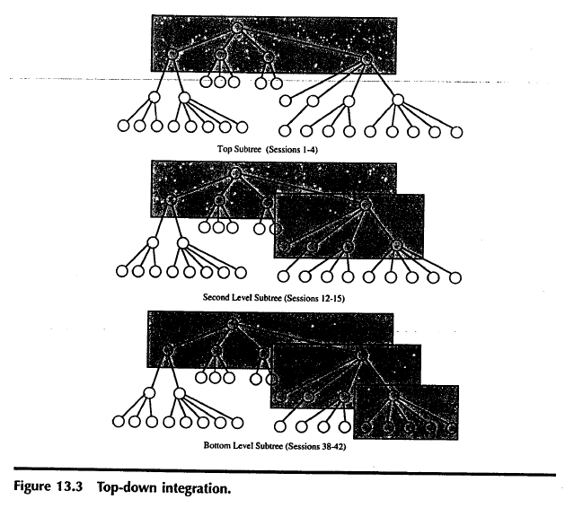

Slide 31
Bottom up Integration
It’s mirror image to the top down approach.
Only change is we use Drivers instead of stubs.

Slide 32
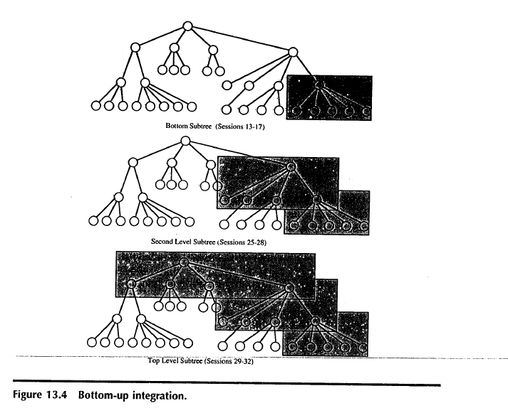

Slide 33
Top-Down Integration Mechanism
•Breadth-first traversal of the functional
decomposition tree.
• First step: Check main program logic, with all called
units replaced by stubs that always return correct
values.
• Move down one level
– replace one stub at a time with actual code.
– any fault must be in the newly integrated unit

Slide 34
Bottom-Up Integration Mechanism
• Reverse of top-down integration
• Start at leaves of the functional decomposition tree.
• Driver units...
– call next level unit
– serve as a small test bed
– “drive” the unit with inputs
– drivers know expected outputs
• As with top-down integration, one driver unit at a
time is replaced with actual code.
• Any fault is (most likely) in the newly integrated
code.

Slide 35
Call Graph-Based Integration
• Definition: The Call Graph of a program is a directed graph in which
– nodes are unit
– edges correspond to actual program calls (or messages)
• Call Graph Integration avoids the possibility of impossible edges in decomposition-based
integration.
• Can still use the notions of stubs and drivers.
• Can still traverse the Call Graph in a top-down or bottom-up strategy.

Slide 36
Call Graph-Based Integration (continued)
• Two strategies
– Pair-wise integration
– Neighborhood integration
• Degrees of nodes in the Call Graph indicate
integration sessions
– isLeap and weekDay are each used by three units
• Possible strategies
– test high indegree nodes first, or at least,
– pay special attention to “popular” nodes

Slide 37
Pair-Wise Integration
• By definition, and edge in the Call Graph refers to
an interface between the units that are the
endpoints of the edge.
• Every edge represents a pair of units to test.
• Still might need stubs and drivers
• Fault isolation is localized to the pair being
integrated

Slide 38
Neighborhood Integration
• The neighborhood (or radius 1) of a node in a
graph is the set of nodes that are one edge away
from the given node.
• This can be extended to larger sets by choosing
larger values for the radius.
• Stub and driver effort is reduced.

Slide 39
Path-Based Integration
• Wanted: an integration testing level construct
similar to DD-Paths for unit testing...
– extend the symbiosis of spec-based and code-based
testing to the integration level
– greater emphasis on behavioral threads
– shift emphasis from interface testing to interactions (confutations)
among units
• Need some new definitions
– source and sink nodes in a program graph
– module (unit ) execution path
– generalized message
– MM-Path

