Slide 1
Unit 2
ENERGY ECONOMIC ANALYSIS
Prepared by
Prof. S.D.Hirekodi
Assistant Professor
Dept of EEE
HIT-Nidasoshi

Slide 2
Syllabus
The time value of money concept, developing cash flow models, payback analysis, depreciation, taxes and tax credit – numerical problems.
7 Hours

Slide 3
Objectives
To understand the time value of money concept
To study the different cash flow models
To develop a cash flow model for uniform series compound amount factor & single compound amount factor
To learn about payback analysis
To understand about depreciation
To explain the meaning of life cycle cost analysis
To learn about tax & credits

Slide 4
Common Terminology In Energy Economics
Fixed capital
Cost spent for purchase land, plant & equipment
Capital cost of generating equipment
Capital cost of transmission system
Capital cost of distribution system

Slide 5
Common Terminology In Energy Economics
2.Running capital
Capital for purchase of raw material
Payment of salary
Wages
Fuel cost
Maintaing and repairing cost
Cost of water
Cost of lubricating oil

Slide 6
Common Terminology In Energy Economics
3. Taxes
Property of taxes levied on generating station building and substation building.
Tax should be paid to municipal corporation for the use of street road
Income tax from employees

Slide 7
Common Terminology In Energy Economics
4. Insurance charges
To cover the risk of fire to the building
To cover accidental breakdown
Workers compensation
5.Depreciation & sinking fund
After a certain time the equipment is to be replaced because of physical & functional reasons
Eg. Plant has worn out & become unfit for further use (physical reason) , capacity of the plant become inadequate due to load growth (functional reason)

Slide 8
Interest
Interest is the earning power of money.
It represents the growth of capital per unit period.
The period may be a month, a qurter, semi annual or a year.
Interest is the income produced by money that is lent or loaned.
Simple interest & Compound interest are the type of interest.

Slide 9
Interest
Simple interest
F= Total sum realized after n years
n= no. of periods
i= Interest, i= PnR
F=P(1+ni)
Compound interest
Fn= P*(1+i)^n

Slide 10
Cash flow model
What is cash flow???????
In financial accounting, a cash flow statement, also known as statement of cash flows, is a financial statement that shows how changes in balance sheet accounts and income affect cash and cash equivalents, and breaks the analysis down to operating, investing and financing activities.

Slide 11
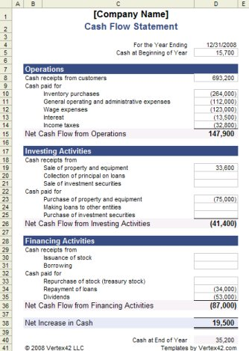
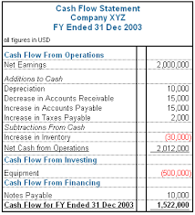
Cash flow model
Examples of cash flow

Slide 12
Cash flow model
In evaluating energy investing opportunities, the timing of cash receipts & expenditure are the– Objectives of cash flow model
Different cash flow models are available
( Three types)
End of period convention
Mid period convention
Continuous period convention

Slide 13
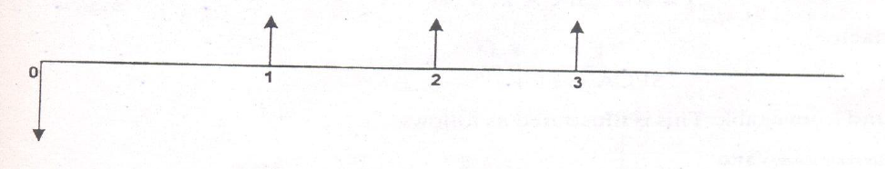
Cash flow model
1.End of period convention
All cash flow which occur at any time interval assumed to occur at the end of each interval.
Simplify the computation & errors.
The above diagram illustrates 3 years of duration.

Slide 14
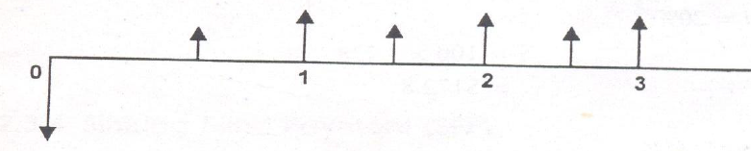
Cash flow model
2.Mid period convention
Cash flow can be assumed to occur at midperiod
Fig illustrate 3 year duration of mid period convention.

Slide 15
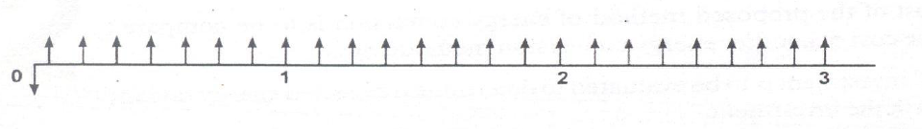
Cash flow model
3. Continuous flow convention
Cash flow for any period are received at a continues rate
The following diagram shows this for 8 cash flows per year again over three year period.

Slide 16
Time value of money concept
The change in the amount of money over a given time period is called time value of money
Money can “make” money if invested.
Money made depends upon interest rate
Money has a time value
Money can be spent, money to be borrowed, money to be kept as a depreciation

Slide 17
Time value of money
To compare the various option or alternatives it is necessary to convert all cash flows for each measures or scheme into equivalent base.
This is based on the guiding principle that money in hand today is more valuable than money received at some time in future.
To convert cash from one time into another different techniques are to be used.

Slide 18
Time value of money
Different techniques for time value of money are
1. Single Payment Compound Amount (SPCA)
2. Single Payment Present Worth (SPPW)
3. Uniform Series Compound Amount (USCA)
4. Sinking Fund Payment (SFP)
5. Uniform Series Present Worth (USPW)
6. Capital Recovery (CR)
7. Gradient Present Worth (GPW)

Slide 19
Time value of money
Different techniques for time value of money
1. Single Payment Compound Amount (SPCA)
This formula simply gives the future value (S) of an amount of money with present value (P) after n periods at an interest rate i.
S= P* SPCA at i,n
Where SPCA= (1+i)^n

Slide 20
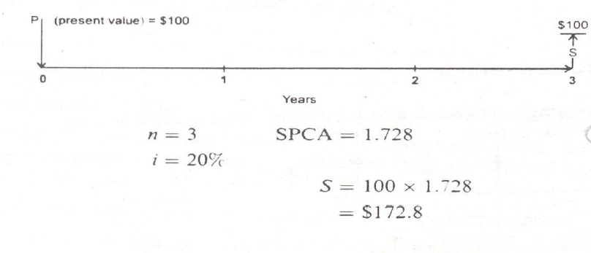
Time value of money
1. Single Payment Compound Amount (SPCA)

Slide 21

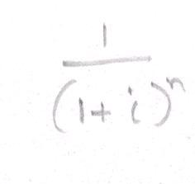
Time value of money
2. Single Payment Present Worth (SPPW)
This gives the present value P in terms of future value S after n periods at an interest rate i and is just opposite of SPCA.
Where SPPW equals

Slide 22
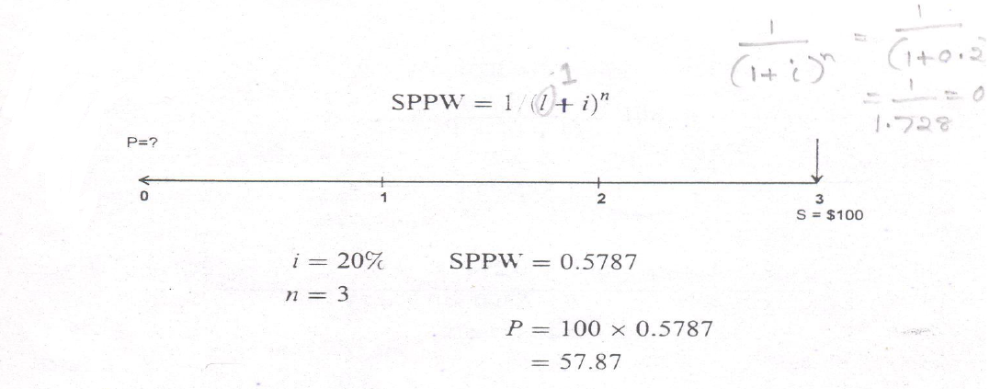
Time value of money
2. Single Payment Present Worth (SPPW)

Slide 23
Time value of money
3. Uniform Series Compound Amount (USCA)
This will determine the amount S that an equal annual payment R will total in n years at i interest

Slide 24
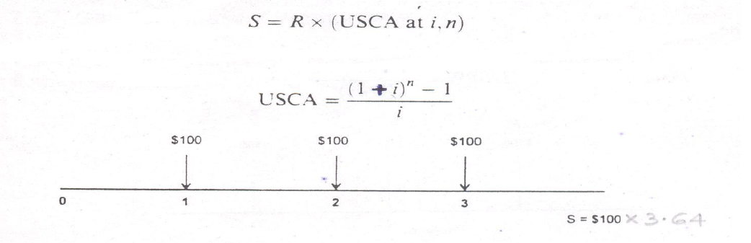
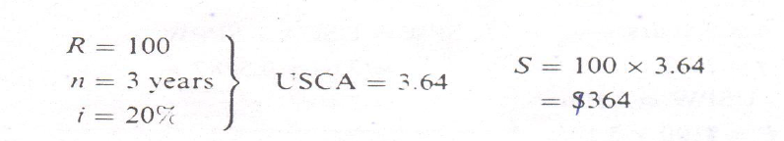
Time value of money
3. Uniform Series Compound Amount (USCA)

Slide 25

Time value of money
4.Sinking Fund Payment (SFP)
This will determine the equal annual amount R that must be invested for n years at i interest to accumulate a specified future amount.
This is opposite of Uniform Series Compound Amount (USCA)

Slide 26
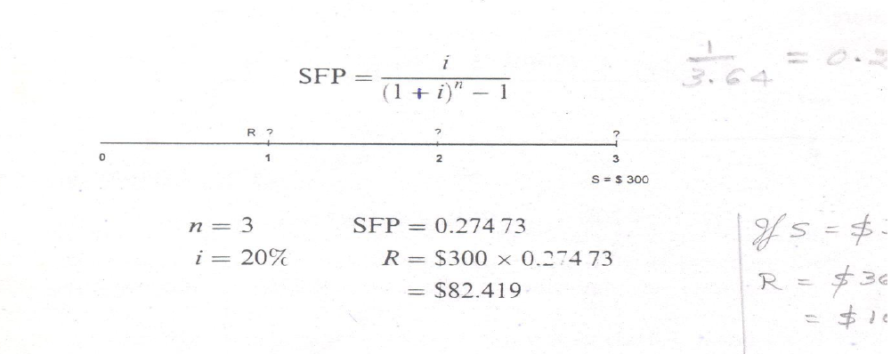
Time value of money
4.Sinking Fund Payment (SFP)

Slide 27
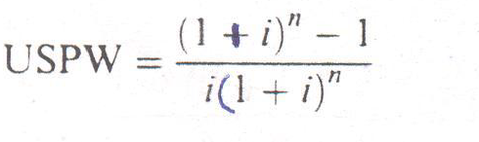
Time value of money
5. Uniform Series Present Worth (USPW)
This will determine the present amount P that can be paid by equal payment of R at i interest over n years .
USPW= USCA*SPPW
P= R* USPW at i ,n
USCA- Uniform Series Compound Amount
SPPW- Single Payment Present Worth

Slide 28
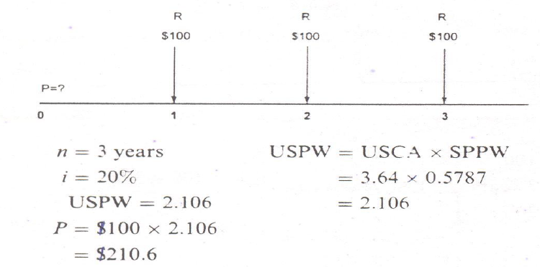
Time value of money
5. Uniform Series Present Worth (USPW)

Slide 29
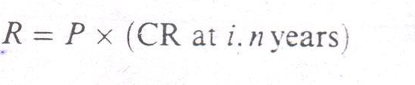
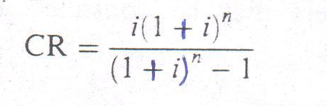
Time value of money
6. Capital Recovery (CR)
This will determine an annual payment R required to pay off a present amount P at i interest for n years
Capital Recovery technique is also opposite of Uniform Series Present Worth (USPW)
Where

Slide 30
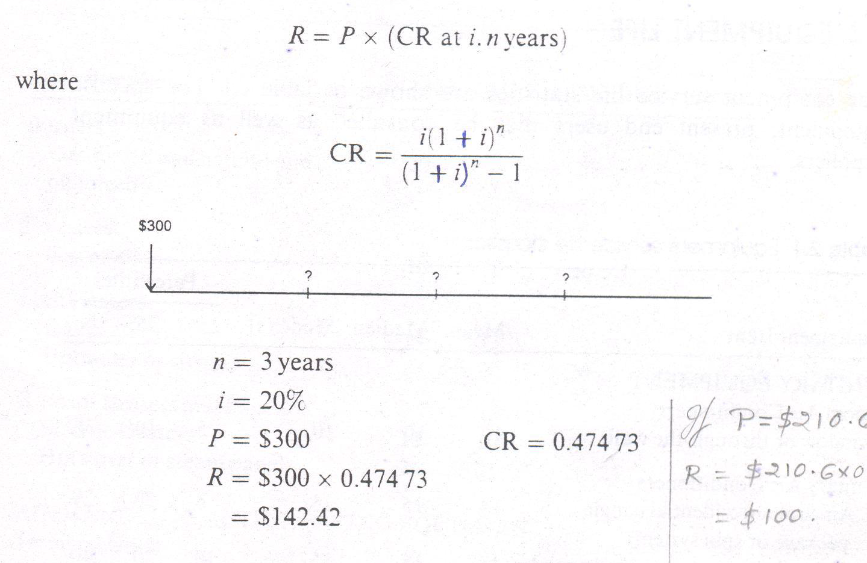
Time value of money
6. Capital Recovery (CR)

Slide 31
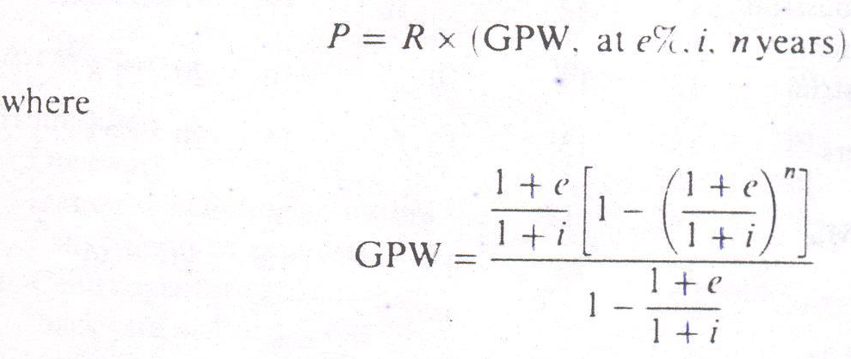
Time value of money
7.Gradient Present Worth (GPW)
This will determine the present amount P that can be paid by annual amounts R which escalates at e% at i interest for n years

Slide 32
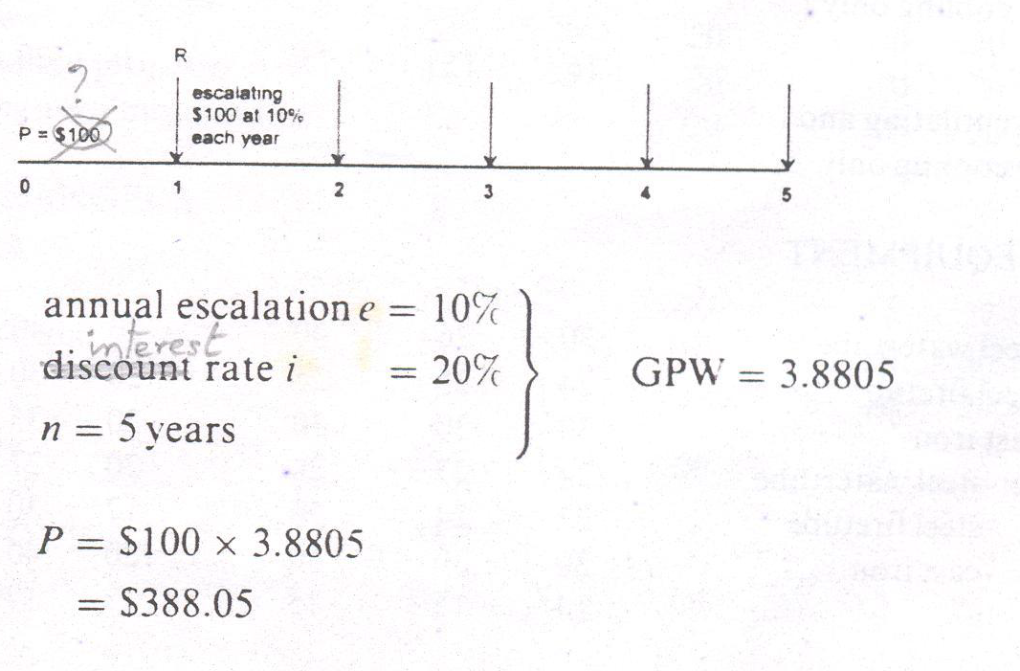
Time value of money
7.Gradient Present Worth (GPW)
Percentage at which an annual change in the price levels of the goods and services occurs or is expected to occur is called escalation rate.
Eg. Inflation & deflation of money will influence on escalation rate.

Slide 33
Payback Analysis
Simple payback is defined as the investment divided by annual saving after taxes.
The duration require to recover the capital amount/investment is called payback period.
Payback period= (Net investment or capital cost)
(Net annual cash flow or net annual saving)

Slide 34
Payback Analysis
If the sum of difference between capital cash flow to overall cost is positive implies the project will accept.Else the project will be rejected.

Slide 35
Payback Analysis
Advantages
Can be able to judge availability of financial resource.
Helps to achieve successful investments for a project.
Disadvantages
Time value of money is not directly considered
Effect of cash flow after pay back is not considered.

Slide 36
Depreciation
After a certain time the equipment is to be replaced because of physical & functional reasons
Eg. Plant has worn out & become unfit for further use (physical reason) , capacity of the plant become inadequate due to load growth & plant has become obsolute due to new technical improvement (functional reason)

Slide 37
Depreciation
Methods of Depreciation
Straight line depreciation
Sum of years digits depreciation
Declining balance depreciation
4. Diminishing value method
5. Sinking fund depreciation

Slide 38
Depreciation
Methods of Depreciation
1.Straight line depreciation
There is reduction in value of equipment & other property of the plant every year due to depreciation.
A constant depreciation charge is made every year on the basis of total depreciation and the useful life of the property.
The annual depreciation charge equals to the total depreciation divided by the useful life of the property.

Slide 39
Depreciation
Methods of Depreciation
1.Straight line depreciation
Example: If the initial cost of the equipment is Rs 100000 and its scrap value is 10000 after the useful life of 20 years. Calculate annual depreciation charges?
Annual depreciation= Total depreciation
Useful life

Slide 40
Depreciation
Methods of Depreciation
1.Straight line depreciation
100000 - 10000
= Rs. 4500/-
20

Slide 41
Depreciation
Methods of Depreciation
1.Straight line depreciation
Annual depreciation charge= P – S
P= initial cost of the equipment
n = useful life of the equipment in years
S= scrap value or salvage value after the useful life of the plant.
n

Slide 42
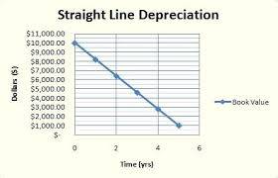
Depreciation
Methods of Depreciation
1.Straight line depreciation
Drawbacks
Assumption of constant depreciation charge is not correct.
It does not account for the interest which may be drawn during accumulation.

Slide 43
Depreciation
Methods of Depreciation
2. Sum of years digit depreciation
In this method depreciation is determined by finding the sum of digits using the following formulae
N= n(n+1)/ 2
n= life of equipment
N= Sum of digit

Slide 44
Depreciation
Methods of Depreciation
2. Sum of years digit depreciation
First year, D= (n/N) *(P-L)
Second year, D= ((n-1)/N)*(P-L)
Third year, D= ((n-2)/N)* (P-L)

Slide 45
Depreciation
Methods of Depreciation
3. Declining Balance Depreciation
Depreciation charges are larger in the earlier stage
In this method Depreciation rate can be reestablished

Slide 46
Depreciation
Methods of Depreciation
3. Declining Balance Depreciation
D= 1- (L/P)^(1/N)
D- Annual depreciation rate
L- Salvage value or scrap value
P- Initial investment
N- Duration / Useful life

Slide 47
Depreciation
Methods of Depreciation
4. Diminishing value Depreciation
Similar to declining balance method
Depreciation charge is fixed for every year
More rational than straight line method
Depreciation value D= 1- (L/P)^(1/N)
Depreciation after n years= P*(1- D)^n

Slide 48
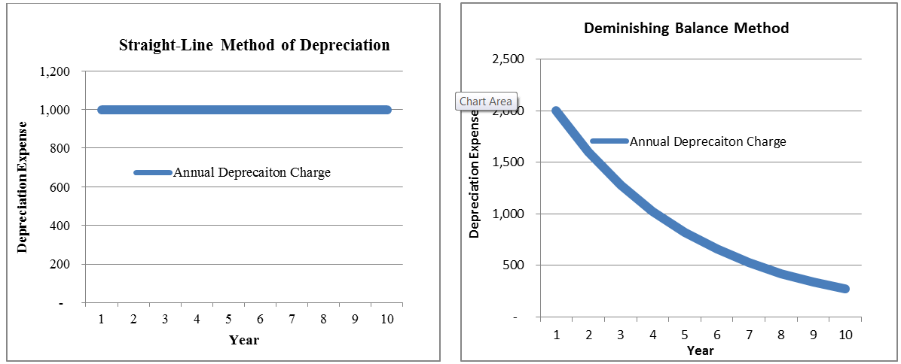
Depreciation
Methods of Depreciation
4. Diminishing value Depreciation

Slide 49
Depreciation
Methods of Depreciation
5.Sinking Fund Depreciation
Fixed depreciation charge is made every year & interest compounded on it annually.
Interest is considered.
Depreciation charge implies cost of replacement of equipment after its useful life.
Depreciation charge= total annual installment + interest accumulations.

Slide 50
Depreciation
Methods of Depreciation
5.Sinking Fund Depreciation
“Total fund must be equal to the cost of replacement of equipment”.
Cost of replacement= P – S (a)
P= Initial investment or Capital
S= Scrap value or Salvage value

Slide 51
Depreciation
Methods of Depreciation
5.Sinking Fund Depreciation
Total fund= q(1+r)^n – 1/r (b)
According to sinking fund method , total fund equals to cost of replacement.
Equate (a) and (b)

Slide 52
Depreciation
Methods of Depreciation
5.Sinking Fund Depreciation
P - S = q(1+r)^n – 1/ r
Sinking fund q= (P-S)* (r/(1+r)^n – 1))
Where r/(1+r)^n -1 is called sinking fund factor.
P-Initial value of equipment
n – Useful life of equipment in years
S- Scrap value after useful life
r – Annual rate of interest expressed as a decimal

Slide 53
Depreciation
Methods of Depreciation
5.Sinking Fund Depreciation
Advantages
Interest is considered
Economically sound
Provide cash for replacement
Enable drawing up of balance sheet

Slide 54
Depreciation
Methods of Depreciation
5.Sinking Fund Depreciation
Disadvantages
Calculation is difficult
Accounting is rather difficult

Slide 55
Taxes & Tax credits
What is tax?
A compulsory contribution to state revenue, levied by the government on workers' income and business profits, or added to the cost of some goods, services, and transactions is termed as tax.
A fee charged ("levied") by a government on a product, income, or activity.
Two types of taxes- direct tax & indirect tax

Slide 56
Taxes & Tax credits
What is tax?
If tax is levied directly on personal or corporate income, then it is a direct tax.
If tax is levied on the price of a good or service, then it is called an indirect tax.

Slide 57
Taxes & Tax credits
What is tax?
A tax is a financial charge
Tax imposed upon a taxpayer by a state or the functional equivalent of a state to fund various public expenditures.
A failure to pay is usually punishable by law.
Taxes are also imposed by many administrative divisions.

Slide 58
Taxes & Tax credits
Why Tax?
The purpose of taxation is to finance government expenditure.
One of the most important uses of taxes is to finance public goods and services, such as street lighting and street cleaning.

Slide 59
Taxes & Tax credits
Why Tax?
Tax deductable expenses such as maintenance , energy, operating cost, insurance & property taxes reduce the income subject to taxes.
AS= (1-i)*E+ i*D- Equation for finding tax saving
AS= Yearly annual after tax saving
E = Yearly annual energy saving
D = Annual depreciation rate
i = Income tax

Slide 60
Taxes & Tax credits
Tax credit
A tax credit is a tax incentive which allows certain taxpayers to subtract the amount of the credit from the total they owe(liable) the state.
Tax credit encourages the capital investments.
encourage behaviors like investment.
The tax credit lowers the income tax.
Increases the investment merit.

Slide 61
Taxes & Tax credits
Tax credit
A credit directly reduces tax bills, unlike tax deductions and tax exemptions , which indirectly reduce tax bills by reducing the size of the base.
Most tax credits are nonrefundable tax credits. Meaning that they can only be used to the point at which no more taxes are owed (liable).
Some tax credits are refundable tax credits. Meaning if the credit exceeds the amount of taxes owed, the excess is given to the taxpayer.

Slide 62
Numerical Problems
Q1. Calculate the depreciation rate using the i)straight line & ii) sum of year’s digit for the data given below: Salvage value L is Rs 0, Life of equipment , n=5 years, Initial expenditure , P=Rs 1,50,000, for a declining balance method use a 200% rate.

Slide 63
Numerical Problems
Straight line method
D= (P – L)/n
=(1,50,000 – 0)/5
= 30,000 per year

Slide 64
Numerical Problems
ii)Sum of year’s digit method
N= n(n+1)/2
5(5+1)/2
N= 15
D1= (n/N)*P = 50,000/-
D2= ((n-1)/N)*P = 40,000/-
D3= ((n-2)/N)*P = 30,000/-
D4= ((n-3)/N)*P = 20,000/-
D5=((n-4)/N)*P = 10,000/-

Slide 65
Numerical Problems
Q2. The equipment in a power station costs Rs 15,60,000/- and has a salvage value of Rs 60,000/- at the end of 25 years. Determine the depreciation value of equipment at the end of 20years by the following methods. i)straight line method ii) Diminishing value method iii)Sinking fund method at 5% compounded annually.

Slide 66
Numerical Problems
Q2. Solution
P= 15,60,000/-
Salvage value , S = 60,000/-
N= 25 years, n=20
Straight line method
Annual depreciation= (P – S)/N
(15,60,000- 60,000)/25 =60,000/-
Depreciation value at the end of 20 years
P – (Annual depreciation *20)
=15,60,000 – (20*60,000)= Rs 3,60,000/-

Slide 67
Numerical Problems
Q2. Solution
ii) Diminishing value method
D= 1- (L/P)^(1/N) here L= S= Salvage value
Therefore
D= 1- (L/P)^(1/N)= 1- (60,000/1560000)^(1/25)
= 0.122
Depreciation after 20 years = P*(1- D)^n
=1560000*(1-0.122)^20
= Rs 1,15,615/-

Slide 68
Numerical Problems
Q2. Solution
iii) Sinking fund
rate of interest r=5%
Sinking fund q= (P-L)* (r/(1+r)^N – 1)) (15,60,000-60,000)*0.05/((1+0.05)^25-1))
q= 31,433/-

Slide 69
Numerical Problems
Q2. solution
Sinking fund after 20 years = (P(1+r)^n – 1)/r (USCA – time value money calculation)
Rs 10,39,362/-
The value of plant after 20 years
Rs (15,60,000-10,39,362)
= Rs 5,20,638 /-

Slide 70
Numerical Problems
Q3. A transformer costing Rs 90,000 has an useful life of 20 years .Determine the annual depreciation charge using straight line method. Assume the salvage value of the equipment to be Rs 10,000/-.
P= 90,000/-
S= 10,000/-
N= 20 years

Slide 71
Numerical Problems
Q3. Solution
Annual depreciation charge =( P – S) /n
= (90,000 – 10,000)/20
= Rs.4000/-

Slide 72
Numerical Problems
Q4. A distribution transformer costs Rs 2,00,000 and has a useful life of 20 years. If the salvage value is Rs 10,000 & the rate of annual compound interest is 8%, calculate the amount to be saved annually for replacement of the transformer after the end of 20 years by sinking fund method.

Slide 73
Numerical Problems
Q4. Solution
P= 2,00,000/-
n= 20 years
S= 10,000/-
r = 8%

Slide 74
Numerical Problems
Q4. Solution
q = (P – S) ( r/ (1+r)^n -1)
Rs 4153/-

Slide 75
Numerical Problems
Q5. You have accumulated Rs 5000/- in credit card debit. The credit card company charges 18% nominal annual interest compounded monthly. You can offered to pay only Rs 100 per month. How many months will it take you to pay off debit?

Slide 76
Numerical Problems
Q5. Solution
P= 5000/-
A or R= 100
i or r = 0.18
c = 12
n =?

Slide 77
Numerical Problems
Q3. Solution
P/A = ((1+ i/c )^cn – 1)/ i/c *(1+i/c)^cn
Solve the equation
& find n
Answer
n= 96 months or 8 years

Slide 78
THANK YOU

