Slide 1
Unit 3
ENERGY AUDITING
Prepared by
Prof. S.D.Hirekodi
Assistant Professor
Dept of EEE
HIT-Nidasoshi

Slide 2
Syllabus- unit 3
ENERGY AUDITING
Introduction, Elements of energy
audits, energy use profiles,
measurements in energy audits,
presentation of energy audit
results. 8 Hours

Slide 3
Objectives
To introduce the importance of Energy Management
Principle of Energy Management
To understand the concept of ‘Energy Auditing’
Definition & types of energy audit
To study the Various measurement in Energy Auditing
To understand the Energy Audit Instruments
Steps involve Energy Audit Report Generation

Slide 4
Objectives continued….
To List the 10 step methodology for detailed Energy Audit
To Define Energy Audit profile
To Learn the detailed Energy Audit activities
To Describe the different steps for presenting Energy Audit result

Slide 5
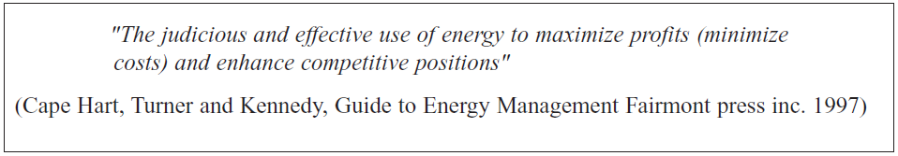
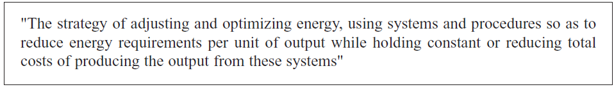
Definitions of Energy Management

Slide 6
What is Energy Management ?
Utilization of minimum quantity of energy for a task at an appropriate quality neither better nor worst than needed. “task in energy use”
To minimize the energy cost without effecting production & quality.
Energy forms of high quality/grade shouldn’t used for low grade applications.
The fundamental goal of energy management is to produce goods and provide services with the least cost and least environmental effect.

Slide 7
What is Energy Management ? Contd.
Three basic approaches of energy Management
Reduction in usage- by using economic pressure & regulation.
Increase efficiency- better house keeping equipment, more efficient material & equipments.
Substitute energy form

Slide 8
Principles of Energy Management ?
Historical Energy Use
Energy Audits
House keeping & maintenance
Analysis of Energy use
More efficient equipments
More efficient process
Energy containment –confine energy, reduce losses & recover heat
Substitute materials
Aggregation of Energy sources
Alternative Energy Sources

Slide 9
Principles of Energy Management ?
12. Construction of new facilities.
13. Manage the energy at the highest energy efficiency.
14. Reuse and recycle energy by cascading.
15. Use most appropriate technology.
16. Reduce the available losses.
17. Economic Evaluation

Slide 10
Energy Management Programme
Three phases
Initiation phase- Based on need & potential of economic return
Audit & analysis phase a) Review of historical energy use b) Energy audit c)Engineering analysis d) Economic analysis
Implementation phase

Slide 11
Energy Management Strategy
Identify a strategic corporate
approach
Prepare energy management
Prepare & undertake a
declared project
Appoint an Energy Manager
Set up an energy monitoring
& reporting
Implement staff awareness
And training
Conduct Energy Audit
Annual Review

Slide 12
Energy Management Strategy
Identify a strategic corporate approach
Problems, planning & finance
2. Appoint Energy Manager
Senior staff member
Be an overall coordinator
3. Set up Energy Monitoring & Reporting system
Collect, analysis & report the energy cost
System needs to be recorded
Billing data & tariff details
4. Conduct Energy Audit
Where & how the energy being used
Potential for energy saving
Walk through survey, review of energy use & preparation of energy budget
Energy audit report includes recommendations for actions & cost of energy saving

Slide 13
Energy Management Strategy
5.Formalize an Energy Management policy statement
Help for improving energy efficiency
Represents a commitment to saving energy
Ensure the success of the program
It includes billing, time table, energy cost reduction & cost centres
6.Prepare & Undertake a detailed implementation plan
Project implementation developed as a part of energy audit
Techniques for reducing energy consumption
Maximize financial benefit

Slide 14
Energy Management Strategy
7.Implement staff awareness & training program
Management program
Formal training, news letters, posters & publications
Report submission once in a year
8. Annual review
Once in a year

Slide 15

Energy Audit
What is Energy Audit?????????
Energy Audit is the key to a systematic approach for decision-making in the area of energy management.
The verification, monitoring, and analysis of use of energy including submission of technical report containing recommendations for improving energy efficiency with cost benefit analysis and an action plan to reduce energy consumption (Energy Conservation Act, 2001)

Slide 16
Energy Audit
What is Energy Audit?????????
Energy Audit is the key to a systematic approach for decision making in the area of energy management.
It enables breaking down the total energy consumption into all its components and helps in identifying the area where maximum savings can be achieved. It also establishes the base from which the extent of those savings can be measured.
The primary objective of energy audit is to determine ways to reduce energy consumption per unit of product output or to lower operating costs.

Slide 17
Energy Audit
Need for Energy Audit
To minimize the cost of energy
To minimize the operational cost
To minimize the cost for repair & reconstruction
To increase the quality of environment that contribute to increased work productivity
Preventive measure for energy wastage
Maintenance and quality control programmes
The primary objective of Energy Audit is to determine ways to reduce energy consumption per unit of product output or to lower operating costs.

Slide 18
Energy Audit
Need for Energy Audit
Helps to understand more about the ways energy and fuel are used in any industry.
Help in identifying the areas where waste can occur & where scope for improvement exists.
Positive orientation to cost reduction.
Preventive maintenance & quality control programs
Check the variation of energy cost.
Reliability of energy supply
Identify energy conservation techniques.
Finding the feasible solution for energy wastage
Energy auditing provide ‘benchmark’ for managing energy in the organization

Slide 19
Energy Audit
Types of Energy Audit- Depending upon function & type of industry, Depth to which final audit is needed, potential & magnitude of cost reduction desired
1.Preliminary Energy Audit
2.Plant Survey or Mini Audit
3.Detailed Energy Audit or Maxi Audit
Phase I
Phase II
Phase III

Slide 20
Energy Audit
Types of Energy Audit-
Preliminary Energy Audit
  Usually takes one to three days depending upon the complexity of plant.
  Performed by a quick walkthrough of the facilities and by analyzing utility and fuel bills.
  Visual inspection is made to determine broad energy saving opportunities and to establish the need for a more detailed analysis.
  Focuses on major energy supplies and demands, accounting for about 60 – 70% of total energy requirements.

Slide 21
Energy Audit
Types of Energy Audit-
1.Preliminary Energy Audit contd..
Establish energy consumption in the organization
Estimate the scope of saving
Identify the most likely & the easiest areas for attention
Identify immediate improvement/saving
Set reference point
Identify areas for more detailed study/measurement
Existing data/preliminary data collection

Slide 22
Energy Audit
2. Plant Survey or Mini Audit
  Involves identifying obvious energy wastage situations
  Recommending measures through improved operation & maintenance (O&M) practices.
  Requires tests and measurements to quantify energy uses and losses.
  Involves recommending energy management opportunities (e.m.o’s) which require minor expense and major capital investments.

Slide 23
Energy Audit
3. Detailed Energy Audit or Maxi Audit
    Consists of recording complete energy use data for every item/ process over a fixed period of time and calculating energy balances and efficiencies.
    Portable measuring/ monitoring instruments needed.
    Includes engineering recommendations and well defined projects with priorities.
    Accounts approx. 95% of energy utilized.
    Requires weeks, sometimes months to finish depending upon complexity of the plant.

Slide 24
Energy Audit
3. Detailed Energy Audit or Maxi Audit contd…
Most accurate estimate of energy saving & cost.
Consider all interactive projects.
Accounts for the energy use all major equipments.
Detailed energy cost saving calculation & project cost.
Calculation of energy use.
Estimated use is compared to utility bill charges.

Slide 25
Energy Audit
3. Detailed Energy Audit or Maxi Audit contd…
Detailed energy audit is carried out in three phases (It includes 10 steps)
Phase-1: Pre Audit Phase (step 1 & 2)
Phase-II: Audit Phase (step 3-9)
Phase-III: Post Audit Phase (step 10)

Slide 26
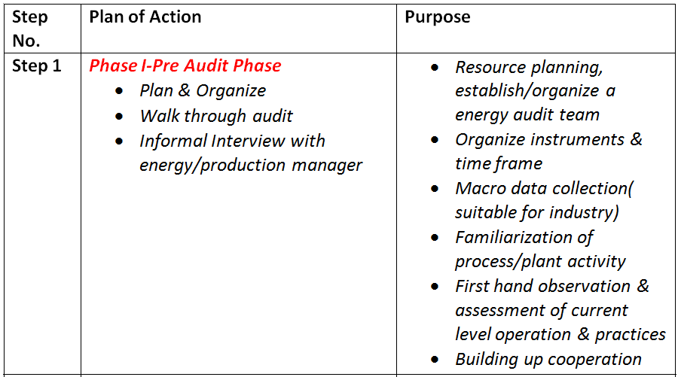
Energy Audit
3. Detailed Energy Audit or Maxi Audit contd…

Slide 27
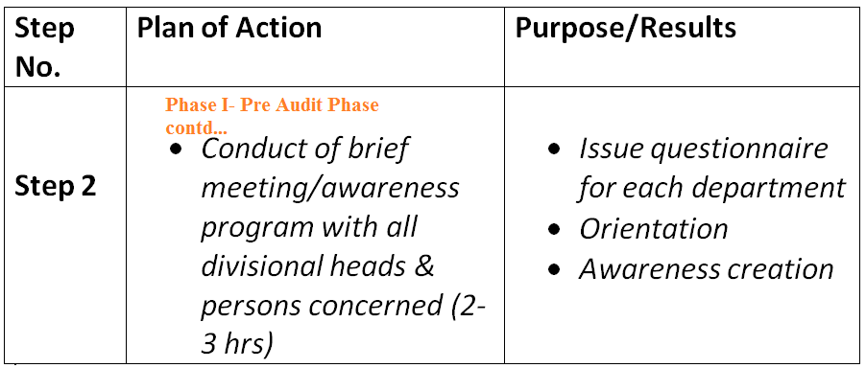
Energy Audit
3. Detailed Energy Audit or Maxi Audit contd…

Slide 28
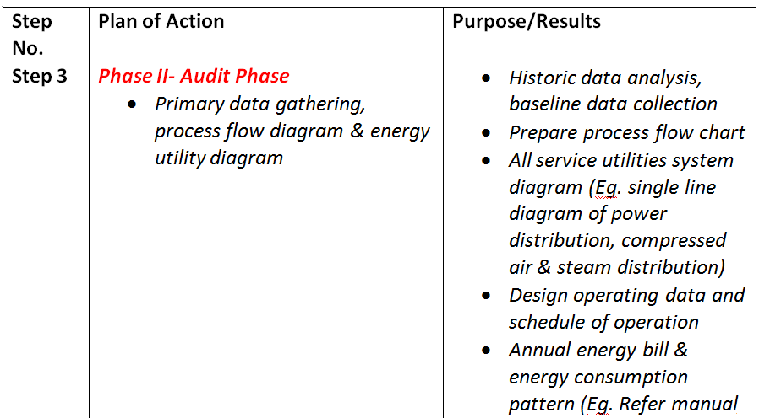
Energy Audit
3. Detailed Energy Audit or Maxi Audit contd…
Nameplate, interview

Slide 29
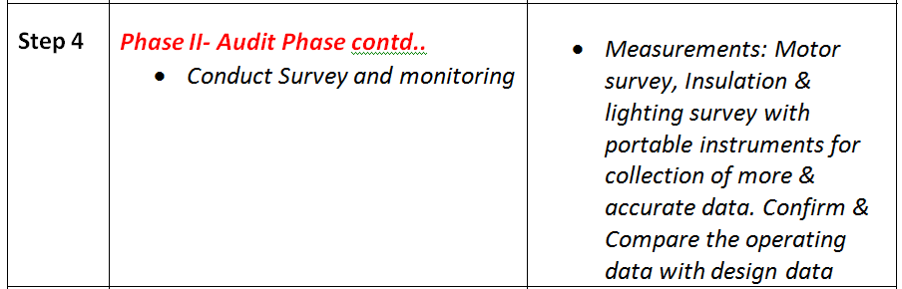
Energy Audit
3. Detailed Energy Audit or Maxi Audit contd…

Slide 30
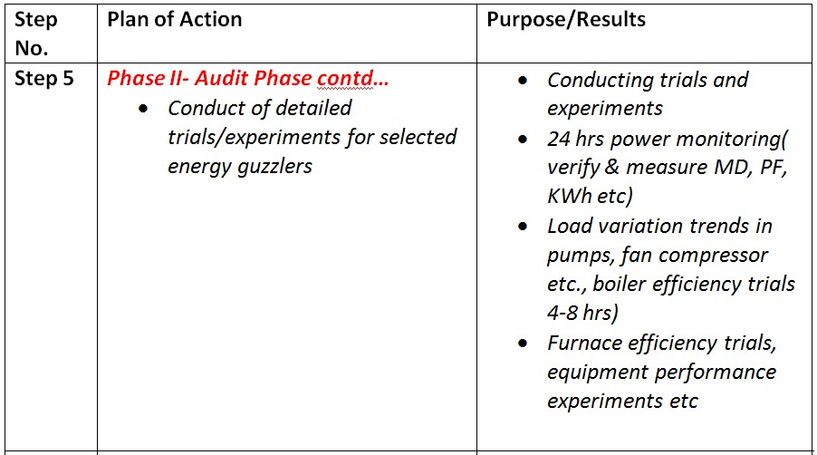
Energy Audit
3. Detailed Energy Audit or Maxi Audit contd…

Slide 31
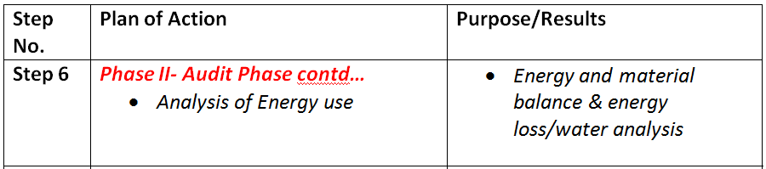
Energy Audit
3. Detailed Energy Audit or Maxi Audit contd…

Slide 32
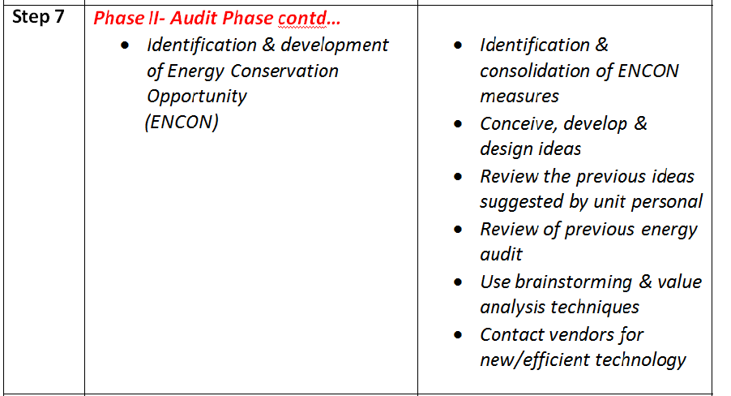
Energy Audit
3. Detailed Energy Audit or Maxi Audit contd…

Slide 33
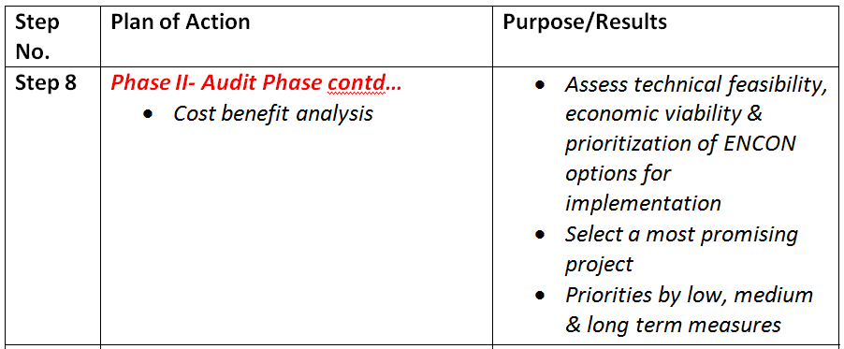
Energy Audit
3. Detailed Energy Audit or Maxi Audit contd…

Slide 34
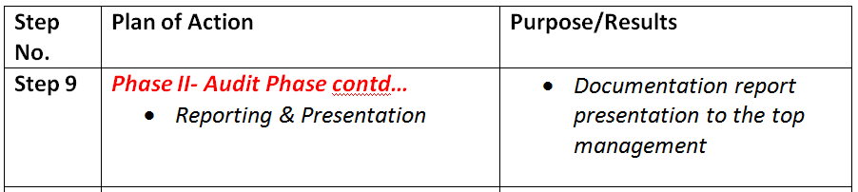
Energy Audit
3. Detailed Energy Audit or Maxi Audit contd…

Slide 35
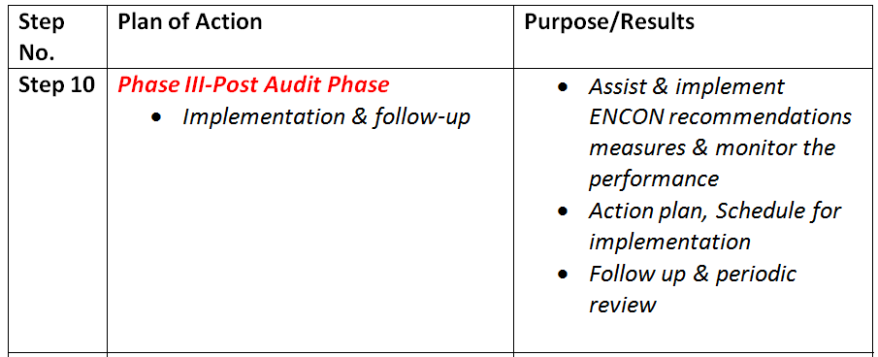
Energy Audit
3. Detailed Energy Audit or Maxi Audit contd…

Slide 36
Energy Audit (Activities)
Phase I-Pre Audit Phase Activities
Initial site visit
Discuss with site senior management about the aim of energy audit
Discuss the economic guidelines associated with energy audit
Analysis major energy consumption data with relevant personnel
Obtaining site drawing & layout
Finalize energy audit team
Identify main energy consumption plant/area
Identify any existing instrumentation/ additional metering
Identify instruments required for energy audit
To plan with time frame
To collect macro data on plant energy resources & major energy consuming centers
Create awareness through meeting/programmes

Slide 37
Energy Audit (Activities)
Phase II-Pre Audit Phase Activities
Depending upon the plant complexity
Evaluate the efficiency of all the process
Specific recommendation
Payback period
Material balance data
Energy cost & tariff data
Sources of energy supply
Includes energy management programs
Energy awareness program

Slide 38
Energy Audit
Role of energy management team
Compilation of energy audit data
Preparation of energy efficiency program & budget estimates
Identification of energy loss, inefficient device & equipments
Preparation of energy audit schedule
Initiation of energy conservation measures
Evaluation of energy saving
Spreading energy awareness & publicity

Slide 39
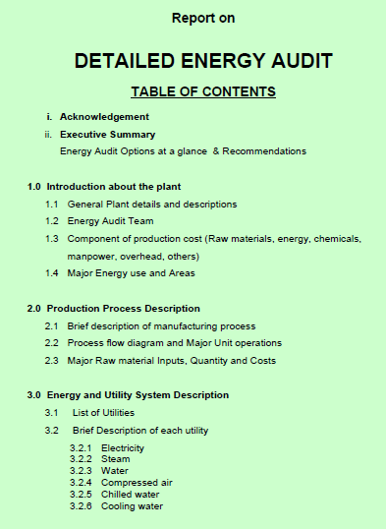
Energy Audit
Reporting format

Slide 40
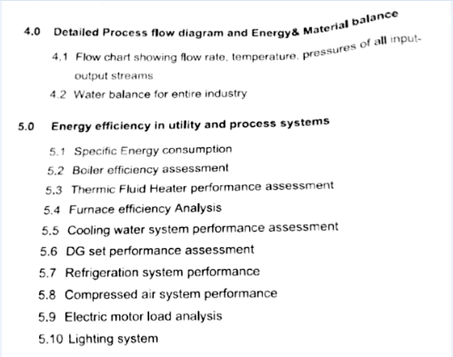
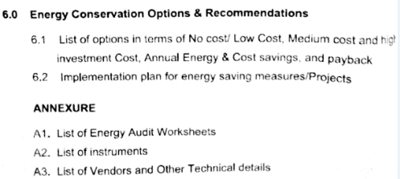
Energy Audit
Reporting format

Slide 41
Energy Audit
Energy use profile
A part of energy audit process
To find the energy waste
The patterns (or profiles) of energy usage contained within interval energy data are great for discovering where a building is wasting energy.
The charting features of Microsoft Excel will allow you to create your own energy profiles from interval data.

Slide 42
Energy Audit
Energy use profile
Looking at energy profiles to find energy waste requires you to have some knowledge of the way that the building is operated.
Energy profiles show how much energy is being used at particular times-of-the-day and days-of-the-week.
you want to be able to have a pretty good idea of what equipment is using that energy, and why it needs to be using it at the times in question.

Slide 43
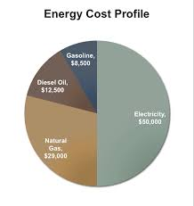
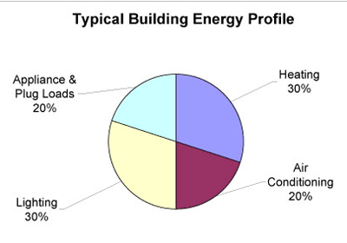
Energy Audit
Energy use profile

Slide 44
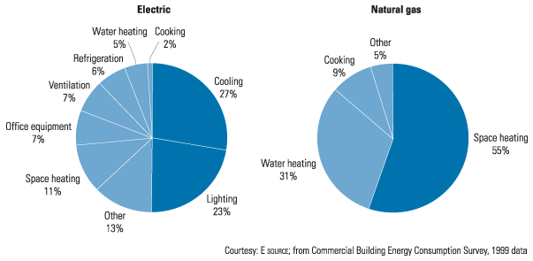
Energy Audit
Energy use profile

Slide 45
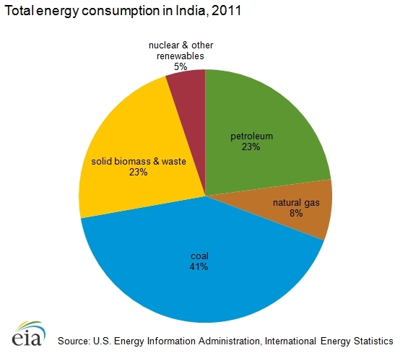
Energy Audit
Energy use profile

Slide 46
Energy Audit
Energy use profile
Energy use profile is helpful in visualizing how energy is being used.
It can identify energy conservation potential.
‘Energy Lens’ is one of the software helps to determine energy use profile

Slide 47
Energy Audit
Energy use profile
Types of audits required to construct energy use profile
Envelop audit- Determine the amount of energy required for a particular area & identifies energy conservation opportunities (ENCON). It includes
Heating, ventilation & air conditioning
Building, Lighting & domestic hot water
Air distribution

Slide 48
Energy Audit
Energy use profile
Types of audits required to construct energy use profile
(b) Process audit- This audit determine the amount of energy required for each process function & identify energy conservation opportunities (ENCON).
process machinery
Heating, ventilation & air conditioning process
Heat treatment
Furnaces

Slide 49
Energy Audit
Energy use profile
Types of audits required to construct energy use profile
(c) Transportation audit- This audit determines the amount of energy required for truck, cars, vehicles, forklift etc.
(d) Utility audit- This audit analyses the monthly, daily or yearly energy use for each utility.

Slide 50
Energy Audit
Energy Audit Instruments
To obtain the best information for a successful energy cost control program.
The auditor must make some measurements during the type of energy-consuming equipment audit visit.
Identification and quantification of energy necessitates.
These instruments must be portable, durable & easy to operate and relatively inexpensive.

Slide 51
Energy Audit
Energy Audit Instruments
Basic Electrical Parameters in AC &DC systems – Voltage (V), Current (I), Power factor, Active power (kW), apparent power (demand) (kVA), Reactive power (kVAr), Energy consumption (kWh), Frequency (Hz), Harmonics, etc.
Other parameters such as temperature & heat flow, radiation, air and gas flow, liquid flow, revolutions per minute (RPM), air velocity, noise and vibration, dust concentration, Total Dissolved Solids (TDS), pH, moisture content, relative humidity, flue gas analysis – CO², O², CO, SO^{x}, NO^{x}, combustion efficiency etc.

Slide 52
Energy Audit
Energy Audit Instruments
Electrical parameters
Combustion analyzer
Fuel efficiency monitor
Fyrites- gas analyzer
Temperature measurements
Pressure measurements
Velocity measurements
Speed measurements
Leak detectors
Measurement of light
Measurement of water flow
Humidity measurement

Slide 53
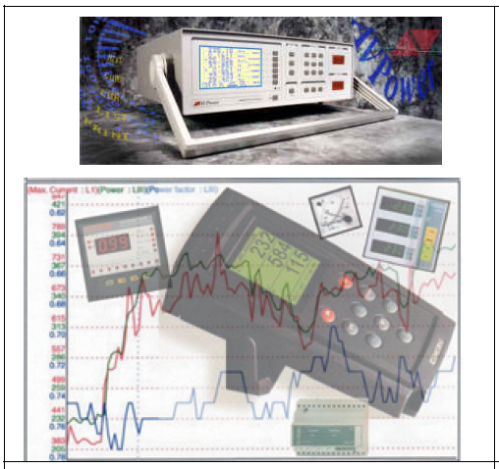
Energy Audit
Energy Audit Instruments
1. Electrical System Parameters
These are instruments for measuring major electrical parameters such as kVA, kW, PF, Hertz, kVAr, Amps and Volts.
some of these instruments also measure harmonics. (Harmonic analyzer)
These instruments are applied on-line i.e on running motors without any need to stop the motor.
Instant measurements can be taken with hand-held meters, while more advanced ones facilitates cumulative readings with print outs at specified intervals.

Slide 54
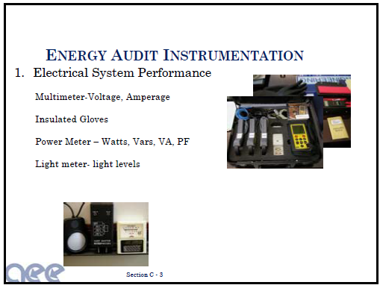
Energy Audit
Energy Audit Instruments
1. Electrical System Parameters contd….

Slide 55
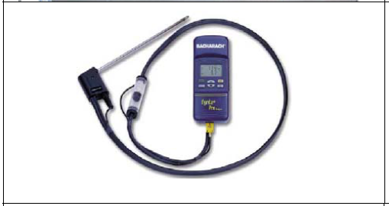
Energy Audit
2. Combustion Analyzer
This instrument has in-built chemical cells which measure various gases such as O2, CO, NOx and SOx.

Slide 56
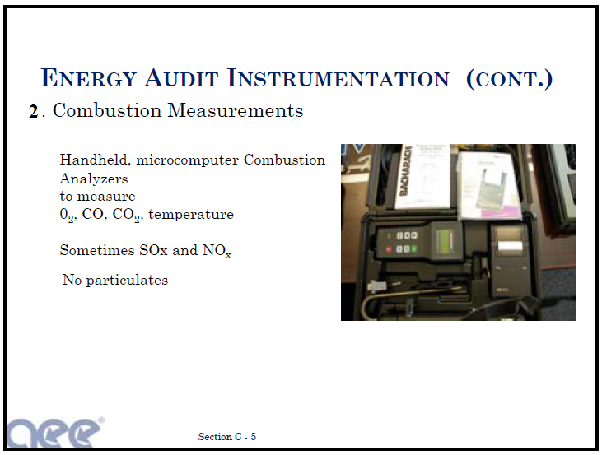
Energy Audit
2. Combustion Analyzer

Slide 57
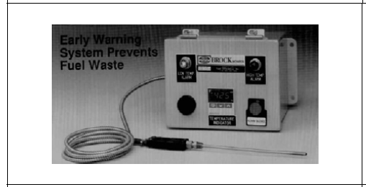
Energy Audit
3. Fuel efficiency monitor
This measures oxygen and temperature of the flue gas.
Calorific values of common fuels are fed into the microprocessor which calculates the combustion efficiency.

Slide 58
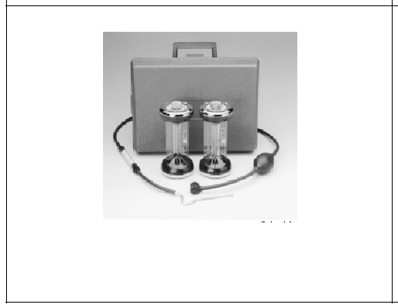
Energy Audit
4.Fyrites
Accurate and easy to use instruments for measuring and analyzing carbon dioxide or oxygen.
A hand bellow pump draws the flue gas sample into the solution inside the fyrite.
A chemical reaction changes the liquid volume revealing the amount of gas.
A separate fyrite can be used for O2 and CO2 measurement.

Slide 59
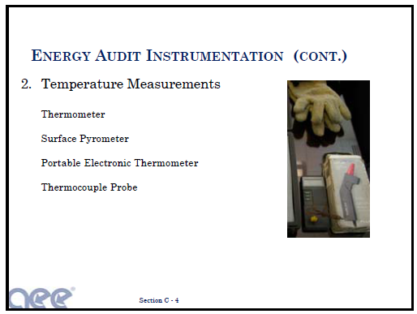
Energy Audit
5.Temperature measurements
High temperature measurement
Non conducting

Slide 60
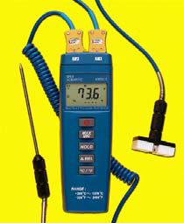
Energy Audit
5.Temperature measurements contd…
Contact thermo meter
These are thermocouples which measures for example flue gas, hot air, hot water temperatures by insertion of probe into the stream.
For surface temperature, a leaf type probe is used with the same instrument.

Slide 61
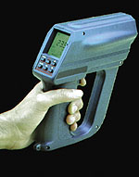
Energy Audit
5.Temperature measurements contd…
(b) Infrared thermometer
This is a non-contact type measurement which when directed at a heat source directly gives the temperature read out.
This instrument is useful for measuring hot spots in furnaces, surface temperatures etc.

Slide 62
Energy Audit
5.Temperature measurements contd…
(c) Resistance Thermometer Detectors (RTD)
(d) Thermocouples
(e) Thermistors

Slide 63
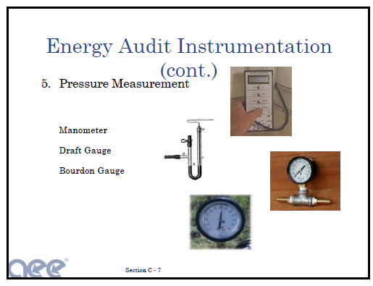
Energy Audit
6. Pressure measurements

Slide 64

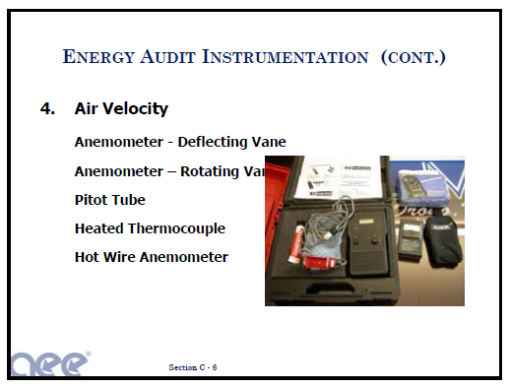
Energy Audit
7. Velocity measurements
Wind meter
Fluid flow velocity

Slide 65
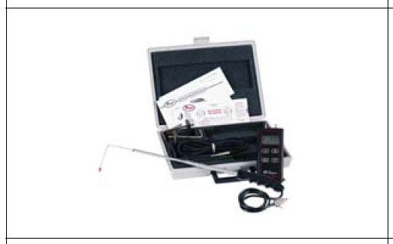
Energy Audit
7. Velocity measurements contd…
Air velocity in ducts can be measured using a pitot tube and inclined manometer for further calculation of flows.

Slide 66
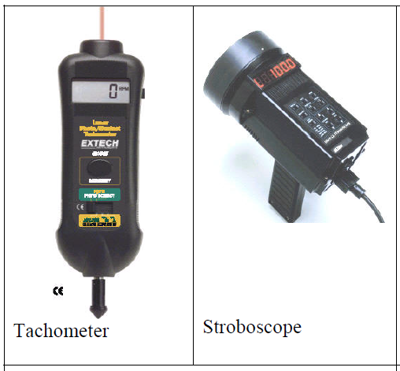
Energy Audit
8. Speed measurements
In any audit exercise speed measurements are critical as they may change with frequency, belt slip and loading.
A simple tachometer is a contact type instrument which can be used where direct access is possible.
More sophisticated and safer ones are non contact instruments such as stroboscopes.

Slide 67
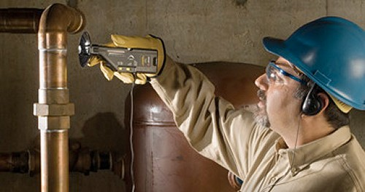
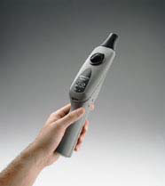
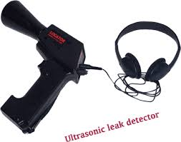
Energy Audit
9. Leak detectors
Ultrasonic instruments are available which can be used to detect leaks of compressed air
Other gases which are normally not possible to detect with human abilities.
Compressed Air Leaks by Ultrasonic Leak Detectors
Steam Leak Detectors by Ultrasonic leak detectors

Slide 68
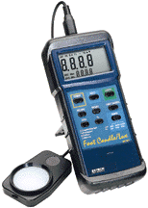
Energy Audit
10. Measurement of light
By using Lux meters
Illumination levels are measured with a lux meter.
It consists of a photo cell which senses the light output, converts to electrical impulses which are calibrated as lux.

Slide 69
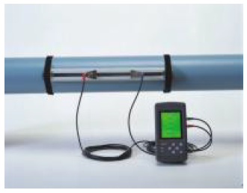
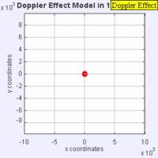
Energy Audit
11. Measurement of water flow
Water flow meter
This non-contact flow measuring device using Doppler effect / Ultra sonic principle.
There is a transmitter and receiver which are positioned on opposite sides of the pipe.
The meter directly gives the flow.
Water and other fluid flows can be easily measured with this meter.

Slide 70
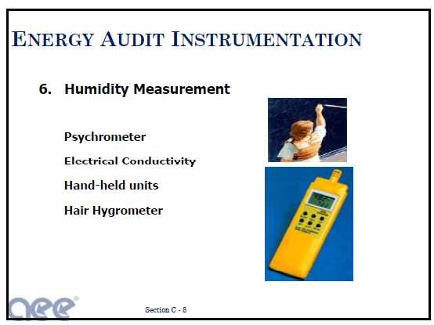
Energy Audit
12. Humidity measurements
Relative humidity

Slide 71
Energy Audit
12. Humidity measurements contd…
Psychrometer- wet & dry bulb thermometer
It consists of two temperature sensors
Lithium chloride cell
Digital humidity meter
Thermo-hydrograph

Slide 72
Review Questions on Energy Audit
Write a short note on energy audit instruments. ( June/july, 2011 ,2014 10marks)
Explain detailed energy audit. (June/july 2014, 10 Marks)
Explain various classification of energy audit.
(Dec 2011, 10 Marks)
4. Discuss the role of energy management team. (Dec 2011, 10 Marks)

Slide 73
Review Questions on Energy Audit
5. Explain in brief the types of energy audit and outcome of the audit. (June/july 2011, 08 Marks)
6. Explain the steps in energy audit report generation. ( june/july 2011,2010, 06 Marks)
7. Give a 10 methodology steps for detailed energy auditing explain. (Dec 2010, 10 Marks)
8. What is energy use profile? What are the audits required for constructing the energy use profile?
(Dec 2010,10 Marks)

Slide 74
Review Questions on Energy Audit
9. Define energy audit. Explain the importance of energy audit in the industry.
(06 Marks, jan 2010)
10. Explain the detailed energy audit activities.
(06 Marks, jan 2010)
11. Explain the different steps of presenting the
energy audit results. (08 Marks, jan 2010)

Slide 75



Seminar
Group 1 – Review questions 1 to 3
(20 members)
Group 2 – Review questions 4 to 7
(20 members)
Group 3 – Review questions 8 to 11
(20 members)

Slide 76

Thank You…..

