Slide 1
[PART-B]
Unit 5&6
ELECTRICAL EQUIPMENT & POWER FACTOR
Prepared by
Prof. S.D.Hirekodi
Assistant Professor
Dept of EEE
HIT-Nidasoshi

Slide 2
Syllabus- unit 5&6
Electrical EQUIPMENT & POWER FACTOR
Correction & location of capacitors, energy efficient motors, lighting basics, electrical tariff, Concept of ABT.
10 Hours

Slide 3
Topics to be covered
Energy Efficient Motors
Lighting Basics
ABT

Slide 4

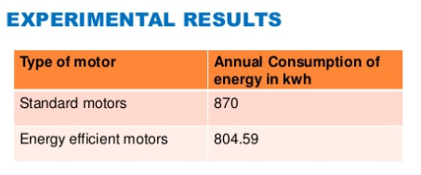
Energy Efficient Motor
Introduction
An energy efficiency motor is a motor that give you the same output strength by consuming lesser amount of power.

Slide 5
Energy Efficient Motor
Introduction
Along with saving money, energy efficient appliances and motors save the plant.
An Energy Efficient Motor produces the same shaft output power, but uses less input power than a standard efficiency motor.

Slide 6
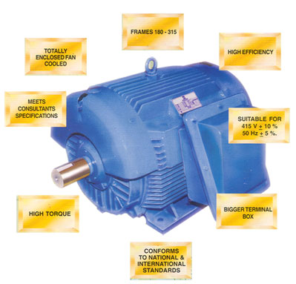
Energy Efficient Motor
Introduction

Slide 7
Energy Efficient Motor
Introduction
Energy efficient motor has more copper in its winding.
The fan losses are very less.
The energy efficient motors operates with efficiencies that are typically 2-6% higher than standard motors.
The cost is slightly more than conventional motors (15-30% more).

Slide 8
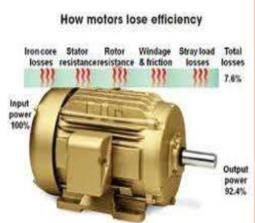
Energy Efficient Motor
Analysis of Losses in Energy Efficient Motor
Copper losses
Core losses
Friction & Windage losses
Stray load losses
Are the main losses of a motor.

Slide 9
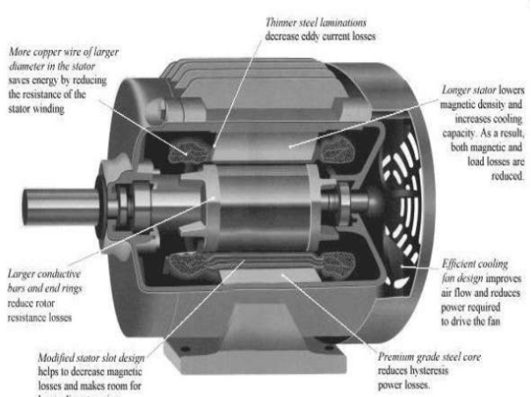
Energy Efficient Motor
Analysis of Losses in Energy Efficient Motor

Slide 10
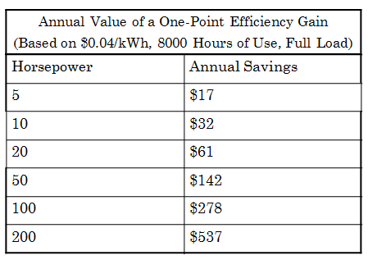
Energy Efficient Motor
Analysis of Losses in Energy Efficient Motor

Slide 11
Energy Efficient Motor
Constructional features
EEM is manufactured using the same frame as a standard motor.
Higher quality and thinner steel laminations in the stator.
More copper in the windings.
Optimized air gap between the rotor and the stator.
Reduced fan losses.
A greater length.
High quality aluminum used in rotor frame.
Closer machining tolerances.

Slide 12
Energy Efficient Motor
Advantages of Energy Efficient Motor
Electric power saving
Operating temperature is less
Noise level is lower
Operating more satisfactorily under abnormal voltage.
EEM has a lower slip so they have a higher speed than standard motors.
EEM can reduce maintenance costs and improve operations in industry due to robustness and reliability.
Increasing the productivity.

Slide 13
Energy Efficient Motor
Disadvantages of Energy Efficient Motor
Initial cost is more
Portability
Speed control

Slide 14
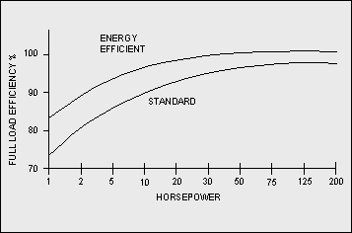
Energy Efficient Motor
Comparison between Energy Efficient motor & Conventional motors

Slide 15
Energy Efficient Motor
Applications
Wide industrial applications like paper, cements, textiles, blowers, cranes, machine tools, Industrial drives etc.

Slide 16
Review Questions on Energy Efficient Motor
Write a note on energy efficient motors.
(Jan 2010, 2012, 10 Marks)
2. Explain the energy sowing techniques in electric motors. (Dec 2011, 10 Marks)

Slide 17
ABT – (Availability Based Tariff)
What is ABT?????????
It is a frequency based tariff.
It is a reactive based tariff.
It is a performance based tariff.
ABT is introduced by Central Electricity Regulatory Commission (CERC) in 2000.
The main objective is to improve the quality of power.
Aiming more responsibility & accountability in power generation and consumption through a scheme of incentives & disincentives.

Slide 18
ABT – (Availability Based Tariff)
What is ABT?????????
ABT brings about enhanced grid discipline
It will promote competition & efficiency
Encourage the use of economic dispatch in India.
It works based on financial principles.
Ensure grid stability
Maintain supply frequency 50 cycles per second.
Any deviation from the schedule is charged at the rate which are frequency dependent.

Slide 19
ABT – (Availability Based Tariff)
Example of ABT?????????
If a power plant delivers 600MW while it was scheduled supply only 500MW. The energy charge payment would still be for the scheduled power generation (500MW) and the excess generation (100MW) would get paid for at the rate dependent on the system condition prevailing(existing) at the time.

Slide 20
ABT – (Availability Based Tariff)
Example of ABT?????????
If a power plant delivers 400MW while it was scheduled supply of 500MW. The energy charge payment would still be for the scheduled power generation (500MW) and the lack of generation (100MW) would get penalty.

Slide 21
ABT – (Availability Based Tariff)
Components of ABT
1.Fixed Charge or Capacity Charge-
2.Energy Charge or Variable Charge
3. Unscheduled Interchange Charge(UI)

Slide 22
ABT – (Availability Based Tariff)
Components of ABT
1.Fixed Charge or Capacity Charge- All fixed charge of a plant.
2. Energy Charge or Variable Charge- Fuel cost for scheduled generation.
3. Unscheduled Interchange Charge (UI)-
It is a payment for the deviation from the schedule.
Either it may be penalty or incentives.
The components would be negative in the case of power plant is delivering less power than scheduled.
UI= Total actual drawl –Total scheduled drawl.

Slide 23
ABT – (Availability Based Tariff)
ABT Design/ ABT Scheduling
Each day of 24 hours starting from 00:00 hours be divided into 96 times block of 15 minutes each.
Each generating station is made advanced declaration of its capacity in terms of MWh that is “generation scheduling”.
Generation should be specify the capability during peak hours.
Regional Load Dispatch Centre (RLDC) shall communicate to various beneficiaries (eg. SLDC- State Load Dispatch Centre) their respective share of available capacity.
RLDC shall prepare a generation schedule.

Slide 24
Review Questions on ABT
1. What is ABT? What are the broad features of ABT design? (June/July 2014, 2011, 2010, 10 Marks)

Slide 25
Lighting Basics
Introduction
Light is a hot body.
A hot body radiates energy in all directions.
Light is a form of radiant energy.
A radiant body which gives out light is termed as a source of light.
Light wave emitted by the source fall on a surface to illuminate it.

Slide 26
Lighting Basics
Introduction
Lighting is essential service in all industries.
Power consumption by the industrial lighting varies from 2-10% of the total power depending on the type of industry.
Innovations & new trends in the lighting give rises to tremendous energy saving opportunities.

Slide 27
Lighting Basics
Terminology in Illumination
Luminous Intensity (I)- The power or strength of the source of light is known as Luminous Intensity.
Unit- Candela
Luminous Flux (F) - The flow of light from the source is called as Luminous Flux.
Unit- Lumen

Slide 28
Lighting Basics
Terminology in Illumination
Illuminance (E) -The amount of light falling on a surface is measured in lux.
1 lux = Lumen
= 1 lumen/m^2
Area

Slide 29
Lighting Basics
Laws of Illumination
Inverse square law
The amount of light falling on the surface area is directly proportional to power of source and inversly proportional to the square of distancebetween the source and the surface to be illuminated.
E= I/R^2
Where I=Lumenous intensity , R =distance between source and surface to be illuminated & E =illuminance.
This law ia applicable only when the surface to be illuminated is placed normal to the direction of the light beam.

Slide 30
Lighting Basics
Laws of Illumination
2.Cosine law
Cosine law which states that the illumination on the surface is proportional to the cosine of angle between the normal to the surface & line of force.
Let ‘ѳ’ is the angle between line of flux & normal to the illuminated plane and the illumination on the plane inclined an angle ‘ѳ’ is given by
E=I*COS ѳ/R^2
Both inverse square law & Cosine law are applicable to point sources where there is no reflecting surfaces.

Slide 31

Lighting Basics
Various Types of Light Sources
Incandescent lamps
Reflector lamps
Gas discharge lamps
Compact Fluorescent Lamps (CFL)
Mercury Vapor Lamps
Sodium Vapor Lamps
Metal Halide Lamps
Fluorescent Tube Lamps (FTL)

Slide 32
Lighting Basics
Various Types of Light Sources
4. LED Lighting
5.LASER
Ruby Laser
Gas Laser
Semiconductor Laser
Free electron Laser
Chemical Laser
Dye laser Laser
Ion Laser
Gas dynamic Laser

Slide 33
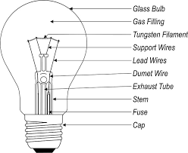
Lighting Basics
Various Types of Light Sources
1.Incandescense lamps
Electric light source which produce light with a wire filament heated to high temperature by an electric current pass through it until it glows.
The hot filament is protected from oxidation with a glass or quartz bulb that is filled with inert gas or evacuated.
Incandescent bulbs are manufactured in a wide range of sizes, light output, and voltage ratings, from 1.5 volts to about 300 volts.

Slide 34
Lighting Basics
Various Types of Light Sources
1.Incandescense lamps
They require no external regulating equipment, have low manufacturing costs, and work equally well on either alternating current or direct current.
Incandescent bulbs are much less efficient than most other types of electric lighting.
Incandescent bulbs convert less than 5% of the energy they use into visible light.
The luminous efficacy of a typical incandescent bulb is 16 lumens per watt.
Incandescent bulbs typically have short lifetimes compared with other types of lighting (around 1000 hrs)

Slide 35
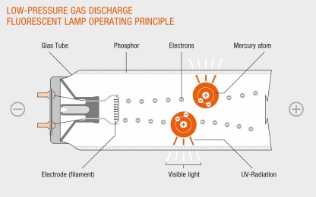
Lighting Basics
Electrons that are bound to mercury atoms are excited to states where they will radiate ultraviolet light as they return to a lower energy level.
This emitted ultraviolet light is converted into visible light as it strikes the fluorescent coating on the bulb.
This coating absorb energy and produces light.
CFLs use one-fifth to one-third the electric power
and last eight to fifteen times longer.
A CFL has a higher purchase price than an incandescent lamp, but can save over five times its purchase price in electricity costs over the lamp's lifetime.
Various Types of Light Sources
2.CFL lamps
Ballast helps for initial voltage build up. It is a starter

Slide 36
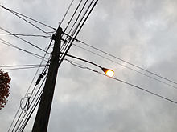
Lighting Basics
Various Types of Light Sources
3.Sodium Vapor lamps
A sodium-vapor lamp is a gas-discharge lamp that uses sodium in an excited state to produce light.
There are two varieties of such lamps: low pressure lamp(high efficient light source) and high pressure lamp.
An amalgam of metallic sodium and mercury lies at the coolest part of the lamp and provides the sodium and mercury vapor that is needed to draw an arc.

Slide 37
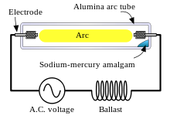
Lighting Basics
Various Types of Light Sources
3.Sodium Vapor lamps
The temperature of the amalgam is determined to a great extent by lamp power.
The higher the lamp power, the higher will be the amalgam temperature.
The higher the temperature of the amalgam, the higher will be the mercury and sodium vapor pressures in the lamp and the higher will be the terminal voltage.
As the temperature rises, the constant current and increasing voltage result in increased power until the nominal power is reached.

Slide 38
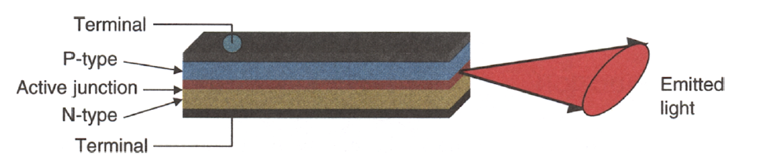
Lighting Basics
Various Types of Light Sources
4.LED lamps

Slide 39
Lighting Basics
Various Types of Light Sources
4.LED lamps
An LED is a monolithically integrated p-n semiconductor device (a diode) that emits light when voltage is applied across its two terminals.
During the recombination process of electrons with holes at the junction of n-doped and p-doped semiconductors, energy is released in the form of light.

Slide 40
Review Questions on Lighting
1.Briefly explain the types of light sources and energy saving options in lightning.
(June 2012, 06 )

Slide 41


