Slide 1
Magnetic Force and Magnetic Materials

Slide 2
Force on moving charges in a magnetic field
Force on moving charges in a magnetic field
Figure Force on conductor in the magnetic field

Slide 3
Magnetic Materials
Diamagnetic Materials
Paramagnetic Materials
Ferromagnetic Materials

Slide 4
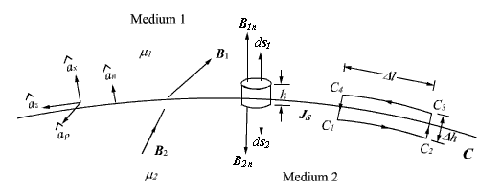
Magnetic Boundary Conditions

