Slide 1
TIME VARYING MAGNETIC FIELDS AND MAXWELL’S EQUATIONS

Slide 2
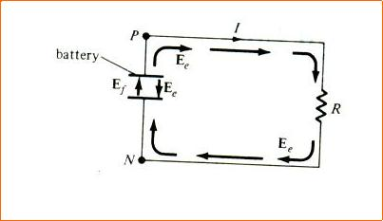
Faraday’s Law, and it can be expressed as
emf induced= -N dψ/dt

Slide 3
MAXWELL'S EQUATIONS FOR STATIC EM FIELDS
Differential (or |  |  | Integral Form |  |  |  | Remarks
Point) Form
∇ . D = ρv |  |  | ∫_{S} ^{D} ^{⋅dS} ⁼ ∫^{ρ}v ^{dv} |  |  |  | Gauss's law
 |  |  | v
∇ . B = 0 |  |  | _{∫S}B ⋅dS = 0 |  |  |  | Nonexistence of magnetic
 |  |  |  |  |  |  | monopole
∂B |  |  | _{∫L} E ⋅dl = − | ∂ | ∫^{B}
∇ x E =- _{∂t} |  |  |  |  |  | ⋅dS | Faraday’s Law
 |  |  |  | ∂t
 |  |  |  |  | s
∇ x H = J + | ∂D |  | _{∫L} H ⋅dl = ∫J ⋅dS |  |  |  | Ampere's circuit law
 | ∂t
 |  |  | s

Slide 4
UNIFORM PLANE WAVES
The wave equation (2) is a composition of these equations, one each component wise,
ie,

Slide 5
Wave equations for a conducting medium

Slide 6
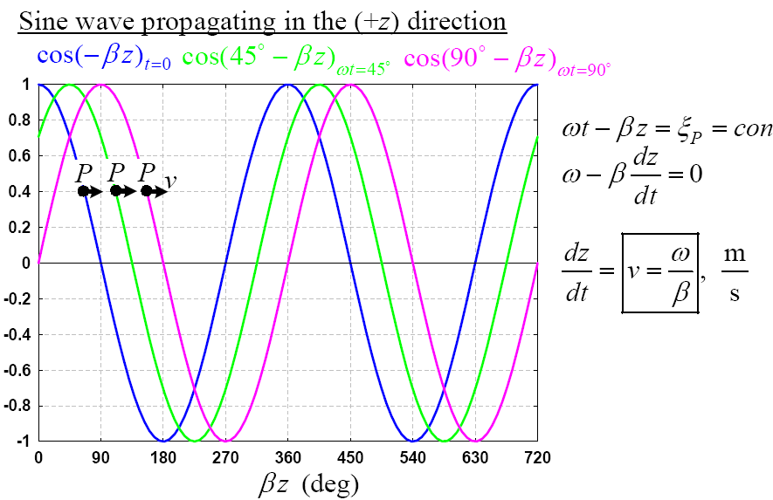

Slide 7
Poynting’s theorem
The flow of power in the direction of wave propagation. P gives power density of the wave
P = EXH

Slide 8
Thank you

