Slide 1

Branching and Looping Statement in C
 | S J P N Trust's Hirasugar Institute of Technology, Nidasoshi. Inculcating Values, Promoting Prosperity Approved by AICTE, Recognized by Govt. of Karnataka, Affiliated to VTU Belagavi &
Ravindra R Patil

Slide 2
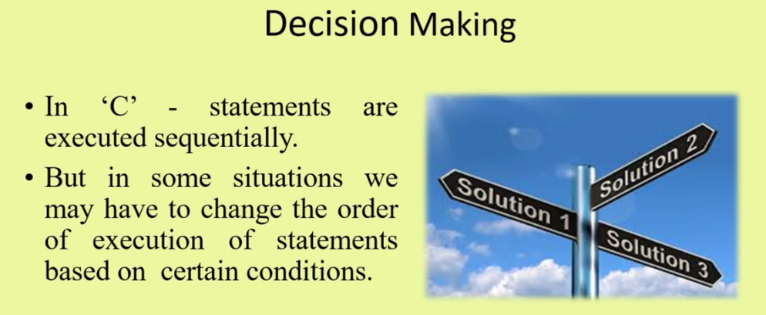
Branching or Decision Making

Slide 3
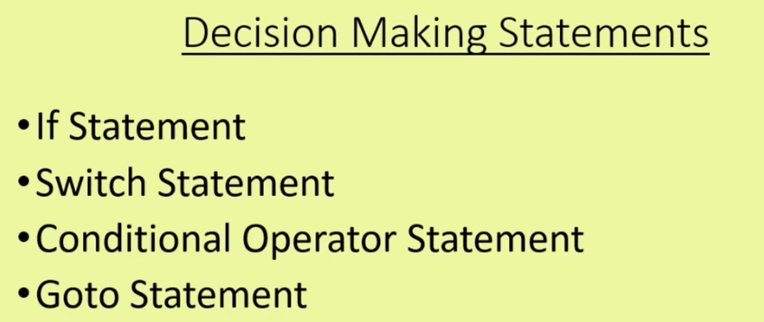

Slide 4
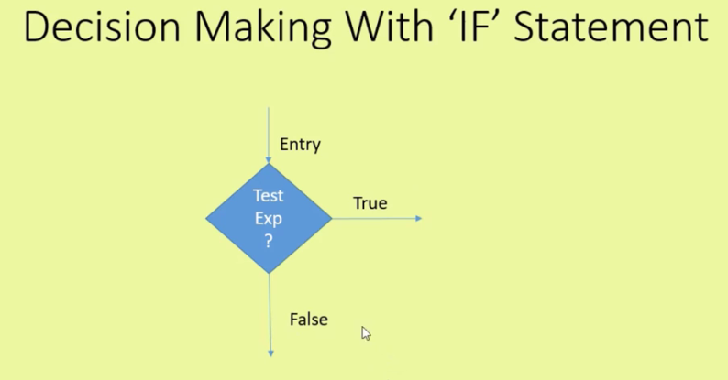
Two way branching

Slide 5
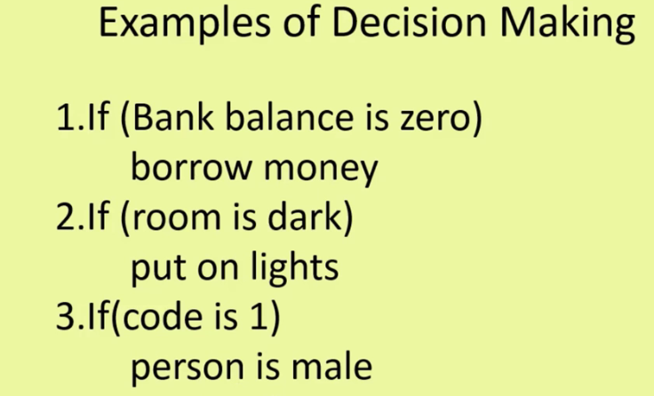

Slide 6
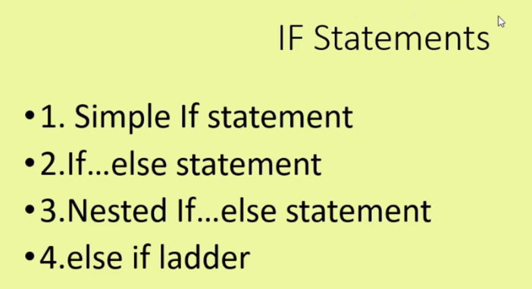

Slide 7

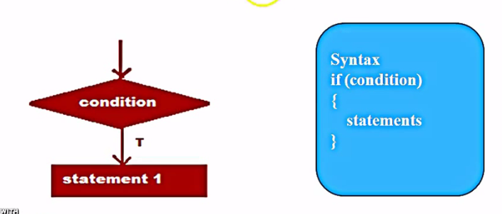
F

Slide 8
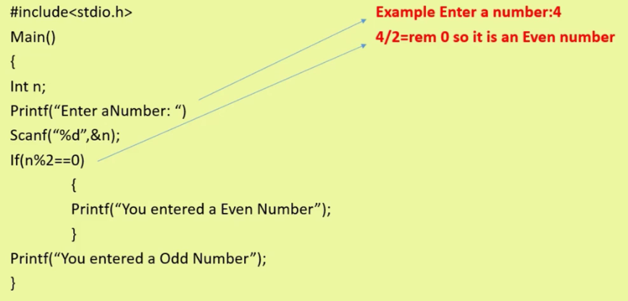
Example Program

Slide 9
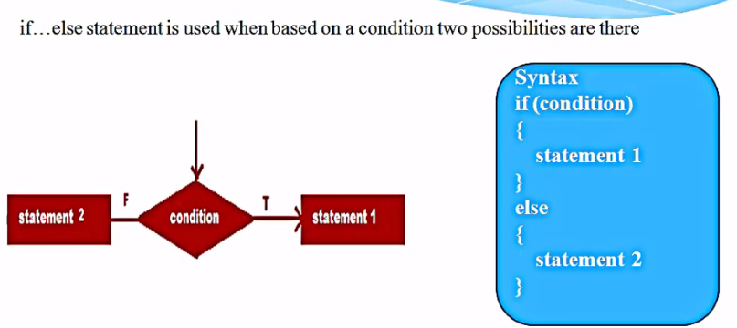
if……….else

Slide 10
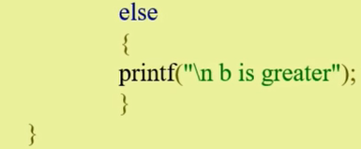
Example on if……else

Slide 11
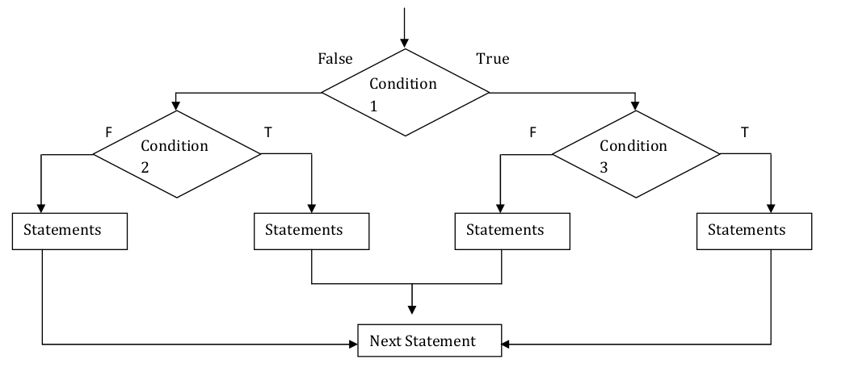
Nested if……else
Syntax:
if (test_expression1)
{
if (test_expression2)
{
Statements;
}
else
{
Statements;
}
}
else
{
if (test_condition3)
{
Statements;
}
else
{
Statements;
}
}

Slide 12
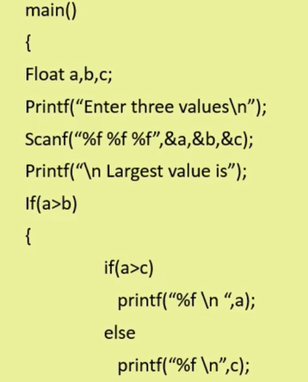
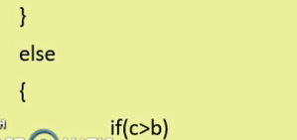
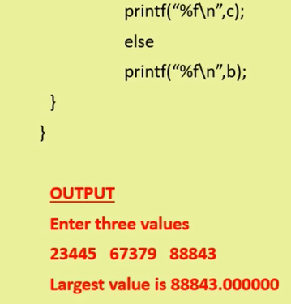
Example for nested if……..else

Slide 13
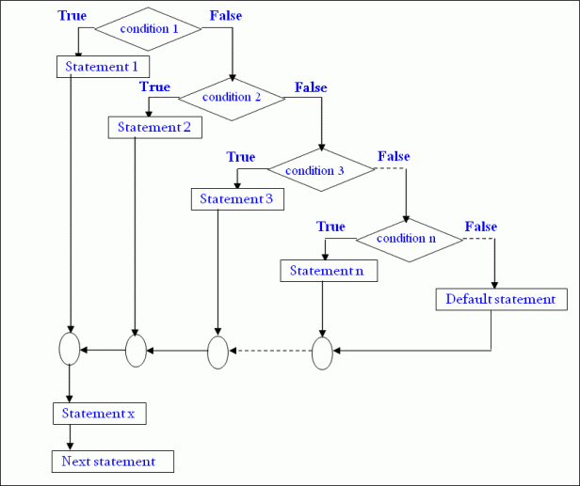
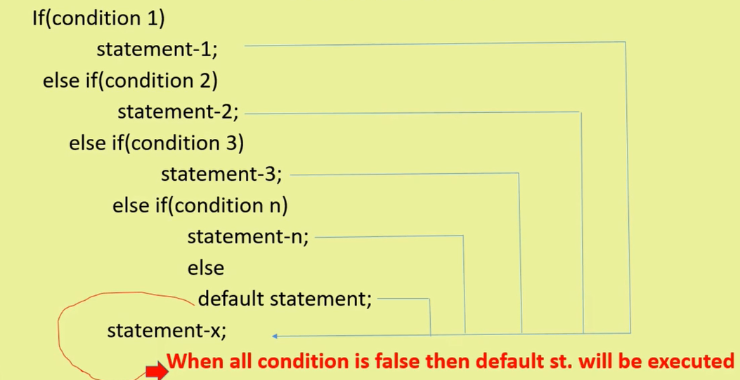
else…….if ladder

Slide 14
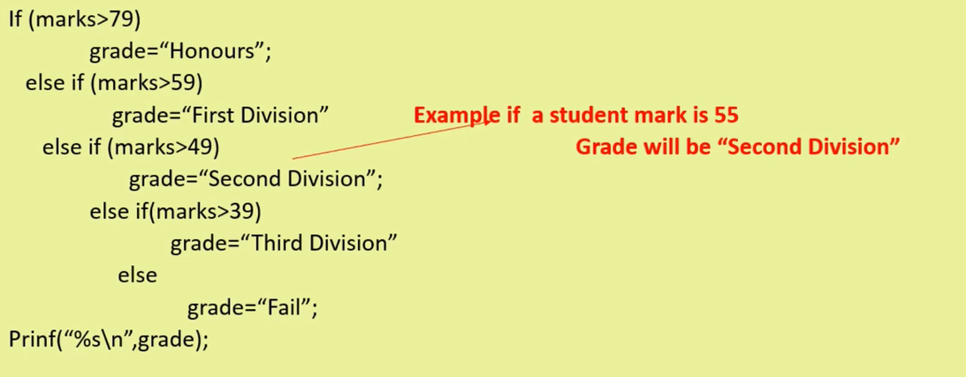
Example for else…if ladder

Slide 15
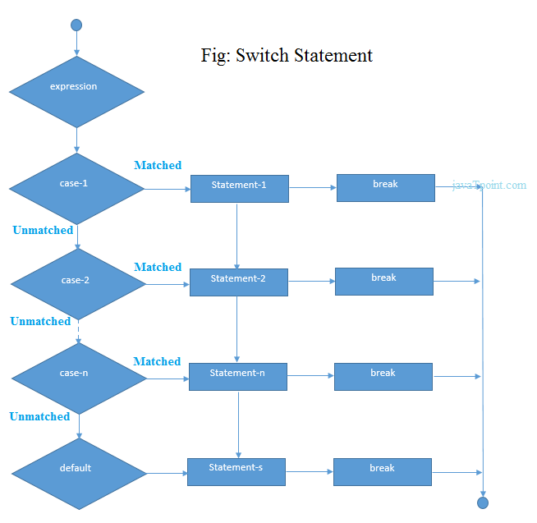
Switch statement
switch( choice )
{
case 1:
statement 1;
break;
case 2:
statement 2;
break;
case 3:
statement 3;
break;
.
.
case n:
statement n;
break;
default case:
default statement;
}

Slide 16
Simple calculator using switch
main()
{
char op;
float firstNum, secondNum;
scanf("%f %c %f",&firstNum,&op,&secondNum);
switch(op)
{
case '+': printf("Summation result is =%.2f",firstNum+secondNum);
break;
case '-': printf("Subtraction result is =%.2f",firstNum-secondNum);
break;
case '*': printf("Multiplication result is =%.2f",firstNum*secondNum);
break;
case '/': if(secondNum==0)
printf(“Dived by Zero Error\n”);
else
printf("Division result is =%.2f",firstNum/secondNum);
break;
default: printf("Invalid operator");
break;
}
}

Slide 17
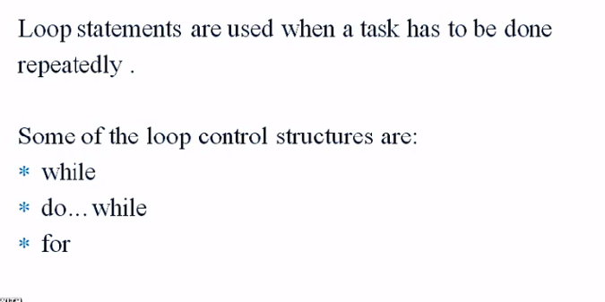
Looping Statements

Slide 18

While statement
Syntax
Initialization;
While(condition)
{
Body of loop;
Updating of initial
variable;
}

Slide 19
Example for while loop
#include <stdio.h>
void main ()
{
int a = 10; /* local variable definition */
while( a < 20 ) /* while loop execution */
{
printf("value of a: %d\n", a);
a++;
}
getch();
}

Slide 20
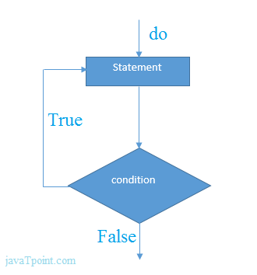
do……while loop
Initialization
Syntax:
Initialization;
do
{
Statements;
Increment/decrement (++ or --);
} while(condition);
Updating

Slide 21
do…….while example
#include <stdio.h>
#include <conio.h>
void main()
{
int i=1;
clrscr();
do
{
printf("%d \n",i);
i++;
}while(i<=10);
getch();
}

Slide 22
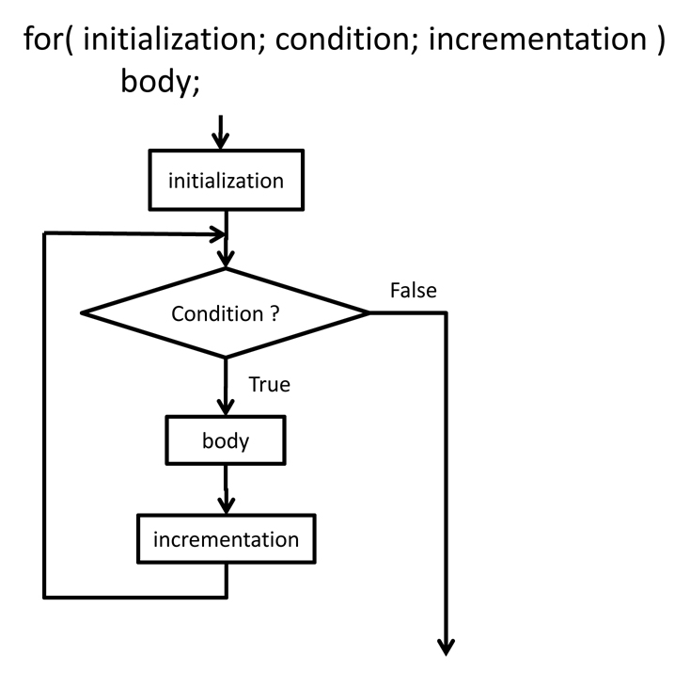

for loop

Slide 23
for loop example
#include <stdio.h>
#include <conio.h>
void main()
{
int i=0;
clrscr();
for(i=1;i<=10;i++)
{
printf("%d \n",i);
}
getch();
}

Slide 24
Differences between entry control and exit control loops
Entry Controlled Loop | Exit Controlled Loop
Test condition is checked first, and then loop body will be executed. | Loop body will be executed first, and then condition is checked.
If Test condition is false, loop body will not be executed. | If Test condition is false, loop body will be executed once.
for loop and while loop are the examples of Entry Controlled Loop. | do while loop is the example of Exit controlled loop.
Entry Controlled Loops are used when checking of test condition is mandatory before executing loop body. | Exit Controlled Loop is used when checking of test condition is mandatory after executing the loop body.

Slide 25
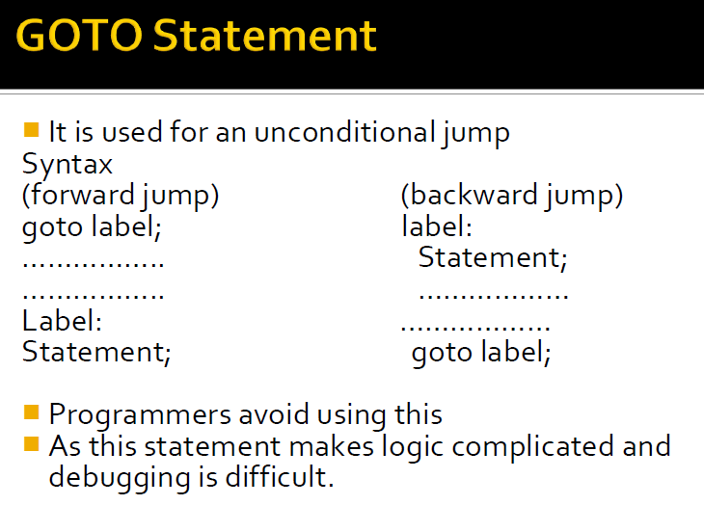
Unconditional control statements

Slide 26
Example on goto statement
#include<stdio.h>
void main()
{
int age;
g: //label name
printf("you are Eligible\n");
s: //label name
printf("you are not Eligible");
printf("Enter you age:");
scanf("%d", &age);
if(age>=18)
goto g; //goto label g
else
goto s; //goto label s
getch();
}

Slide 27
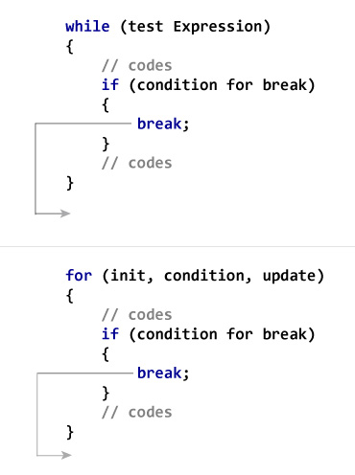
Break statement

Slide 28
Example on break
#include <stdio.h>
int main ()
{
int a = 10; /* local variable definition */
while( a < 20 ) /* while loop execution */
{
printf("value of a: %d\n", a);
a++;
if( a > 15)
{
/* terminate the loop using break statement */
break;
}
}
return 0;
}

Slide 29
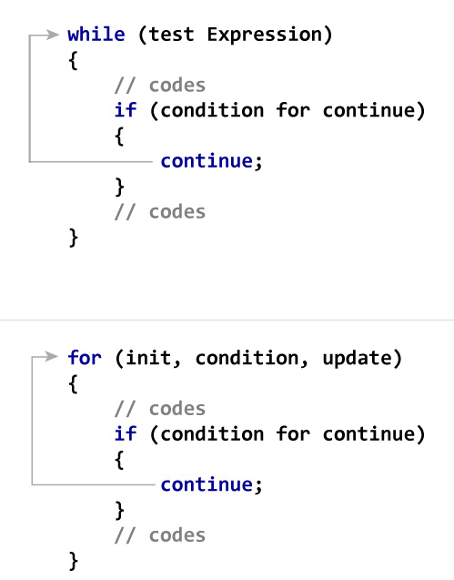
Continue statement

Slide 30
Example on continue
#include <stdio.h>
int main ()
{
int a = 10; /* local variable definition */
do /* do loop execution */
{
if( a == 15)
{
/* skip the iteration */
a = a + 1;
continue;
}
printf("value of a: %d\n", a);
a++;
} while( a < 20 );
return 0;
}

Slide 31
Difference between Break and Continue
Break | Continue
Break is used to terminate the execution of the loop. | Continue is not used to terminate the execution of loop.
It breaks the iteration. | It skips the iteration.
When this statement is executed, control will come out from the loop and executes the statement immediate after loop. | When this statement is executed, it will not come out of the loop but moves/jumps to the next iteration of loop.
Break is used with loops as well as switch case. | Continue is only used in loops, it is not used in switch case.

