Slide 1

 | S J P N Trust's Hirasugar Institute of Technology, Nidasoshi. Inculcating Values, Promoting Prosperity Approved by AICTE and Affiliated to VTU Belgaum.
R
Prof. Ravindra R. Patil
Assistant Professor, Dept. Of CSE
Programming in C and Data structures
(15PCD13/23)

Slide 2
Define Pseudocode. Write a pseudocode to find sum and average of given two numbers.
Pseudocode: Pseudocode is an informal way of programming description that does not require any strict programming language syntax or underlying technology considerations
Solution:
Begin
WRITE “Please enter two numbers to add”
READ num1
READ num2
Sum = num1+num2
Avg = Sum/2
WRITE Sum, Avg
End

Slide 3
Write down Pseudocode that will take marks of physics, chemistry and math as input, calculates the average and displays output.
Solution:
Begin
PRINT “please enter marks of physics”
INPUT Phy_marks
PRINT “please enter marks of chemistry”
INPUT Chem_marks
PRINT “please enter marks of maths”
INPUT math_marks
Avg = (Phy_marks + Chem_marks + math_marks)/3
PRINT Avg
End

Slide 4
Write pseudocode that will take numbers input and add them while the input number is greater than or equal to 0. Print the final result.
Solution:
Begin
Total = 0
WRITE “Input Number”
READ num
WHILE num>= 0
DO
Total =Total + num
READ num
ENDWHILE
WRITE “Total sum is:”, Total
End

Slide 5
Write pseudocode that will take a number as input and tells whether a number is positive, negative or zero.
Solution:
Begin
WRITE “Enter a number”
READ num
IF num> 0
THEN
WRITE “The number is positive”
ELSE IF num = 0
THEN
WRITE “The number is zero”
ELSE WRITE “The number is negative”
ENDIF
ENDIF
End

Slide 6
Define an algorithm. Write an algorithm to find the area and perimeter of a rectangle.
Definition: Step by step procedure to solve a given problem , and which (like a map or flowchart) will lead to the correct result if followed correctly. Algorithms have a definite beginning and a definite end, and a finite number of steps.
Solution:
Step 1: Start
Step 2: Input length as l, breadth as b
Step 3: Calculate Area as a=l*b
Perimeter as p= 2(l + b)
Step 4: Print a, p
Step 5: Stop

Slide 7
Write an algorithm to Convert Temperature from Fahrenheit (℉) to Celsius (℃)
Solution:
Step 1: Start
Step 2: Read temperature in Fahrenheit as F,
Step 3: Calculate temperature as C
C = 5/9*(F-32),
Step 4: Print C
Step 5: Stop

Slide 8
Write an algorithm to find the largest among three different numbers entered by user.
Solution:
Step 1: Start
Step 2: Declare variables a, b and c.
Step 3: Read variables a, b and c.
Step 4: If a>b
If a>c
Display “a” is the largest number.
Else
Display “c” is the largest number.
Else
If b>c
Display “b” is the largest number.
Else
Display “c” is the greatest number.
Step 5: Stop

Slide 9
Write an algorithm to find the factorial of a number entered by user.
Solution:
Step 1: Start
Step 2: Declare variables n, factorial and i. Step 3: Initialize variables factorial←1, i←1 Step 4: Read value of n
Step 5: Repeat the steps until i=n
5.1: factorial ← factorial*i
5.2: i←i+1
Step 6: Display factorial
Step 7: Stop

Slide 10
Write an algorithm to find the Fibonacci series till term≤1000.
Solution:
Step 1: Start
Step 2: Declare variables first_term, second_term and temp.
Step 3: Initialize variables first_term←0 second_term←1
Step 4: Display first_term and second_term
Step 5: Repeat the steps until second_term≤1000
5.1: temp←second_term
5.2: second_term←second_term+first term
5.3: first_term←temp
5.4: Display second_term
Step 6: Stop

Slide 11
Basic concepts in a C program
C programming language – Structured and disciplined approach to program design.
C is developed by Dennis Ritchie
C is a structured programming language
C supports functions that enables easy maintainability of code, by breaking large file into smaller modules
Comments in C provides easy readability
C is a powerful language.
C programs built from
Variable and type declarations
Functions
Statements
  Expressions

Slide 12
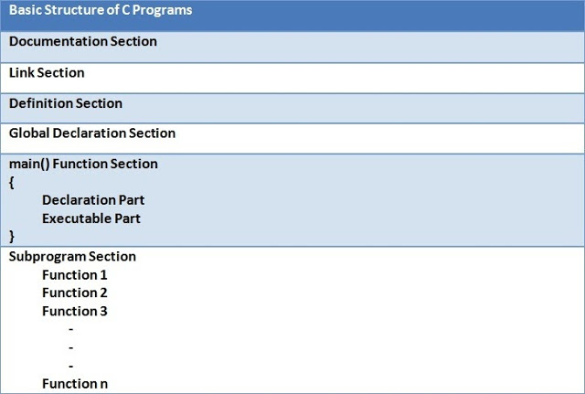

Slide 13
Documentation Section: The line /*...*/ will be ignored by the compiler and it has been put to add additional comments in the program. So such lines are called comments in the program.
Link Section: line of the program #include <stdio.h> is a preprocessor command, which tells a C compiler to include stdio.h file before going to actual compilation.
Definition Section: The definition section defines all symbolic constants. A symbolic constant is a constant value given to a name which can't be changed in program. Example: #define PI 3.14
Global Declaration: In global declaration section, global variables and user defined functions are declared.
Example: int add(int a, int b);

Slide 14
main() Function Section: The main () function section is the most important section of any C program. The compiler start executing C program from main() function. The main() function is mandatory in C programming. It has two parts:
Declaration Part - All the variables that are later used in the executable part are declared in this part.
Executable Part - This part contains the statements that are to be executed by the compiler.
Subprogram Section: The subprogram section contains all the user defined functions. A complete and fully functions C program can be written without use of user-defined function in C programming but the code maybe be redundant and inefficient if user-defined functions are not used for complex programs.

Slide 15
Simple Example Program
/* This is the very simple C program to print add tow numbers*/ //This section is documentation section
#include<stdio.h> //link section
#define x 20 //definition section
viod add(int, int); //golobal declaration section
int main() // main() function
{
int a=2,b=3; //declaration part
clrscr();
add(a,b); //executable part
getch();
}
void add(int p, int q) //subprogram section
{
int c;
c = p + q:
printf(“The result is %d”, c);
return ;
}

Slide 16
C LANGUAGE TOKENS
What are actually tokens?
The smallest individual units in a C program are known as tokens. In a C source program, the basic element recognized by the compiler is the "token." A token is source-program text that the compiler does not break down into component elements.
TOKEN TYPES IN ‘C’
C has 6 different types of tokens viz.
1.Keywords [e.g. float, int, while]
2.Identifiers [e.g. main, amount]
3.Constants [e.g. -25.6, 100]
4.Strings [e.g. “SMIT”, “year”]
5.Special Symbols [e.g. {, }, [, ] ]
6.Operators [e.g. +, -, *]
C programs are written using these tokens and the general syntax.

Slide 17
THE KEYWORDS
Definition: "Keywords" are words that have special meaning to the C compiler. Their meaning cannot be changed at any instance. Serve as basic building blocks for program statements. All keywords are written in only lowercase.
Kewords: void, volatile, while, long, register, return, short, signed, sizeof, static, struct, int, double, else, enum, etern, float, for, goto ,if, auto, switch, typedef, union ,unsigned, break, case, char const, continue, default, do, unsigned.

Slide 18
THE IDENTIFIERS
Definition: Identifiers are names for entities in a C program, such as variables, arrays, functions, structures, unions and labels.
Rules for constructing identifiers
1.Cannot use C keywords as identifiers
2.Must begin with alpha character or _, followed by alpha,
numeric, or _
3.Must consist of only letters, digits or underscore ( _ ).
4.Only first 31 characters are significant.
5. Must NOT contain spaces .

Slide 19
VALIDITY OF IDENTIFIERS (EXAMPLES)
a. record1 => Valid
b. 1record => Invalid Identifier name must start with alphabets
c. file_3 => Valid
d. return => Invalid Keywords cannot be used as identifiers
e. #tax => Invalid Identifier should not contain any special symbols except underscore (_) symbol.
f. name => Valid
g. goto => Invalid It is a keyword and cannot be used as identifier.
h. name and address => Invalid No white spaces are permitted in name of identifier.
i. name-and-address => Invalid Identifier should not contain any special symbols except underscore (_) symbol.
j. 123-45-6789 => Invalid Identifier should not contain any special symbols except underscore (_) symbol. And also identifier name must start with alphabet.
k. void => Invalid It is a keyword and cannot be used as identifier.
l. name_address => Valid

Slide 20
Differentiate between Keywords words and identifiers
Keywords | Identifiers
Predefined-word | User-defined word
Must be written in lowercase only | Can written in lowercase and uppercase
Has fixed meaning | Must be meaningful in the program
Whose meaning has already been explained to the C compiler | Whose meaning not explained to the C compiler
Used only for it intended purpose | Used for required purpose

Slide 21
CONSTANTS
Definition: Constants in C are the fixed values that do not change during the execution of a program.
1. Integer Constants
Refers to sequence of digits such as decimal integer, octal integer and
hexadecimal integer.
Some of the examples are 112, 0551, 56579u, 0X2 etc.
2. Real Constants
The floating point constants such as 0.0083, -0.78, +67.89 etc.
3.Single Character Constants
A single char constant contains a single character enclosed within pair of single quotes [ ‘ ’ ]. For example, ‘8’, ‘a’ , ‘i’ etc.
4.String Constants
A string constant is a sequence of characters enclosed in double quotes
[ “ ” ]; For example, “0211”, “Stack Overflow” etc.

Slide 22
DECLARATIONS
Constants and variables must be declared before they can
be used.
A constant declaration specifies the type, the name and
the value of the constant.
any attempt to alter the value of a variable defined
as constant results in an error message by the compiler
A variable declaration specifies the type, the name and
possibly the initial value of the variable.
When you declare a constant or a variable, the compiler:
1. Reserves a memory location in which to store the value of the constant or variable.
2. Associates the name of the constant or variable with
the memory location.

Slide 23
WHAT ARE VARIABLES IN C?
Definition: C variable is a named location in a memory where a program can manipulate the data. This location is used to hold the value of the variable.
RULES FOR DECLARING C VARIABLE:
1.Variable name must begin with letter or underscore.
2.Variables are case sensitive
3.They can be constructed with digits, letters.
4.No special symbols are allowed other than underscore.
5. Should not be a keyword

Slide 24
Valid and invalid variables
Valid Variables:
Invalided Variables:
Total | Amount | ctr | name1
n1 | M_age | AMOUNT
13th | (name) | 111 | %nm

Slide 25
DECLARING VARIABLES
Before using a variable, you must give the compiler some information about the variable; i.e., you must declare it.
The declaration statement includes the data type of the variable.
Examples of variable declarations:
int length ;
float area ;
Variables are not automatically initialized. For example, after
declaration int sum;
the value of the variable sum can be anything (garbage).
Thus, it is good practice to initialize variables when they are declared.
Once a value has been placed in a variable it stays there until the
program alters it.

Slide 26
DATA TYPES IN ‘ANSI C’
Definition: A data type, in programming, is a classification that specifies which type of value a variable has.
There are three classes of data types here::
1. Primitive data types
int, float, double, char
2. Aggregate OR derived data types
Arrays come under this category
Arrays can contain collection of int or float or char or double data
3. User defined data types
Structures and enum fall under this category.

Slide 27
All C compilers support four fundamental data types
Type | Range of values | Description
char (Characters) | -128 to 127 | a single byte(8 bits) and can store one character type data
int Integers (whole numbers) | -32768 to 32767 | an integer type is used to represent whole numbers within a specified range of values.
float Floating point (real numbers) | 3.4e-38 to 3.4e+38 | single-precision floating point
double (Double) | 1.7e-308 to 1.7e+308 | double-precision floating point

Slide 28
char- Character data Types :
A single character can be defined as a character type data. Characters are usually stored in 8 bits of internal storage. The qualifier signed or unsigned may be explicitly applied to char. While unsigned chars have values between 0 and 255, signed chars have values from -128 to 127.
Numeric value of character is stored in memory:
Example: MEMORY:
char letter; letter
letter = 'C';
67

Slide 29
DECLARATION OF CHARACTER
VARIABLES
Variables of character type can be defined:
- On separate lines:
char x;
- On the same line:
char x, y;
Declaration and initialization Examples:
const char star = '*';
char letter, one = '1';

Slide 30
int - Integer data types
Integers are whole numbers that can have both positive and negative values but no decimal values. Example: 0, -5, 10
In C programming, keyword int is used for declaring integer variable. For example:
int id;
Here, id is a variable of type integer.
You can declare multiple variable at once in C programming. For example:
int id, age;
The size of int is either 2 bytes(In older PC's) or 4 bytes

Slide 31
float - Floating types
Floating type variables can hold real numbers such as: 2.34, -9.382, 5.0 etc. You can declare a floating point variable in C by using either float or double keyword.
For example:
float accountBalance;
double bookPrice;
Here, both accountBalance and bookPrice are floating type variables.

Slide 32
Difference between float and double
The size of float (single precision float data type) is 4 bytes. And the size of double (double precision float data type) is 8 bytes. Floating point variables has a precision of 6 digits whereas the precision of double is 14 digits.

Slide 33
Size and range of Integer type on 16-bit machine
Type | Size(bytes) | Range
int or signed int | 2 | -32,768 to 32767
unsigned int | 2 | 0 to 65535
short int or signed short int | 1 | -128 to 127
unsigned short int | 1 | 0 to 255
long int or signed long int | 4 | -2,147,483,648 to 2,147,483,647
unsigned long int | 4 | 0 to 4,294,967,295

Slide 34
Simple Example addition of two numbers
#include<stdio.h>
#include<conio.h>
void main()
{
int a,b,sum; //variable declaration
a=10; //variable definition
b=20; //variable definition
sum=a+b;
printf("Sum is %d",sum);
getch();
}

Slide 35
Initialization of Variable
C variables declared can be initialized with the help of assignment operator ‘=’.
Syntax
data_type variable_name=constant/literal/expression;
or
variable_name=constant/literal/expression;
Examples:
int a=10;
int a=b+c;
a=10;
a=b+c;
Multiple variables can be initialized in a single statement by single value, for example, a=b=c=d=e=10;

Slide 36
C Input Output (I/O)
Input : In any programming language input means to feed some data into program.
Output : In any programming language output means to display some data on screen, printer or in any file.
Types of I/O Functions
1.Formatted
2.Unformatted

Slide 37
printf() - Formatted output function
Syntax:
printf(“format string/ Conversion specifiers”, arg1, arg2, ..);
'format string' will contain the information that is formatted
Conversion specifiers replace the respective variable with its value.
arg1, arg2 are the output data items.
Example:
1.printf(“Enter a value:”);
2. int dec=10;
char str[10]=“HIT”, ch=‘A’;
float pi=3.1426;
printf("%d %s %f %c\n", dec, str, pi, ch);
%d,%s,%f,%c are Convertion specifiers

Slide 38
scanf()- Formatted input function
Syntax:
scanf (“format string”, &arg1, &arg2, …..);
Format string consists of the conversion specifier.
Arguments can be variables or array name and represent the address of the variable.
Example:
int avg;
float per;
char grade;
scanf(“%d %f %c”,&avg, &per, &grade):

Slide 39
List of all format specifiers in C programming
Format specifier | Description | Supported data types
%c | Character | char unsigned char
%d | Signed Integer | short unsigned short int long
%e or %E | Scientific notation of float values | float double
%f | Floating point | float
%g or %G | Similar as %e or %E | float double
%hi | Signed Integer(Short) | short
%hu | Unsigned Integer(Short) | unsigned short
%i | Signed Integer | short unsigned short int long
%l or %ld or %li | Signed Integer | long
%lf | Floating point | double
%Lf | Floating point | long double
%lu | Unsigned integer | unsigned int unsigned long
%lli, %lld | Signed Integer | long long
%llu | Unsigned Integer | unsigned long long

Slide 40
Operators & Expressions in C
Definition: An operator is a symbol that tells the compiler to perform specific mathematical or logical functions.
Operators- Types:
1.Arithmetic Operators (+, -, *, /, %)
2. Relational Operators (<, >, <=, >=, ==, !=)
3. Logical Operators (&&, ||, !)
4. Bitwise Operators (&, |)
5. Assignment Operators (=)
6. Increment/Decrement Operators.
7 Conditional Operators.
8. Special operators.

Slide 41
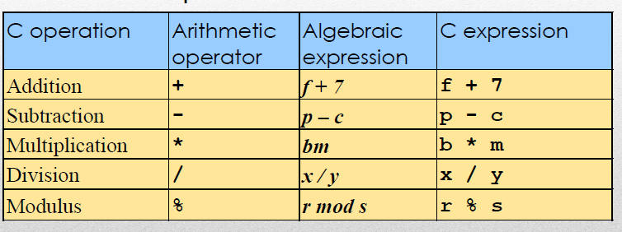
Arithmetic Operators

Slide 42
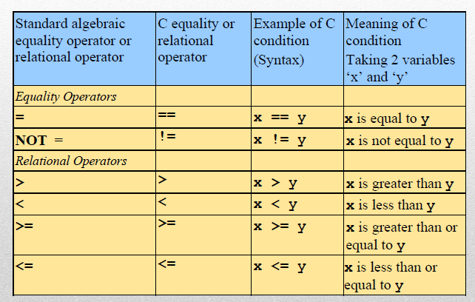
Relational Operators

Slide 43
A relational operator compares two values of C built in data types such as char, int, float
Relational operators return Boolean values:
0 if relation is FALSE
1 if relation is TRUE
Example:
int x=44;
int y=12;
(x == y) // false... Returns 0
(x >= y) // true... Returns 1
(x != y) // true ... Returns 1

Slide 44
LOGICAL OPERATORS
Logical Operators are used to create compound expressions
Operator | Description | Example
&& | Called Logical AND operator. If both the operands are non-zero, then the condition becomes true. | (A && B) is false.
|| | Called Logical OR Operator. If any of the two operands is non-zero, then the condition becomes true. | (A || B) is true.
! | Called Logical NOT Operator. It is used to reverse the logical state of its operand. If a condition is true, then Logical NOT operator will make it false. | !(A && B) is true.

Slide 45
ASSIGNMENT OPERATORS
Operator | Description | Example
= | Simple assignment operator. Assigns values from right side operands to left side operand | C = A + B will assign the value of A + B to C
+= | Add AND assignment operator. It adds the right operand to the left operand and assign the result to the left operand. | C += A is equivalent to C = C + A
-= | Subtract AND assignment operator. It subtracts the right operand from the left operand and assigns the result to the left operand. | C -= A is equivalent to C = C - A
*= | Multiply AND assignment operator. It multiplies the right operand with the left operand and assigns the result to the left operand. | C *= A is equivalent to C = C * A

Slide 46
= | Divide AND assignment operator. It divides the left operand with the right operand and assigns the result to the left operand. | C /= A is equivalent to C = C / A
%= | Modulus AND assignment operator. It takes modulus using two operands and assigns the result to the left operand. | C %= A is equivalent to C = C % A
<<= | Left shift AND assignment operator. | C <<= 2 is same as C = C << 2
>>= | Right shift AND assignment operator. | C >>= 2 is same as C = C >> 2

Slide 47
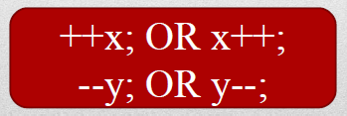
INCREMENT/DECREMENT OPERATORS
In C, we have 2 very useful operators called the
increment & decrement operators:
• Increment : ++ adds 1 to the operand
• Decrement : -- subtracts 1 from the operand
Both the operators are unary and take the following
form::

Slide 48
Rules for ++ and – – operators
++ and – – are unary operators; they require variable as their operands.
When postfix ++ (or – –) is used with a variable in an exp., the expression is evaluated first using the original value of the variable and then the variable’s value is accordingly incremented or decremented.
When prefix ++ (or – –) is used with a variable in an exp., firstly, the variable’s value is accordingly incremented or decremented and then the expression is evaluated using the new value of the variable.
• The precedence and associativity if ++ & – – are same as that of unary + and unary –.

Slide 49
BITWISE OPERATORS
Operator | Description | Example
& | Binary AND Operator copies a bit to the result if it exists in both operands. | (A & B) = 12, i.e., 0000 1100
| | Binary OR Operator copies a bit if it exists in either operand. | (A | B) = 61, i.e., 0011 1101
^ | Binary XOR Operator copies the bit if it is set in one operand but not both. | (A ^ B) = 49, i.e., 0011 0001
~ | Binary Ones Complement Operator is unary and has the effect of 'flipping' bits. | (~A ) = -61, i.e,. 1100 0011 in 2's complement form.
<< | Binary Left Shift Operator. The left operands value is moved left by the number of bits specified by the right operand. | A << 2 = 240 i.e., 1111 0000
>> | Binary Right Shift Operator. The left operands value is moved right by the number of bits specified by the right operand. | A >> 2 = 15 i.e., 0000 1111

Slide 50
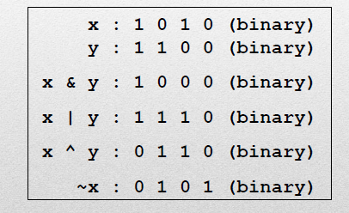


Slide 51
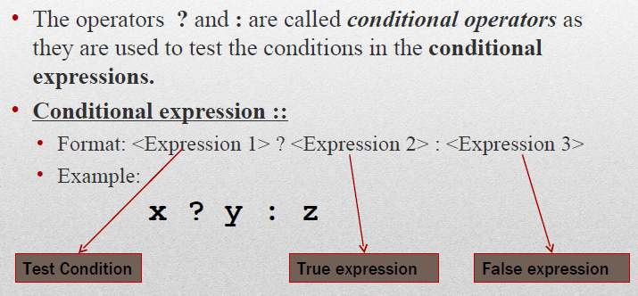
CONDITIONAL OPERATORS

Slide 52
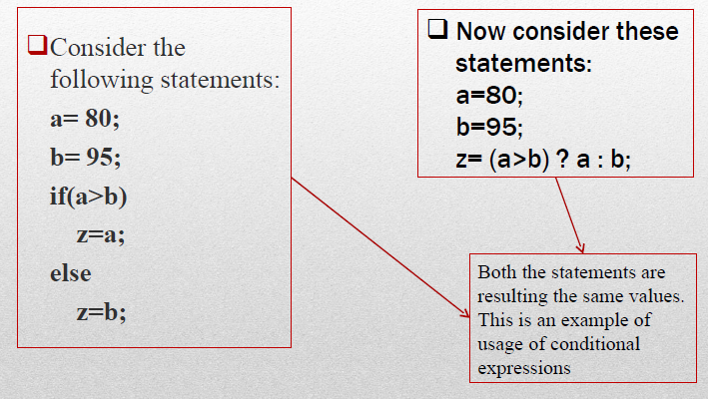
Use of Conditional Operators

Slide 53
Rules of Precedence & Associativity
Precedence rule decides the order in which different operators are applied.
Associativity rule decides the order in which multiple occurrences of the same operator are applied.

Slide 54
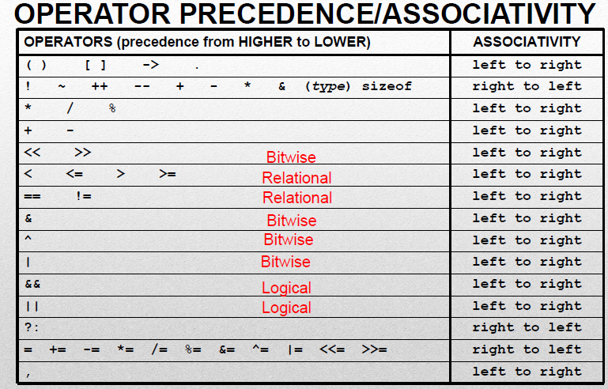

Slide 55
Examples
1. x = a-b/3+c*2-1 Let a = 9, b =12, and c=3.
x = 9-4+3*2-1 (*)
x = 9-4+6-1 (-)
x = 5+6-1 (+)
x = 11-1 (-)
x = 10
2. x==10+15&&y<10 Let x=20 and y=5
20==10+15&&5<10 (+)
20==25&&5<10 (<)
20==25&&1 (==)
0&&1 (&&)
0

Slide 56
3. a=(++a)+(++a)+(a++)+(a++) where a=10
a = (++10)+(++a)+(a++)+(a++)
= 11+(++11)+(a++)+(a++)
= 11+12 +(12++)+(a++)
= 11+12+12+(13++)
= 11+12+12+13
a = 48
4. char a='a',b='b'; ASCII a=97 b=98
c=a&b -> a=1100001
& b=1100010
1100000=96

